Slide 1
Ceratopteris LFY RNAseq Update
Feb 18, 2025

Slide 2
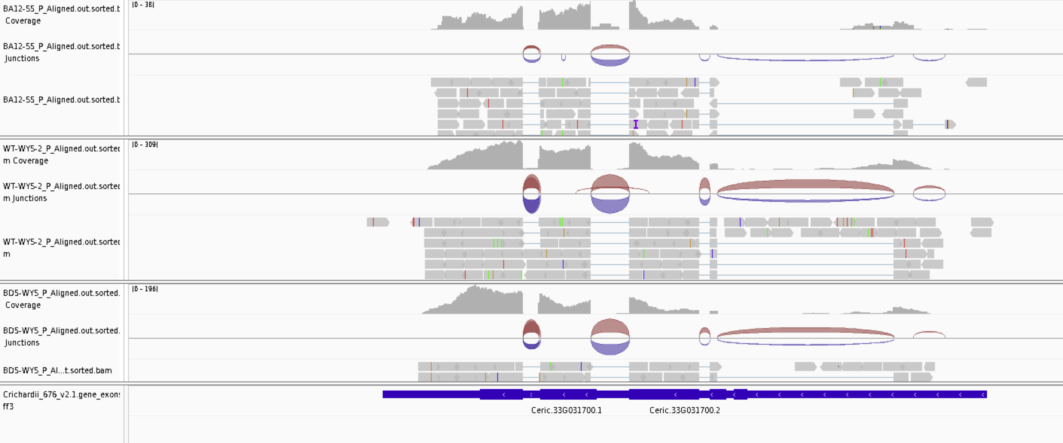
Is the annotation for LFY1 OK? Yes

Slide 3
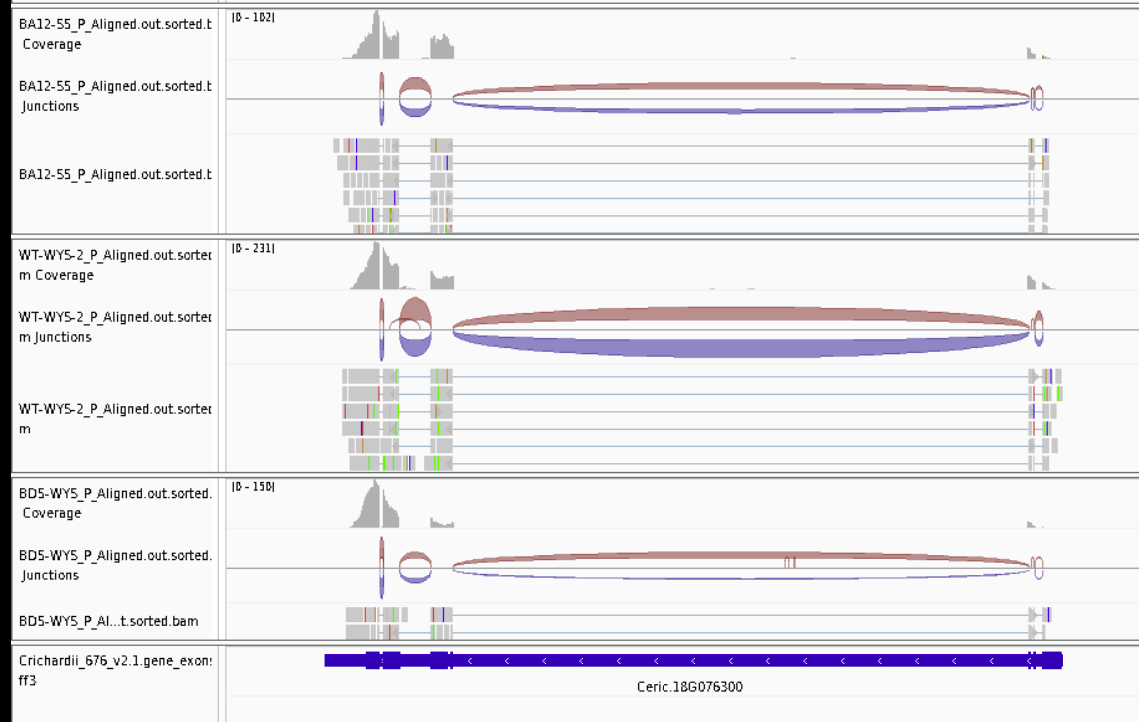
Is the annotation for LFY2 OK? Yes

Slide 4
Annotation follow-up
I did realize that I was only counting reads that mapped to exons and therefore missing 5’ and 3’UTR.
Updated counts in process.

Slide 5
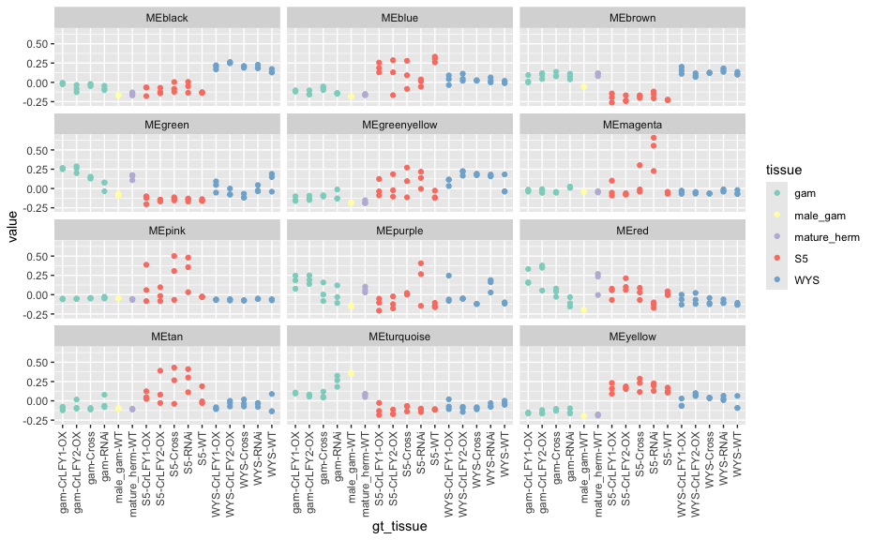
Network attempt 1: WGCNA, all samples
Each “color” is a module
Y-axis is first PC of expression of that module
LFY1 is in MEblack
LFY2 is in MEturquoise

Slide 6
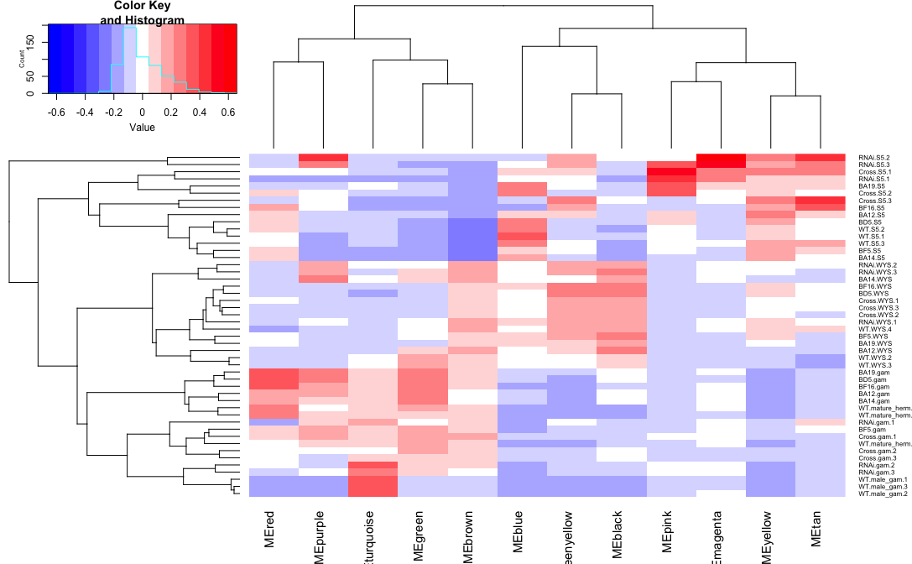
Network attempt 1: WGCNA, all samples
Each “color” is a module
heatmap is first PC of expression of that module
LFY1 is in MEblack
LFY2 is in MEturquoise

Slide 7
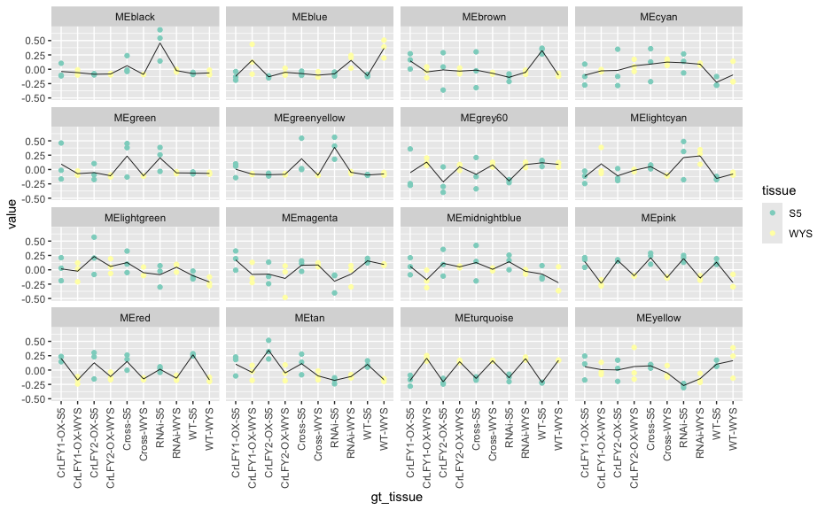
Network attempt 1: WGCNA, sporophyte
Each “color” is a module
Y-axis is first PC of expression of that module
LFY1 is in MEturquoise
LFY2 is in MEblue

Slide 8
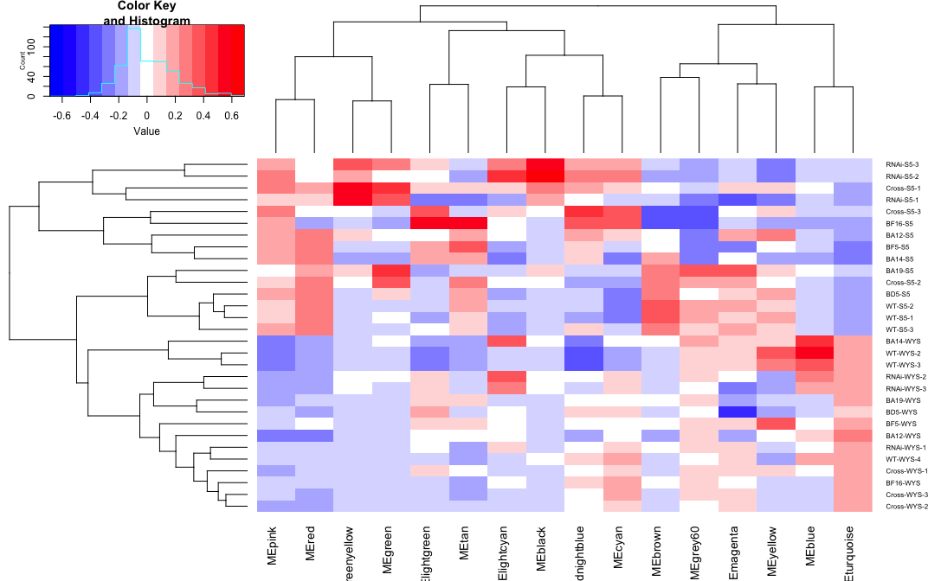
Network attempt 1: WGCNA, sporophyte
Each “color” is a module
heatmap is first PC of expression of that module
LFY1 is in MEturquoise
LFY2 is in MEblue

Slide 9
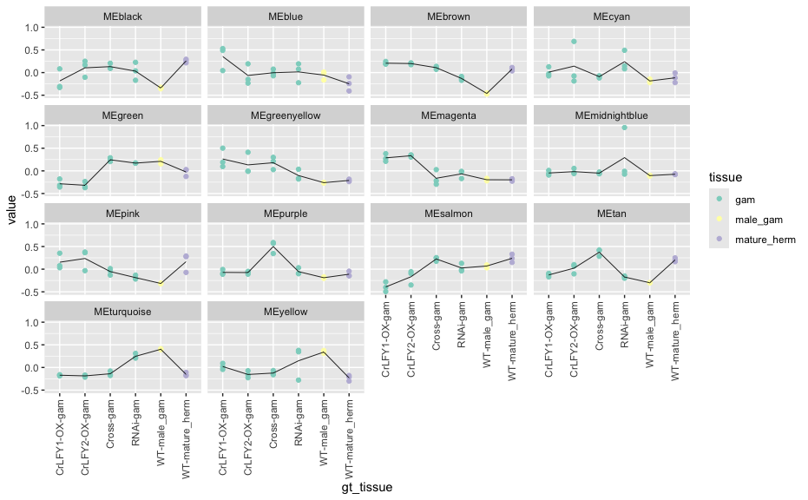
Network attempt 1: WGCNA, gametophyte
Each “color” is a module
Y-axis is first PC of expression of that module
LFY1 is in MEblue & alternative transcript is in MEturquoise
LFY2 is in MEblue

Slide 10
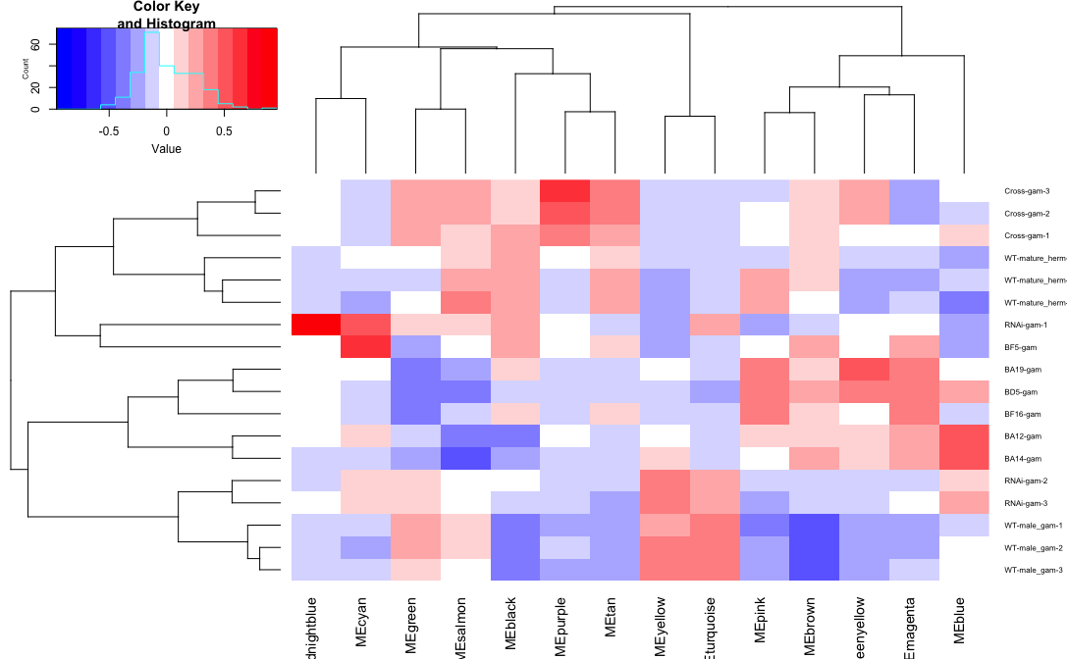
Network attempt 1: WGCNA, gametophyte
Each “color” is a module
LFY1 is in MEblue & alternative transcript is in MEturquoise
LFY2 is in MEblue

