Slide 1
Ceratopteris LFY RNAseq Update
Feb 18, 2025

Slide 2
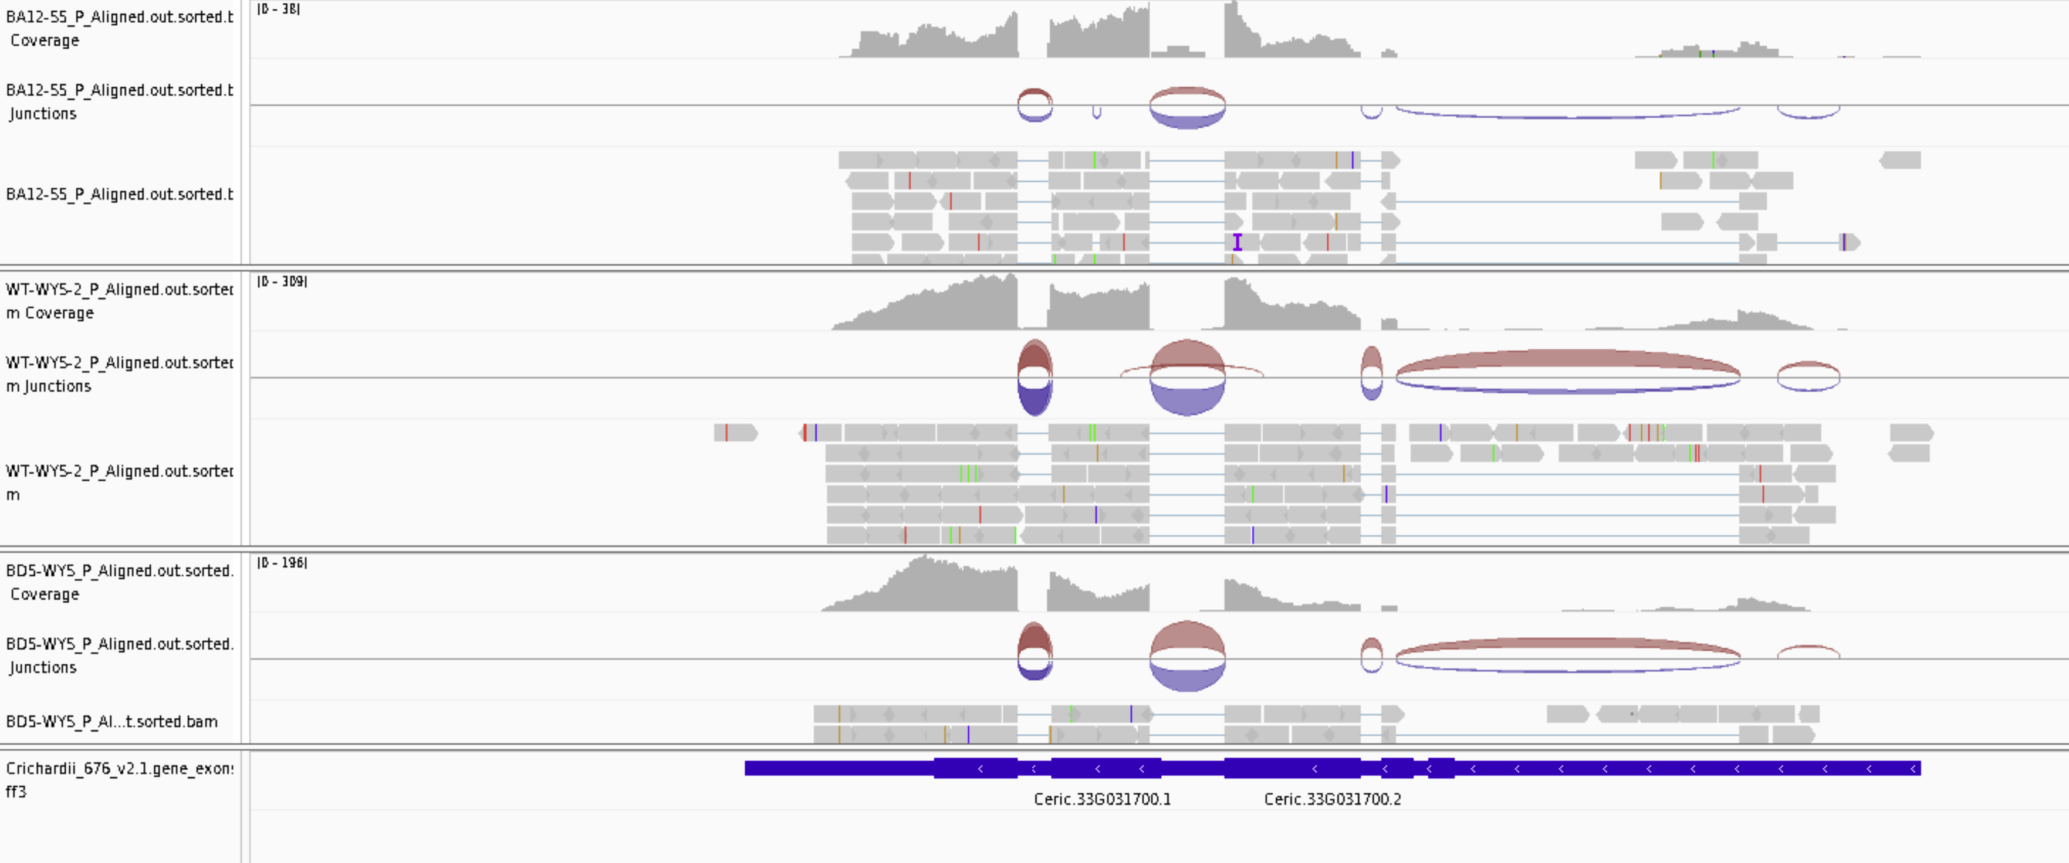
Is the annotation for LFY1 OK? Yes

Slide 3
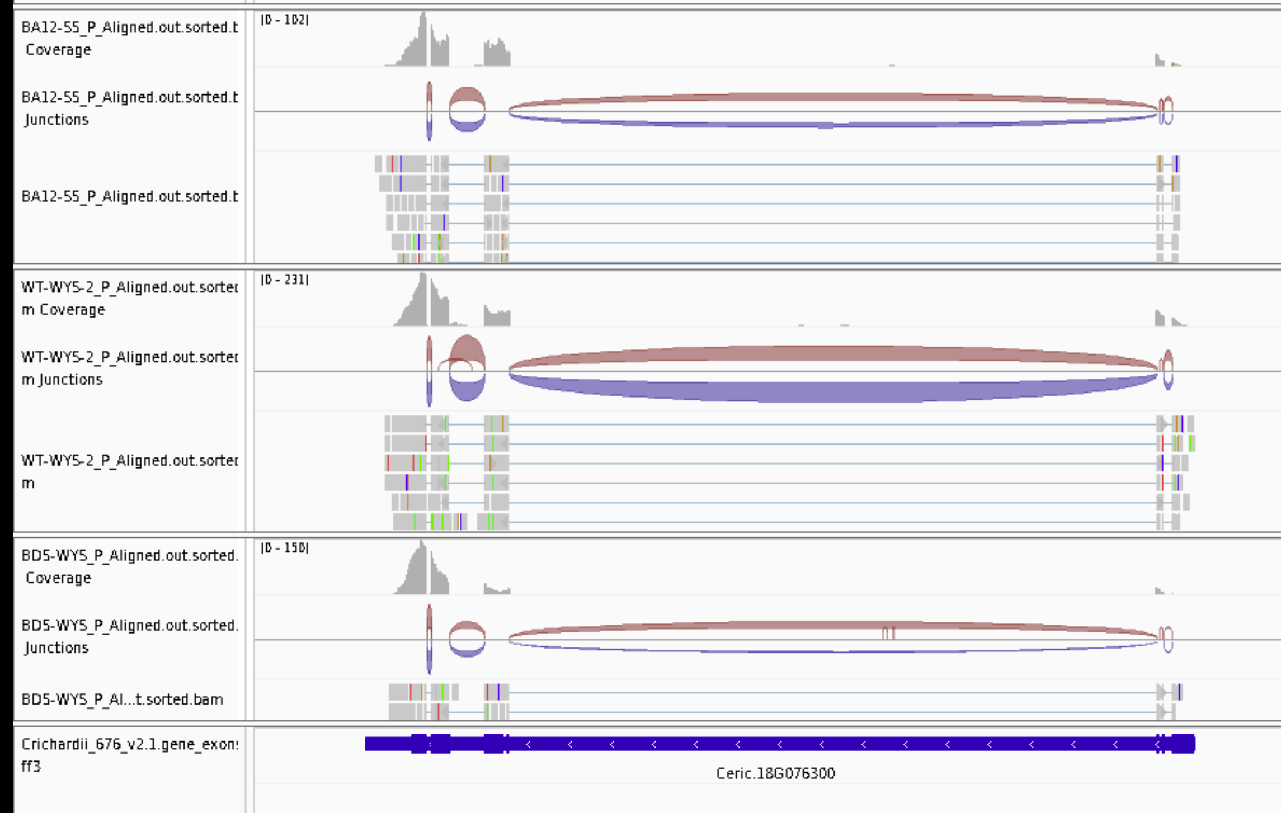
Is the annotation for LFY2 OK? Yes

Slide 4
Was I counting reads correctly? NO
The annotation file has multiple isoforms and did not account for the correctly in my original analysis. Now fixed.

Slide 5
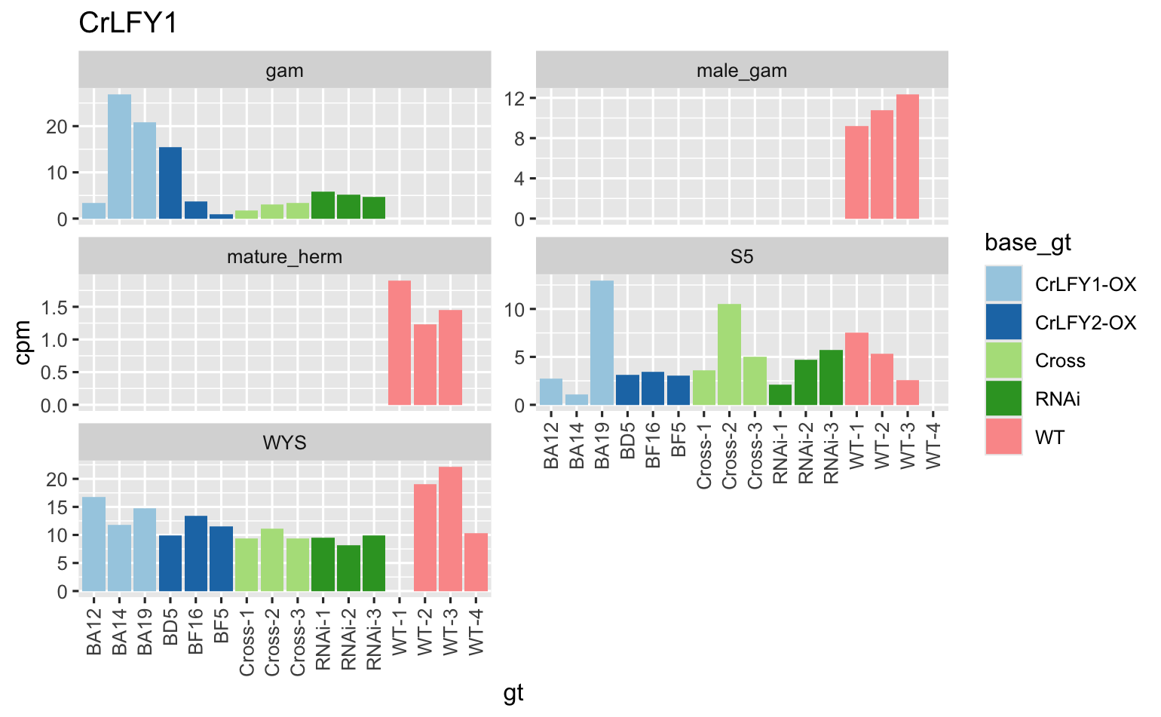
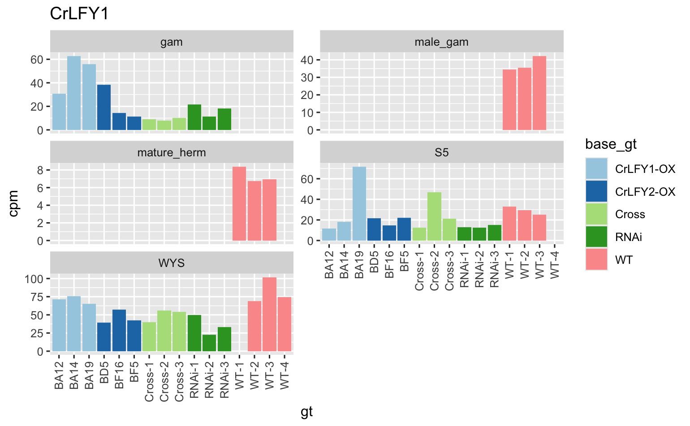
LFY1: old on left, new on right. Pattern is similar but counts are more reasonable.

Slide 6
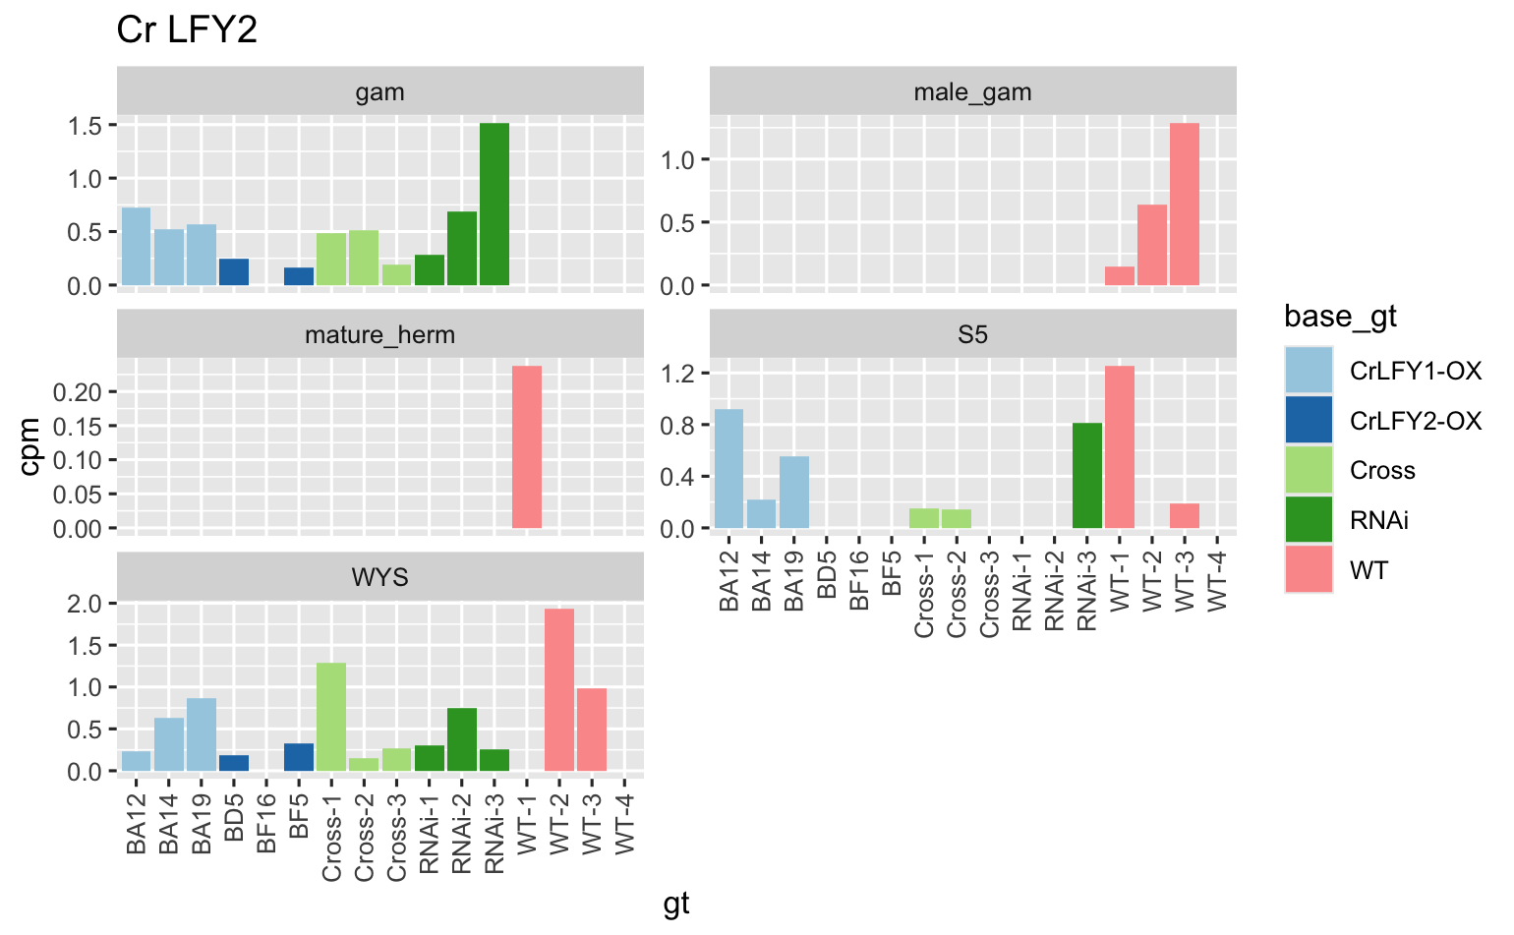
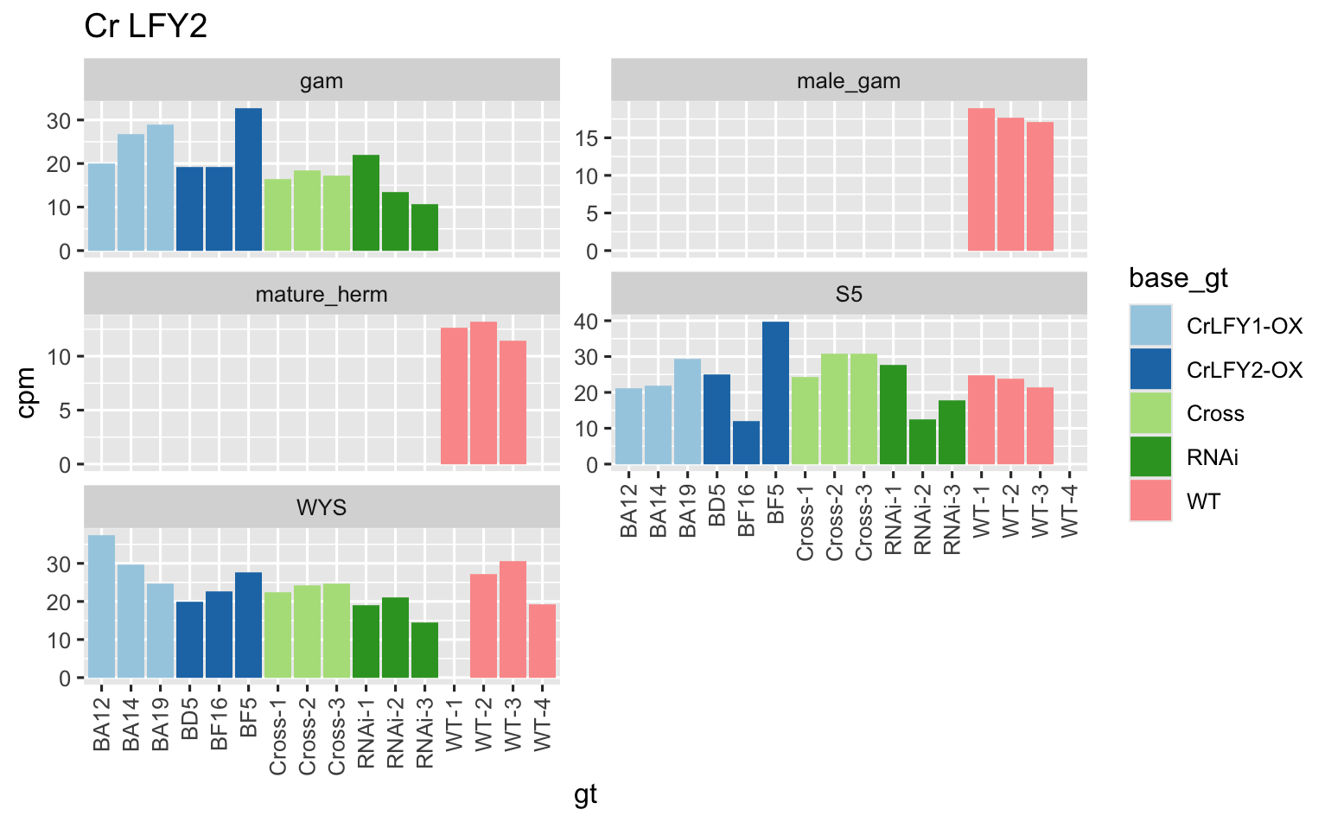
LFY2: old on left, new on right. Pattern is similar but counts are more reasonable.

Slide 7
LFY1 vs LFY2

Slide 8
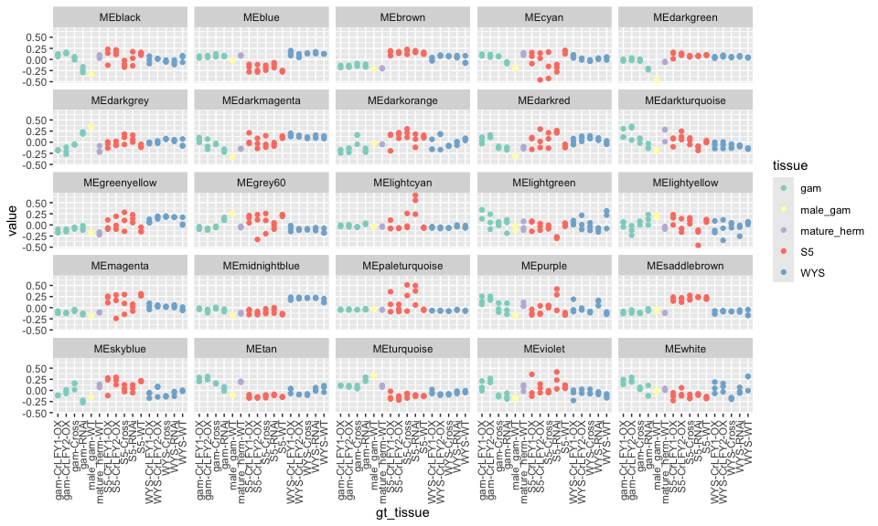
Network attempt 1: WGCNA, all samples
Each “color” is a module
Y-axis is first PC of expression of that module
LFY1 is in MIDNIGHT BLUE
LFY2 is in MAGENTA

Slide 9
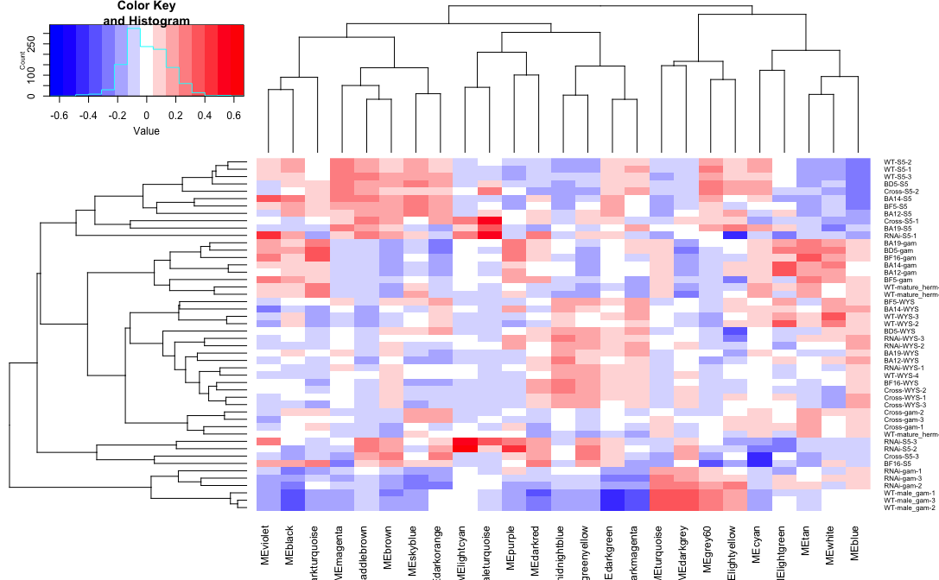
Network attempt 1: WGCNA, all samples
Each “color” is a module
heatmap is first PC of expression of that module
LFY1 is in MIDNIGHT BLUE
LFY2 is in MAGENTA

Slide 10
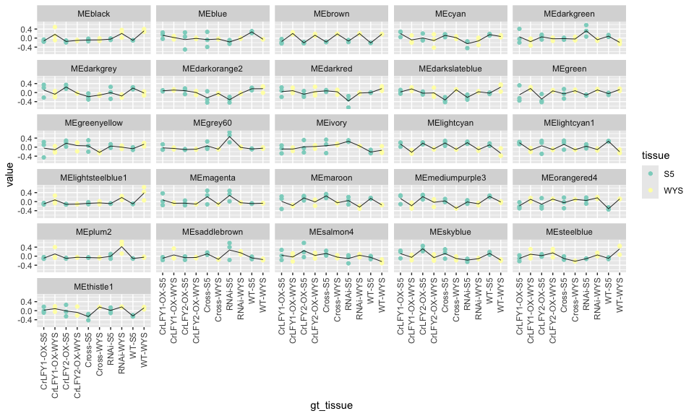
Network attempt 1: WGCNA, sporophyte
Each “color” is a module
Y-axis is first PC of expression of that module
LFY1 is in BROWN
LFY2 is in BLUE

Slide 11
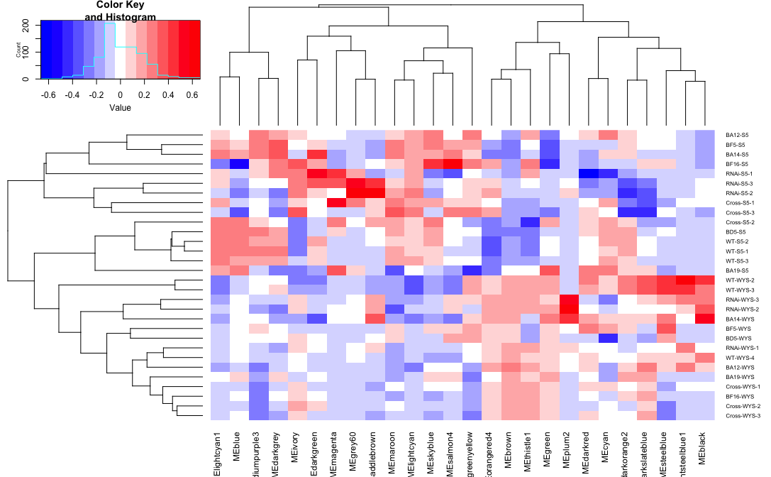
Network attempt 1: WGCNA, sporophyte
Each “color” is a module
heatmap is first PC of expression of that module
LFY1 is in BROWN
LFY2 is in BLUE

Slide 12
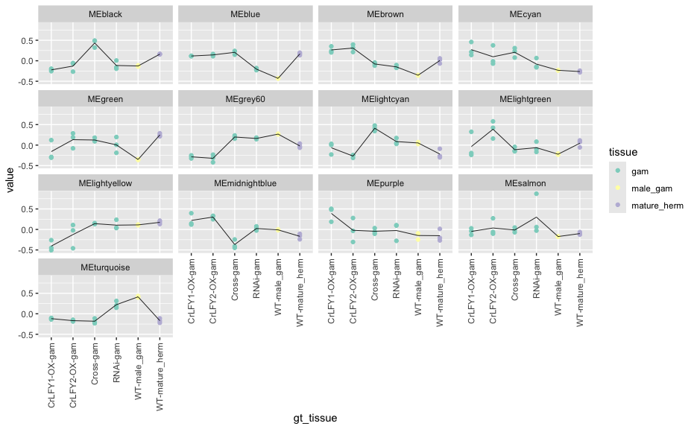
Network attempt 1: WGCNA, gametophyte
Each “color” is a module
Y-axis is first PC of expression of that module
LFY1 is in TURQUOISE
LFY2 is in BROWN

Slide 13
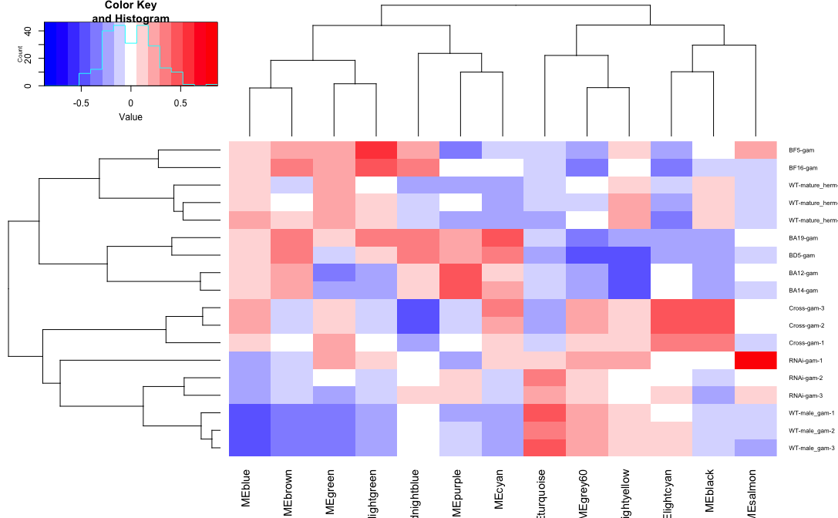
Network attempt 1: WGCNA, gametophyte
Each “color” is a module
LFY1 is in TURQUOISE
LFY2 is in BROWN

Slide 14
Next Steps
Gene Ontology (GO) categories for each module
Enriched promoter motifs for each modules
Build a mutual rank (MR) network
Rationale:
Current LFY modules are very large many hundreds to thousands of genes
A MR network will allow me to more easily identify LFYs’ closest connections

Slide 15
Update March 13, 2025

Slide 16
Overview of new progress
GO enrichment of WGCNA modules
Looked for module membership of MADS box genes
Tried a new method “Targeted Gene Correlation Network” (TGCN)
Built mutual rank (MR) networks

Slide 17
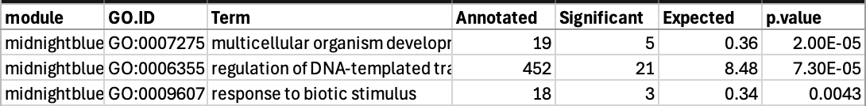
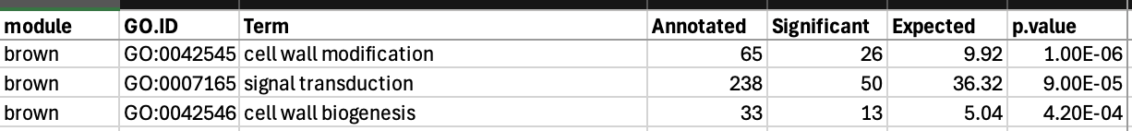
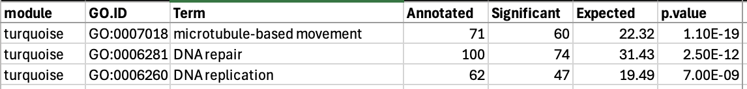
TOP3 GO Enrichment: LFY1
All Samples:
Sporophyte:
Gametophyte:

Slide 18
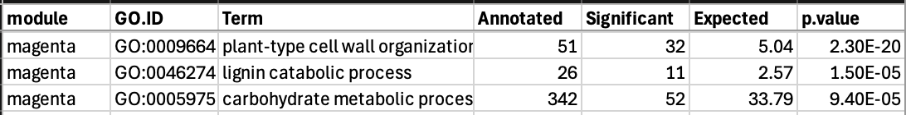
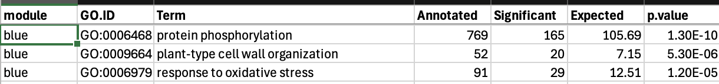
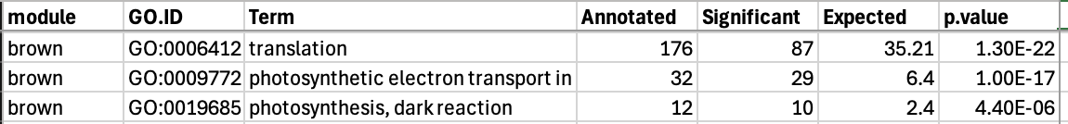
Top3 GO Enrichment: LFY2
All Samples:
Sporophyte:
Gametophyte:

Slide 19


What modules are the MADS box genes in?
WGCNA all samples: LFY1 = midnightblue, LFY2 = magenta
Sporophyte: LFY1 = brown, LFY2 = blue
Gametophyte: LFY1 = turquoise, LFY2 = brown

Slide 20
TGCN network
Idea: build network around a trait (or gene expression) of interest
Method:
LASSO regression to identify genes that are good predictors of the trait
Bootstrap replicates to test reproducibility
Resulting genes from LASSO are “hubs”
Use the LASSO hub genes to build subnetworks via correlation

Slide 21
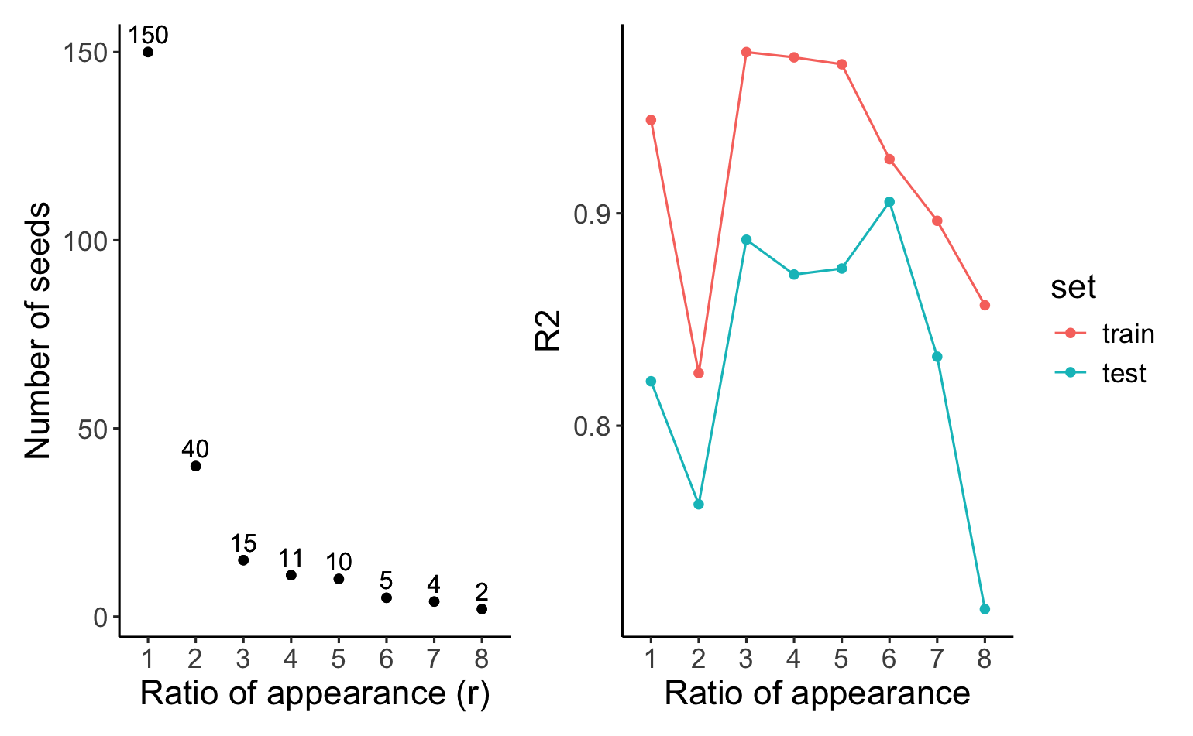
TGCN LASSO Diagnostics LFY1
Ratio of appearance = number of times a gene appeared in 10 bootstrap.

Slide 22
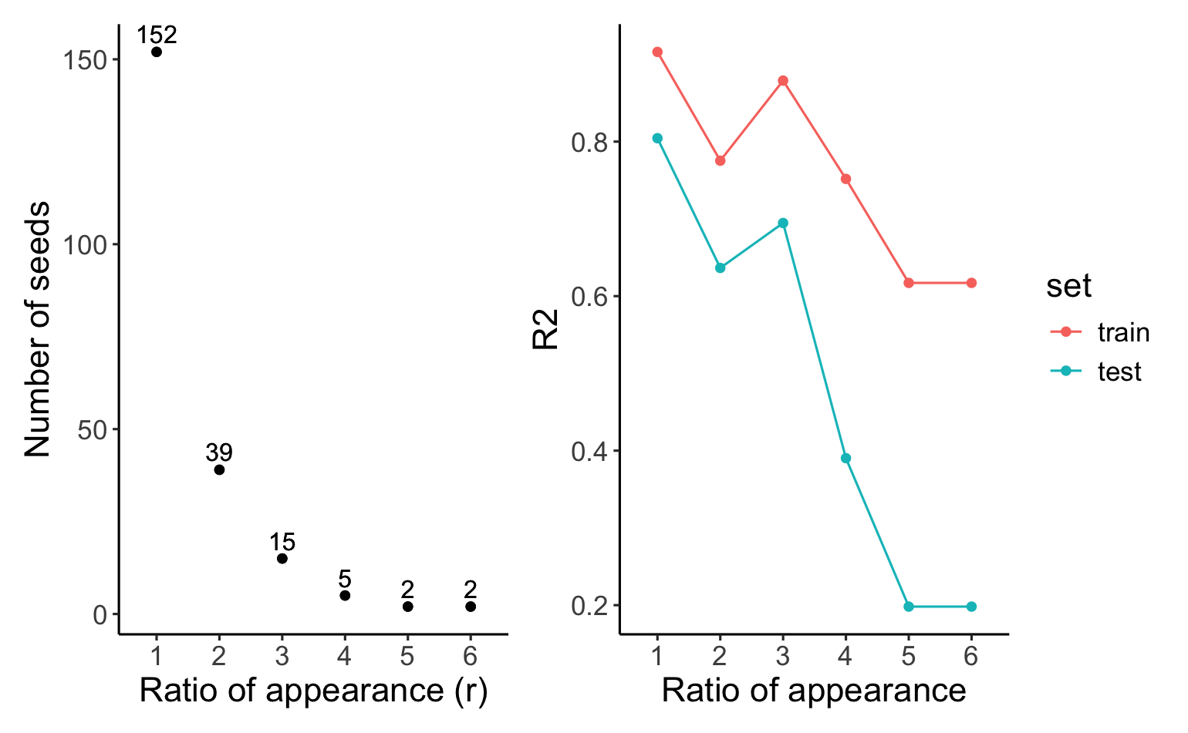
TGCN LASSO Diagnostics LFY2
Ratio of appearance = number of times a gene appeared in 10 bootstrap.

Slide 23
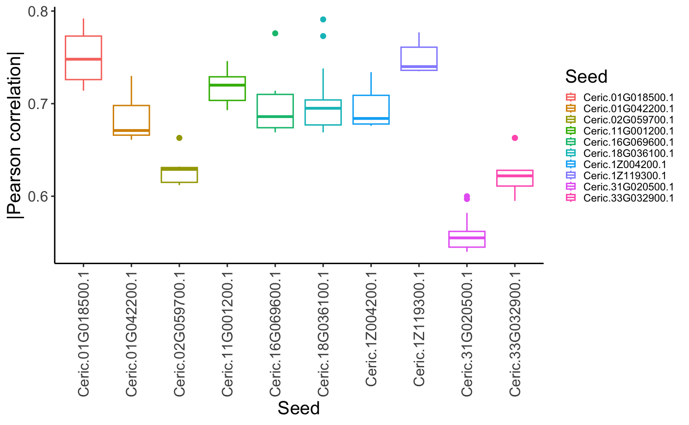
TGCNc5 LFY 1 subnetwork correlation with LFY1

Slide 24
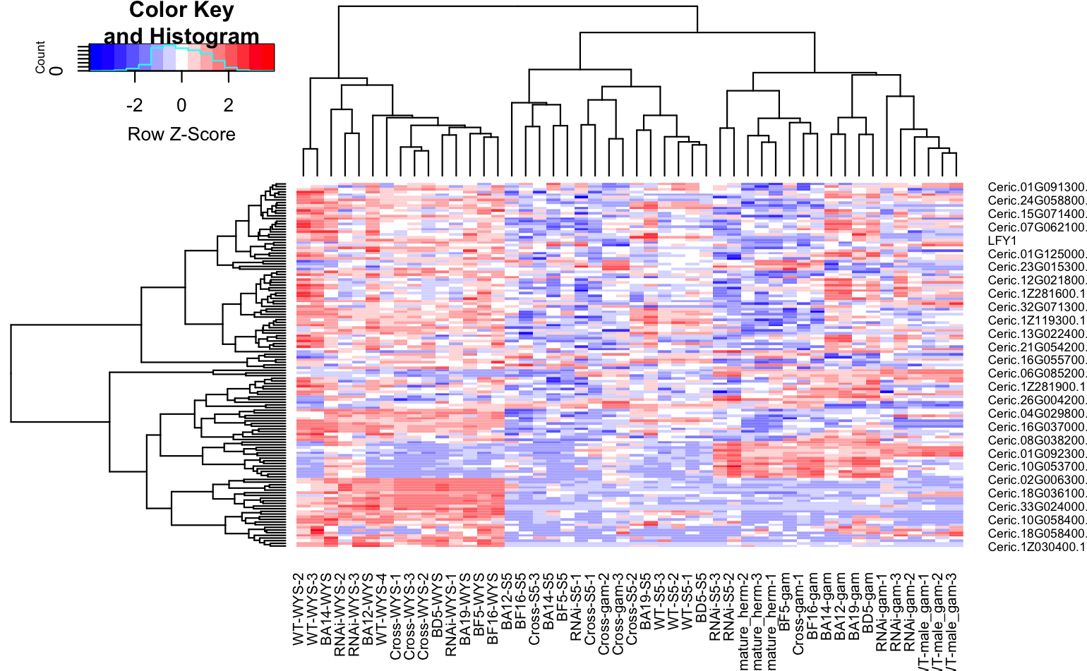
TGCNc5 LFY 1 heatmap

Slide 25
TGCNc5 LFY 1 GO terms (should redo on whole list)
query | GO.ID | Term | Annotated | Significant | Expected | p_value
Ceric.01G018500.1 | GO:0010411 | xyloglucan metabolic process | 21 | 1 | 0.02 | 0.016
Ceric.01G018500.1 | GO:0007275 | multicellular organism development | 25 | 1 | 0.02 | 0.019
Ceric.01G018500.1 | GO:0042546 | cell wall biogenesis | 35 | 1 | 0.03 | 0.026
Ceric.01G018500.1 | GO:0009664 | plant-type cell wall organization | 52 | 1 | 0.04 | 0.039
Ceric.01G042200.1 | GO:0006355 | regulation of DNA-templated transcriptio... | 603 | 2 | 0.23 | 0.016
Ceric.02G059700.1 | GO:0009116 | nucleoside metabolic process | 18 | 1 | 0.01 | 0.009
Ceric.02G059700.1 | GO:0006479 | protein methylation | 20 | 1 | 0.01 | 0.01
Ceric.02G059700.1 | GO:0016567 | protein ubiquitination | 63 | 1 | 0.03 | 0.031
Ceric.11G001200.1 | GO:0006633 | fatty acid biosynthetic process | 87 | 1 | 0.03 | 0.033
Ceric.11G001200.1 | GO:0009058 | biosynthetic process | 2357 | 3 | 0.89 | 0.036
Ceric.16G069600.1 | GO:0007275 | multicellular organism development | 25 | 1 | 0.01 | 0.0063
Ceric.16G069600.1 | GO:0030001 | metal ion transport | 167 | 1 | 0.04 | 0.0417
Ceric.18G036100.1 | GO:0009664 | plant-type cell wall organization | 52 | 2 | 0.05 | 0.00087
Ceric.18G036100.1 | GO:0010411 | xyloglucan metabolic process | 21 | 1 | 0.02 | 0.01839
Ceric.18G036100.1 | GO:0042546 | cell wall biogenesis | 35 | 1 | 0.03 | 0.03049
Ceric.1Z004200.1 | GO:0007275 | multicellular organism development | 25 | 1 | 0.01 | 0.013
Ceric.1Z004200.1 | GO:0006355 | regulation of DNA-templated transcriptio... | 603 | 2 | 0.3 | 0.031
Ceric.1Z119300.1 | GO:0006364 | rRNA processing | 33 | 1 | 0.01 | 0.012
Ceric.1Z119300.1 | GO:0006470 | protein dephosphorylation | 121 | 1 | 0.05 | 0.045
Ceric.31G020500.1 | GO:0006189 | 'de novo' IMP biosynthetic process | 6 | 1 | 0.01 | 0.0083
Ceric.31G020500.1 | GO:0006108 | malate metabolic process | 13 | 1 | 0.02 | 0.0179
Ceric.33G032900.1 | GO:0045892 | negative regulation of DNA-templated tra... | 6 | 1 | 0 | 0.003
Ceric.33G032900.1 | GO:0006535 | cysteine biosynthetic process from serin... | 18 | 1 | 0.01 | 0.009
Ceric.33G032900.1 | GO:0006096 | glycolytic process | 48 | 1 | 0.02 | 0.024

Slide 26
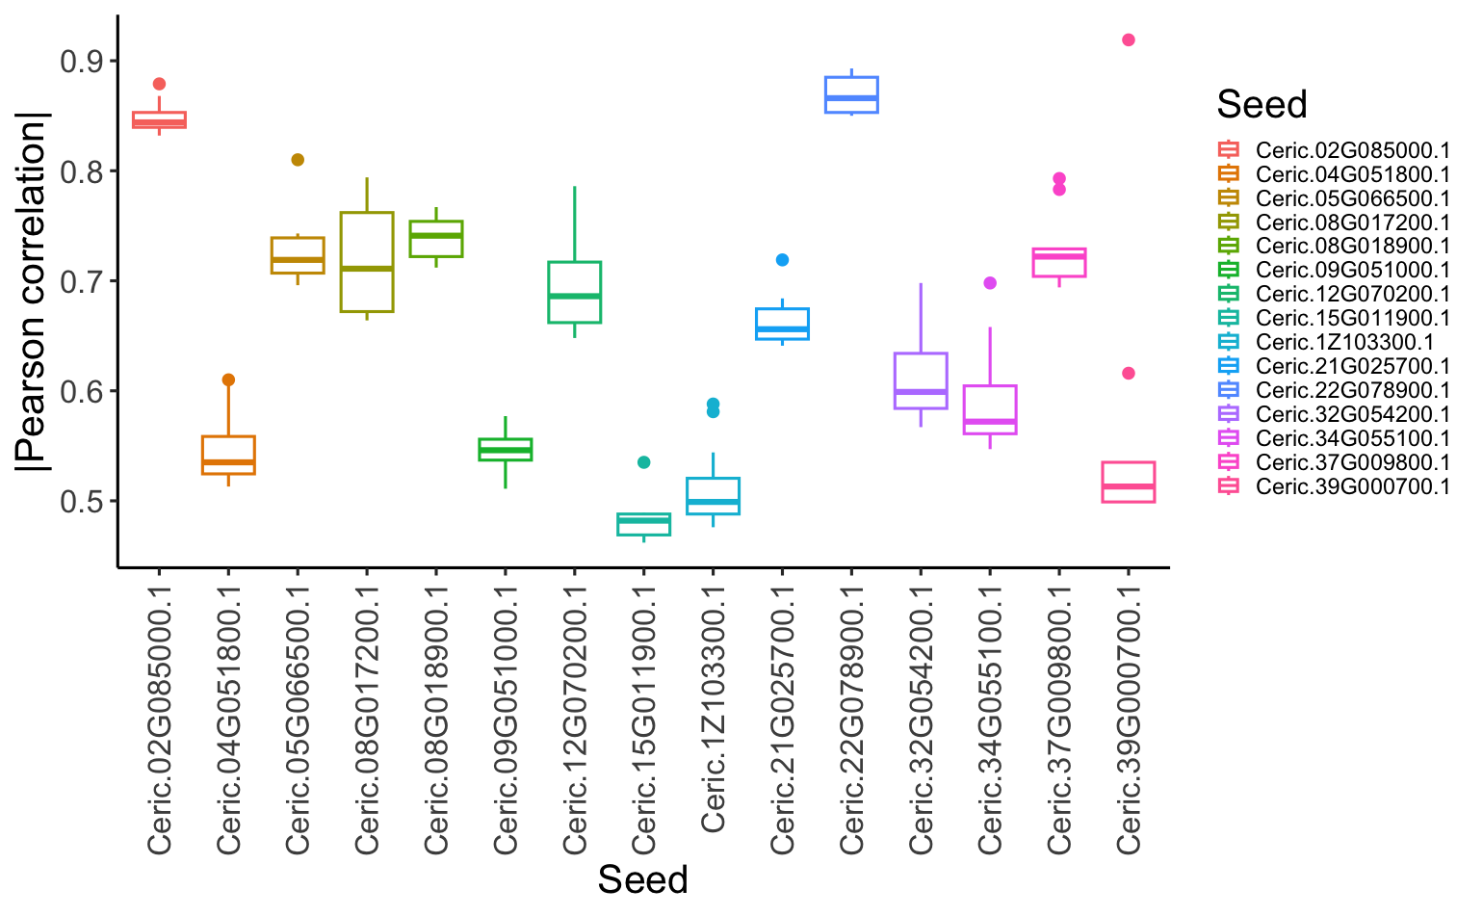
TGCNc3 LFY2 subnetwork correlation with LFY2

Slide 27
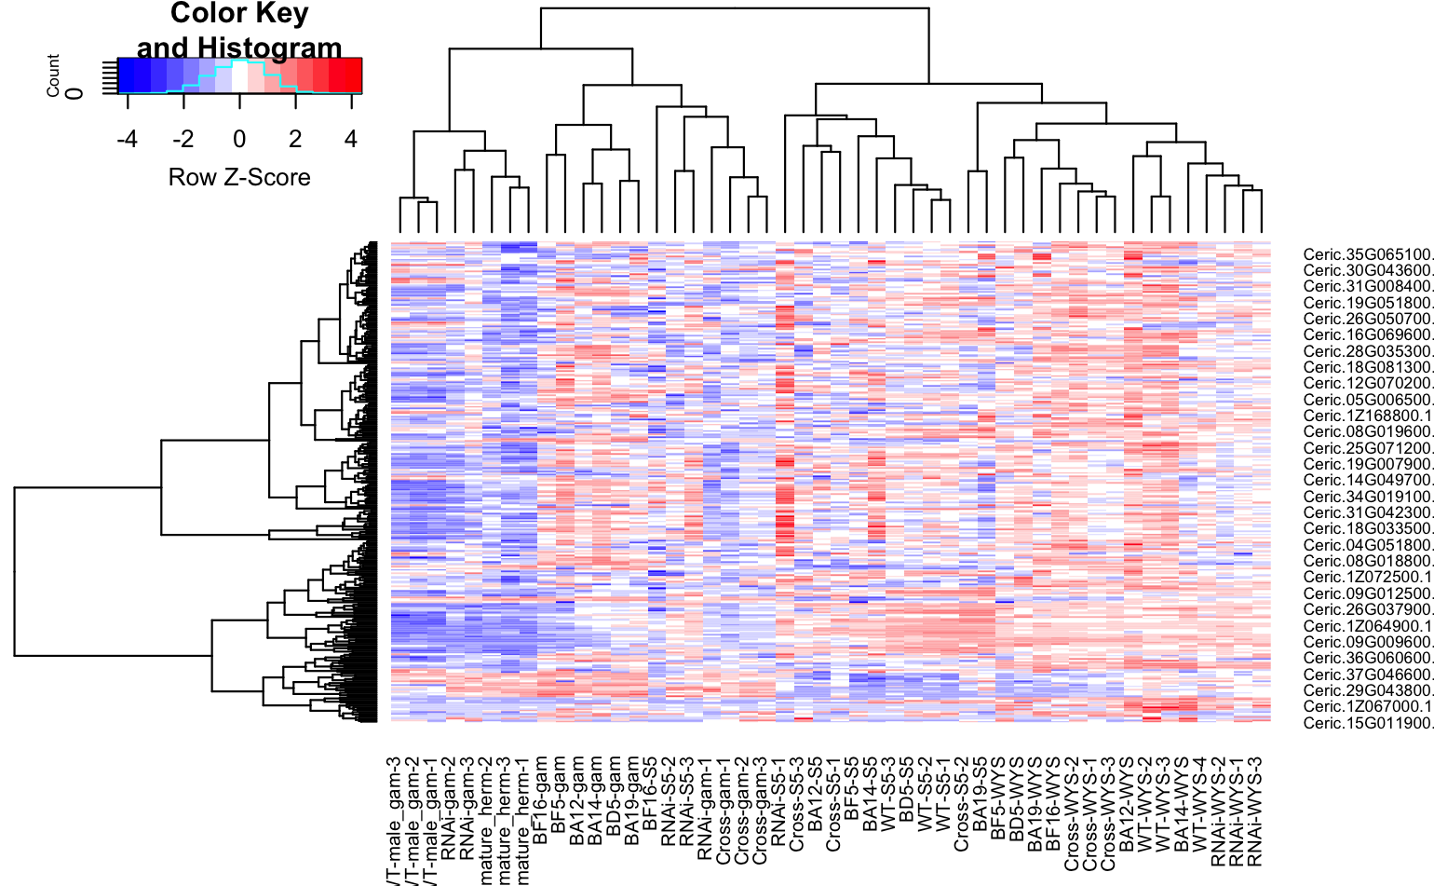
TGCNc3 LFY2 heatmap

Slide 28
TGCNc3 LFY2 GO terms (should redo on whole list)
query | GO.ID | Term | Annotated | Significant | Expected | p_value
Ceric.02G085000.1 | GO:0006075 | (1->3)-beta-D-glucan biosynthetic proces... | 16 | 1 | 0.02 | 0.016
Ceric.02G085000.1 | GO:0006820 | monoatomic anion transport | 17 | 1 | 0.02 | 0.017
Ceric.02G085000.1 | GO:0006355 | regulation of DNA-templated transcriptio... | 603 | 3 | 0.61 | 0.018
Ceric.02G085000.1 | GO:0007275 | multicellular organism development | 25 | 1 | 0.03 | 0.025
Ceric.04G051800.1 | GO:0006355 | regulation of DNA-templated transcriptio... | 603 | 4 | 0.76 | 0.0048
Ceric.04G051800.1 | GO:0009107 | lipoate biosynthetic process | 5 | 1 | 0.01 | 0.0063
Ceric.04G051800.1 | GO:0009116 | nucleoside metabolic process | 18 | 1 | 0.02 | 0.0225
Ceric.04G051800.1 | GO:0006352 | DNA-templated transcription initiation | 38 | 1 | 0.05 | 0.0469
Ceric.05G066500.1 | GO:0007165 | signal transduction | 327 | 1 | 0.08 | 0.081
Ceric.08G017200.1 | GO:0016998 | cell wall macromolecule catabolic proces... | 8 | 1 | 0 | 0.004
Ceric.08G017200.1 | GO:0006888 | endoplasmic reticulum to Golgi vesicle-m... | 17 | 1 | 0.01 | 0.0085
Ceric.08G017200.1 | GO:0030163 | protein catabolic process | 69 | 1 | 0.03 | 0.0344
Ceric.08G017200.1 | GO:0016192 | vesicle-mediated transport | 129 | 2 | 0.07 | 0.0349
Ceric.08G018900.1 | GO:0006468 | protein phosphorylation | 983 | 3 | 0.62 | 0.016
Ceric.09G051000.1 | GO:0006419 | alanyl-tRNA aminoacylation | 3 | 1 | 0 | 0.0019
Ceric.09G051000.1 | GO:0009107 | lipoate biosynthetic process | 5 | 1 | 0 | 0.0031
Ceric.09G051000.1 | GO:0030042 | actin filament depolymerization | 12 | 1 | 0.01 | 0.0075
Ceric.12G070200.1 | GO:0006412 | translation | 447 | 11 | 1.18 | 1.90E-08
Ceric.12G070200.1 | GO:0044571 | [2Fe-2S] cluster assembly | 2 | 1 | 0.01 | 0.0053
Ceric.12G070200.1 | GO:0030042 | actin filament depolymerization | 12 | 1 | 0.03 | 0.0313
Ceric.12G070200.1 | GO:0006888 | endoplasmic reticulum to Golgi vesicle-m... | 17 | 1 | 0.05 | 0.0441
Ceric.15G011900.1 | GO:0006508 | proteolysis | 350 | 1 | 0.13 | 0.13
Ceric.1Z103300.1 | GO:0006166 | purine ribonucleoside salvage | 2 | 1 | 0 | 0.0018
Ceric.1Z103300.1 | GO:0006412 | translation | 447 | 3 | 0.39 | 0.0052

Slide 29
TGCNc3 LFY2 GO terms (should redo on whole list)
Ceric.21G025700.1 | GO:0051252 | regulation of RNA metabolic process | 605 | 2 | 0.38 | 0.0011
Ceric.21G025700.1 | GO:0006099 | tricarboxylic acid cycle | 14 | 1 | 0.01 | 0.0088
Ceric.21G025700.1 | GO:0019290 | siderophore biosynthetic process | 41 | 1 | 0.03 | 0.0256
Ceric.22G078900.1 | GO:0009956 | radial pattern formation | 1 | 1 | 0 | 0.00038
Ceric.22G078900.1 | GO:0008356 | asymmetric cell division | 1 | 1 | 0 | 0.00038
Ceric.22G078900.1 | GO:0048366 | leaf development | 1 | 1 | 0 | 0.00038
Ceric.22G078900.1 | GO:0006511 | ubiquitin-dependent protein catabolic pr... | 46 | 1 | 0.02 | 0.0173
Ceric.22G078900.1 | GO:0006979 | response to oxidative stress | 105 | 1 | 0.04 | 0.03919
Ceric.32G054200.1 | GO:0015693 | magnesium ion transport | 7 | 1 | 0 | 0.0044
Ceric.32G054200.1 | GO:0007034 | vacuolar transport | 17 | 1 | 0.01 | 0.0107
Ceric.34G055100.1 | GO:0009956 | radial pattern formation | 1 | 1 | 0 | 0.0011
Ceric.34G055100.1 | GO:0048366 | leaf development | 1 | 1 | 0 | 0.0011
Ceric.34G055100.1 | GO:0008356 | asymmetric cell division | 1 | 1 | 0 | 0.0011
Ceric.34G055100.1 | GO:0015693 | magnesium ion transport | 7 | 1 | 0.01 | 0.0079
Ceric.34G055100.1 | GO:0010468 | regulation of gene expression | 628 | 3 | 0.71 | 0.0236
Ceric.37G009800.1 | GO:0005992 | trehalose biosynthetic process | 20 | 1 | 0.01 | 0.005
Ceric.37G009800.1 | GO:0006633 | fatty acid biosynthetic process | 87 | 1 | 0.02 | 0.022

Slide 30
MR
Wasn’t able to prepare slides yet
Quick look suggests that at least for LFY1 TGCN and MR are pulling out similar genes

Slide 31
Next Steps
Promoter motif enrichment
Expand to include samples from NCBI?

Slide 32
Update April 21

Slide 33
Overview
Performed Male vs Hermaphrodite DEG comparison
Downloaded 53 gametophyte RNAseq samples
Total count including Hannah’s samples = 71
Downloaded 79 sporophyte RNAseq samples
Total count including Hannah’s = 109
Mapped NCBI reads and got expression counts
WGCNA on all gametophyte and all sporophyte samples (separately)
TGCN on all gametophyte and all sporophyte samples (separately)

Slide 34
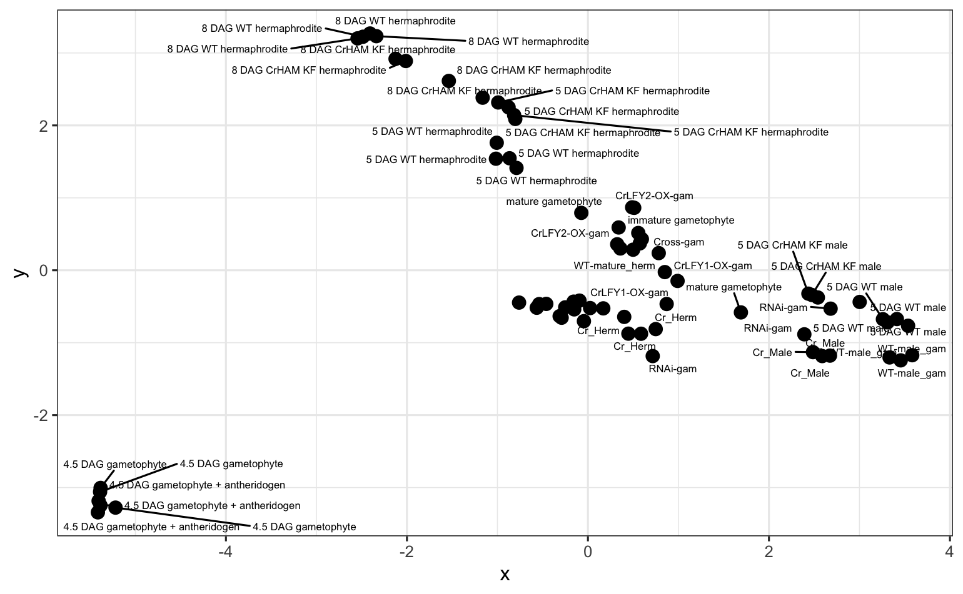
Gametophyte MDS

Slide 35
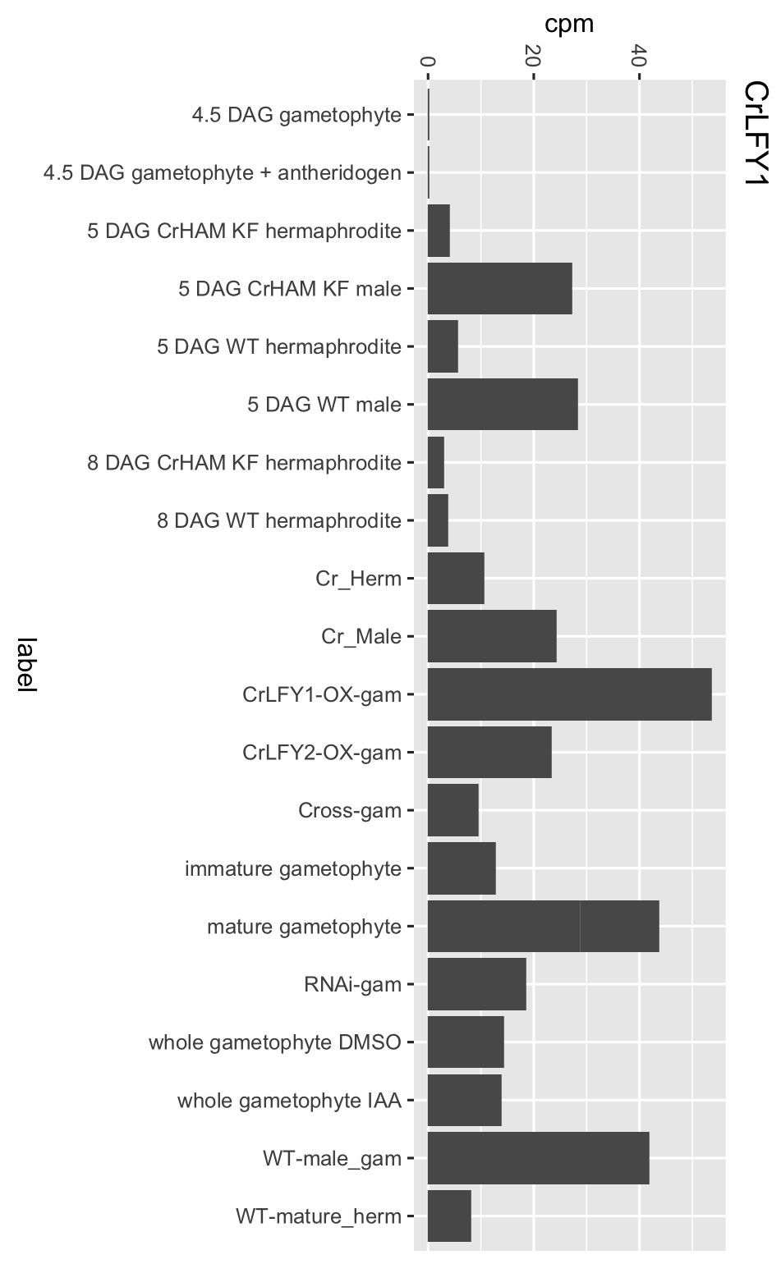
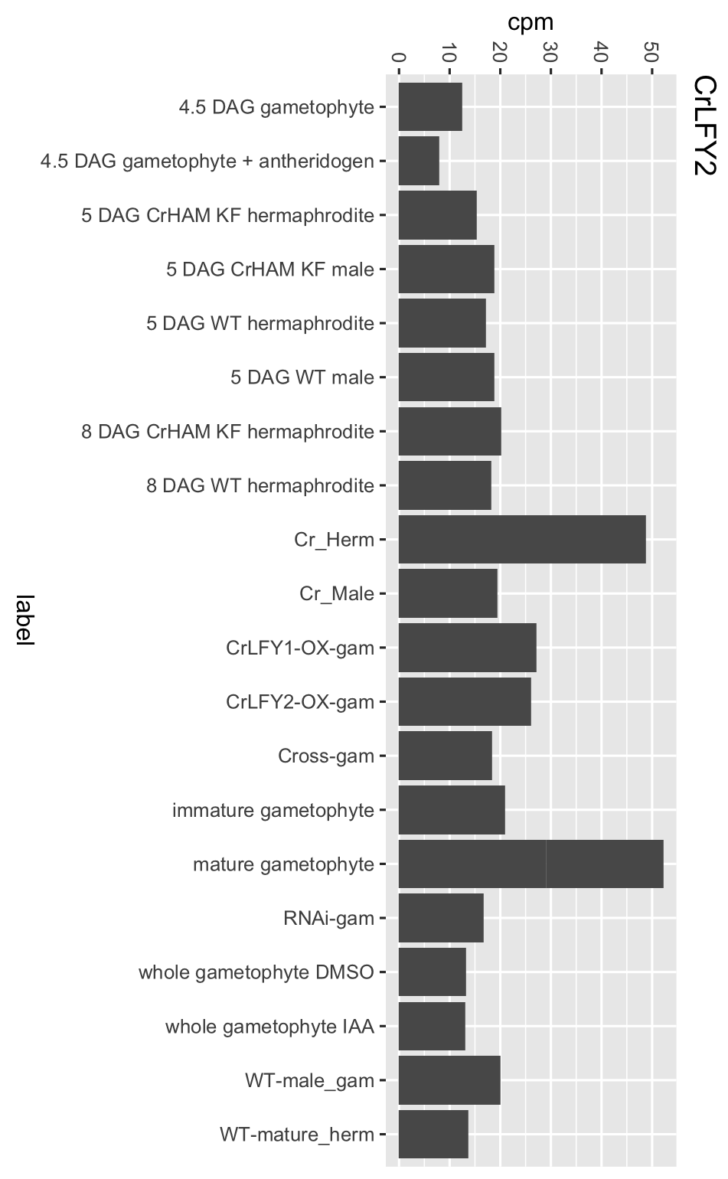
Gametophyte LFY expression

Slide 36
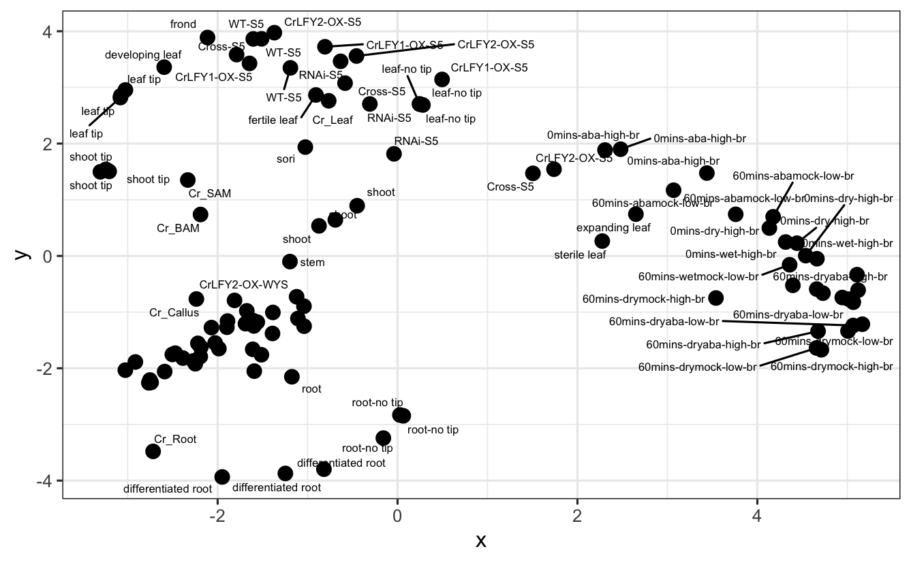
Sporophyte MDS

Slide 37
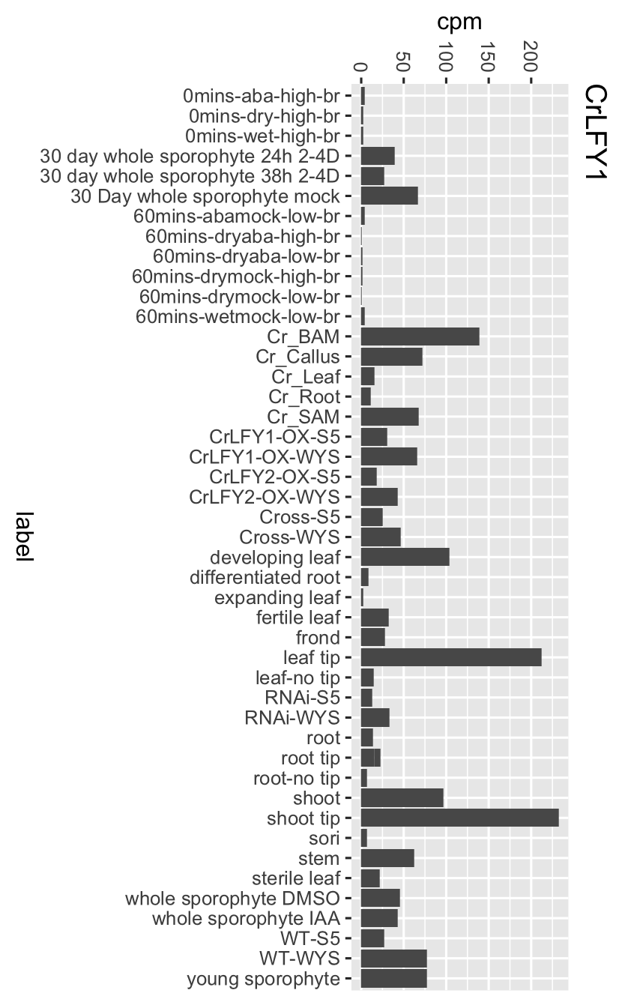
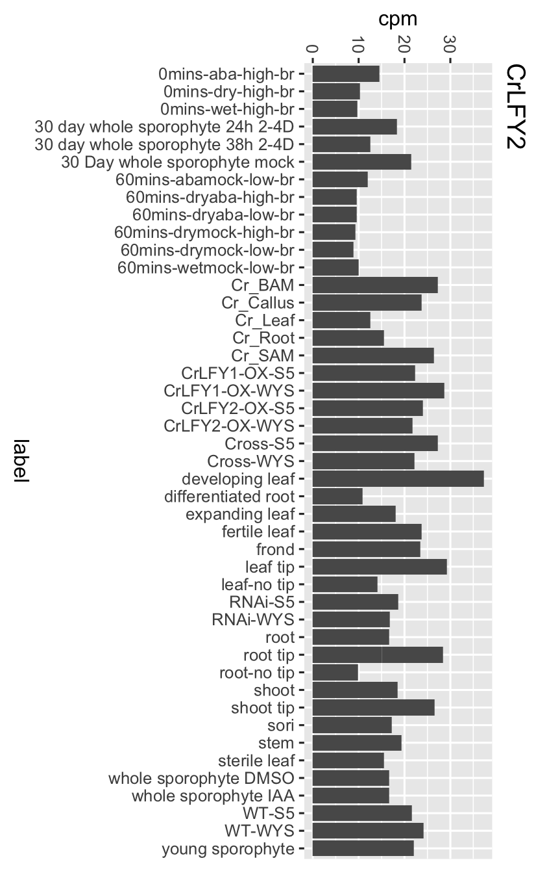
Sporophyte LFY expression

Slide 38
WGCNA LFY Module Size (more samples mostly did not help)
Samples | LFY1 | LFY2
McConnell Gametophyte | 6,483 | 3,745
All Gametophyte | 3,212 | 784
Samples | LFY1 | LFY2
McConnell Sporophyte | 3,736 | 2,521
All Sporophyte | 6,459 | 6,459

Slide 39
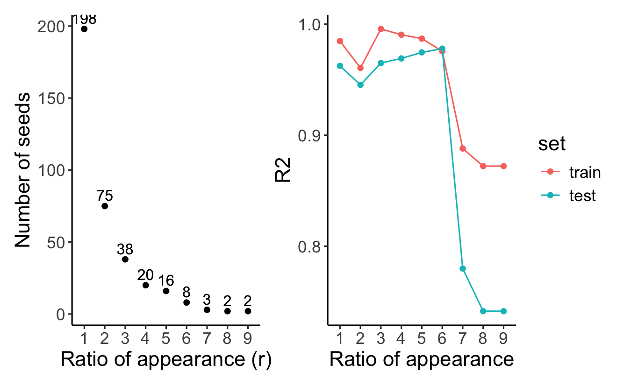
TGCN LFY1 gametophyte maybe looks better
Old
Gametophyte

Slide 40
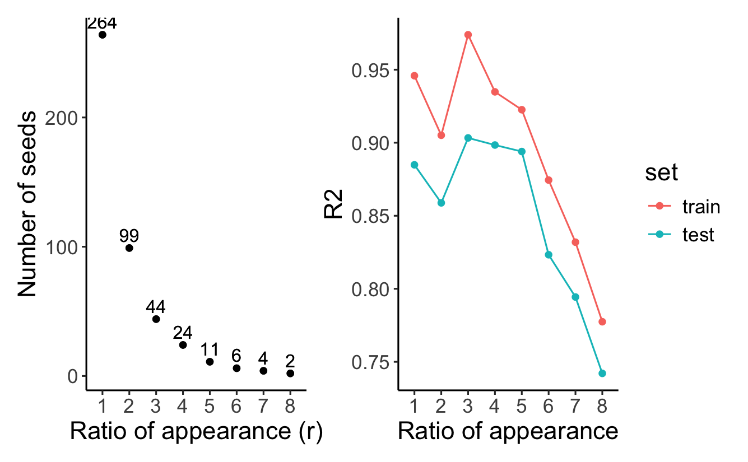
TGCN LFY1 sporophyte…
Old
Sporophyte

Slide 41
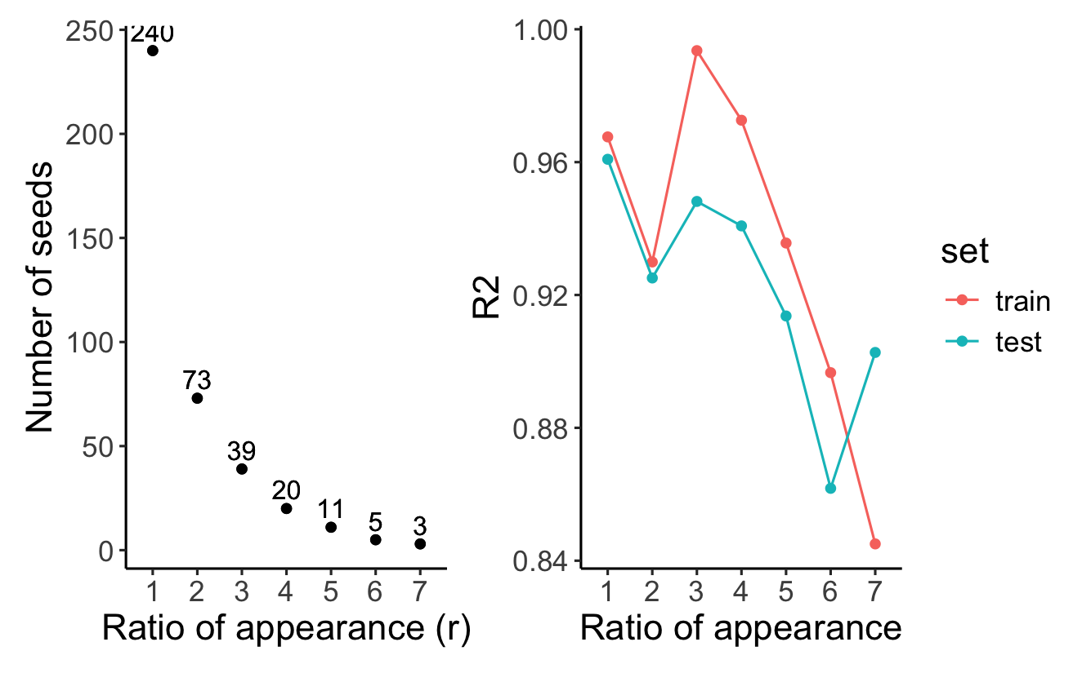
TGCN LFY2 gametophyte maybe looks better
Old
Gametophyte

Slide 42
TGCN LFY2 sporophyte maybe looks better
Old
sporophyte

Slide 43
Update May 5, 2025

Slide 44
MADS box enrichment
Method | Tissue | Gene | # Genes in module | # MADS in module | P-value
WGCNA | gametophyte | LFY1 | 3212 | 2 | 0.75
WGCNA | gametophyte | LFY2 | 784 | 3 | 0.03
WGCNA | sporophyte | LFY1 | 6459 | 1 | --
WGCNA | sporophyte | LFY2 | 6459 | 1 | --
TGCN | gametophyte | LFY1 |  | 0 | --
TGCN | gametophyte | LFY2 |  | 0 | --
TGCN | sporophyte | LFY1 |  | 0 | --
TGCN | sporophyte | LFY2 |  | 0 | --

Slide 45
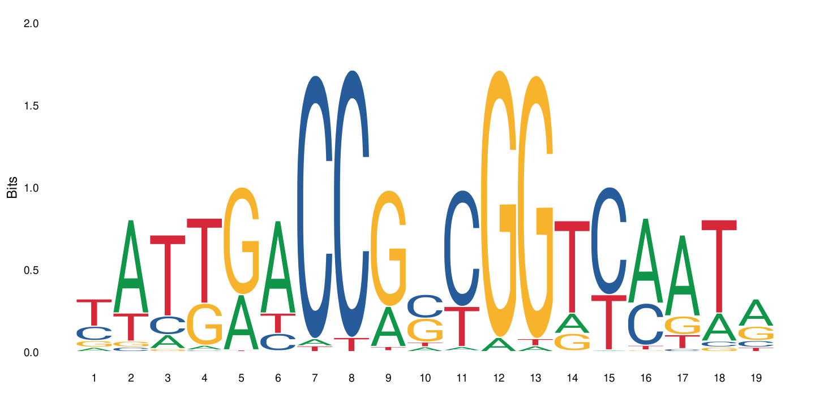
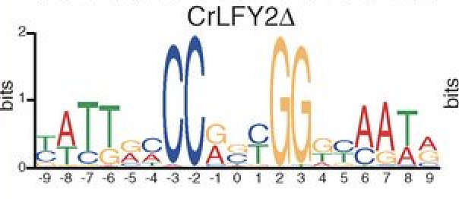
LFY binding site enrichment
I used the Arabidopsis site (because the PWM is in the database)
(but it is VERY similar to CrLFY2 from Sayou et al.)
Arabidopsis

Slide 46
LFY binding site enrichment
Method | Tissue | Gene | Mean LFY sites in module | Mean LFY sites outside of module | P-value
WGCNA | gametophyte | LFY1 | 2 | 2 | 0.77
WGCNA | gametophyte | LFY2 | 2.09 | 2 | 0.12
WGCNA | sporophyte | LFY1 | 2.02 | 2 | 0.29
WGCNA | sporophyte | LFY2 | 2.02 | 2 | 0.29
TGCN | gametophyte | LFY1 | 1.81 | 2.00 | 0.21
TGCN | gametophyte | LFY2 | 2.44 | 2.00 | 0.01
TGCN | sporophyte | LFY1 | 2.17 | 2.00 | 0.07
TGCN | sporophyte | LFY2 | 2.22 | 2.00 | 0.005
Used t-test…probably not best choice for count data
Best results defining promoter as 5,000bp upstream. (tried 1500; 3000; 5000; 7500)

Slide 47
Single cell / nuclei RNAseq
Had a meeting with Azeneta/Genewiz
They have done this on most/all crops
Prefer us to send cryo-preserved protoplasts
Cell vs nuclei: maximum cell size 50uM
Young plants work better for nuclear isolation
If we did four samples, ~ $1853 per sample; $7500 total.

Slide 48
Update June 10, 2025

Slide 49
“How come Marchant reports so many more expressed genes?”
Marchant: 33,301 expressed in gametophyte
Methods do not define criteria for “expressed”
Maloof (NCBI): 27,206 expressed in gametophyte
Criteria: > 5 counts in >= 3 samples
If I use > 0 counts in > 0 samples I get 32,310
Maloof (McConnell-All gam):
> 5 counts >= 3 samples = 24,775
> 0 counts > 0 samples = 30,628
Maloof (McConnell-Male vs Herm):
> 5 counts >= 3 samples = 22,719
> 0 counts >= 0 samples = 28,614

Slide 50
First draft of methods for males vs hermaphrodites done

Slide 51
Redid gametophyte networks without 4.5 DAG samples
Big picture results similar…

Slide 52
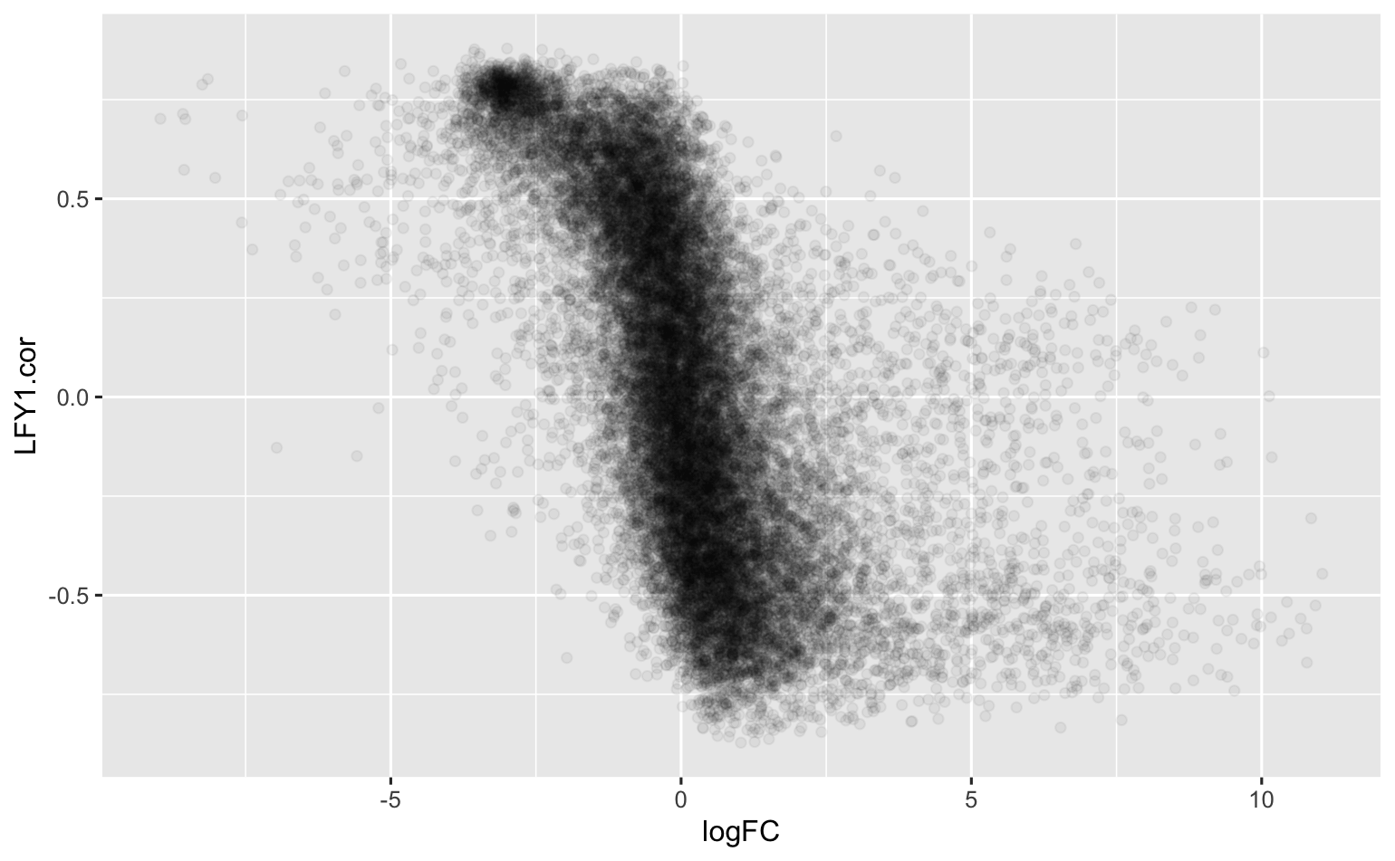
LFY1 vs male/hermaphrodite DEG
The genes most correlated with LFY1 are expressed higher in males
(Maybe I should redo this excluding Hannah’s male vs hermaphrodite samples from the network…)

Slide 53
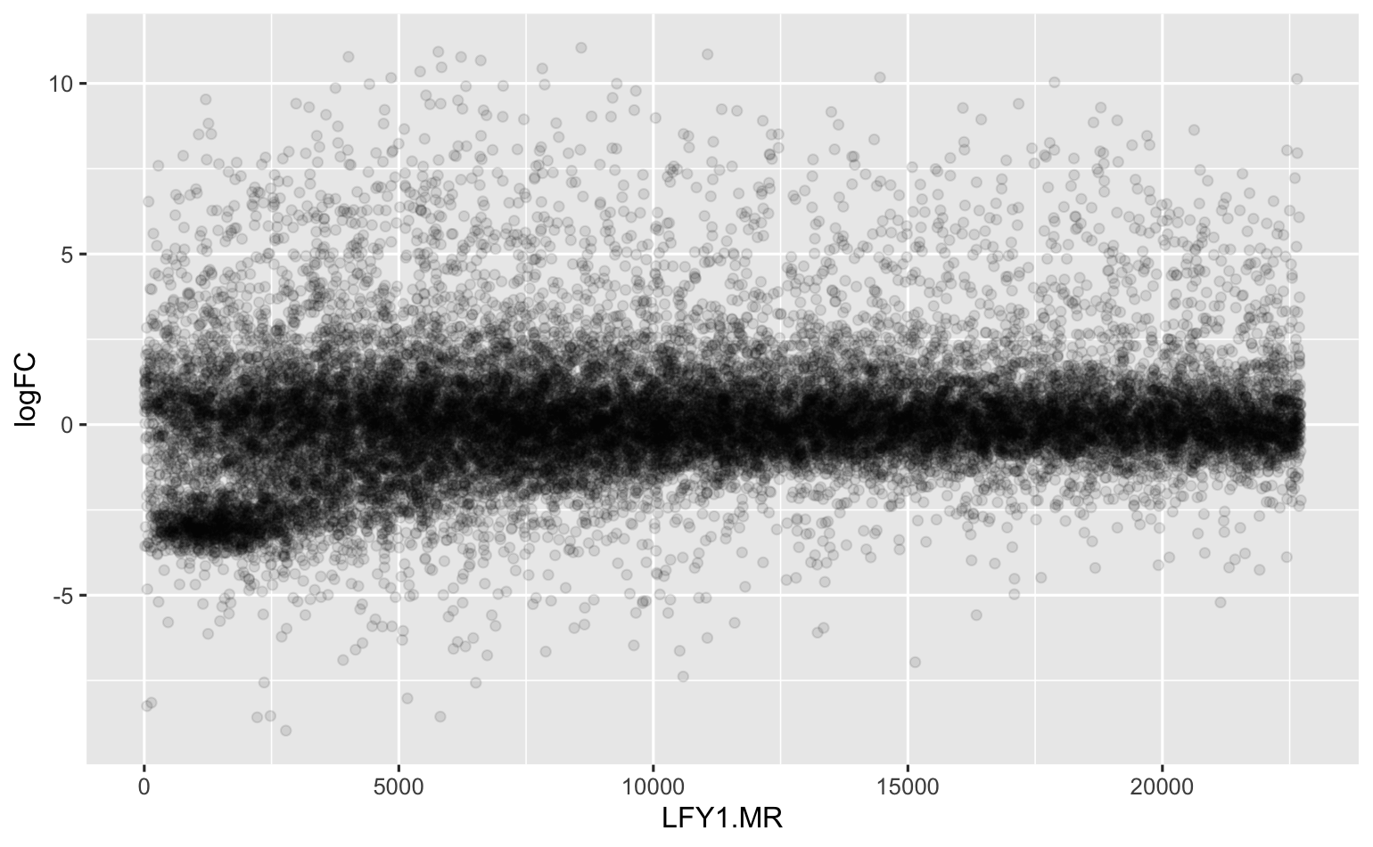
LFY1 vs male/hermaphrodite DEG
Looking at mutual correlation rank

Slide 54
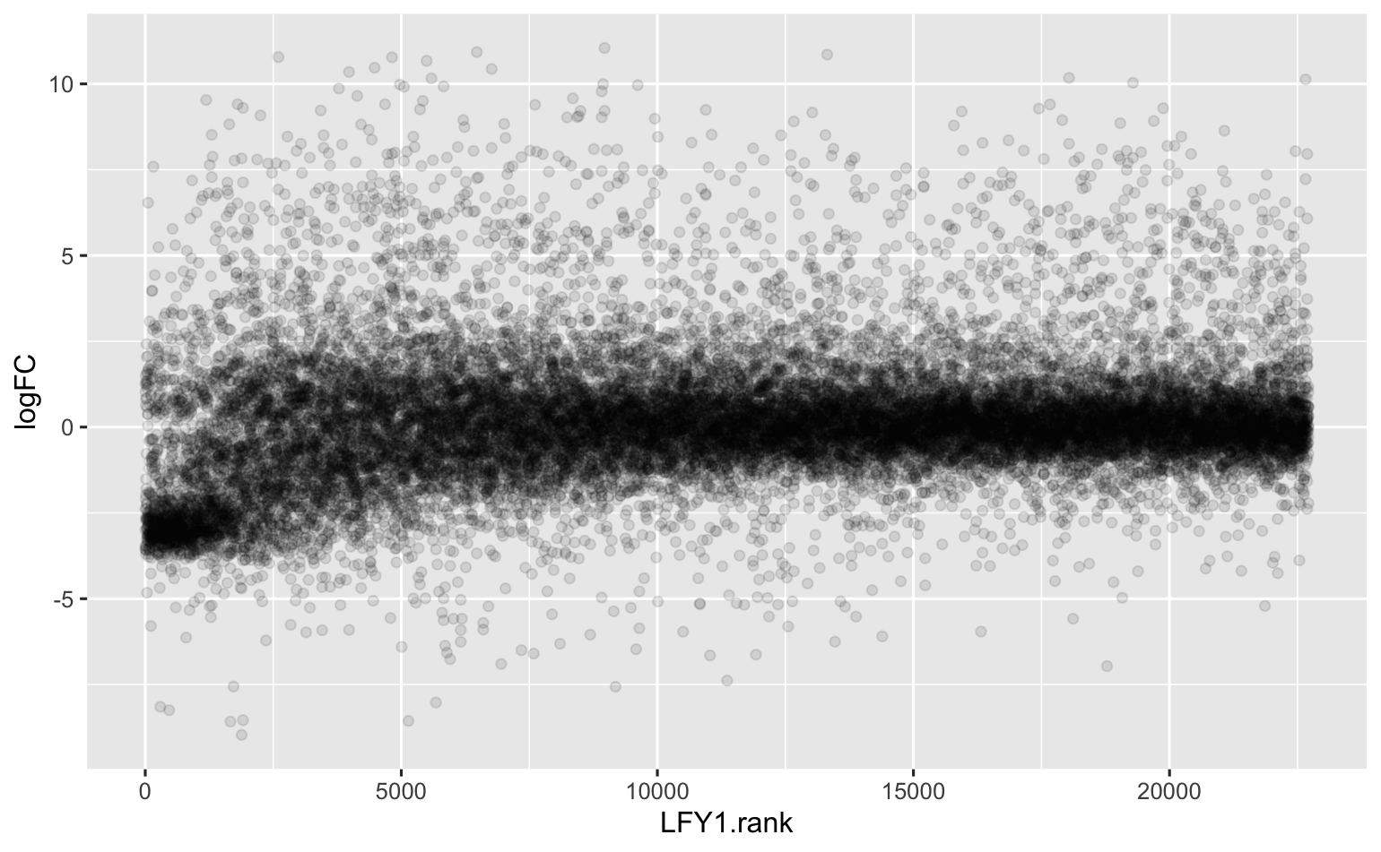
LFY1 vs male/hermaphrodite DEG
Looking at LFY1 correlation rank

Slide 55
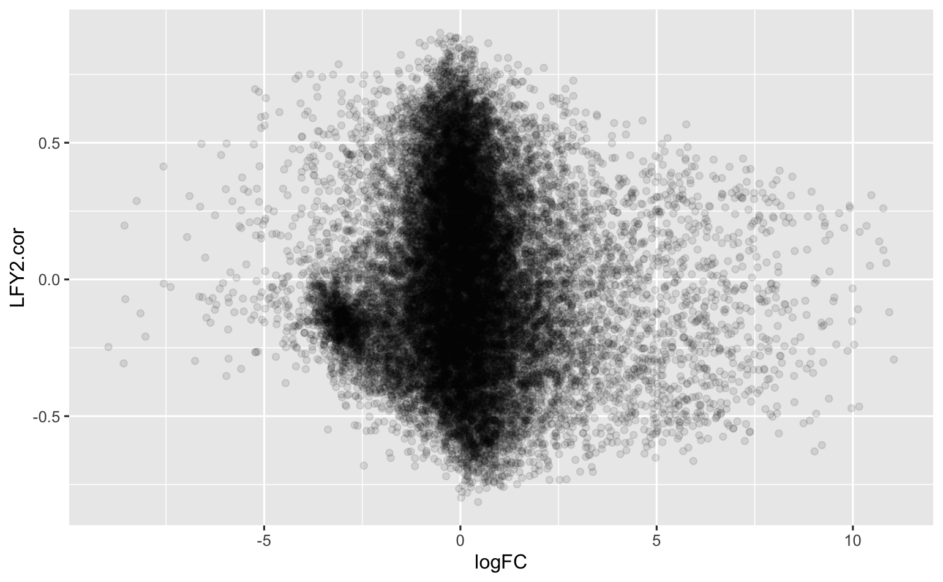
LFY2 vs male/hermaphrodite DEG
Not much pattern with LFY2

Slide 56
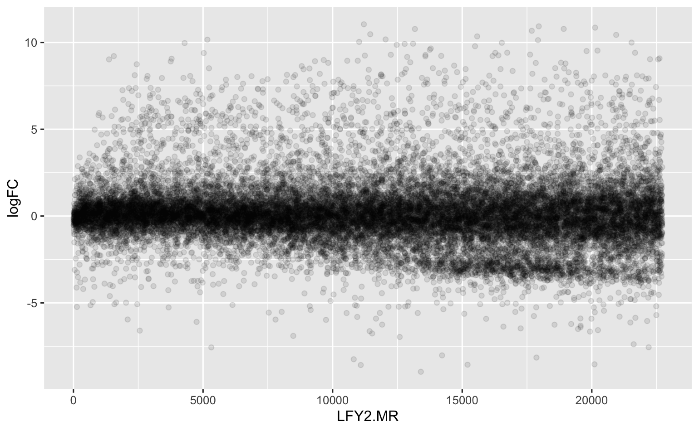
LFY2 vs male/hermaphrodite DEG
Looking at mutual correlation rank

Slide 57
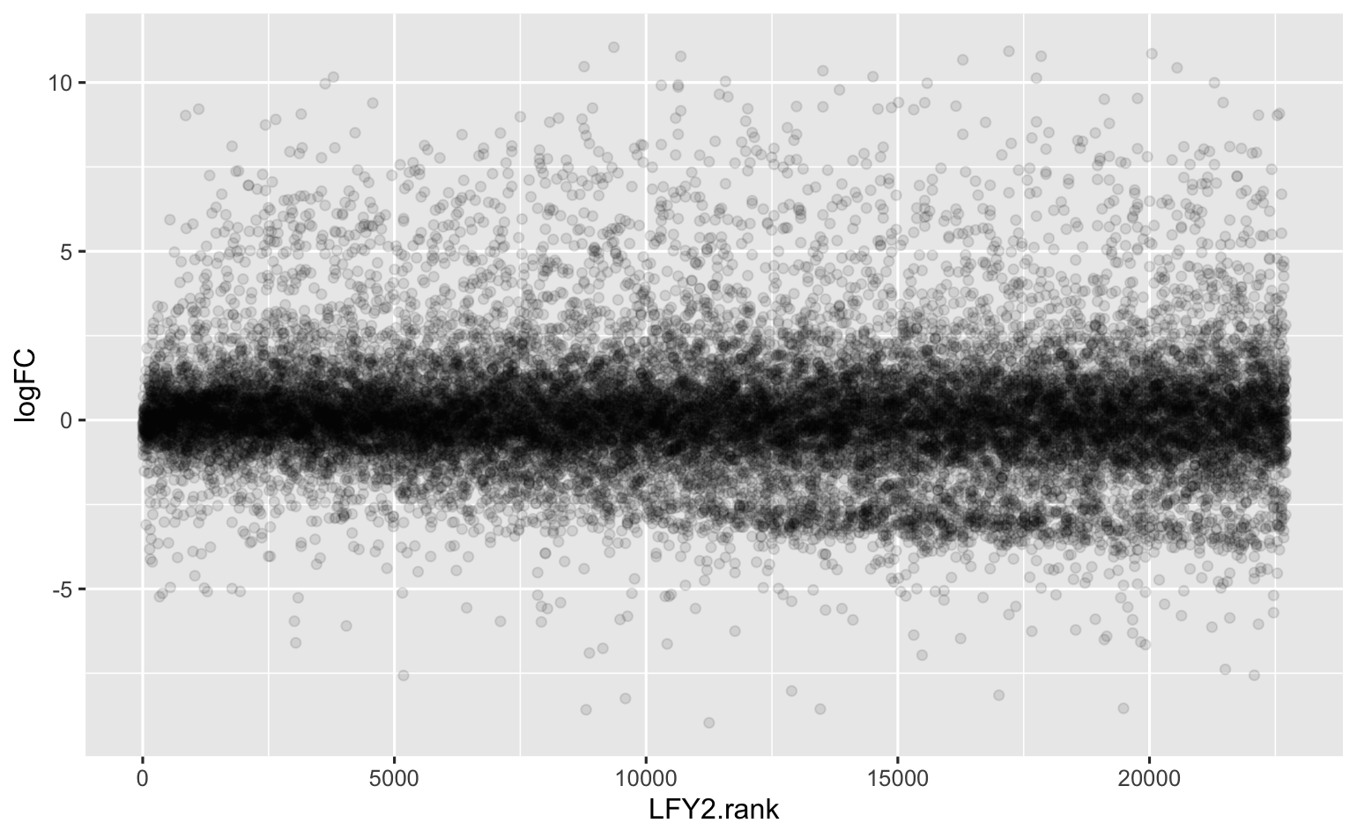
LFY2 vs male/hermaphrodite DEG
Looking at LFY2 correlation rank

Slide 58
Update June 20, 2025

Slide 59

The relationship between male/hermaphrodite DEG genes and the LFY1 network persists when I build the network without the male/hermaphrodite samples
Original
New: male/herm samples
removed

Slide 60
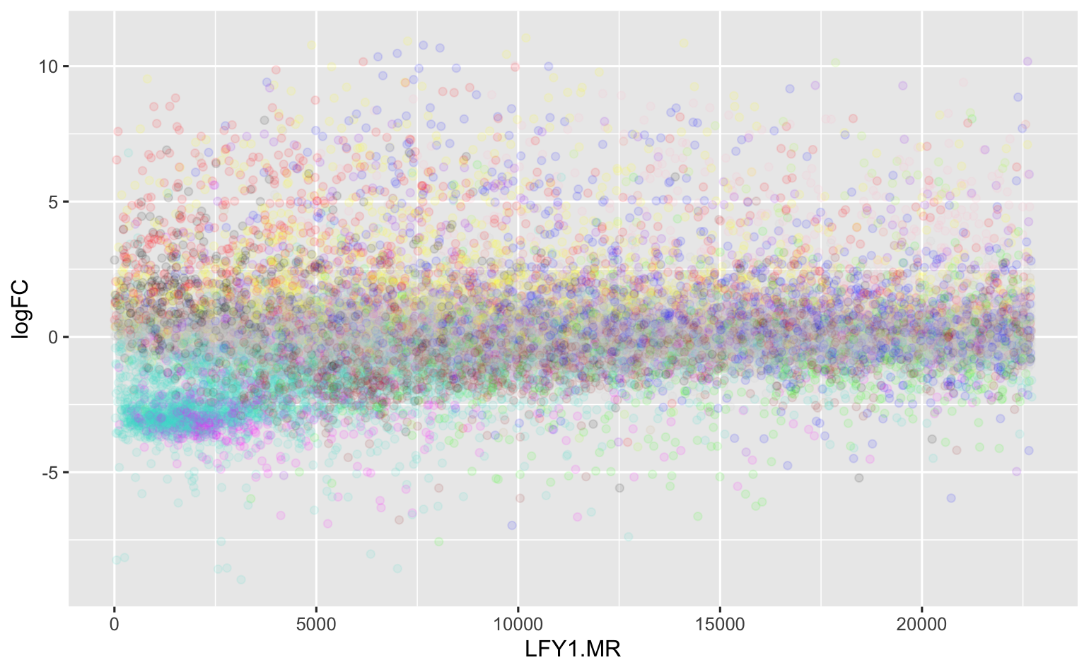
Trying to ID genes in the cluster
First attempt: use WGCNA modules
Maybe Turquoise?

Slide 61
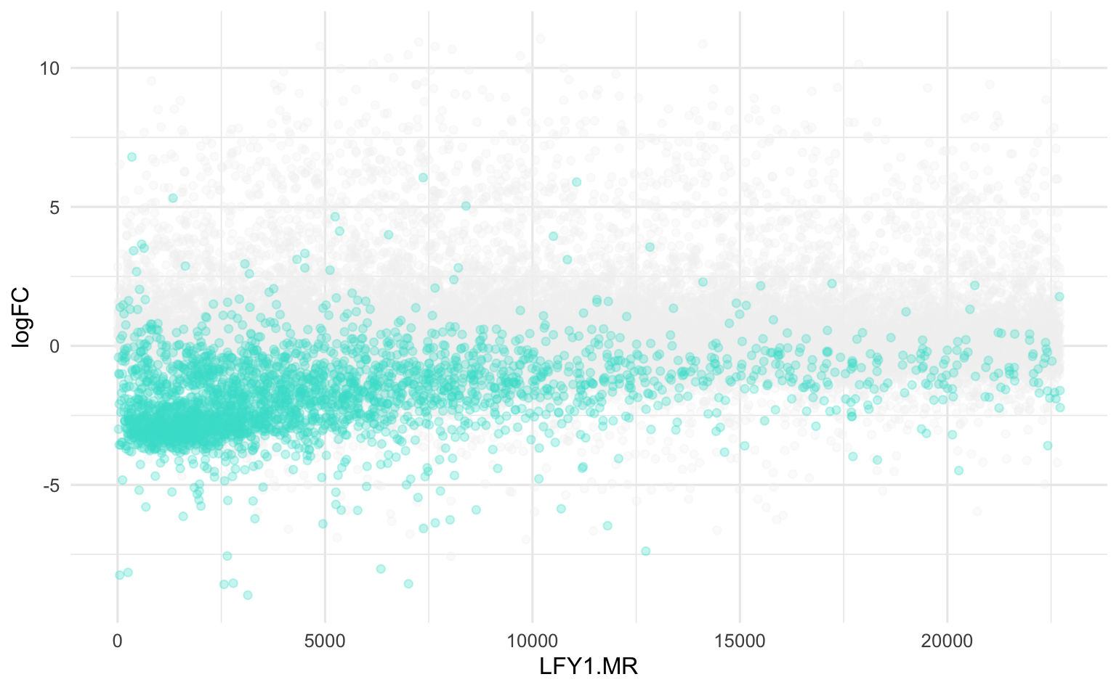
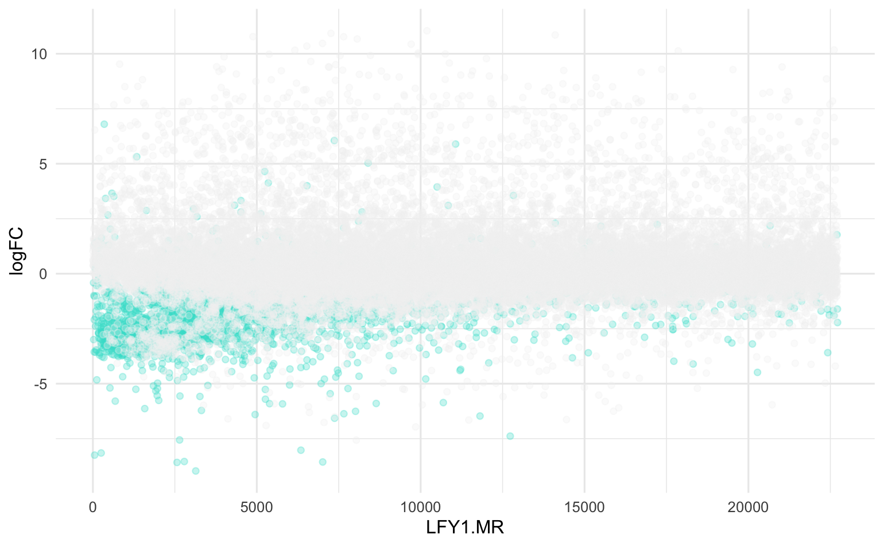
Trying to ID genes in the cluster
First attempt: use WGCNA modules
Maybe Turquoise? Yes, but too broad and not specific enough
Plot turquoise on top
Plot turquoise on bottom

Slide 62
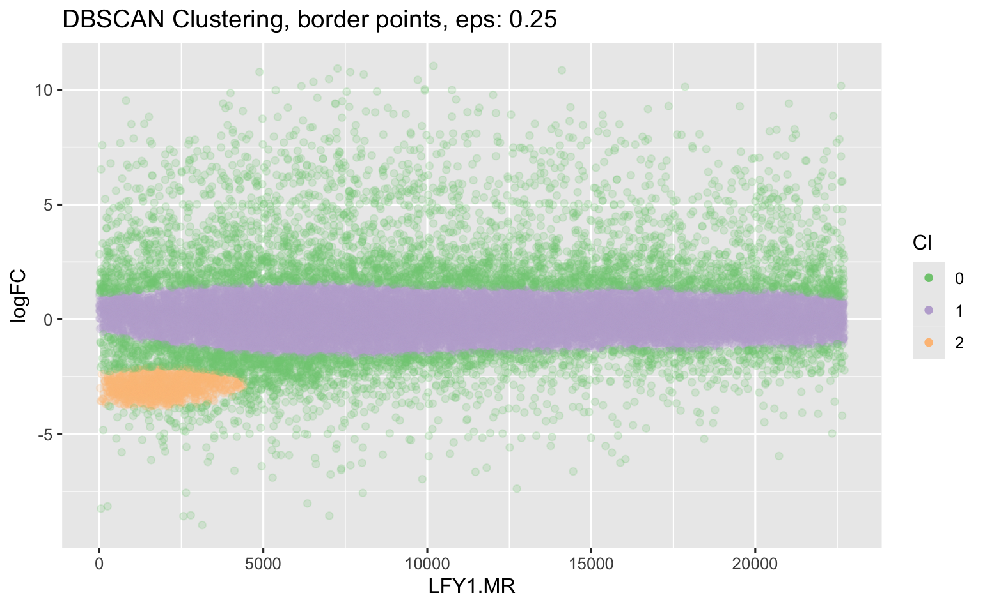
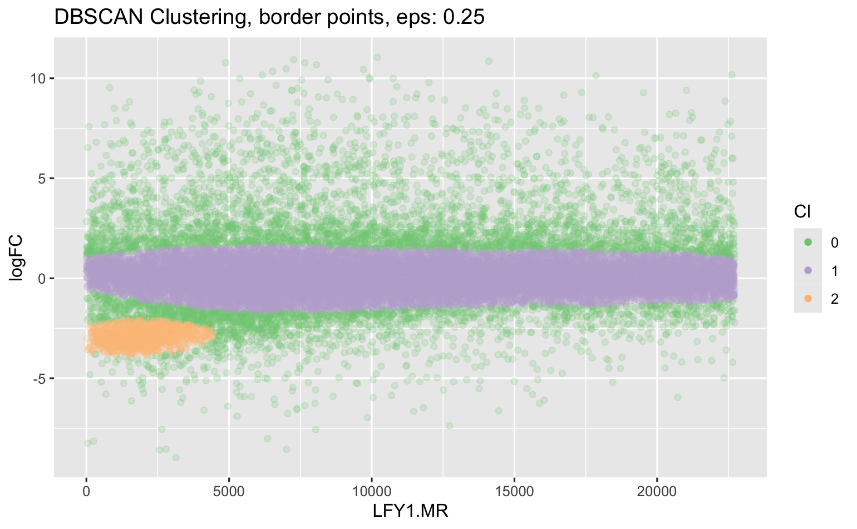
Trying to ID genes in the cluster
Second attempt: density-based clustering
Plot cluster on top
Plot cluster on bottom

Slide 63
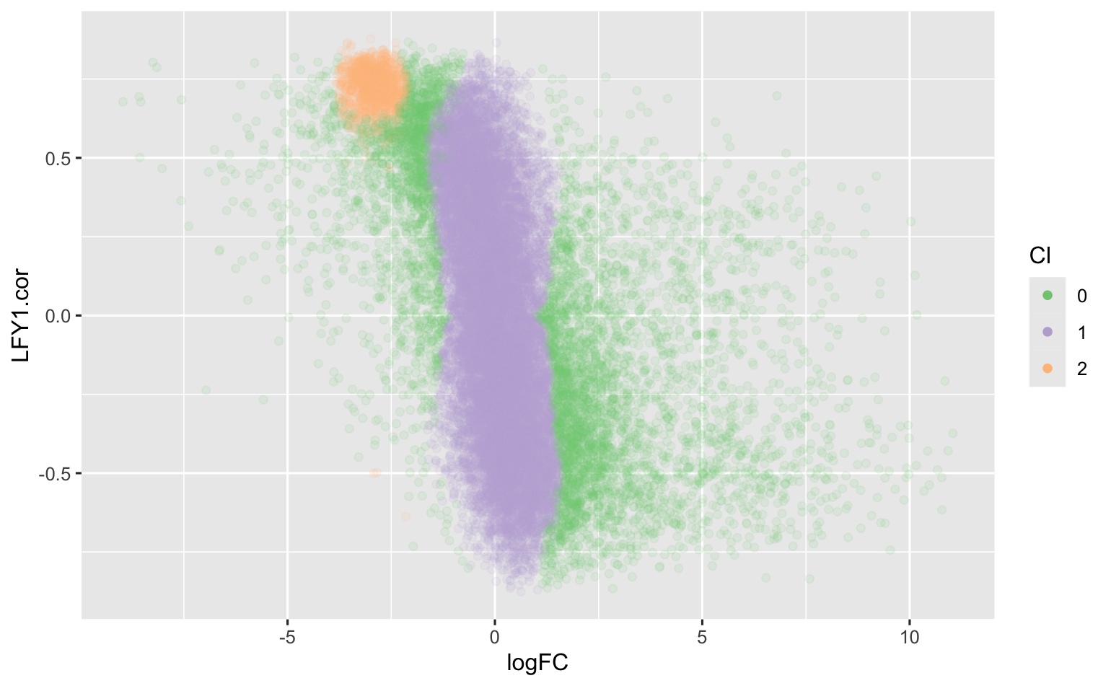
Trying to ID genes in the cluster
Second attempt: density-based clustering
View using correlation axis

Slide 64
There are 1180 genes in the cluster

Slide 65
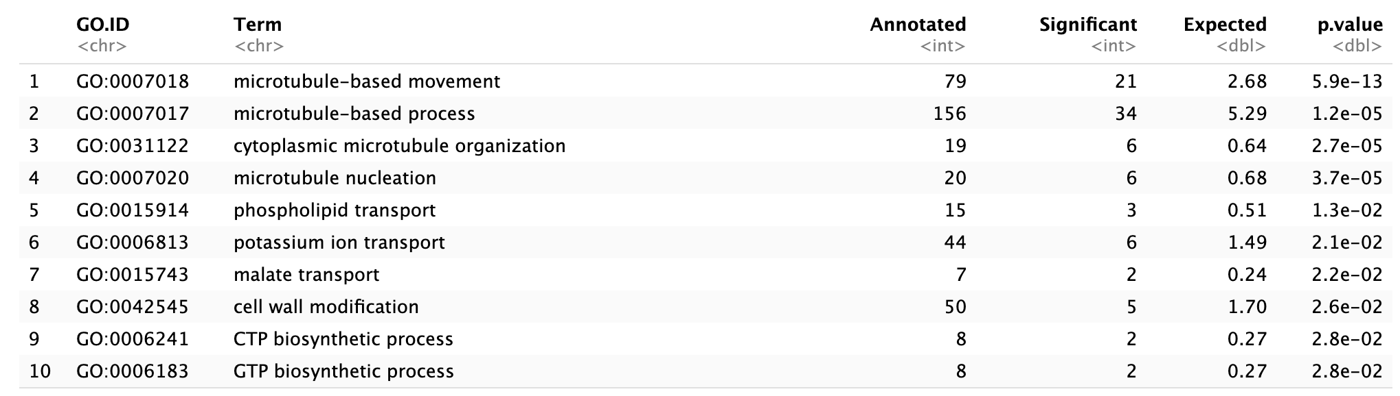
GO enrichment

Slide 66
Next Steps
A priori gene location in network
Compare location of a priori genes in C. richardii and Arabidopsis networks.

Slide 67
Update July 03, 2025

Slide 68
Reviewed 2015 Arabidopsis Analysis
Developmental Atlas approach did not work(!)
I tried a variety of gene subsets from the developmental atlas
WGCNA LFY module sizes 2250 – 8500
For the full dataset and two subsets, little enrichment for known targets
For a hand-selected subset focusing on diversity in LFY levels some target enrichment
What did work was a floral induction series with WT and lfy mutant plants
This is why the original grant plan (pre-budget cut) was inducible LFY constructs (along with ChIP-seq to ID bona fide targets).

Slide 69
Update Dec 02, 2025
And Redo with Andy;s new dataset Jan 13, 2026

Slide 70
Background for Andy
Original Goal:
Define CrLFY1 and CrLFY2 GRN and make evo. Comparisions
Original plan:
Inducible GR-LFY fusions
ChIP on GUS or GR lines or native protein
CRISPR KO
RNAseq on inducible lines plus existing RNAi and OX lines, & developmental time course
Funding cut
Plan deemed too ambition, funding cut to essentially only find resource development
GR-LFY and CRISPR constructs made but not transformed…

Slide 71
Background for Andy
What we have
RNAseq on WT, RNAi and OX lines, multiple tissues. But RNAi and OX lines did not “behave”
RNAseq on mature males and hermaphrodites
47 gametophyte RNAseq samples from public domain
79 sporophyte RNAseq samples from public domain
What I have done
WGCNA networks on NCBI + Hannah samples, separately for sporophyte and gametophyte
TGCNA networks
Mutual rank networks
Generally CrLFYs are in very large modules
Little to no enrichment for MADS box genes in CrLFY modules

Slide 72
Background for Andy
What I have done
WGCNA networks on NCBI + Hannah samples, separately for sporophyte and gametophyte
TGCN networks
Mutual rank networks
Generally, CrLFYs are in very large modules
Little to no enrichment for MADS box genes in CrLFY modules
Motif analysis (some enrichment for LFY motif in some networks)
GO enrichment
GSEA for A.t. reproductive categories
Probably the most interesting result is the intersection between the CrLFY1 MR network and the male vs hermaphrodite DEG (you have seen this)

Slide 73
Working with Andy’s Annotations
Andy has
Updated GO and other functional annotations
Although only minor difference
Categories of Arabidopsis genes based on expression in reproductive tissues
Ortholog clusters Arabidopsis ← → C-fern

Slide 74
Things that can be done with Andy’s data
Use new GO categories and annotations for male vs hermaphrodite DEG. (not done)
Use new GO categories for GO enrichment in WGCNA modules (not done)
Look for enrichment of reproductive gene categories in WGCNA modules (done)
Look for enrichment of reproductive gene categories in male vs hermaphrodite DEG (done)
Look for enrichment of reproductive gene categories in LFY MR networks (GSEA analysis done…nothing significant)

Slide 75
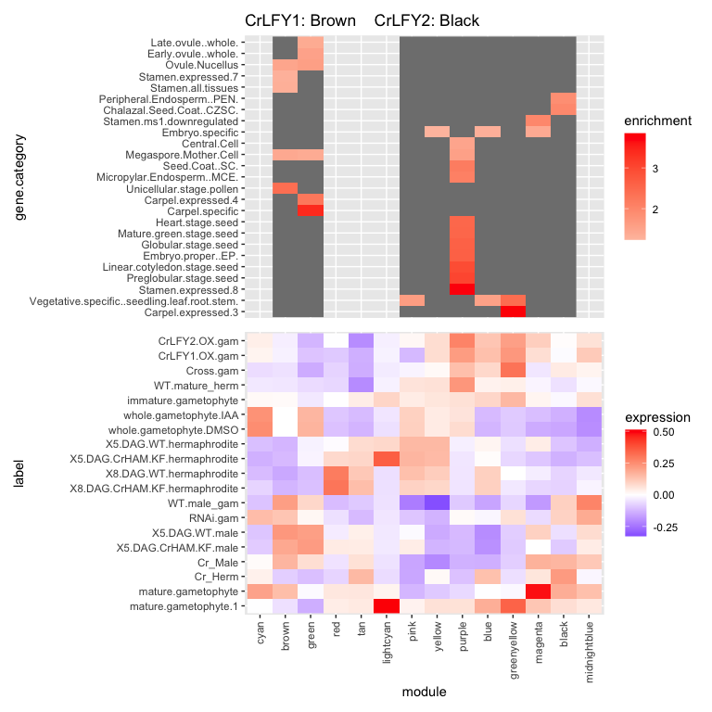
Enrichment of reproductive gene categories in WGCNA modules (gametophyte)

Slide 76
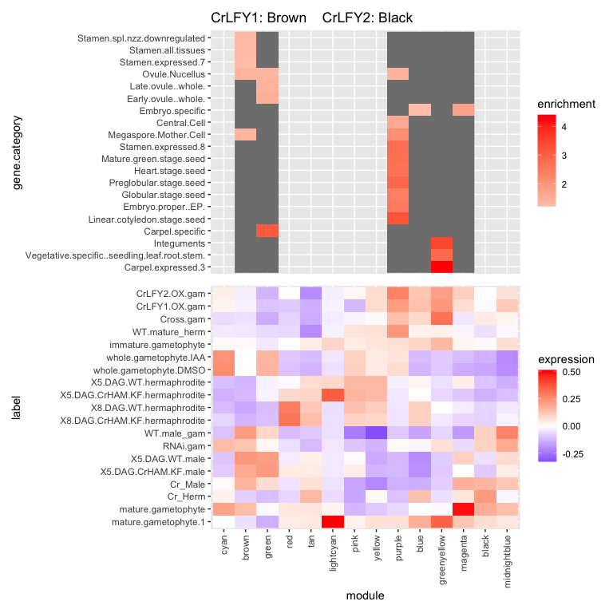
NEW Enrichment of reproductive gene categories in WGCNA modules (gametophyte)

Slide 77

Enrichment of reproductive gene categories in WGCNA modules (sporophyte)

Slide 78

NEW Enrichment of reproductive gene categories in WGCNA modules (sporophyte)

Slide 79

Enrichment of reproductive gene categories in male vs hermaphrodite

Slide 80
NEW Enrichment of reproductive gene categories in male vs hermaphrodite
module | gene.category | estimate | fisher.fdr | fisher.p.value
upHermaphrodite | Carpel.expressed.3 | 2.02 | 1.45E-04 | 2.11E-06
upHermaphrodite | Vegetative.specific..seedling.leaf.root.stem. | 1.58 | 1.45E-04 | 3.45E-06
upHermaphrodite | Megaspore.Mother.Cell | 1.15 | 5.56E-04 | 1.98E-05
upHermaphrodite | Micropylar.Endosperm..MCE. | 1.32 | 8.64E-03 | 6.17E-04
upHermaphrodite | Central.Cell | 1.15 | 8.97E-03 | 8.54E-04
upHermaphrodite | Mature.green.stage.seed | 1.43 | 2.97E-02 | 3.19E-03
upHermaphrodite | Seed.Coat..SC. | 1.30 | 2.97E-02 | 3.61E-03
upHermaphrodite | Chalazal.Seed.Coat..CZSC. | 1.29 | 2.97E-02 | 3.89E-03
upMale | Post.pollination.stage.pollen | 1.39 | 5.96E-03 | 3.04E-04
upMale | Early.ovule..whole. | 1.12 | 5.96E-03 | 3.55E-04
upMale | Stamen.expressed.7 | 1.21 | 8.97E-03 | 7.92E-04
upMale | Early.stage.pollen | 1.52 | 4.16E-02 | 6.17E-03
upMale | Stamen.all.tissues | 1.18 | 4.16E-02 | 6.44E-03

Slide 81

Enrichment of reproductive gene categories in Male/Hermaphrodite LFY1 cluster

Slide 82
NEW Enrichment of reproductive gene categories in Male/Hermaphrodite LFY1 cluster
module | gene.category | estimate | fisher.fdr | fisher.p.value
in_LFY1_cluster | Stamen.expressed.7 | 2.75 | 9.86E-13 | 2.35E-14
in_LFY1_cluster | Stamen.spl.nzz.downregulated | 3.08 | 8.78E-12 | 4.18E-13
in_LFY1_cluster | Stamen.all.tissues | 2.69 | 4.80E-11 | 3.43E-12
in_LFY1_cluster | Embryo.specific | 1.72 | 4.86E-09 | 4.62E-10
in_LFY1_cluster | Stamen.ms1.downregulated | 2.81 | 1.78E-05 | 2.12E-06
in_LFY1_cluster | Post.pollination.stage.pollen | 2.59 | 1.86E-05 | 2.66E-06
in_LFY1_cluster | Mature.pollen | 2.00 | 9.37E-03 | 1.65E-03
in_LFY1_cluster | Late.stamen..whole. | 2.61 | 9.37E-03 | 1.78E-03
in_LFY1_cluster | Embryo.sac | 1.68 | 1.71E-02 | 3.67E-03
in_LFY1_cluster | Intermediate.stamen..whole. | 2.35 | 1.81E-02 | 4.43E-03
in_LFY1_cluster | Stamen.specific | 2.65 | 1.81E-02 | 4.75E-03

Slide 83
Overview of fern LFY investigation
Jan 30, 2026
Julin Maloof. UC Davis.

Slide 84
Background
Original Goal:
Define CrLFY1 and CrLFY2 GRN and make evo. Comparisons
Original plan:
Inducible GR-LFY fusions
ChIP on GUS or GR lines or native protein
CRISPR KO
RNAseq on inducible lines plus existing RNAi and OX lines, & developmental time course
Funding cut
Plan deemed too ambition, funding cut to essentially only find resource development
GR-LFY and CRISPR constructs made but not transformed…

Slide 85
Background
What we have
RNAseq on WT, RNAi and OX lines, multiple tissues. But RNAi and OX lines did not “behave”
Still need to confirm based on Andy’s suggestions…
RNAseq on mature males and hermaphrodites
47 gametophyte RNAseq samples from public domain
79 sporophyte RNAseq samples from public domain

Slide 86
Background
What I have done
WGCNA networks on NCBI + Hannah samples, separately for sporophyte and gametophyte
TGCN networks
Mutual rank networks
Generally, CrLFYs are in very large modules
Some enrichment for MADS box genes with gametophyte CrLFY2 network
Motif analysis (some enrichment for LFY motif in some networks)
GO enrichment
GSEA for A.t. reproductive categories
CrLFY1 in Male vs Hermaphrodite Differential expressed genes

Slide 87
WGCNA Network Analysis
(Note: we have publication plans for the gametophyte data)

Slide 88
Gametophyte Sample MDS

Slide 89
Gametophyte LFY expression

Slide 90
Sporophyte Sample MDS

Slide 91
Sporophyte LFY expression

Slide 92
WGCNA Modules: Gametophyte
LFY1: Brown (4,534 genes)
LFY2: Black (1,192 genes)

Slide 93
Enrichment of reproductive gene categories in WGCNA modules (gametophyte)

Slide 94
WGCNA Modules: Sporophyte
LFY1: Blue (6,459 genes)
LFY2: Blue (6,459 genes)

Slide 95
Enrichment of reproductive gene categories in WGCNA modules (sporophyte)

Slide 96
MADS box enrichment
Using NEW MADS box list from Andy
43 MADS box genes
Method | Tissue | Gene | # Genes in module | # MADS in module | Fisher Test P-value
WGCNA | gametophyte | LFY1 | 4534 | 9 | 1
WGCNA | gametophyte | LFY2 | 1192 | 10 | 0.0001
WGCNA | sporophyte | LFY1 | 6459 | 11 | 1
WGCNA | sporophyte | LFY2 | 6459 | 11 | 1
TGCN | gametophyte | LFY1 |  | 0 | --
TGCN | gametophyte | LFY2 |  | 0 | --
TGCN | sporophyte | LFY1 |  | 0 | --
TGCN | sporophyte | LFY2 |  | 0 | --
Should repeat WGCNA tests with permutation

Slide 97
MADS box enrichment: GSEA using correlation or mutual ranks
Using NEW MADS box list from Andy
43 MADS box genes
Method | Tissue | Gene | GSEA p-value
MR | gametophyte | LFY1 | 0.12
MR | gametophyte | LFY2 | 0.92
MR | sporophyte | LFY1 | 0.73
MR | sporophyte | LFY2 | 0.91
Cor | gametophyte | LFY1 | 0.98
Cor | gametophyte | LFY2 | 0.000013
Cor | sporophyte | LFY1 | 0.95
Cor | sporophyte | LFY2 | 0.67

Slide 98
LFY binding site enrichment
I used the Arabidopsis site (because the PWM is in the database)
(but it is VERY similar to CrLFY2 from Sayou et al.)
Arabidopsis

Slide 99
LFY binding site enrichment
Method | Tissue | Gene | Mean LFY sites in module | Mean LFY sites outside of module | P-value
WGCNA | gametophyte | LFY1 | 2 | 2 | 0.77
WGCNA | gametophyte | LFY2 | 2.09 | 2 | 0.12
WGCNA | sporophyte | LFY1 | 2.02 | 2 | 0.29
WGCNA | sporophyte | LFY2 | 2.02 | 2 | 0.29
TGCN | gametophyte | LFY1 | 1.81 | 2.00 | 0.21
TGCN | gametophyte | LFY2 | 2.44 | 2.00 | 0.01
TGCN | sporophyte | LFY1 | 2.17 | 2.00 | 0.07
TGCN | sporophyte | LFY2 | 2.22 | 2.00 | 0.005
Used t-test…probably not best choice for count data
Best results defining promoter as 5,000bp upstream. (tried 1500; 3000; 5000; 7500)
NOTE: COULD/SHOULD BE REDONE WITH MR R COR DATA SET IF PUBLISHING WITH YOAN
(FOR CONSISTENCY WITH MADS ENRICHMENT METHODS/DATA SET

Slide 100
CrLFY1 in male gametophyte development
Hannah gathered RNA from mature male and hermaphrodite gametophytes
Many genes differentially expressed
What is the relationship between the DEG and CrLFY1 (or CrLFY2)?

Slide 101
Genes mostly strongly correlated with CrLFY1 are preferentially expressed in males

Slide 102
Enrichment of reproductive gene categories in Male/Hermaphrodite LFY1 cluster
module | gene.category | estimate | fisher.fdr | fisher.p.value
in_LFY1_cluster | Stamen.expressed.7 | 2.75 | 9.86E-13 | 2.35E-14
in_LFY1_cluster | Stamen.spl.nzz.downregulated | 3.08 | 8.78E-12 | 4.18E-13
in_LFY1_cluster | Stamen.all.tissues | 2.69 | 4.80E-11 | 3.43E-12
in_LFY1_cluster | Embryo.specific | 1.72 | 4.86E-09 | 4.62E-10
in_LFY1_cluster | Stamen.ms1.downregulated | 2.81 | 1.78E-05 | 2.12E-06
in_LFY1_cluster | Post.pollination.stage.pollen | 2.59 | 1.86E-05 | 2.66E-06
in_LFY1_cluster | Mature.pollen | 2.00 | 9.37E-03 | 1.65E-03
in_LFY1_cluster | Late.stamen..whole. | 2.61 | 9.37E-03 | 1.78E-03
in_LFY1_cluster | Embryo.sac | 1.68 | 1.71E-02 | 3.67E-03
in_LFY1_cluster | Intermediate.stamen..whole. | 2.35 | 1.81E-02 | 4.43E-03
in_LFY1_cluster | Stamen.specific | 2.65 | 1.81E-02 | 4.75E-03

Slide 103
GO enrichment LFY1 cluster

