Slide 1
Language Development and Technology
Bryan Arnold

Slide 2
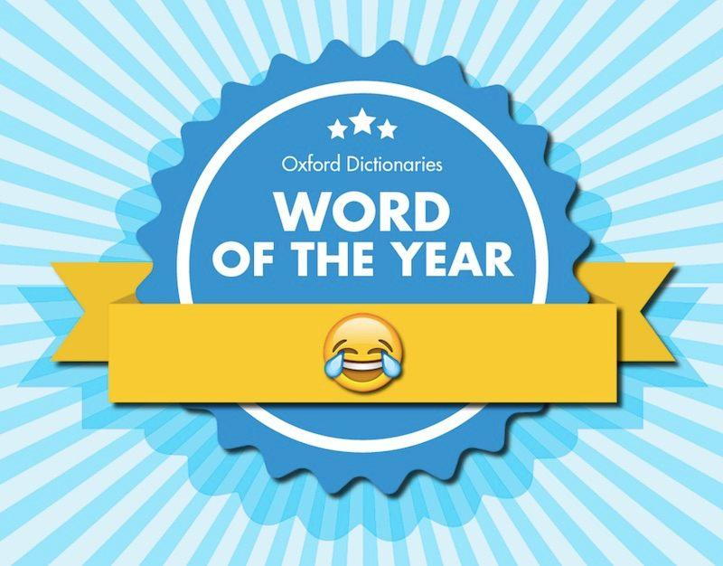
Technology is Ruining Language!
This ideology has been developing more and more as technology becomes more entrenched in our daily lives.
Social medias, new industry terms, device utilizing communication in general (i.e, LOL)
Internet slang and new tech related words are being added to the dictionary constantly.
Bitcoin, Selfie, Emojis, TL;DR, etc… are very recent additions to the Oxford English Dictionary
The use of some of these words has left a sour taste in the mouths of English traditionalists, and many want technology out of the equation for language use and development.
Some individuals let online slang out as casual, verbal conversation, which is a big deal to traditionalists
But how influential is tech really on language competence and are these new developments negative?

Slide 3
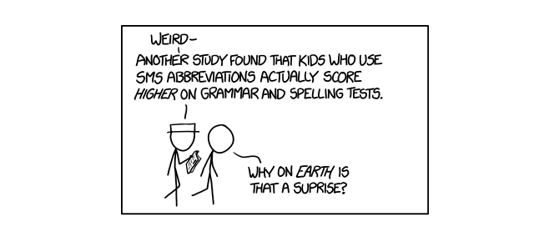
Not at All!
Technology has little to no negative impact on how the younger generations develop their language, and in some cases it can be beneficial.
Seen through observation and data collection of young adults’ and teens’ communication using technology.
Positive mindsets and resulting positive consequences of technology use in language learning in multiple age groups.
New concepts and implementations of technology in teaching are already being put into practice with high amounts of success.
With a few caveats of course...

Slide 4
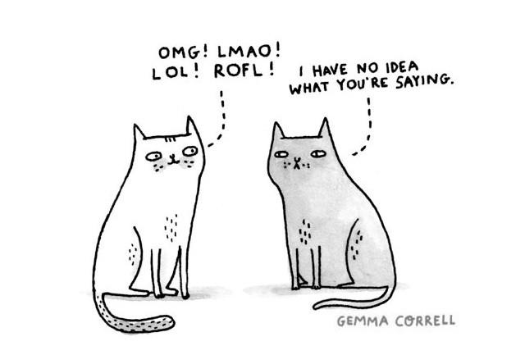
What Kind of Language Communication Is Taking Place?
Study conducted by Sali A. Tagliamonte and Derek Denis sought to see exactly what type of language was being used by teens and young adults with technology.
Focused on instant messaging, as almost everyone with a phone uses these.
Analyzed the message logs of over 200 volunteers ages 17-20 in casual, online communication.
Many of which had been using technology to communication from a much earlier age
Millions of words were amassed to see what language is like through technology to set a strong representation of how younger generations communicate with technology.

Slide 5
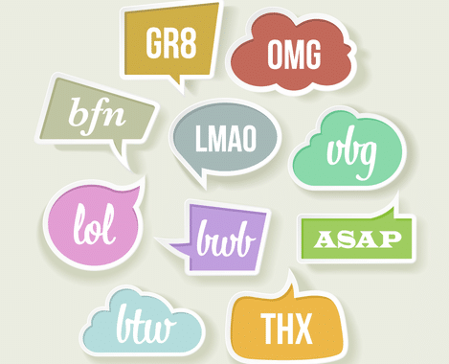
Results
Most common language used that isn’t used verbally outside of technology were ones expressing emotion or abbreviations for phrases.
Includes things such as haha, omg, ttyl
Roughly 26,000 cases of these types of words, yet was only 2.4% of the words gathered.
Next most common type of language used was spelling errors, grammar, or variable versions of other words.
Includes things such as not capitalizing correctly, punctuation errors, and replacing ‘you’ with ‘u’
Grammar and spelling are commonplace in writing anyways, and variable forms make up only roughly 9% of the uses of the word
Other complaints of language used in technology only made up 3% of the data.
Interesting that the ‘like’ phenomena isn’t present in digital speak, so a nasty speaking habit is eliminated.
Media tends to misrepresent and misinterpret how much we use these and assumes they are extremely commonplace.

Slide 6
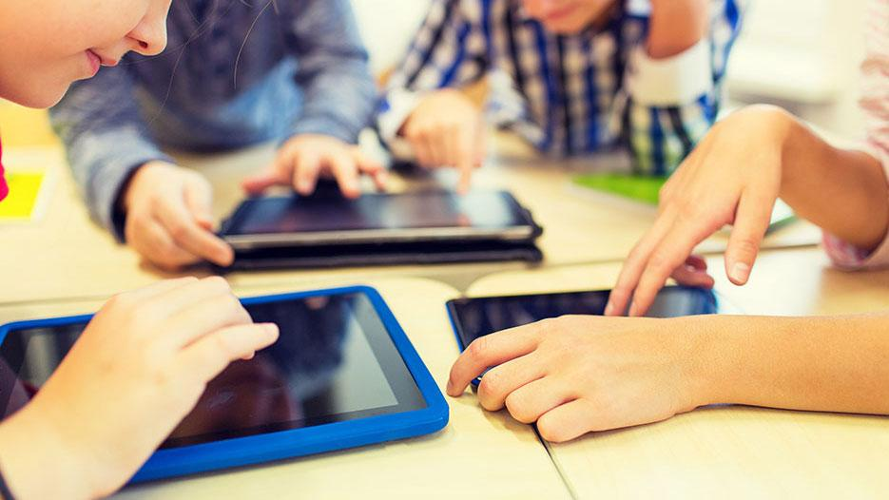
How Do Language Educators and Students Feel About Technology?
Binnur Genc İlter did research into how teachers and students of the English language felt about putting technology in their classrooms as well as how students use their technology as a learning tool.
Interviewed various English language teachers as well as students in the fourth grade.
Asked questions such as “how can technology help language learning”, “how are students using technology to supplement what they learn”, and “is using technology to teach language in the classroom a good idea?”
Students also gauged on their linguistic abilities when responding to see if what they say matches reality

Slide 7
Results
Overall, overwhelmingly positive feedback and student linguistic ability in responses.
Teachers saw technology as a way to help grab the attention of their students and offer alternatives to those who struggle to learn through certain mediums.
Teachers saw technology as inevitable part of a child’s life, so there is no point in trying to reject it. Using it in a positive way is good for the students and should be encouraged.
Students agreed with teachers that using technology for language inside and outside of the classroom is beneficial.
Many used it to search vocabulary they didn’t know, improved pronunciation through hearing it in film or music, as well as grammar and syntax clarity.

Slide 8
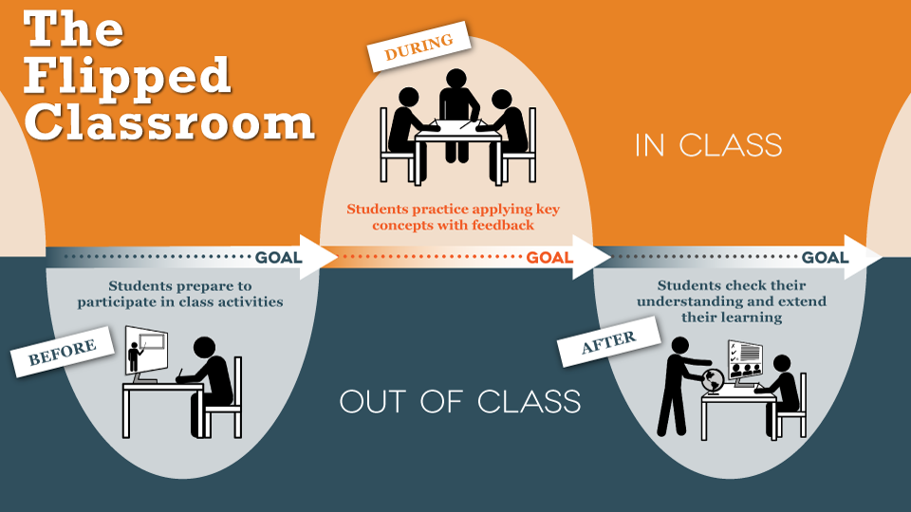
Technology for Language Learning: Flipped Classroom
One approach to the idea of using technology in the classroom to aid in language learning is the idea of a flipped classroom.
Theoretical and abstract material of a lesson is learned by the students through online means, such as videos provided online of lectures or lessons. Then, during class time, the instructor leads students through examples and homework.
The idea is students have no time constraints and a limitless pool of references to learn abstracts on their own, and apply it with guidance in a classroom.
How effective is this?
Arina Evseeba and Anton Solozhenko got a college (non-native English college) class to try this model for a semester to learn the English language, and gauged English abilities against a control group

Slide 9

Results
Control group showed poorer academic English abilities both oral and written than the flipped classroom students.
Students commented on the abundant amount of resources to aid learning as well as being able to have a more flexible timeline in their schedules to learn effectively.
Collaborations, no time constraints, online references, etc.
As a consequence, showed more motivation to learn the material and positive attitudes towards the material.

Slide 10

Those Earlier Caveats I Mentioned...
When speech used in technology leaks into verbal conversations, sometimes negative things can occur.
Incorrect or inappropriate term to use as well as barriers from those who are not so digitally linguistic.
Can lead to confusion or sometimes even conflict
Another problem with technology in learning language is the availability and some students’ capacity to utilize it positively.
Internet issues/availability for some students, tons of possible distractions to deviate from learning, as well as some not being tech savvy enough to use technology as a learning medium.
All of these are of concern, but the vast majority of results make these out to be not very severe at all.
Verbal use of digital speech is VERY rare for the most part
The positive versus negative effects of technology in language learning are roughly 90-10 in favor of usage and can be improved upon.

Slide 11
Conclusions
Language and technology are an inevitable pairing in our ever growing world, so there’s no use in trying to prevent the two from interacting.
The way media and language traditionalists portray the negative aspects of technology speech is usually misinterpreted as well as blown out of proportion.
New ways to implement technology with learning languages are being practiced today and show promising results.
All of the possible negative connotations of technology lingo are very minimal, uncommon, and can easily be improved upon with time.

Slide 12
Sources
Tagliamonte, S. A., & Denis, D. (2008). Linguistic Ruin? LOL! Instant Messaging and Teen Language. American Speech, 83(01), 3-34. doi: 10.1215/00031283-2008-001. Website: https://read.dukeupress.edu/american-speech/article/83/1/3-34/5806
İlter, B. G. (2015). How does Technology Affect Language Learning Process at an Early Age? Procedia – Social and Behavioral Sciences, 199(01), 311-316. doi: 10.1016/j.sbspro.2015.07.552. Website: https://www.sciencedirect.com/science/article/pii/S1877042815045632?via%3Dihub
Evseeva, A., & Solozhenko, A. (2015). Use of Flipped Classroom Technology in Language Learning. Procedia –Social and Behavioral Sciences, 206(01), 205-209. doi: 10.1016/j.sbspr o.2015.10.006 Website: https://www.sciencedirect.com/science/article/pii/S1877042815051393
Gill, D. (2006). Effects of Technology on Second Language Learning. Journal of College Teaching & Learning. 03(02), 19-28. No doi. Website pdf: 1744-Article%20Text-6917-1-10-20110126.pdf
http://www.idgconnect.com/blog-abstract/3495/how-tech-is-ruining-language
https://gadgets.ndtv.com/social-networking/news/face-with-tears-of-joy-emoji-is-oxford-dictionaries-word-of-the-year-766276
https://medium.com/@kelly_mifsud_bonavia/internet-slang-in-our-linguistic-wardrobe-44973b6f431d
http://i.imgur.com/LMpPopU.jpg
https://www.ed2go.com/courses/teacher-professional-development/classroom-technology/ilc/integrating-technology-in-the-classroom
https://www.shutterstock.com/video/clip-4507700-stock-footage-education-and-school-happy-students-showing-thumbs-up.html
https://www.gizmodo.com.au/2014/08/texting-dont-make-you-bad-writer/

