Slide 1
Group 1
Hai Anh Dang, Sören Green, Malte Schneider, Nico Haß

Slide 2
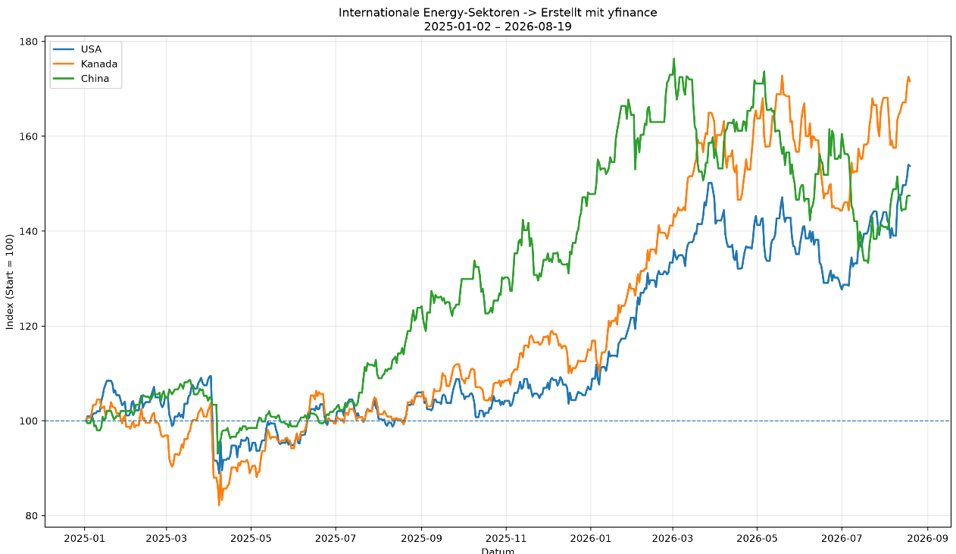
Topic 1: What's the impact of crisis-related events in the news on stock markets
Mediacloud API
yfinance API
RSF Index CSV

Slide 3
Research Questions
Is the impact from news or the impact from an actual economic change bigger within Europe on different markets (artificial vs. real impact)?
Do markets become more resistant to the impact of recurring natural disasters over time, and how does the effect differ between Japan and Southern Europe?
After a global crisis-related news shock, which of the 11 GICS recover fastest?

Slide 4
Research Questions
What's the impact of negative/crisis news on the 11 GICS between China or Russia and the USA, given their differing levels of press freedom?
Does the nature (positive/negative) of crisis-related news coverage predict the direction and magnitude of stock market movements?
How does the magnitude of the initial MOEX (Moscow Exchange) sector index drop following the Ukraine invasion of February 2022, compare to the equivalent DAX sector drop and does the difference correlate with the gap in press freedom scores (RSF) between Russia and Germany at that time?

Slide 5
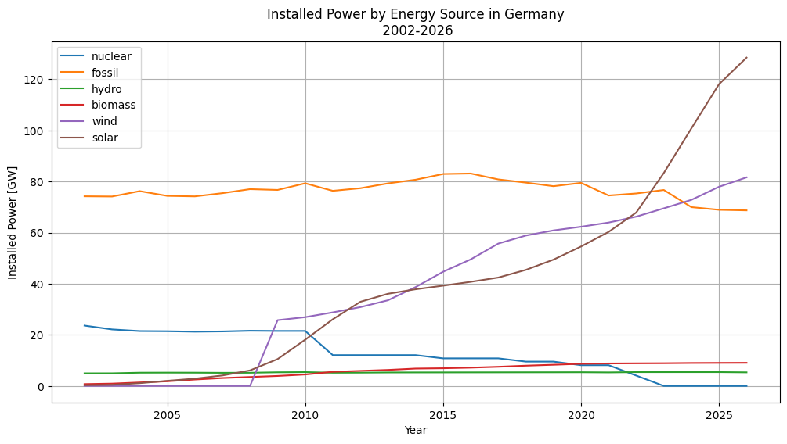
Topic 2: Energy sector of countries in relation to weather events
Weather:
Open-Meteo API
Energy:
Energy-Charts API

Slide 6
Research Questions
How does a heatwave event simultaneously affect solar generation output and hydro generation output in Spain between 2015 and 2024, and which effect dominates in net MWh terms?
To what extent do countries with a higher share of renewables in their energy mix show greater electricity price volatility during extreme weather events compared to countries with a fossil-fuel-dominated mix?
How is renewable electricity generation associated with regional meteorological conditions between Northern and Southern European countries, and has the strength of this relationship changed over time?

Slide 7
Research Questions
In drought years, do countries with high hydro dependency show a statistically significant increase in fossil fuel backup generation compared to countries with a diversified energy mix?
Do countries with higher average wind speeds generate proportionally more electricity per installed wind turbine capacity than countries with lower wind speeds, and which countries over- or underperform relative to their wind potential?
Has the growing share of weather-dependent renewable energy increased the volatility of national electricity generation during extreme weather events, and to what extent do cross-border electricity imports mitigate this volatility differently across countries?

