Slide 1

A Joke-Telling AI: Building a Humor-Driven Transformer Model

Slide 2
What is Our Project?
This project focuses on developing an AI model that tells jokes.
The system takes a keyword as input and generates a related joke.
Based on transformer architecture – the same backbone used by models like ChatGPT.
Our model understands context and builds meaningful, funny responses word by word.

Slide 3
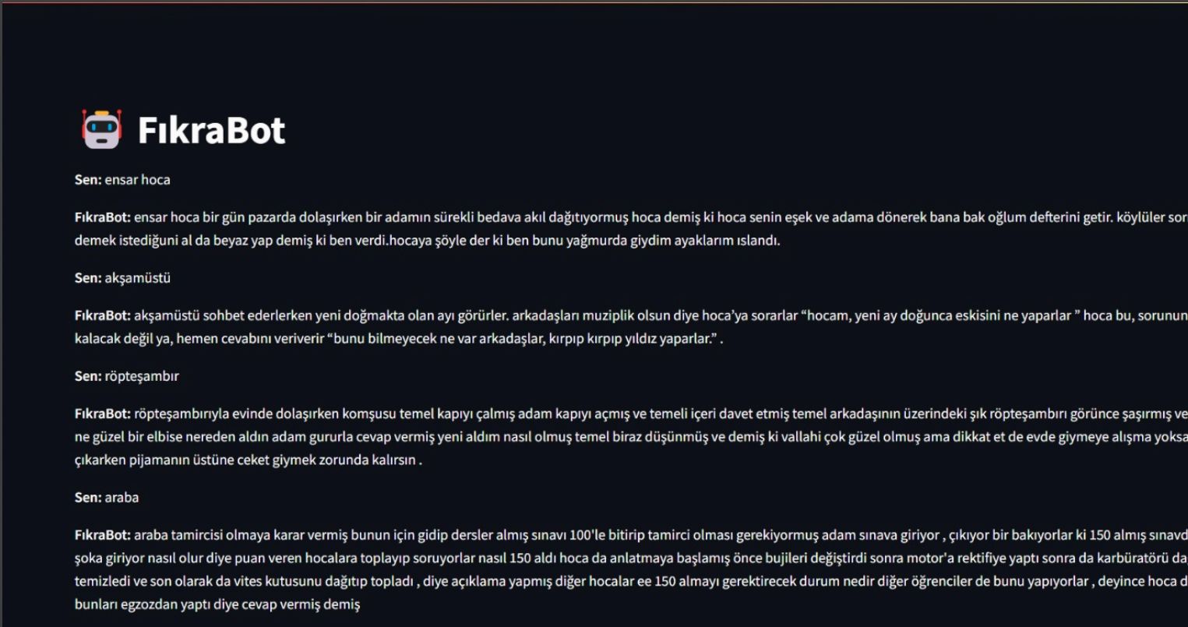

Slide 4
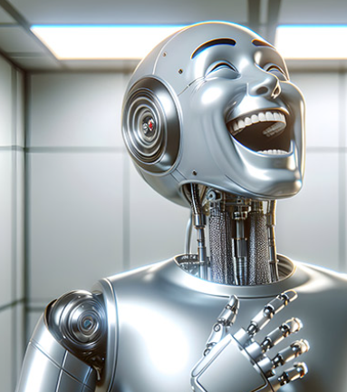
What Are We Aiming For?
Build a lightweight transformer-based model for joke generation.
Ensure jokes are coherent, context-aware, and understandable.
Allow the user to input a keyword and receive a joke related to it.
Evaluate model performance based on human feedback and laughter!

Slide 5
Where Can This Be Used?
Entertainment apps and social bots.
Mental wellness tools (laughter therapy, chatbot companions).
Language learning tools – making learning more fun and engaging.
Content generation for social media or marketing with humor.

Slide 6
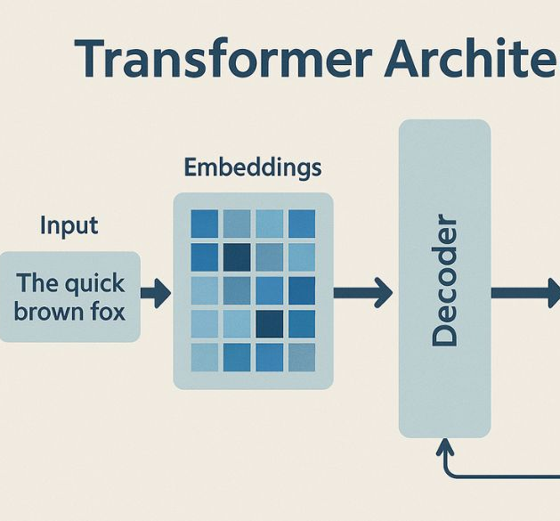
What is a Transformer?
A transformer is a deep learning model that builds text one word at a time, based on context.
Introduced in the paper "Attention Is All You Need" (Vaswani et al., 2017).
Unlike traditional models, transformers retain long-term context using self-attention.
Visual Suggestion: A simple diagram showing input → transformer blocks → output (text generation).

Slide 7
Key Components of a Transformer
Tokenization
Embedding
Positional Encoding
Transformer Blocks (includes Attention & Feedforward)
Softmax Output Layer
Explanation:
Each component contributes to understanding input, maintaining context, and generating coherent output.
Visual Suggestion: A labeled block diagram of the Transformer stack.

Slide 8

Tokenization
Converts raw input text into tokens (words, subwords, punctuation).
Tokens are mapped to unique numerical IDs from a vocabulary.
Example:
“Hello, how are you?” → [hello, ,, how, are, you, ?]
Purpose: Enables the model to process symbolic input numerically.

Slide 9
Embedding
Each token is mapped to a dense vector (embedding).
Similar words have similar vectors (semantic closeness).
Key Idea:
Embeddings capture semantic meaning of words.
Visual Suggestion: Word embeddings plotted in 2D showing similarity (e.g., king – queen vs. man – woman).

Slide 10

Positional Encoding
Since transformers lack recurrence, position must be explicitly encoded.
Positional vectors are added to embedding vectors to encode word order.
Problem Solved:
“I’m not sad, I’m happy” ≠ “I’m not happy, I’m sad”
Visual Suggestion: A chart showing embeddings + positional encodings = position-aware vectors.

Slide 11

Self-Attention Mechanism
Attention helps the model focus on relevant words when encoding each word.
It adjusts meaning of a word based on context (e.g., “bank” in “river” vs. “money”).
Example Sentences:
The bank of the river
Money in the bank
Effect: Word meaning adapts to surrounding words.

Slide 12
Multi-Head Attention
Instead of applying one attention function, the model uses multiple heads.
Each head captures different types of relationships and combines them.
Benefit:
Enhances the model’s ability to capture complex patterns in language.
Visual Suggestion: Diagram showing multiple attention heads focusing on different words.

Slide 13

Dataset Structure
Custom dataset consisting of short jokes and humorous dialogues.
Format: plain text, one joke per line.
No punctuation, all lowercase.
Example:
what do you call fake spaghetti it was an impasta <EOS>

Slide 14

Text Format without Punctuation
Simplified structure: all lowercase
Removed commas, periods, question marks, etc.
Easier tokenization and consistent input
Example:
"Why don't scientists trust atoms?" → why dont scientists trust atoms <EOS>

Slide 15

<EOS> Tag
Title: End-of-Sentence Tag
Content:
<EOS> used to mark end of each joke.
Helps model learn where a sentence/joke ends.
Important for sequence generation during inference.
Visual Suggestion: Token sequence ending with <EOS> shown graphically.

Slide 16
Text Cleaning & Tokenization
Steps:
Lowercasing
Removing extra whitespaces and symbols
Tokenizing into words/subwords
Mapping tokens to IDs
Tool Used: nltk + custom Python scripts

Slide 17
Building the Vocabulary
Unique tokens extracted from training data.
Each token assigned a unique ID.
Special tokens: <PAD>, <EOS>, <UNK>, <START>

Slide 18

Train/Test Split
80% Training set
20% Testing set
Ensures generalization and evaluation

Slide 19

Input: sequence without <EOS>
Target: sequence shifted by one + ends with <EOS>
Example:
Input: why did the chicken cross the road
Target: did the chicken cross the road <EOS>

Slide 20

Hardware Setup
rained on a machine with:
NVIDIA RTX 3060 GPU
16GB RAM
Intel i7 Processor
Frameworks: PyTorch, Google Colab (initial experiments)

Slide 21
Model Structure
Input Embedding Layer
Positional Encoding
Transformer Decoder Blocks (6 layers)
Linear Output Layer with Softmax

Slide 22
Our Implementation (Colab)
Full training pipeline in notebook
Key modules:
preprocess_data()
build_model()
train()
generate_joke()

Slide 23
Show sample of training output:
Loss decreasing
Generated joke examples
Example:
Input: “why did the programmer quit his job” Output: “because he didn’t get arrays <EOS>”

Slide 24

Completion Instead of Q&A
he model is not trained to answer questions.
It completes a sentence or context based on patterns learned.
Similar to how GPT models auto-complete prompts.
Example:
Prompt: why did the chicken cross Output: the road to get to the other side <EOS>

Slide 25
Contextual Joke Completion
he model generates jokes as a continuation of input.
It doesn’t analyze or “understand” humor like a human.
No external knowledge base used.
Visual Suggestion: Diagram comparing Q&A vs. completion-based model.

Slide 26
Prompt to Punchline Mechanism
Input: Joke setup or first part of sentence
Transformer decoder predicts next tokens
Stops at <EOS>
Example:
Input: why was the math book sad Output: because it had too many problems <EOS>

Slide 27
One Token at a Time
Model generates one word at a time.
Each next word depends on the full previous context.
Visual Suggestion: Token-by-token animation.

Slide 28
Decoding Strategies
Greedy Search (always pick highest probability)
Top-k Sampling (add randomness)
Project uses basic greedy decoding for simplicity.

Slide 29

How Does It All Work?
Step-by-step:
Input: Partial joke
Tokenization
Positional encoding
Transformer decoding
Output: Full joke ending with <EOS>

Slide 30
Can the AI Misunderstand Context?
Humor depends on subtle context and wordplay.
Model may:
Miss the joke’s intent
Generate non-sequiturs
Lose coherence in longer setups
Example:
Prompt: why did the moon skip school Output: because the stars were too bright — nonsensical

Slide 31
Risks of Generating Inappropriate Jokes
AI might:
Imitate biased or insensitive jokes
Produce offensive language
Challenge: No true understanding of ethics
Precaution Taken: Filtered training data, <EOS> tagging, test runs with human curation.

Slide 32
Cultural Humor = Cultural Risks
Humor is deeply cultural.
Jokes that are funny in one region may:
Be offensive elsewhere
Fall flat due to lack of shared context
Example: Wordplay doesn’t always translate cross-culturally.

Slide 33
Ethical Issues in Large Language Models
Concerns:
Bias reflection from training data
Accountability for generated content
Explainability of how jokes are created
Best Practices:
Clear disclaimers
Transparent training pipeline
Human oversight

Slide 34
Risk Map
Risk | Severity | Mitigation
Misunderstanding | Medium | Prompt tuning
Offensive jokes | High | Data filtering
Cultural insensitivity | High | Human review
Ethical accountability | Ongoing | Documentation

Slide 35
What the Model Did Well
Highlights:
Learned common joke structures well
Could generate coherent punchlines
Performed decently even with limited dataset

Slide 36
Where the Model Falls Short
Humor generation = surface-level mimicry
Lacks deep reasoning or originality
Sometimes generates repetitive or nonsensical outputs

Slide 37
What’s Next?
Expand dataset with different joke types (e.g., irony, sarcasm, dark humor)
Integrate reinforcement learning to optimize “funny” ratings
Improve filtering to avoid offensive or flat outputs

Slide 38
Going Beyond Text
Add text-to-speech for interactive joke telling
Build a web app or chatbot with dynamic joke generation
Enable user feedback loop to learn what people find funny

Slide 39

Core Functionalities of the Joke-Telling AI
- Joke Generation Engine: Generates one-liner jokes using a transformer-based decoder.
- Interactive UI: A Streamlit-based web app for real-time joke interaction.
- Postprocessing: Cleans up awkward outputs (e.g., repetitions, incomplete endings).
- Model Management: CPU/GPU support and modular design.
- Scalability: Prepared for multilingual and external integration.

Slide 40

Evolution of Project Features
Initially Implemented:
- Transformer decoder in PyTorch
- Custom tokenizer
- Script-based joke generation
Added Later:
- Fine-tuning
- Streamlit interface
- Postprocessing pipeline
- Modular architecture

Slide 41

User Interface Preview
- Prompt input field for users
- AI-generated jokes shown like chat
- Session memory for context
- Simple browser-based access

Slide 42


Slide 43
Deployment & Installation
- Requirements: Python 3.8+, PyTorch, SentencePiece, Streamlit
- Steps:
1. Clone repo
2. Install dependencies
3. Add model/tokenizer
4. Run: streamlit run app.py
- Optional: Cloud deployment (Streamlit Cloud, Heroku)

Slide 44

Team Contributions & Timeline
- Week 1–2: Requirements & data collection
- Week 3: Model training, UI integration
- Final Week: Optimization, testing, presentation
- Used Trello for management
Trello: https://trello.com/b/9CScpG1H/team-1

Slide 45
Managing Risks
- Humor subjectivity: Filtered dataset
- Data quality: Cleaned & normalized
- Model stability: Prompt control & sampling
- Ethics: Reviewed outputs
- Timeline: Focused on core MVP

Slide 46
Testing & Evaluation
- Functional Tests: Tokenizer, model, UI
- Integration Tests: End-to-end validation
- User Tests: Joke ratings
- Error Handling: Edge cases
- Manual Testing Only

Slide 47
Limitations & Future Features
- Multilingual Support
- Joke Rating System
- Advanced Filtering
- Personalization
- Voice/Multimodal Input

Slide 48
Lessons & Experiences
Muharrem: Learned about transformer models and backend deployment
Mert: Focused on data preparation and frontend development
Taha: API development , model testing and preparing a report
Mısra: Data cleaning ,communication tasks and presentation preparation
Simay: Data cleanin,UI design and presentation preparation

Slide 49
What is Fine-Tuning?
Definition: Fine-tuning is the process of taking a pre-trained model and continuing its training on a specific, task-related dataset.
Why Fine-Tune?
Leverages existing knowledge from large models (like GPT).
Speeds up training and reduces compute needs.
Tailors the model’s behavior for domain-specific outputs (e.g., joke generation).

Slide 50
Feature | Basic Transformer Model (Trained from Scratch) | Fine-Tuned GPT Model (Pretrained + Tuned)
Training Data Requirement | Requires large amounts of data | Needs less data (task-specific subset is enough)
Training Time | Very long (days/weeks) | Shorter (hours or less depending on task)
Computational Cost | High GPU usage, expensive | Lower cost due to reused pretrained weights
Performance (Early Training) | Poor – starts from zero | Strong – benefits from pretrained knowledge
General Language Understanding | Limited unless trained extensively | Very strong due to large-scale pretraining
Customization | Fully flexible, but needs effort | Easy to adapt to specific tasks (via fine-tuning)
Use Case Suitability | Experimental or academic | Practical for real-world applications
Pretraining Dependency | Not dependent on any prior model | Dependent on pretrained GPT or similar models
Ease of Implementation | Requires full architecture setup | Minimal setup – focus on tuning
Basic Transformer Model vs Fine-Tuned GPT Model

Slide 51
Code Repository & References
- GitHub: https://github.com/Maltepe-University-SWEng/term-project-team-1
- Key Tools:
• PyTorch
• Streamlit
• SentencePiece
• HuggingFace
• Google Colab
- Paper: 'Attention is All You Need' (Vaswani et al., 2017)

Slide 52
