Slide 1
Turkish Joke-Telling AI Model
A Fine-Tuned LLM-Based Project
Finale Presentation

Slide 2
Project Goal
The primary objective of this project is to build an AI system that can generate culturally appropriate and humorous Turkish jokes using state-of-the-art language modeling techniques. The system leverages the strengths of both existing large language models and domain-specific customization to produce high-quality, relevant, and engaging content.
Key Focus Areas:
Fine-tuning a powerful pre-trained LLM (e.g., LLaMa) using Ollama for local efficiency and flexibility
Training a Turkish-specific model within Ollama by applying targeted fine-tuning techniques
Ensuring joke quality, creativity, and cultural relevance, aligning outputs with Turkish humor conventions and linguistic style

Slide 3
Technologies Used
Python: LLM System Development
NodeJS: WEB UI Development
Ollama Models: Model integration
Training Method: Fine Tune
Dataset: 500+ Jokes Dataset, JSON format

Slide 4
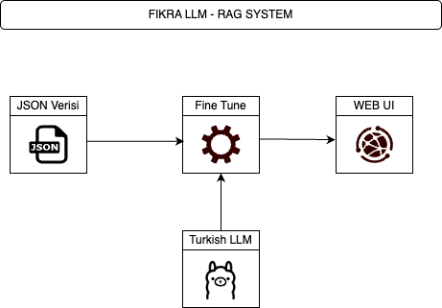

Slide 5
Why Are We Using This RAG System?
Retrieval-Augmented Generation (RAG) was incorporated into our system to enhance the model’s ability to generate contextually accurate and culturally rich Turkish jokes. Instead of relying solely on a pre-trained model's internal knowledge, RAG allows dynamic retrieval of relevant joke data (in our case, from a curated JSON dataset) at generation time. This ensures that the fine-tuned Turkish LLM has access to updated, diverse, and specific examples during inference.
This architecture helps maintain humor relevance, avoids hallucination, and improves joke diversity without needing massive model retraining.

Slide 6
Why Ollama?
Ollama was chosen for this project primarily due to its lightweight, modular, and user-friendly ecosystem that simplifies working with large language models locally. Unlike other platforms that often require complex setup or cloud dependency, Ollama allows efficient execution of LLMs on personal machines with minimal configuration.

Slide 7
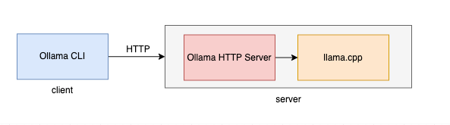
Ollama Structure

Slide 8
Dataset Curation Criteria
While creating the dataset for this project, we focused on collecting Turkish jokes that were culturally relevant, linguistically clean, and ethically appropriate. We curated the data from various public sources, ensuring a balance between traditional fıkras (e.g., Nasreddin Hoca, Temel Reis) and more modern joke formats. Key criteria included humor quality, language clarity, cultural context, and offensiveness filtering.
Additionally, the dataset was formatted into JSON structure for easy integration into the training pipeline.

Slide 9
Model Selection Criteria
During the model selection phase, we evaluated several popular open-source large language models, including Cosmos, Mistral, Gemma, and LLaMa. Our criteria focused on generation quality, Turkish language handling capabilities, fine-tuning support (especially with LoRA), and hardware efficiency.

Slide 10




Experienced Models
Llama Models
Gemma Models
Cosmos Models
SnowFlake Models

Slide 11
Prompt Criteria
We designed prompts to be clear, concise, and culturally relevant to guide the model toward producing context-appropriate Turkish jokes. Special care was taken to include familiar characters or themes (e.g., Nasreddin Hoca) to enhance humor quality.

Slide 12
WEB UI Development
Our creation is a modern, AI-powered joke generator web application built using React, TypeScript, and Tailwind CSS. The web ui showcases a production-ready architecture with responsive design, dark/light mode support Built with scalability in mind, it implements best practices such as component modularity, TypeScript type safety, and efficient state management. The application features a clean, minimalist interface with subtle animations and micro-interactions, enhancing user engagement while maintaining professional aesthetics. Key technical features include real-time API integration, client-side caching for joke history, and cross-device compatibility.

Slide 13
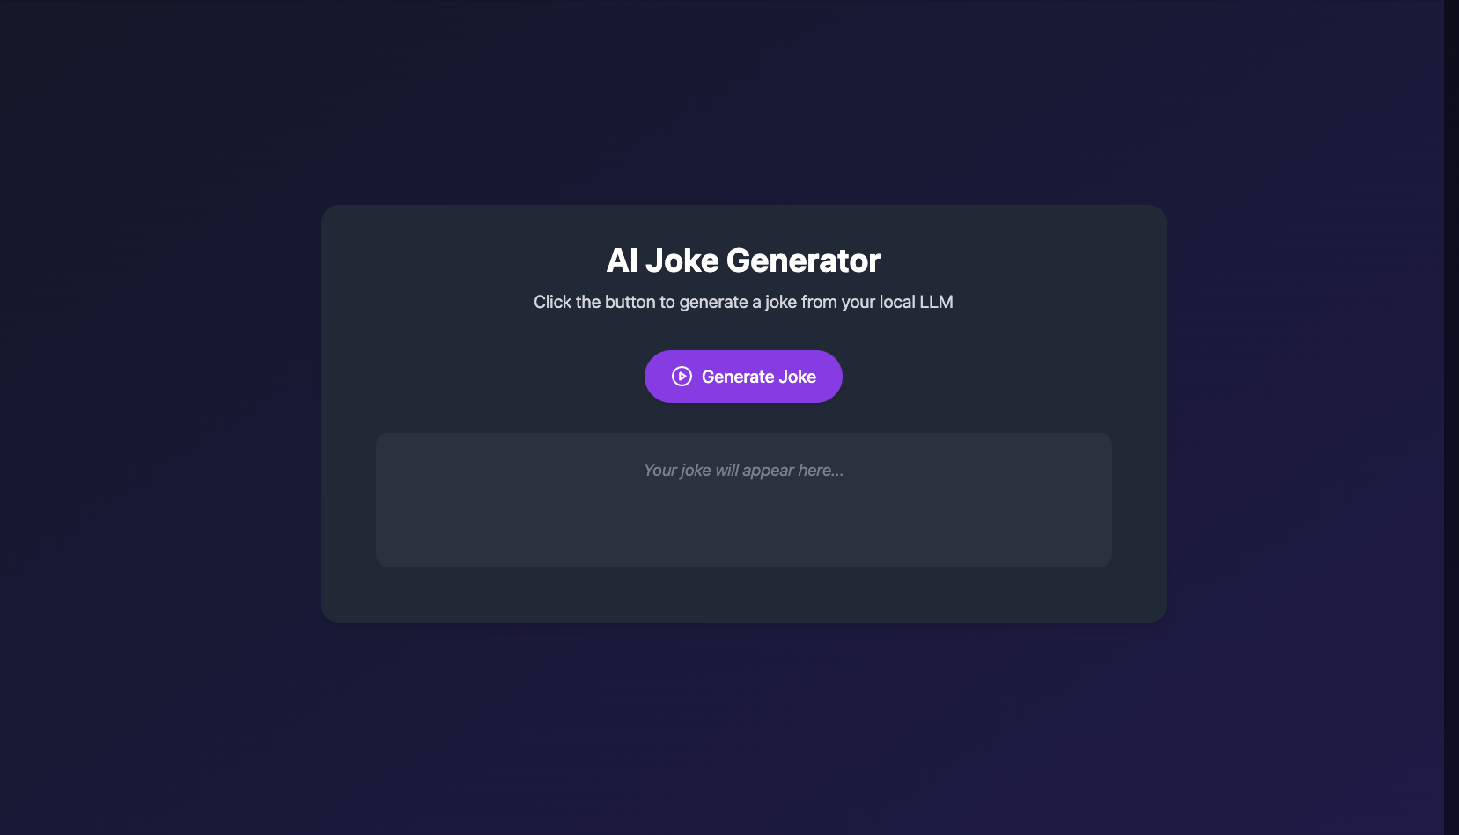
WEB UI Development

Slide 14
Functionality and Development Phases
1
Initial Phase:
Model research and dataset collection
Development Phase:
Fine-tuning completed using jokes dataset
Prompt-based joke generation implemented
REST API integration
Final Phase:
CLI-based interface developed for testing outputs
Web-based, user-friendly UI implemented

Slide 15
Risk Management and Content Strategy
Manual Content Moderation: Implemented a robust process for the manual review and filtering of culturally insensitive or inappropriate humor, ensuring compliance with industry standards and audience sensitivities.
Intellectual Property Compliance: Ensured all content was sourced from public domain material or obtained through proper licensing agreements, minimizing legal risks and safeguarding intellectual property rights.
Data Quality and Diversity Control: Actively managed the risk of content overfitting by closely monitoring joke repetition. Employed strategic augmentation techniques to maintain content variety and relevance, enhancing user engagement without compromising quality.
Scalable Content Architecture: Developed a flexible and modular content delivery system, designed to accommodate future expansions and adapt to evolving user demands, ensuring long-term scalability and efficiency.

Slide 16
Testing and Evaluation
Manual evaluation was conducted to assess joke quality, focusing on humor, fluency, and cultural relevance.
Prompt-based generation was tested to verify contextual alignment and creative output.
Response time was monitored to ensure the model's outputs were generated within acceptable limits for user interaction.
Due to resource and time constraints, automated evaluation methods (e.g., BLEU, ROUGE, METEOR) were not utilized, but are planned for future iterations.

Slide 17
Code Repository
All source code, training scripts, and sample outputs are available on GitHub:
https://github.com/Maltepe-University-SWEng/term-project-team-2

Slide 18
Thank You & Questions
Thank you for your attention.
We are happy to take any questions!

