Slide 1
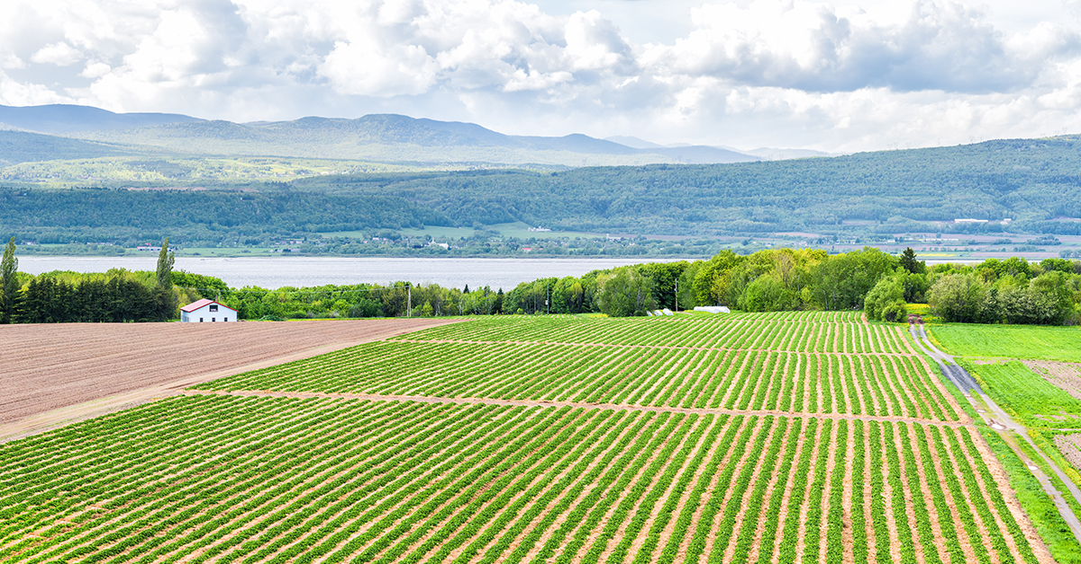
Mini-Project: M19: Exploring smart-farming ontology for attribute-based access control
by
Zak Chambers Hale - 951548
Mariam Kiryakos - 2031543
This Photo by Unknown author is licensed under CC BY-ND.

Slide 2
Agriculture 4.0
Current implementation of Smart Farms.
Sensors allow for rapid and accurate data collection.
Internet of Things provides easy accessibility.
ML and AI can make real time decisions based on collected data.

Slide 3
Attribute Based Access Control
Allows users to access resources based on their assigned attributes.
Uses policies to decide which users can access specific resources.
Policies created using Boolean logic.
Provides flexibility in its implementation.

Slide 4
Attribute Based Access Control
Architecture:
PEP: Policy Enforcement Point
PDP: Policy Decision Point
PIP: Policy Information Point

Slide 5
Attribute Based Access Control
Attributes:
Subjects: Individual asking for access.
Objects: Object being accessed.
Actions: Type of access attempted.
Environment: Factors that influence the decision.

Slide 6
Ontology
Simple representation method displaying properties and relationships within a system.
Can have various levels of formalities: from simple diagram to formal logic
Advantage of ontologies: clear common knowledge between teams or systems

Slide 7

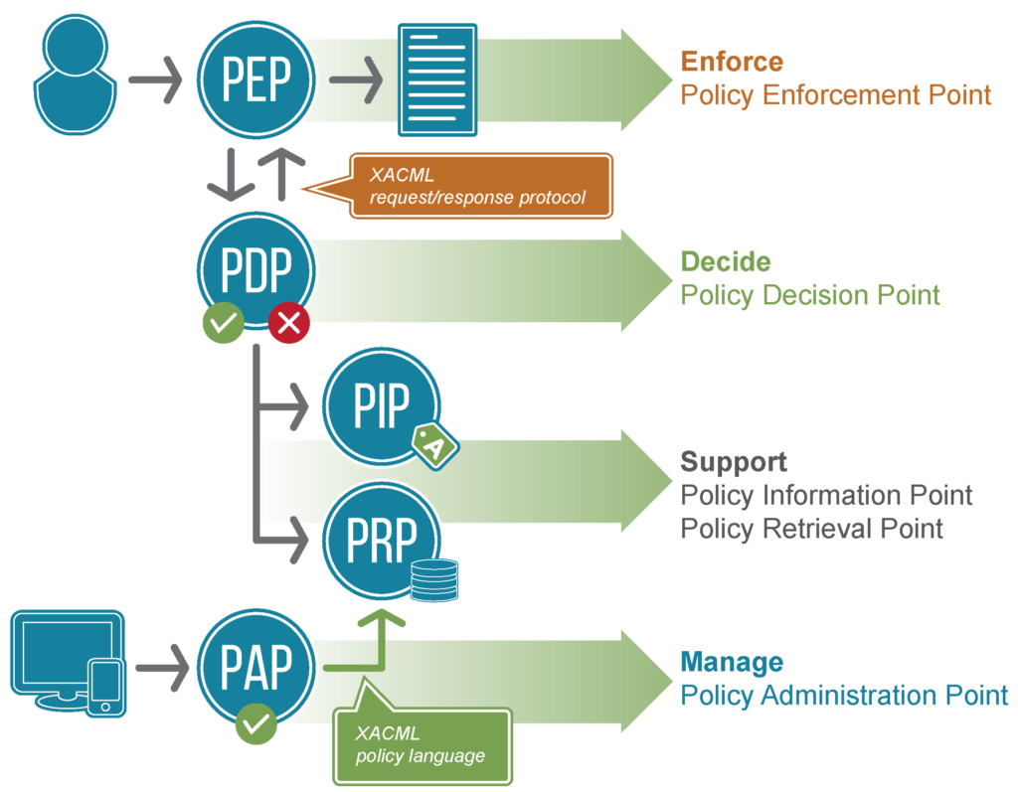
XACML
eXtensible Access Control Markup Language based on XML
Image from https://www.axiomatics.com

Slide 8
ALFA
Abbreviated Language for Authorization
pseudocode language to describe XACML policies
Eclipse plug in automatically translate ALFA code to XACML.

Slide 9


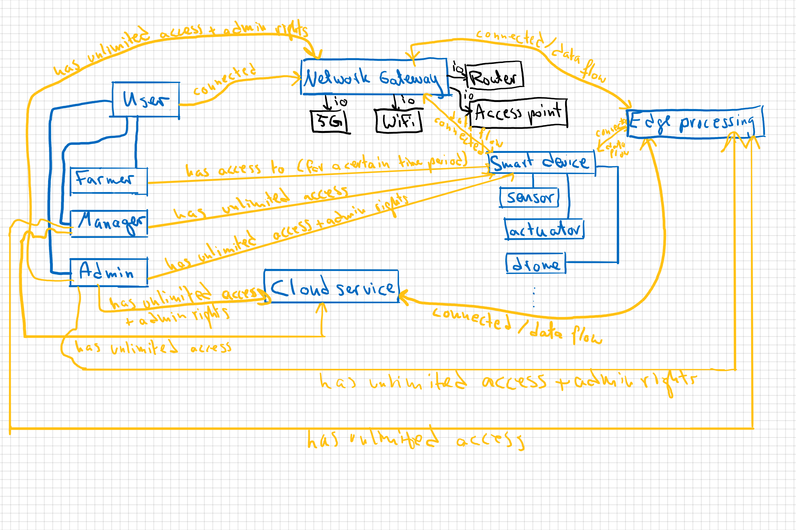
Our Smart Farming Ontology

Slide 10
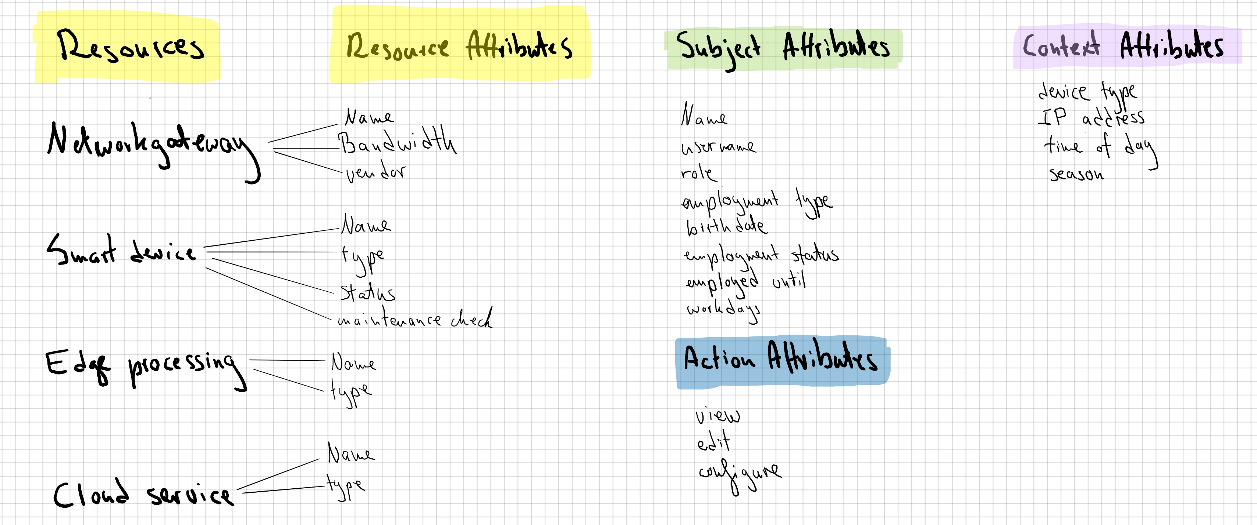
Our Vocabulary

Slide 11
Our ABAC
Demo on Eclipse

Slide 12

Thanks!
Any questions?

