Slide 1
The solar wind's geomagnetic impact and its Sun–Earth evolution
–
Predictive models for space weather and for the Parker Solar Probe orbit
PhD defense
by Malte S. Venzmer
Thursday, 1 November 2018, 14:00
Seminarraum Astrophysik (SR 17, F 05.104)
Institute for Astrophysics
Georg-August-Universität Göttingen
Defense committee members
Dr. Volker Bothmer
Prof. Dr. Ansgar Reiners
Prof. Dr. Stefan Dreizler
Prof. Dr. Wolfram Kollatschny
Prof. Dr. Hardi Peter
Prof. Dr. Andreas Tilgner

Slide 2
The solar wind's geomagnetic impact and its Sun–Earth evolution
–
Predictive models for space weather and for the Parker Solar Probe orbit
two topics

Slide 3
The solar wind's geomagnetic impact
–
Predictive models for space weather
The solar wind's Sun–Earth evolution
–
Predictive models for the Parker Solar Probe orbit

Slide 4
Contents
Solar wind
Study 1
Study 2

Slide 5
Solar wind

Slide 6
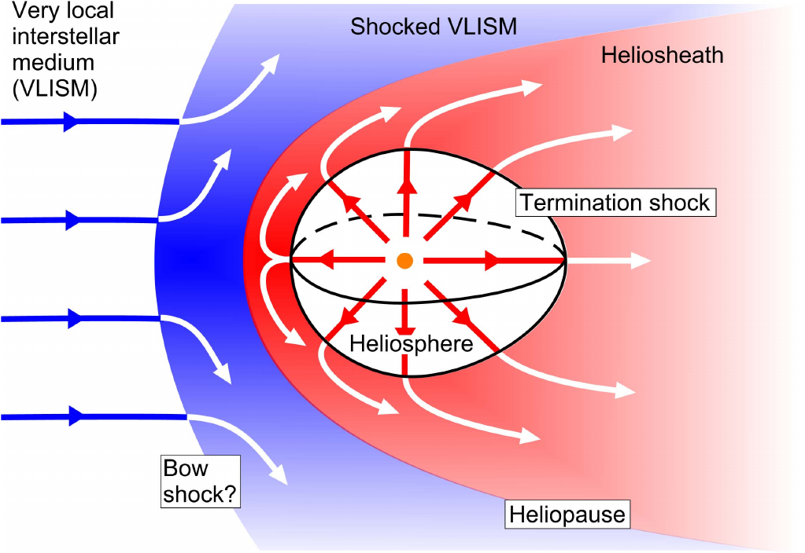
Solar wind

Slide 7
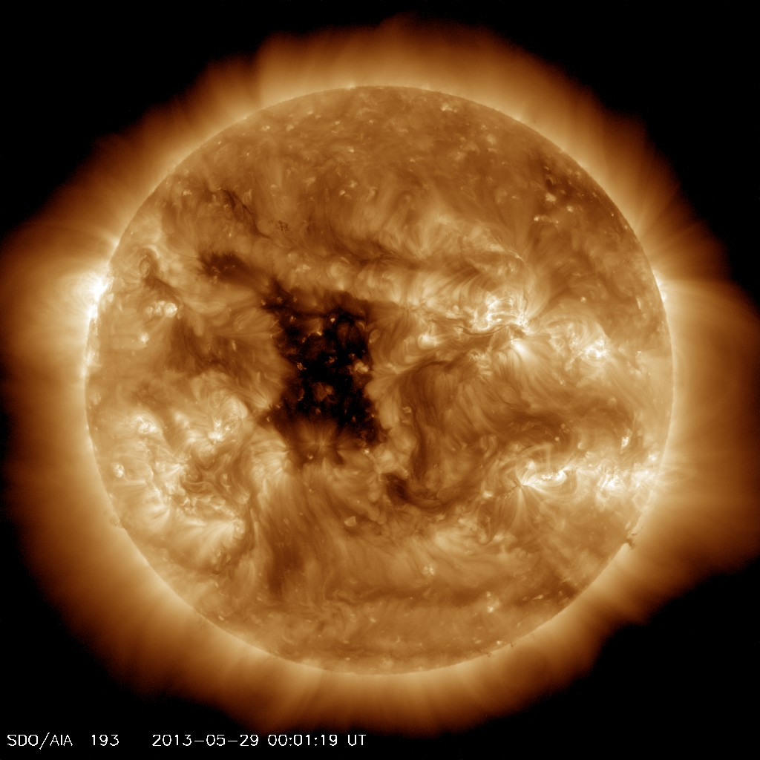
Solar wind

Slide 8
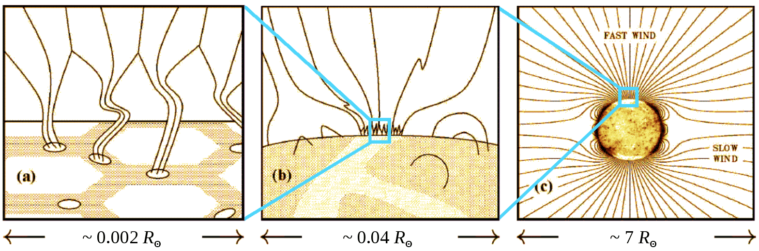
Solar wind
Credit: Cranmer

Slide 9
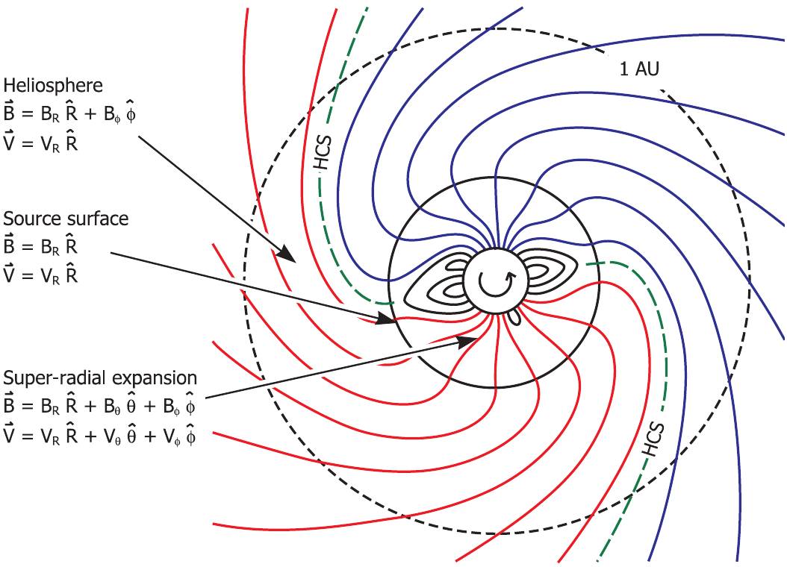
Solar wind

Slide 10
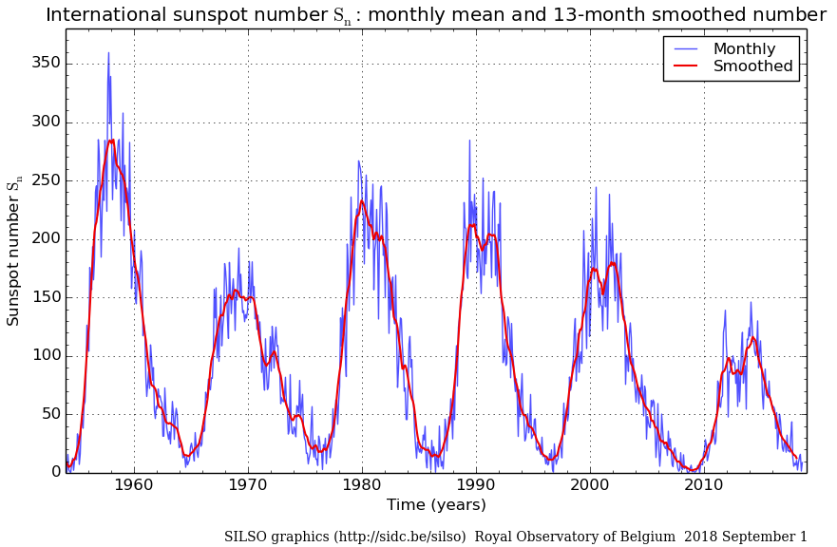
Solar wind

Slide 11
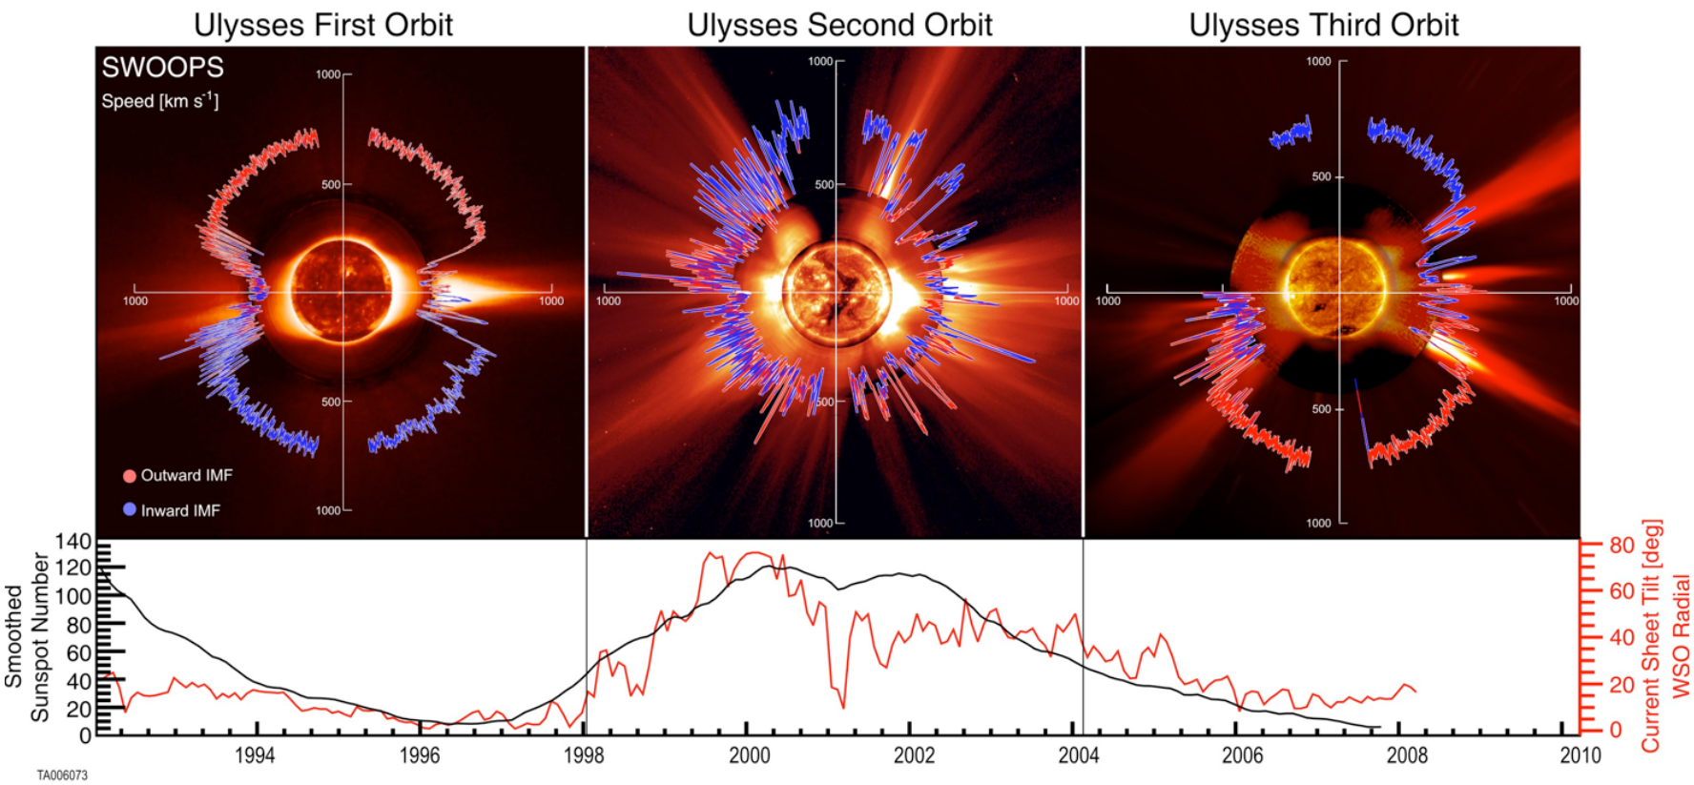
Solar wind

Slide 12
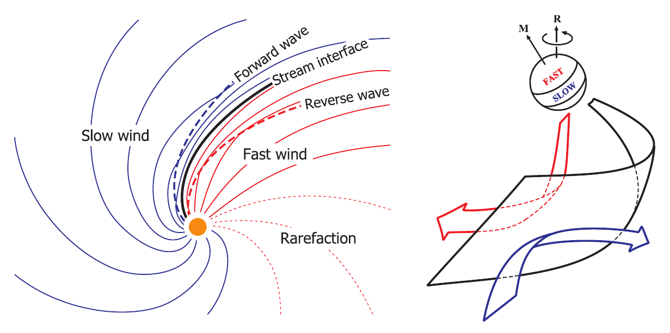
Solar wind

Slide 13
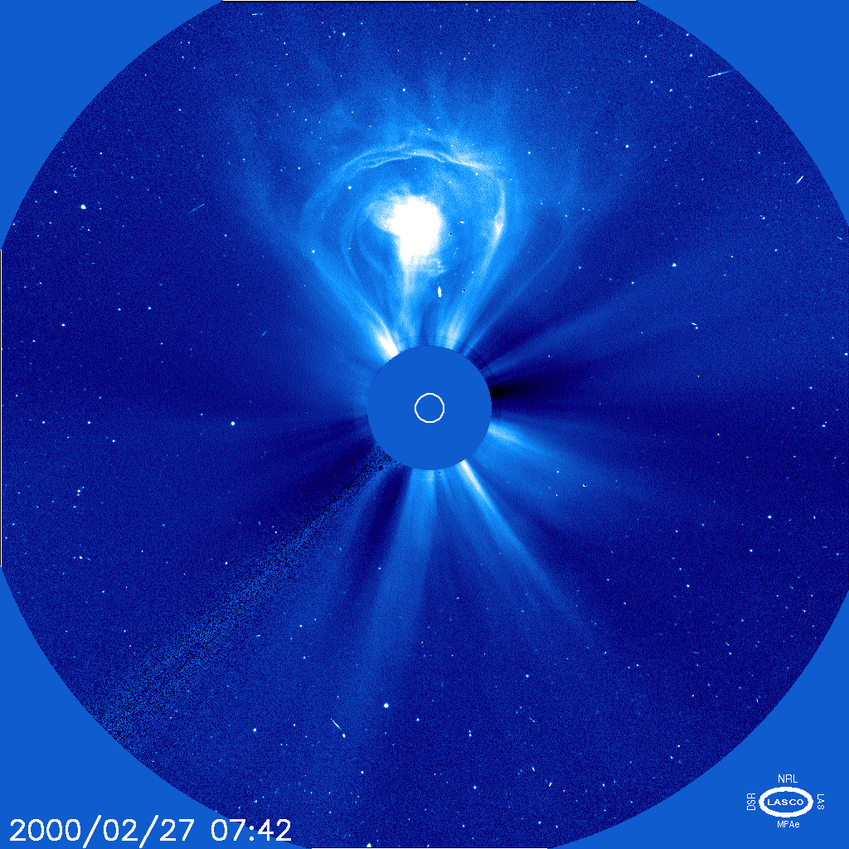
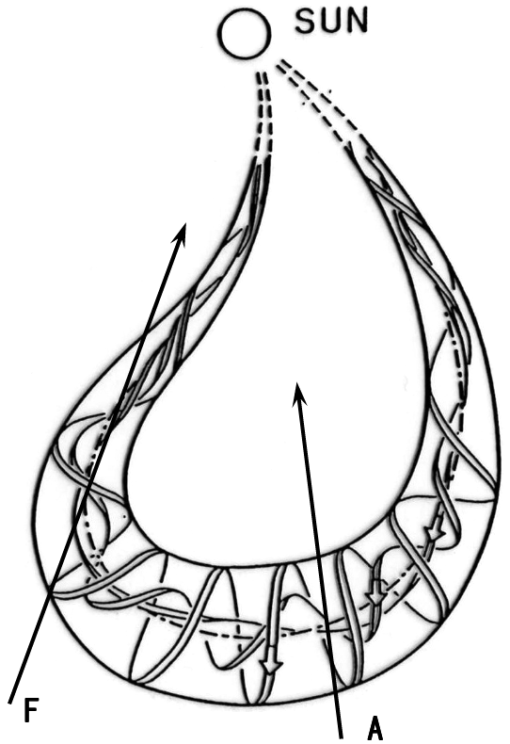
Solar wind

Slide 14
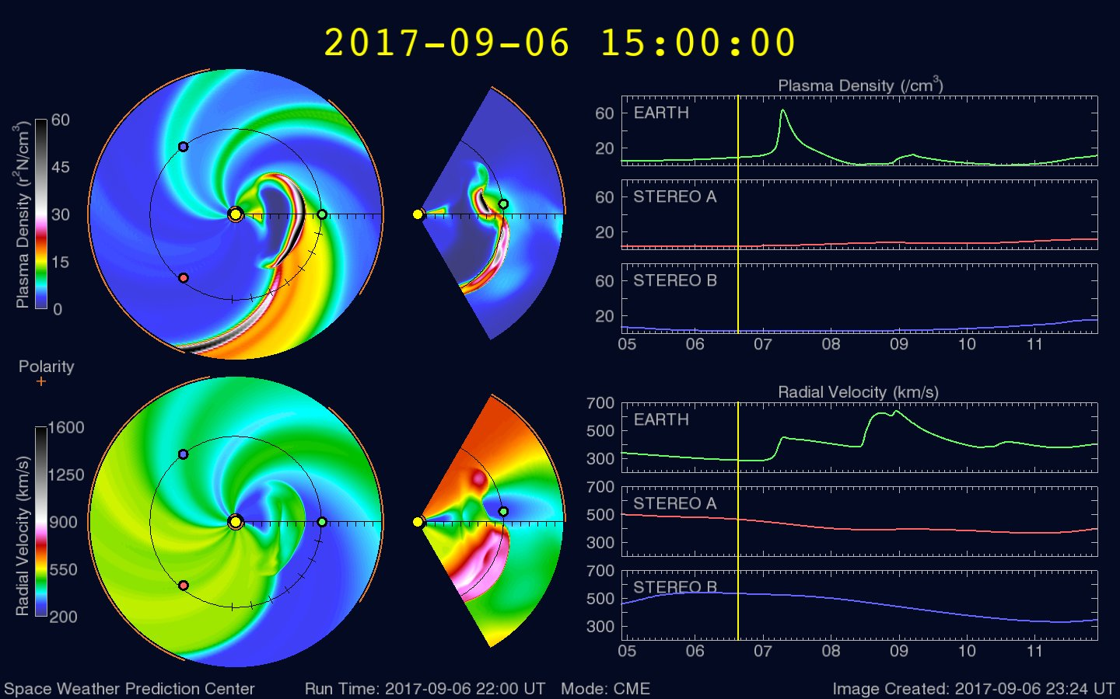
Solar wind

Slide 15
Study 1

Slide 16
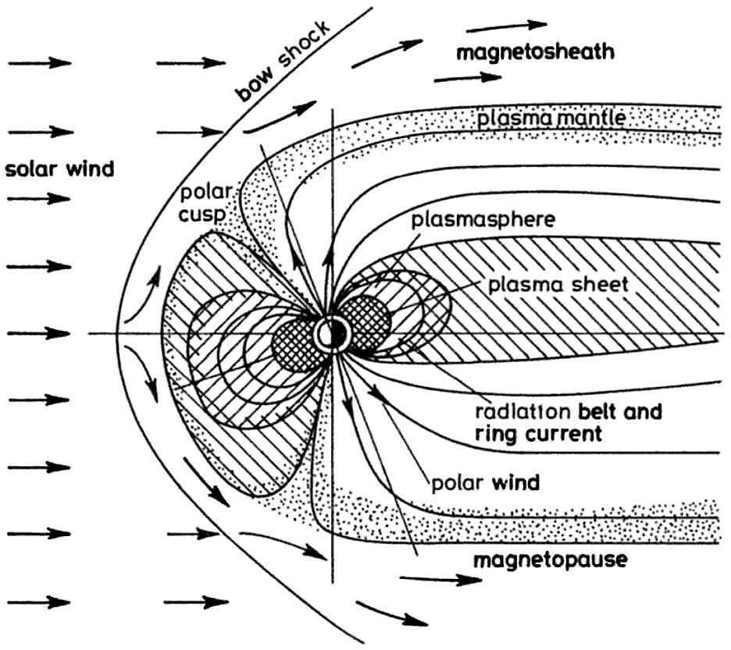
Study 1

Slide 17
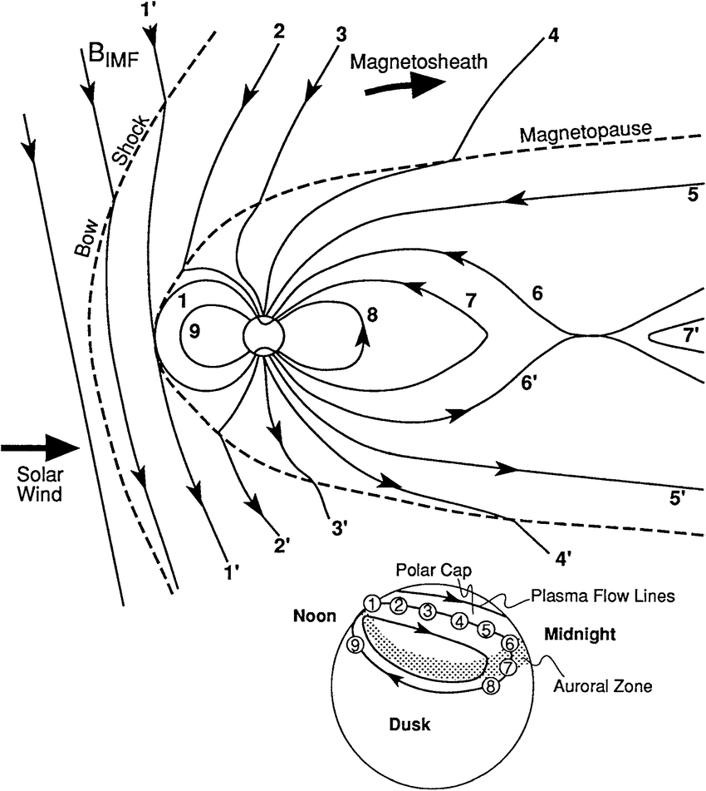
Study 1

Slide 18
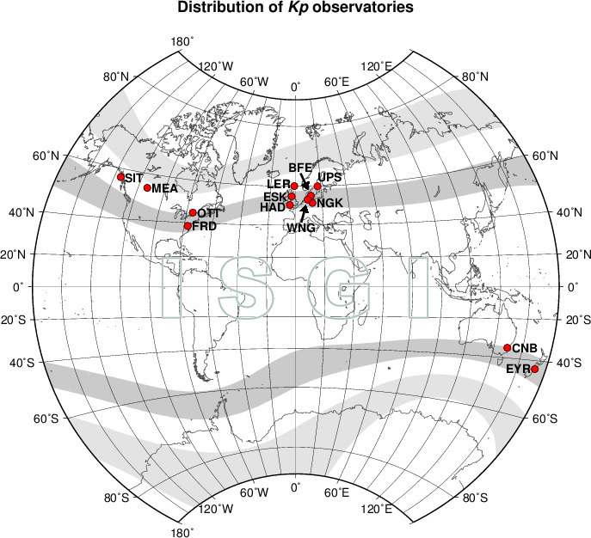
Study 1

Slide 19
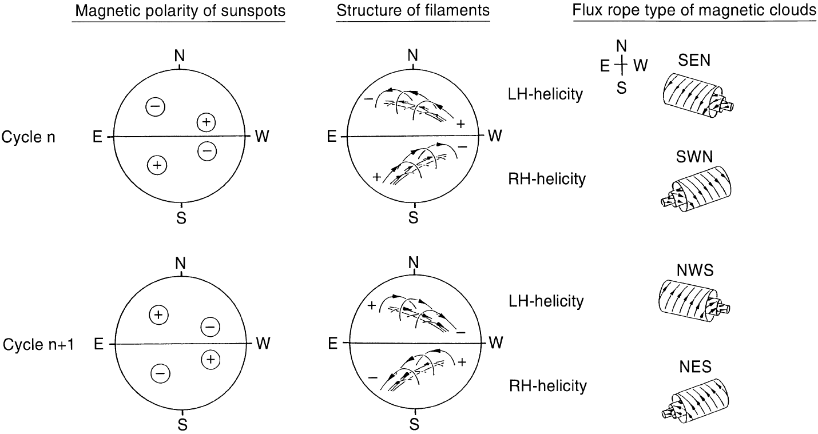
Study 1

Slide 20
Study 2

Slide 21
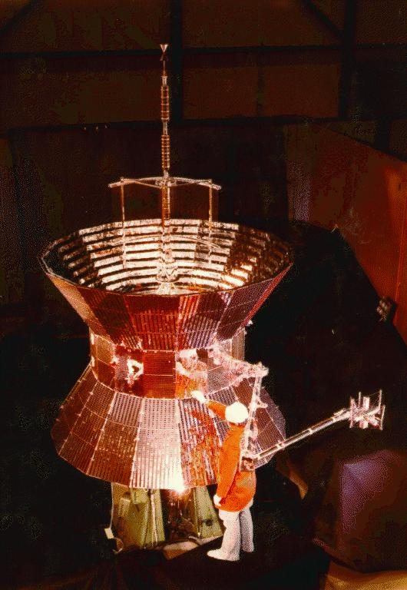
Study 2

Slide 22
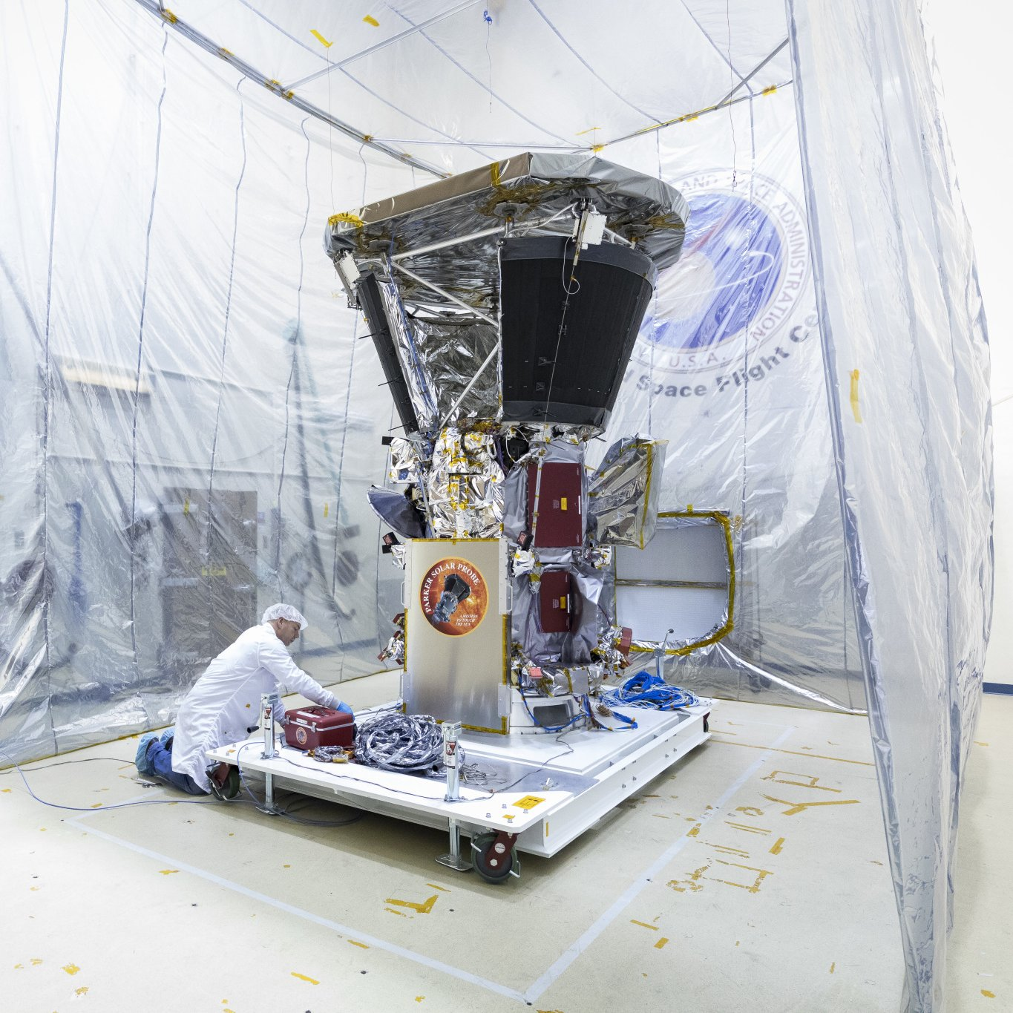
Study 2

Slide 23
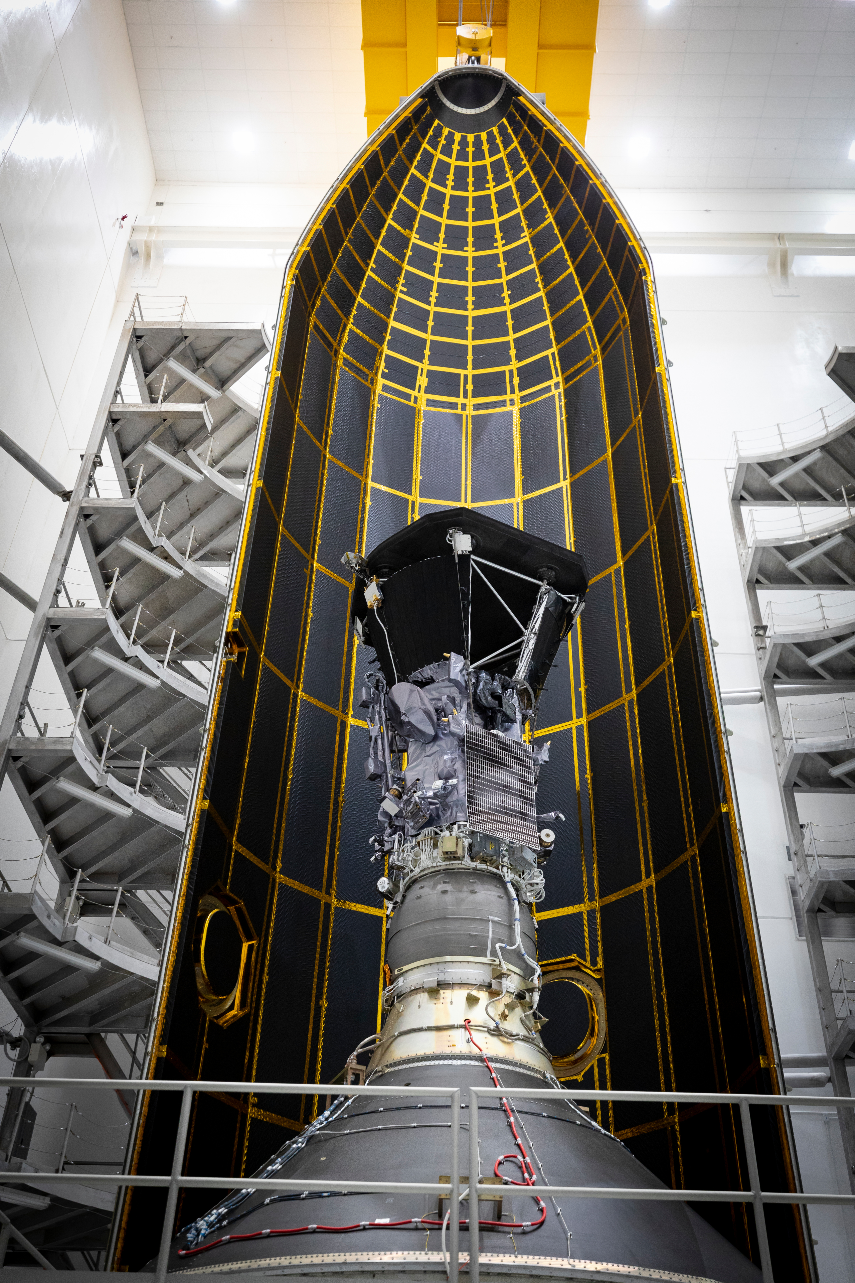
Study 2

Slide 24
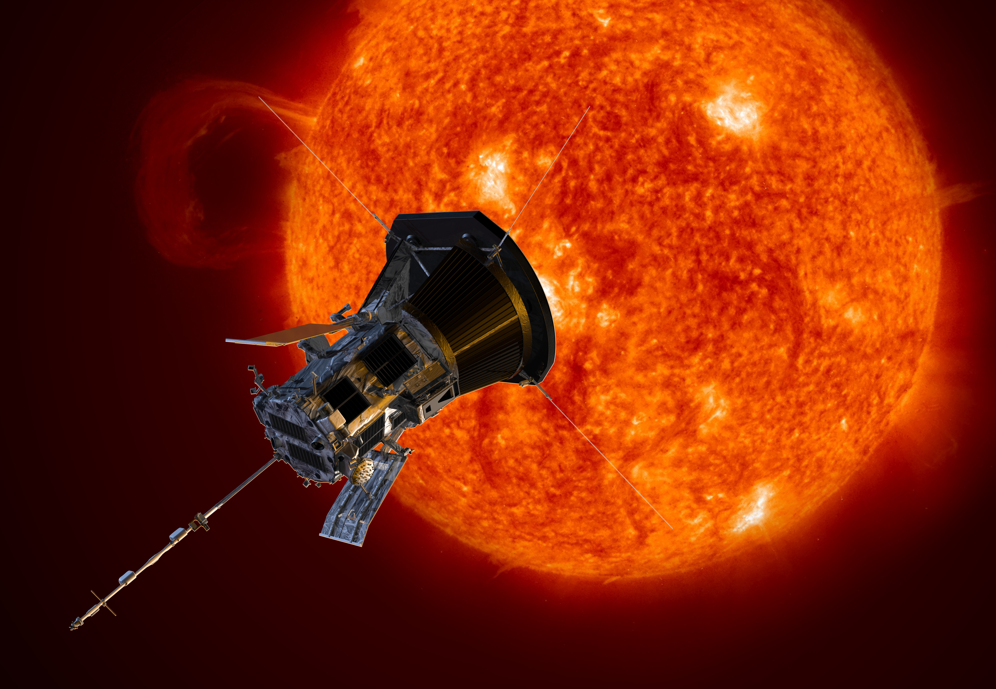
Study 2

Slide 25
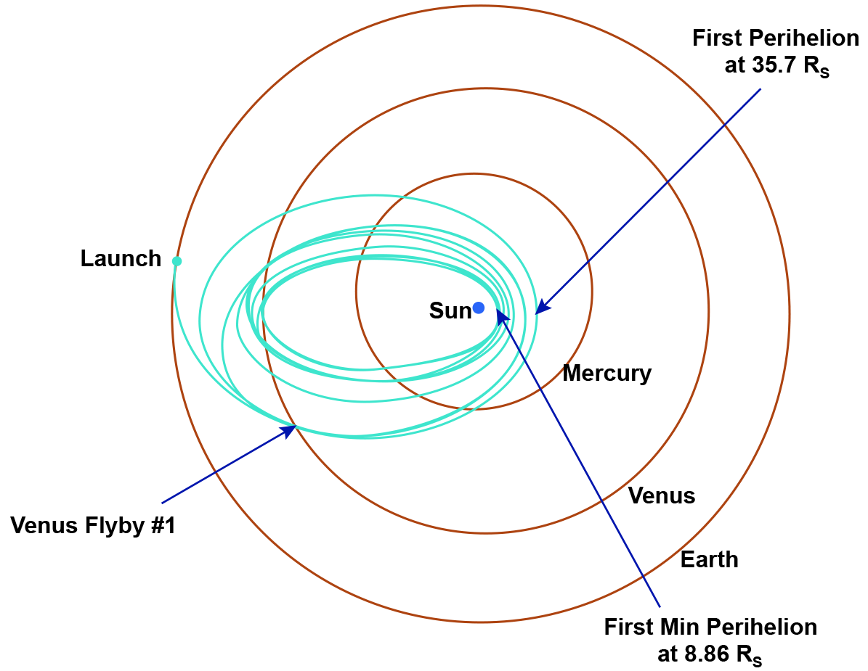
Study 2

Slide 26
Study 2 OLE object

Slide 27
Study 2 *.odg
1
PSP orbit
0.8
Venus flybys
0.6
Examined
Solar distance [au]
perihelia
0.4
0.2
0
SIDC smoothed actual
200
SIDC prediction
200
SWPC prediction
Cycle 24 shifted by 11 years
150
Half/twice cycle 24 amplitude
150
SSN
SSN
100
100
#24
#24
#25
50
#25
50
0
0
2014
2014
2016
2016
2018
2018
2020
2020
2022
2022
2024
2024
2026
2026

Slide 28
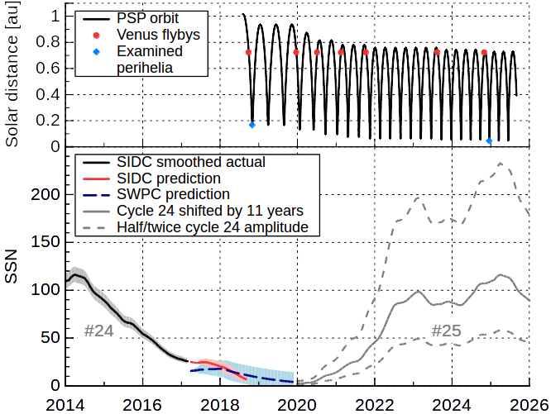
Study 2 *.svg

Slide 29
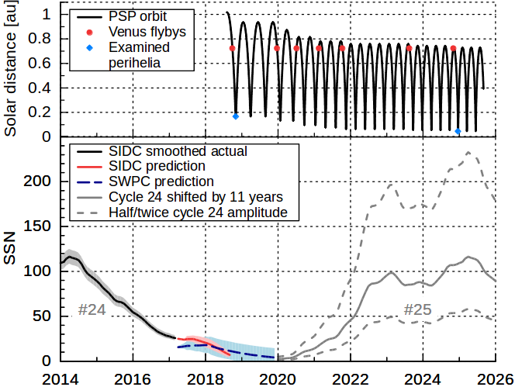
Study 2 *.png

Slide 30
Summary

Slide 31
Thank you!

Slide 32
Backup slides

