Slide 1
Improving structure search with Machine Learning
Malthe Kjær Bisbo
26/6-2018
1) The usefullness of machine learning – simple example
2) A harder problem

Slide 2
Simple case
x1
x2

Slide 3
Simple case
x1
x2

Slide 4
Simple case
x1
x2

Slide 5
Simple case
Training data:
1)
x1
x2

Slide 6
Simple case
Training data:
1)
x1
x2

Slide 7
Simple case
Training data:
1)
x1
x2

Slide 8
Simple case
Invariances
Training data:
Translation
Rotation
1)
Reflection
Permutation
x1

Slide 9
Simple case
Training data:
1)
x1
x2

Slide 10
Simple case
Training data:
1)
2)
x1
x2

Slide 11
Simple case
Training data:
1)
2)
3)
x1
x2

Slide 12
Simple case
Training data:
1)
2)
3)
4)
x1
x2

Slide 13
Simple case
Training data:
1)
2)
3)
4)
5)
x1
x2

Slide 14
Simple case
Training data:
1)
2)
3)
4)
5)
Global minimum

Slide 15




General method
Initial structures
Train
model
Consult DFT
Search ML potential

Slide 16
General method
1)
2)
3)
Initial structures
Train
model
Consult DFT
Search ML potential

Slide 17
General method
1)
2)
3)
Initial structures
Train
model
Consult DFT
Search ML potential

Slide 18
General method
1)
2)
3)
Initial structures
Train
model
x
x
x
Consult DFT
Search ML potential
x
x
x
x

Slide 19
General method
1)
2)
3)
Initial structures
Train
model
x
x
x
Consult DFT
Search ML potential
x
x
x

Slide 20
General method
1)
2)
3)
Initial structures
Train
model
x
x
x
Consult DFT
Search ML potential
x
x
x

Slide 21
General method
1)
2)
3)
# DFT calculations
With ML : 600 * 1 = 600
Initial structures
Train
model
x
x
x
Consult DFT
Search ML potential
x
x
x

Slide 22
General method
1)
2)
3)
# DFT calculations
With ML : 600 * 1 = 600
Initial structures
Train
model
Relax with DFT
Create single candidate
x
x
x
Consult DFT
Search ML potential
x
x
x

Slide 23
General method
1)
2)
3)
# DFT calculations
With ML : 600 * 1 = 600
Without ML : 200
Initial structures
Train
model
Relax with DFT
Create single candidate
x
x
x
Consult DFT
Search ML potential
x
x
x

Slide 24
General method
1)
2)
3)
# DFT calculations
With ML : 600 * 1 = 600
Without ML : 200 * 100 = 20000
Initial structures
Train
model
Relax with DFT
Create single candidate
x
x
x
Consult DFT
Search ML potential
x
x
x

Slide 25
Harder problem – C24 Fullerenes
Initial structures
Train
model
Consult DFT
Search ML potential

Slide 26
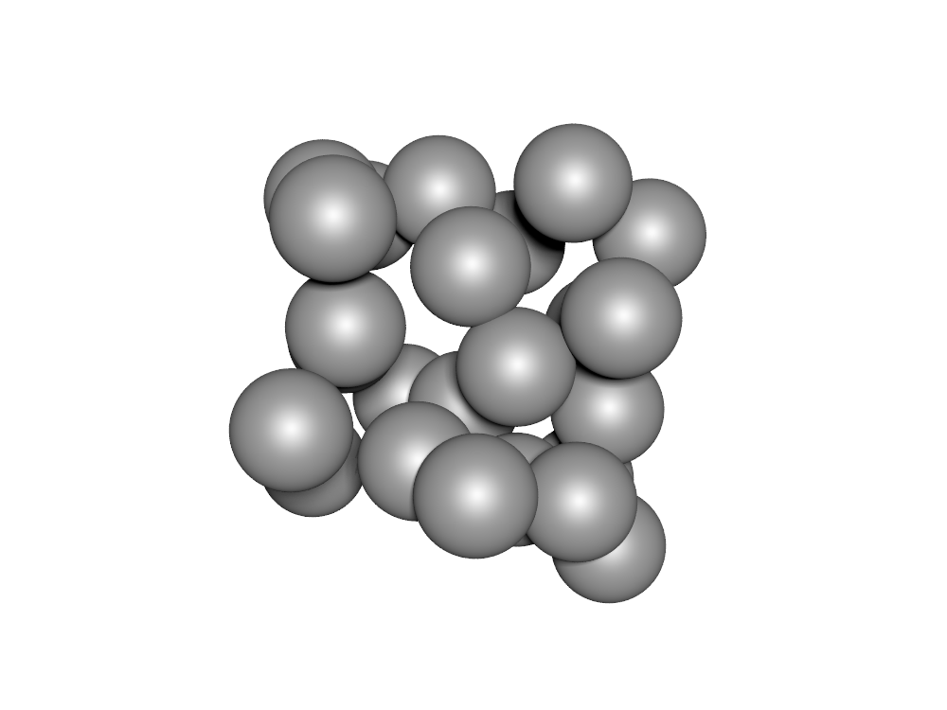
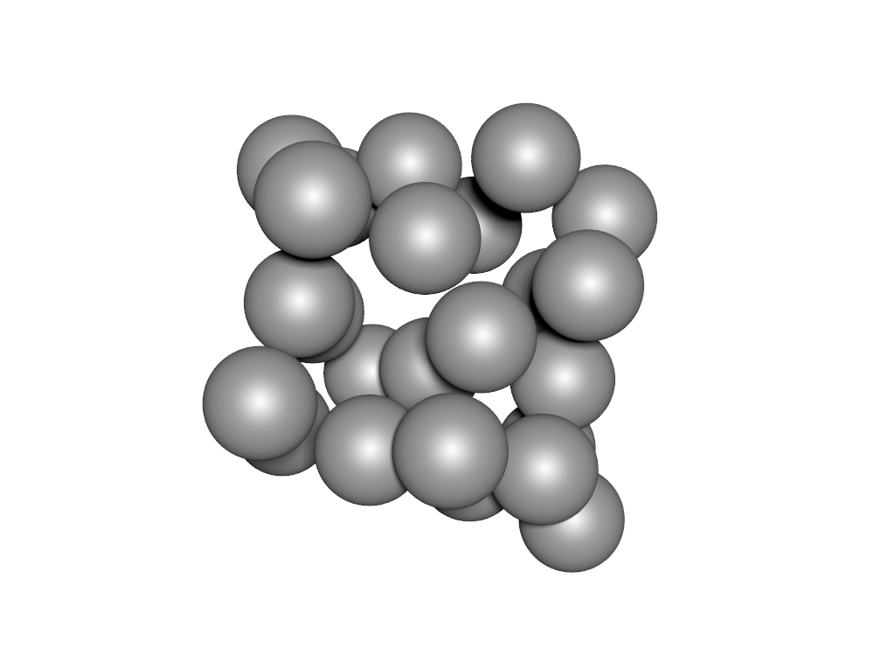
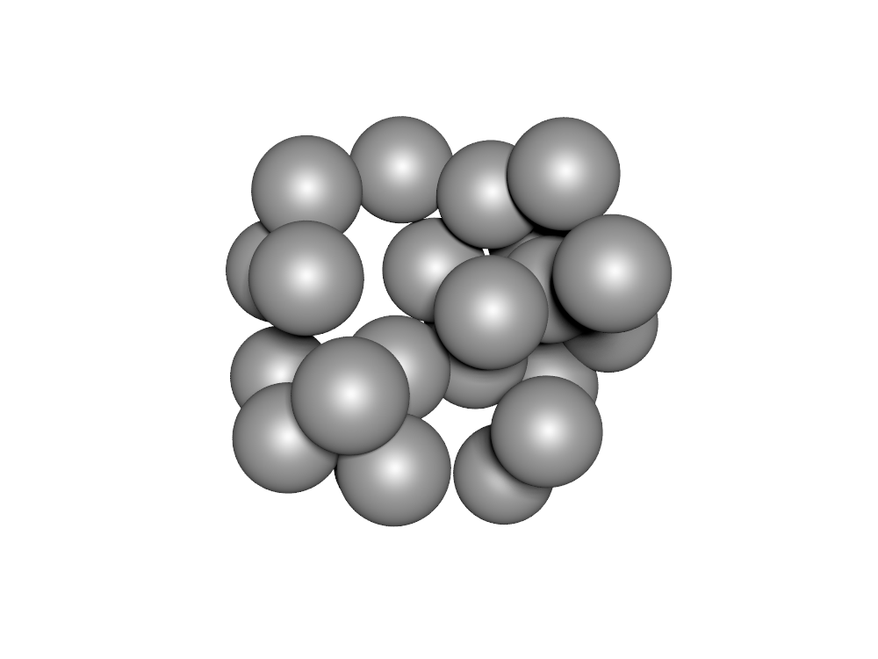
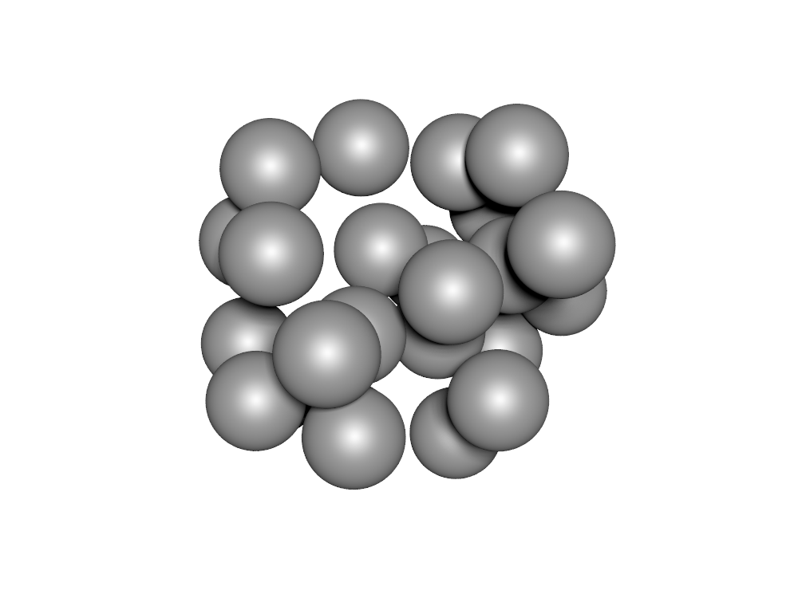
Harder problem – C24 Fullerenes
Initial structures
Train
model
Consult DFT
Search ML potential

Slide 27
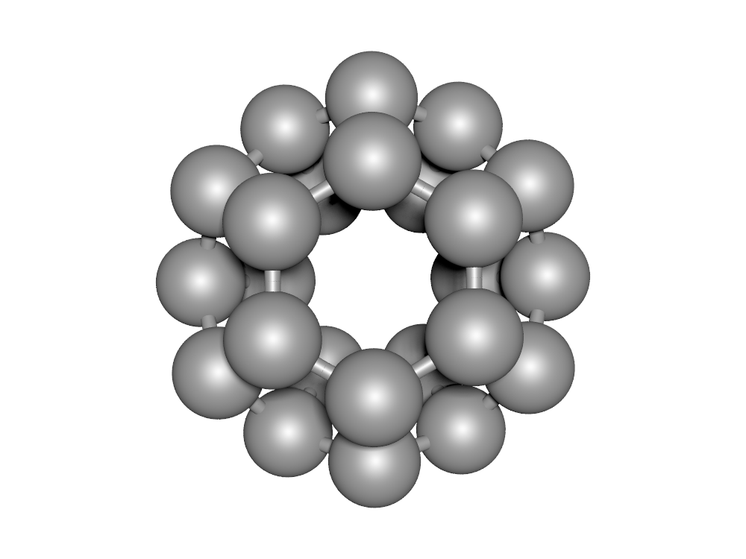
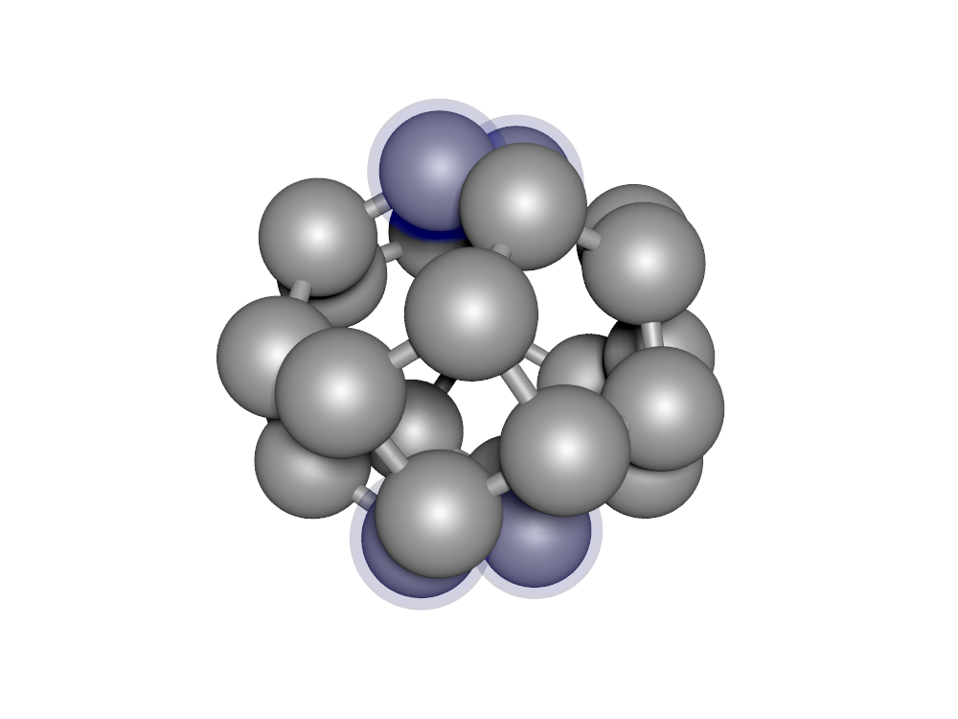
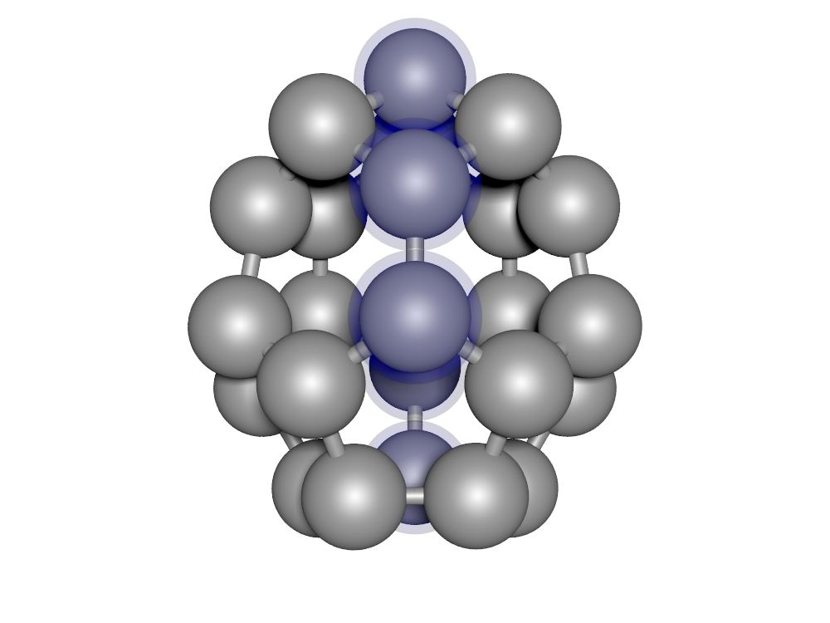
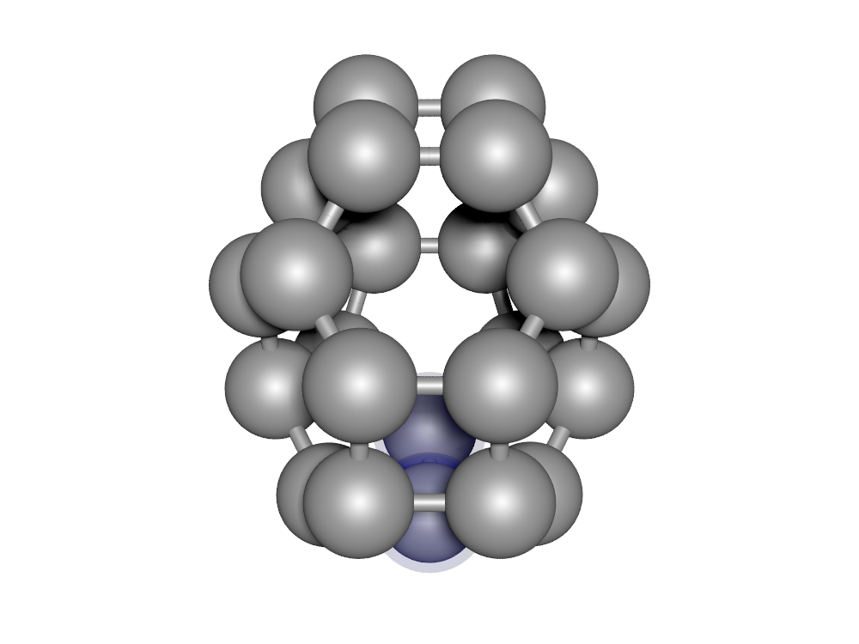
Harder problem – C24 Fullerenes
Initial structures
Train
model
Consult DFT
Search ML potential

Slide 28
Harder problem – C24 Fullerenes
E =
-190.11eV
-189.94eV
-189.91eV
-190.09eV

Slide 29
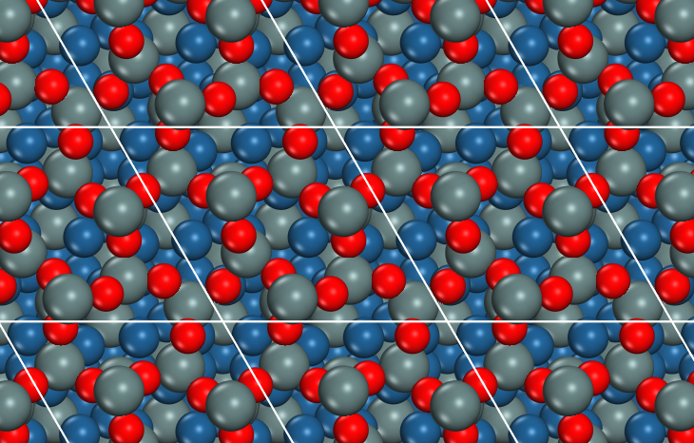
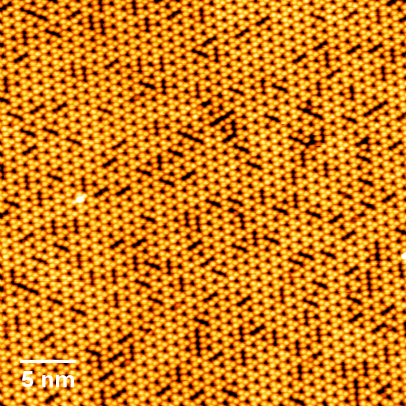
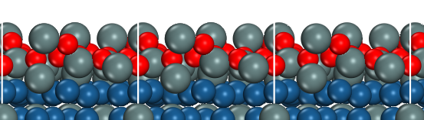
Future problem – Oxidized Pt₃Sn
STM

