Slide 1
Sn3O3

Slide 2
Sn3O3

Slide 3
TiO -2 layer
dmax=0.2
gauss
matern

Slide 4
TiO -2 layer
dmax=0.1
gauss
matern
No successes for dmax = 0.05

Slide 5
TiO -2 layer
dmax=0.2
dmax=0.1
dmax=0.05
No successes
Where dmax is the required maximum distance to the global minimum in the featurespace,
for a structure to count as a success.
The reason for no successes at dmax=0.05 is the limited precision because finite regularization.
The structures can therefore not be converged below a certain point.
In this case reg=10^-5. Lowering the regularization will probably allow for a finer convergence.
- Sadly the search fails for reg=10^-7. (probably numerical issues)

Slide 6
Sn3O3
Energy prediction of straight path
between the point in a search closest
to the global minimum and the
global minimum.
This suggests (not surprisingly) that
lowering the regularization and the
kernel width improves convergence.

Slide 7
TiO -2 layer
dmax=0.2
Some searches seam to get stuck in some low
energy configuration.
This is partly because the population is not very diverse, which results in less diverse new candidates.
As seen in the figure, increasing kappa helps.
Fixes for population:
Increase dmin criteria for entering population.
ML-relax populaton further, if structures from the same ML-minimum is present in the population.
Increase population size. (+ maybe pick parents with some energydependent weight)
Metropolis condition for entering population.
gauss

Slide 8
TiO -2 layer
dmax=0.2
Increasing kappa more does not further improve
The success curves.
The problem is probably that the relevant structures are not generated (due to non diverse population) - Improving the mutations might also help.
gauss

Slide 9
TiO -2 layer
dmax=0.2
Reducing the box height probably helps a bit,
But does not make a huge difference.
gauss

Slide 10
TiO -2 layer
The orange curve is the predicted energy of the global minimum, while grey curve is the best fitness at that iteration.
The plots of these six failed searches therefore show that the problem is that the proper new candidates are not generated by the
mutations. Since if they
were generated, they would be picked based on the energy alone.

Slide 11
TiO -2 layer
The variation in the population (controlled by d_pop) and the population size will influence, what new structures
are generated.
A very narrow population will result in the tendency
to get stuck in a local munimum.
Based on the the success curves there might be a benefit of
the d_pop=0.5, pop_size=10 settings compared to the settings
d_pop=0.2, pop_size=5 used in previous runs.
- But note that the searches are with 800 sp-calculations.
gauss

Slide 12
TiO -2 layer
Cut and splice does not seam to
contribute significantly.
The new rattle does not seam to
contribute significantly.
gauss

Slide 13
Double step – mathias’ best

Slide 14
Double step – new best

Slide 15
Double step – kernel width
Sigma=30
Sigma=10
Sigma=3

Slide 16
Double step – kernel width
Sigma=30
Sigma=10
Sigma=3

Slide 17
Double step – 2 best as refference

Slide 18
Double step – bias influence
Bias = mean(Etrain)
Bias = mean(Etrain) + std(Etrain)

Slide 19
Double step – Changing kernel width
Sigma=30
Sigma=10
Sigma=3

Slide 20
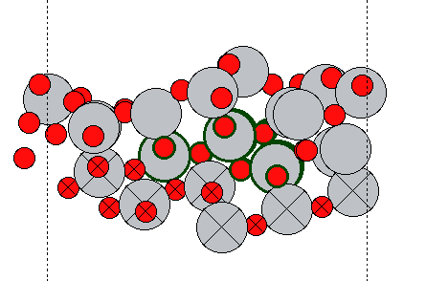
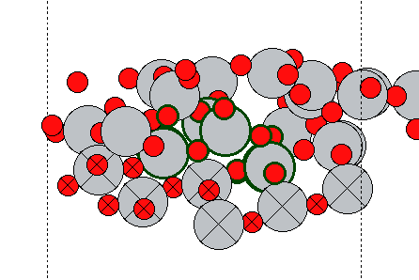
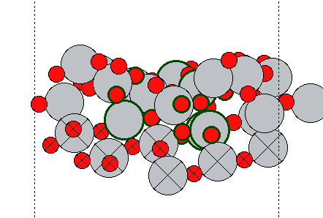
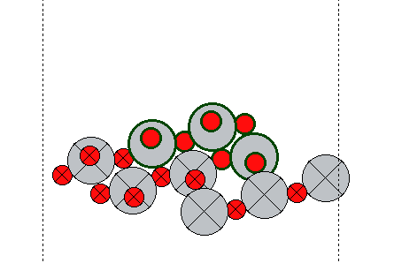
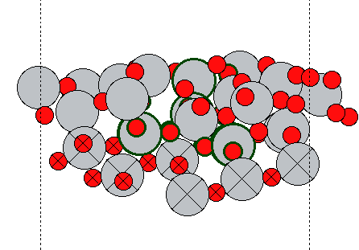
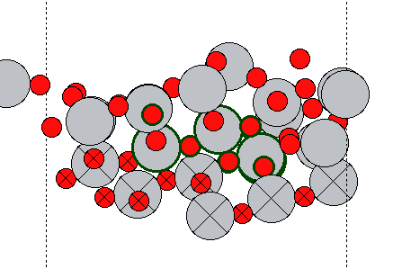
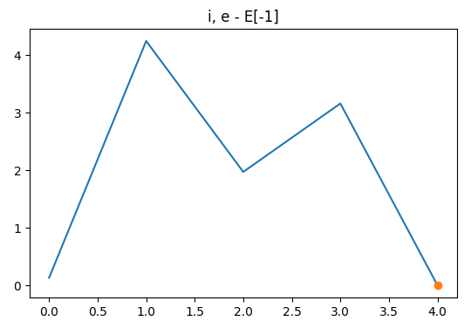
Double step
1
2
3
Slab
4
5
These examples show the best structures from 5 runs. There might be a correlation between the energy and the change in the position of the movable slab atoms. (these
does not take place in mutations, but only in model-relaxation)
=> Maybe they should therefor also take part in mutations.
E = -763.7
Eref = -763.3

Slide 21
Iterative GPR test

Slide 22
Iterative GPR test – predict overall best

Slide 23
Iterative GPR test – predict best in run
reg1 = 1e-5
sigma2 = 3
sigma2 = 1
sigma2 = 0.01

Slide 24
Iterative GPR test – predict best in run
sigma2 = 3
reg1 = 1e-5
reg1 = 1e-4
reg1 = 3e-4

Slide 25
Iterative GPR test – predict best in run
sigma2 = 1

Slide 26
Currently
TiO (DFTB): Running with new rattle
Step: running with new calculator.

Slide 27
To-do
TiO (DFTB): Run with setting that improve the diversity of the population.
Plot step features

Slide 28
Notes
TiO (DFTB): search fails when reg is lowered from 10^-5 to 10^-7

