Slide 1
Simple problem
x1
x2

Slide 2
Simple problem
Training data:
1)
x1
x2

Slide 3
Simple problem
Training data:
1)
2)
x1
x2

Slide 4
Simple problem
Training data:
1)
2)
3)
x1
x2

Slide 5
Simple problem
Training data:
1)
2)
3)
4)
x1
x2

Slide 6
Simple problem
Training data:
1)
2)
3)
4)
5)
x1
x2

Slide 7
Simple problem
Training data:
1)
2)
3)
4)
5)
Global minimum

Slide 8


Larger problems
x1
4
3
$$d_{F}≈3$$
x2
1
2

Slide 9

Larger problems
$$N_{train}=5, d_{F,min }=5$$
x1
4
3
$$d_{F}≈3$$
x2
1
2

Slide 10
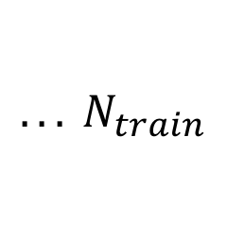
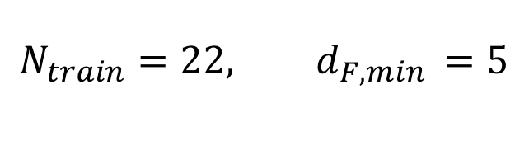
Larger problems
$$N_{train}=22, d_{F,min }=5$$
x1
4
3
$$d_{F}≈3$$
x2
1
2
$${. . . N}_{train}$$

