Slide 2
Describing atomic structures
Defined by atomic coordinates

Slide 3
Describing atomic structures
Defined by atomic coordinates
Problem!
This description is not invariant

Slide 4
Describing atomic structures
Defined by atomic coordinates
Problem!
This description is not invariant
Translation

Slide 5
Describing atomic structures
Defined by atomic coordinates
Problem!
This description is not invariant
Translation
Rotation

Slide 6
Describing atomic structures
Defined by atomic coordinates
Problem!
This description is not invariant
Translation
Rotation
Reflection

Slide 7
Describing atomic structures
Defined by atomic coordinates
Problem!
This description is not invariant
Translation
Rotation
Reflection
permutation

Slide 8

Features
= Invariant descriptions

Slide 9


Features
= Invariant descriptions
Simple solution: use interatomic distances
$$\{x_{1},x_{2},x_{3}, y_{1},y_{2},y_{3}\}$$
$$\{r_{12},r_{13},r_{23}\}$$

Slide 10

Features
= Invariant descriptions
Simple solution: use interatomic distances
$$\{x_{1},x_{2},x_{3}, y_{1},y_{2},y_{3}\}$$
$$\{r_{12},r_{13},r_{23}\}$$
Translation
Rotation
Reflection

Slide 11
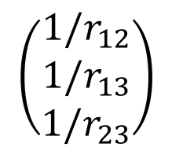
Features
= Invariant descriptions
Simple solution: use interatomic distances
$$\{x_{1},x_{2},x_{3}, y_{1},y_{2},y_{3}\}$$
$$\{r_{12},r_{13},r_{23}\}$$
Translation
Rotation
Reflection
Example 1 – Bag of bonds
List
$$\left(\begin{matrix}1/r_{12} \\ 1/r_{13} \\ 1/r_{23}\end{matrix}\right)$$

Slide 12
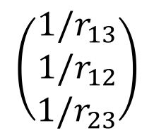
Features
= Invariant descriptions
Simple solution: use interatomic distances
$$\{x_{1},x_{2},x_{3}, y_{1},y_{2},y_{3}\}$$
$$\{r_{12},r_{13},r_{23}\}$$
Translation
Rotation
Reflection
Example 1 – Bag of bonds
List
$$\left(\begin{matrix}1/r_{12} \\ 1/r_{13} \\ 1/r_{23}\end{matrix}\right)$$
Sort
$$\left(\begin{matrix}1/r_{13} \\ 1/r_{12} \\ 1/r_{23}\end{matrix}\right)$$

Slide 13
Features
= Invariant descriptions
Simple solution: use interatomic distances
$$\{x_{1},x_{2},x_{3}, y_{1},y_{2},y_{3}\}$$
$$\{r_{12},r_{13},r_{23}\}$$
Translation
Rotation
Reflection
Example 1 – Bag of bonds
List
$$\left(\begin{matrix}1/r_{12} \\ 1/r_{13} \\ 1/r_{23}\end{matrix}\right)$$
Sort
$$\left(\begin{matrix}1/r_{13} \\ 1/r_{12} \\ 1/r_{23}\end{matrix}\right)$$
Permutation

Slide 14
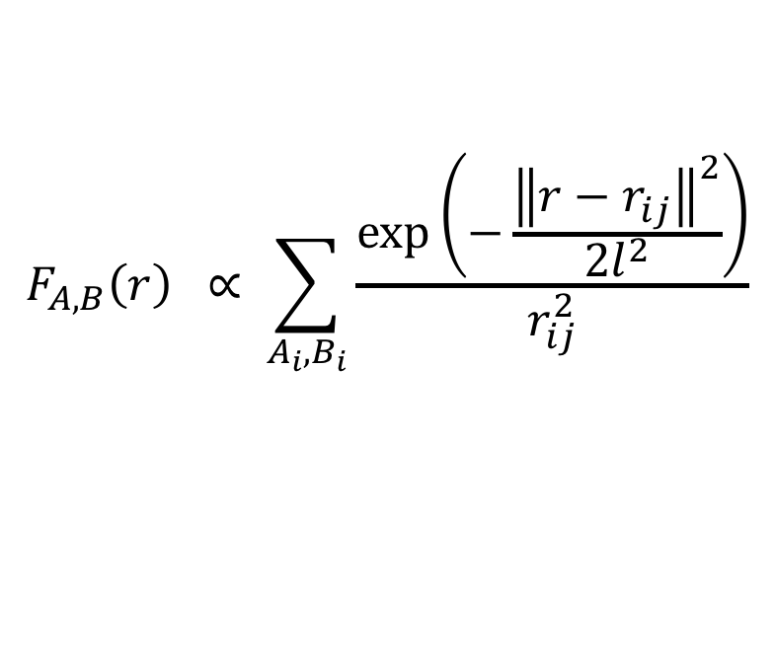
Features
Example 1 – Organov and Valle
$$F_{A,B}\left(r\right) ∝ \sum_{A_{i},B_{i}}{\frac{\exp\left(−\frac{{\left\|r−r_{ij}\right\|}^{2}}{2l^{2}}\right)}{r_{ij}^{2}}}$$

Slide 15

Features
Example 1 – Organov and Valle
$$F_{A,B}\left(r\right) ∝ \sum_{A_{i},B_{i}}{\frac{\exp\left(−\frac{{\left\|r−r_{ij}\right\|}^{2}}{2l^{2}}\right)}{r_{ij}^{2}}}$$
Sum gaussians
$$r_{12}$$

Slide 16

Features
Example 1 – Organov and Valle
$$F_{A,B}\left(r\right) ∝ \sum_{A_{i},B_{i}}{\frac{\exp\left(−\frac{{\left\|r−r_{ij}\right\|}^{2}}{2l^{2}}\right)}{r_{ij}^{2}}}$$
Sum gaussians
$$r_{13}$$
$$r_{12}$$

Slide 17

Features
Example 1 – Organov and Valle
$$F_{A,B}\left(r\right) ∝ \sum_{A_{i},B_{i}}{\frac{\exp\left(−\frac{{\left\|r−r_{ij}\right\|}^{2}}{2l^{2}}\right)}{r_{ij}^{2}}}$$
Sum gaussians
$$r_{13}$$
$$r_{12}$$
$$r_{23}$$

Slide 18
Features
Example 1 – Organov and Valle
$$F_{A,B}\left(r\right) ∝ \sum_{A_{i},B_{i}}{\frac{\exp\left(−\frac{{\left\|r−r_{ij}\right\|}^{2}}{2l^{2}}\right)}{r_{ij}^{2}}}$$
Sum gaussians

Slide 19
Features
Example 1 – Organov and Valle
$$F_{A,B}\left(r\right) ∝ \sum_{A_{i},B_{i}}{\frac{\exp\left(−\frac{{\left\|r−r_{ij}\right\|}^{2}}{2l^{2}}\right)}{r_{ij}^{2}}}$$
Final feature
Sum gaussians
+ scale

Slide 20
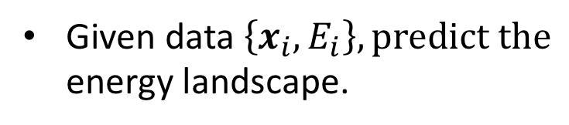
Kernel Regression
Given data $\left\{x_{i}, E_{i}\right\}, predict the$
energy landscape.

Slide 21
Kernel Regression
Given data $\left\{x_{i}, E_{i}\right\}, predict the$
energy landscape.

Slide 22
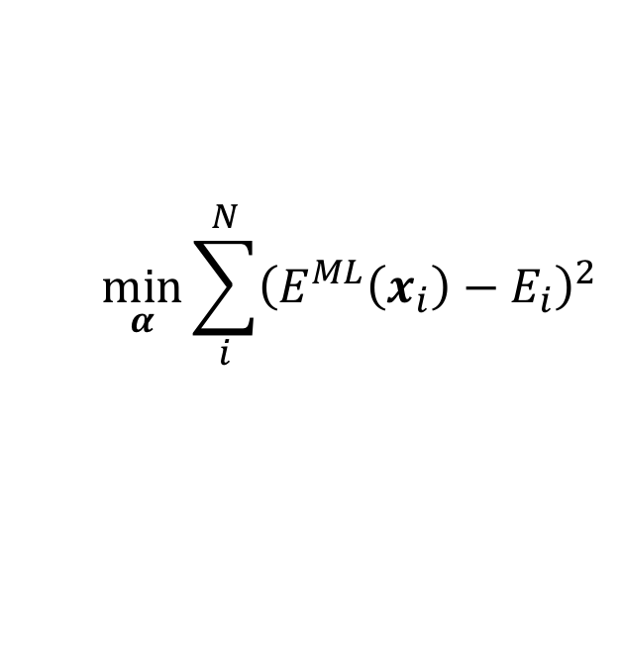
Kernel Regression
Given data $\left\{x_{i}, E_{i}\right\}, predict the$
energy landscape.
$$\min_{α}{\sum_{i}^{N}{{\left(E^{ML}\left(x_{i}\right)−E_{i}\right)}^{2}}}$$

Slide 23
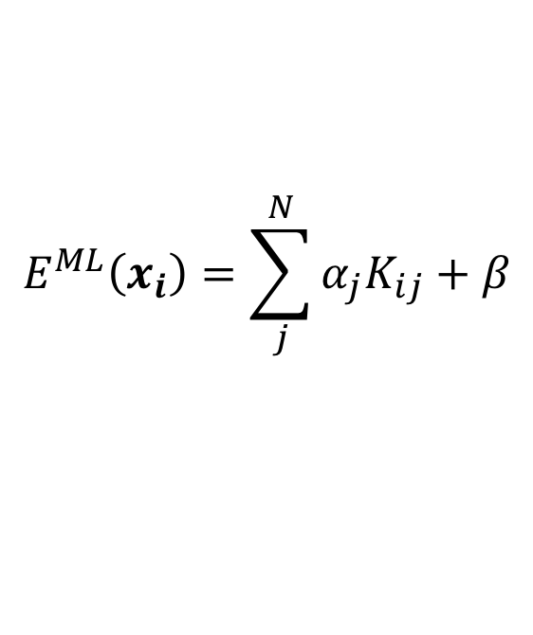
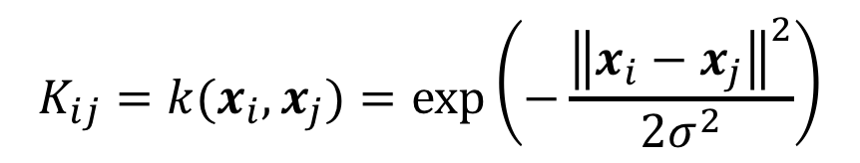
Kernel Regression
Given data $\left\{x_{i}, E_{i}\right\}, predict the$
energy landscape.
$$\min_{α}{\sum_{i}^{N}{{\left(E^{ML}\left(x_{i}\right)−E_{i}\right)}^{2}}}$$
$$E^{ML}\left(x_{i}\right)=\sum_{j}^{N}{α_{j}K_{ij}+β}$$
$$K_{ij}=k(x_{i},x_{j})=\exp\left(−\frac{{\left\|x_{i}−x_{j}\right\|}^{2}}{2σ^{2}}\right)$$

Slide 24
Kernel Regression
Given data $\left\{x_{i}, E_{i}\right\}, predict the$
energy landscape.
$$\min_{α}{\sum_{i}^{N}{{\left(E^{ML}\left(x_{i}\right)−E_{i}\right)}^{2}}}$$
$$E^{ML}\left(x_{i}\right)=\sum_{j}^{N}{α_{j}K_{ij}+β}$$
$$K_{ij}=k(x_{i},x_{j})=\exp\left(−\frac{{\left\|x_{i}−x_{j}\right\|}^{2}}{2σ^{2}}\right)$$

Slide 25
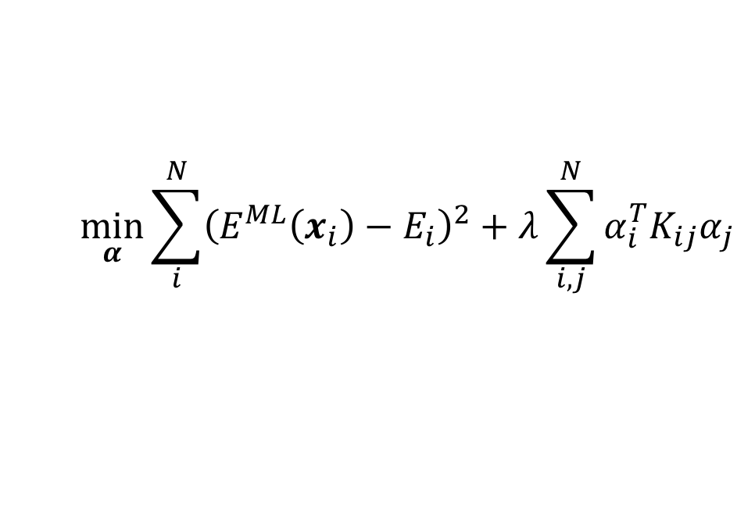
Kernel Ridge Regression
Given data $\left\{x_{i}, E_{i}\right\}, predict the$
energy landscape.
$$\min_{α}{\sum_{i}^{N}{{\left(E^{ML}\left(x_{i}\right)−E_{i}\right)}^{2}+λ}\sum_{i,j}^{N}{α_{i}^{T}K_{ij}α_{j}}}$$
$$E^{ML}\left(x_{i}\right)=\sum_{j}^{N}{α_{j}K_{ij}+β}$$
$$K_{ij}=k(x_{i},x_{j})=\exp\left(−\frac{{\left\|x_{i}−x_{j}\right\|}^{2}}{2σ^{2}}\right)$$

Slide 26
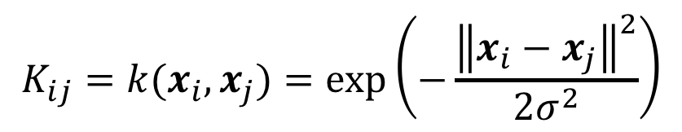
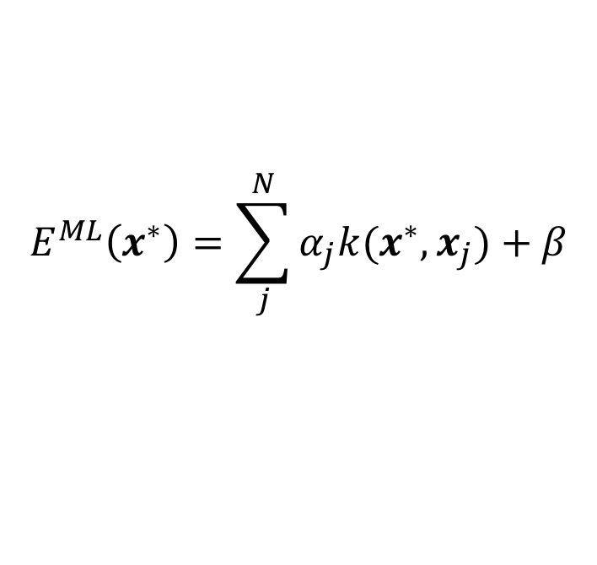
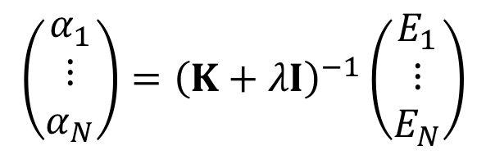
Kernel Ridge Regression
Fit/training:
$$\left(\begin{matrix}α_{1} \\ ⋮ \\ α_{N}\end{matrix}\right)={\left(K+λI\right)}^{−1}\left(\begin{matrix}E_{1} \\ ⋮ \\ E_{N}\end{matrix}\right)$$
Prediction:
$$E^{ML}\left(x^{∗}\right)=\sum_{j}^{N}{α_{j}k(x^{∗},x_{j})+β}$$
where
$$K_{ij}=k(x_{i},x_{j})=\exp\left(−\frac{{\left\|x_{i}−x_{j}\right\|}^{2}}{2σ^{2}}\right)$$

Slide 27
Kernel Ridge Regression
Fit/training:
$$\left(\begin{matrix}α_{1} \\ ⋮ \\ α_{N}\end{matrix}\right)={\left(K+λI\right)}^{−1}\left(\begin{matrix}E_{1} \\ ⋮ \\ E_{N}\end{matrix}\right)$$
Prediction:
$$E^{ML}\left(x^{∗}\right)=\sum_{j}^{N}{α_{j}k(x^{∗},x_{j})+β}$$
where
$$K_{ij}=k(x_{i},x_{j})=\exp\left(−\frac{{\left\|x_{i}−x_{j}\right\|}^{2}}{2σ^{2}}\right)$$

Slide 28
Kernel Ridge Regression
Fit/training:
$$\left(\begin{matrix}α_{1} \\ ⋮ \\ α_{N}\end{matrix}\right)={\left(K+λI\right)}^{−1}\left(\begin{matrix}E_{1} \\ ⋮ \\ E_{N}\end{matrix}\right)$$
Prediction:
$$E^{ML}\left(x^{∗}\right)=\sum_{j}^{N}{α_{j}k(x^{∗},x_{j})+β}$$
Prediction error:
from Gaussian process Regression

Slide 29
Simple example

Slide 30
Simple example

Slide 31
Simple example

Slide 32
Simple example

Slide 33
Simple example

Slide 34
Simple example

