Slide 1
Generalized Density-Functional Tight-Binding Repulsive Potentials from Unsupervised Machine Learning
J. J. Kranz, M. Kubillus, R. Ramakrishnan, O. A. von Lilienfeld, M. Elstner

Slide 2
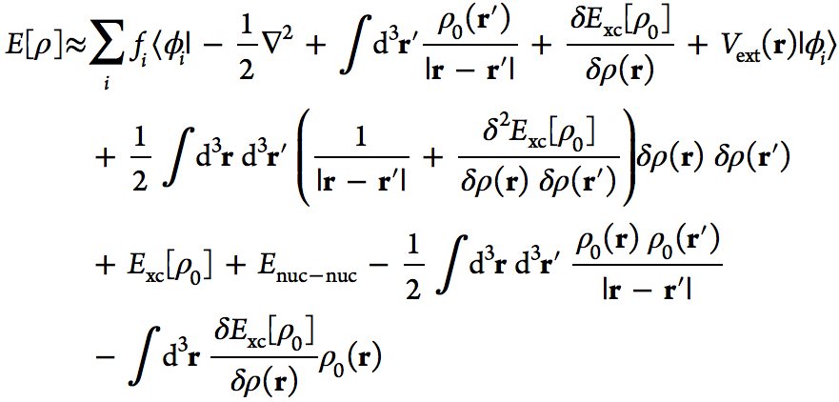
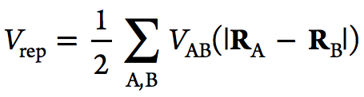


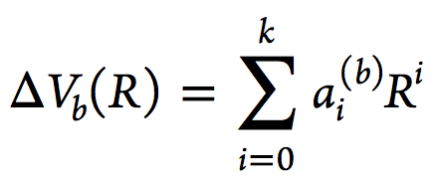
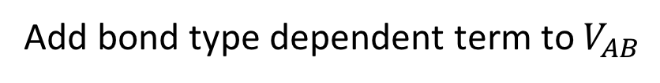
Repulsive potential
DFTB2:
Approximation
Add bond type dependent term to $V_{AB}$
This work
where for a bondtype b

Slide 3

The task is:
1) Determine bond types
Fit
for each bondtype
Fit is based on

Slide 4
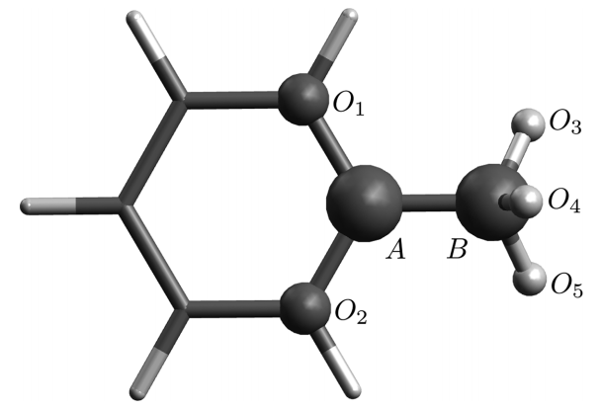
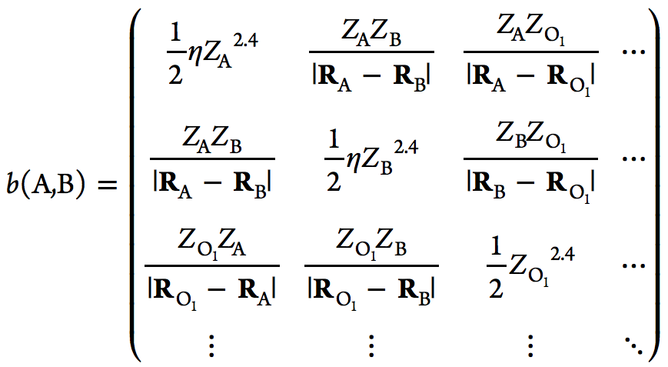
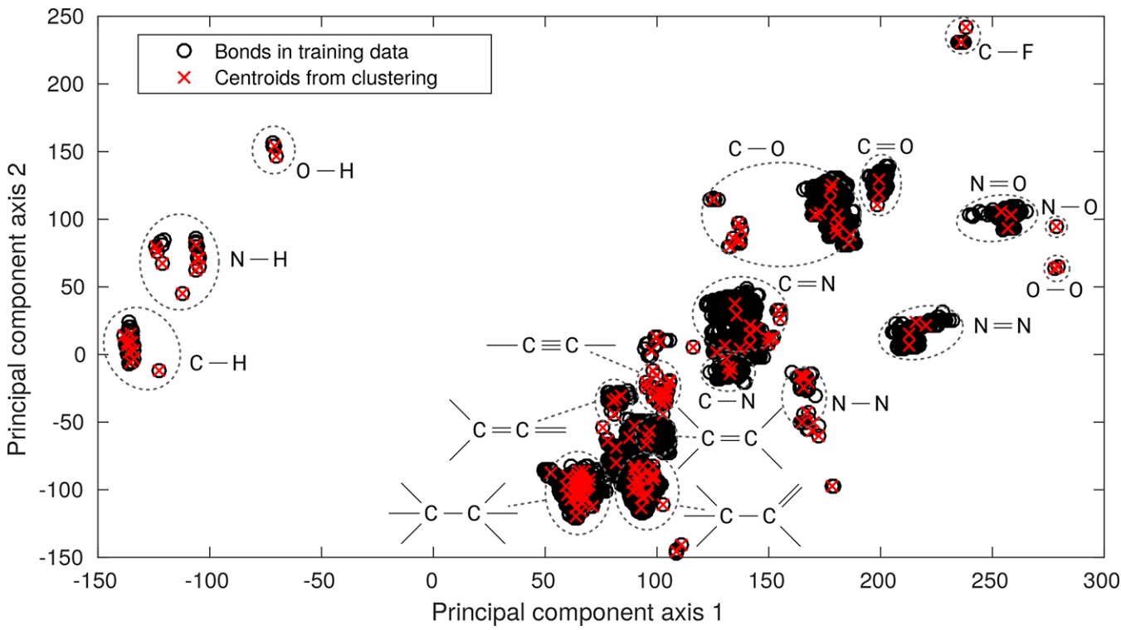
Bondtype clustering
Descriptor (modified Coulomb matrix)
Atoms within cutoff
Distance of A and B
Clustering (Mean-shift)
Mean-shift is used because kmeans
tends to ignore small clusters

Slide 5
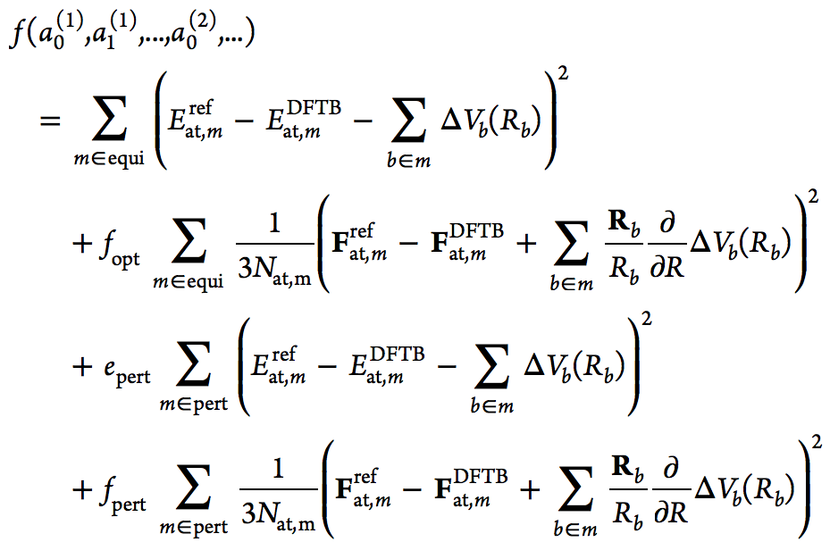


Fitting
Minimize cost function:
Can be written as a least squares problem
Because

