Slide 1
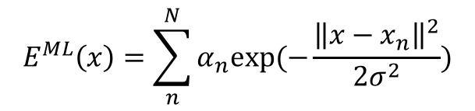
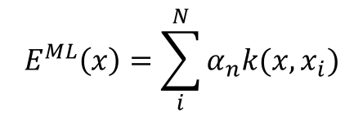
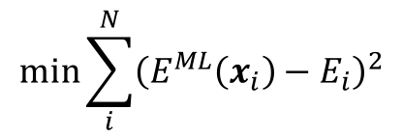
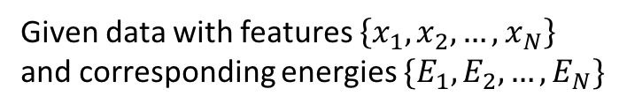
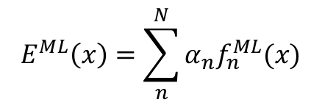
Given data with features $\left\{x_{1}, x_{2},…,x_{N}\right\}$
and corresponding energies $\{E_{1},E_{2},…,E_{N}\}$
Given data $\left\{x_{i}, E_{i}\right\}$ how can we model the energy landscape?
$$\min{\sum_{i}^{N}{{\left(E^{ML}\left(x_{i}\right)−E_{i}\right)}^{2}}}$$
$$E^{ML}\left(x\right)=\sum_{n}^{N}{α_{n}exp⁡(−\frac{{\left\|x−x_{n}\right\|}^{2}}{2σ^{2}})}$$
$$E^{ML}\left(x\right)=\sum_{i}^{N}{α_{n}k(x, x_{i})}$$
$$E^{ML}\left(x\right)=\sum_{n}^{N}{α_{n}f_{n}^{ML}(x)}$$

