Slide 1

Learning the potential energy surface
Malthe Kjær Bisbo
1/6-2018

Slide 2
Describing atomic structures
Defined by atomic coordinates

Slide 3
Describing atomic structures
Defined by atomic coordinates
Problem!
This description is not invariant

Slide 4
Describing atomic structures
Defined by atomic coordinates
Problem!
This description is not invariant
Translation

Slide 5
Describing atomic structures
Defined by atomic coordinates
Problem!
This description is not invariant
Translation
Rotation

Slide 6
Describing atomic structures
Defined by atomic coordinates
Problem!
This description is not invariant
Translation
Rotation
Reflection

Slide 7
Describing atomic structures
Defined by atomic coordinates
Problem!
This description is not invariant
Translation
Rotation
Reflection
permutation

Slide 8

Features
= Invariant descriptions

Slide 9


Features
= Invariant descriptions
Simple solution: use interatomic distances
$$\{x_{1},x_{2},x_{3}, y_{1},y_{2},y_{3}\}$$
$$\{r_{12},r_{13},r_{23}\}$$

Slide 10

Features
= Invariant descriptions
Simple solution: use interatomic distances
$$\{x_{1},x_{2},x_{3}, y_{1},y_{2},y_{3}\}$$
$$\{r_{12},r_{13},r_{23}\}$$
Translation
Rotation
Reflection

Slide 11
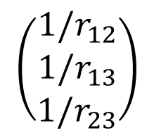
Features
= Invariant descriptions
Simple solution: use interatomic distances
$$\{x_{1},x_{2},x_{3}, y_{1},y_{2},y_{3}\}$$
$$\{r_{12},r_{13},r_{23}\}$$
Translation
Rotation
Reflection
Example 1 – Bag of bonds
List
$$\left(\begin{matrix}1/r_{12} \\ 1/r_{13} \\ 1/r_{23}\end{matrix}\right)$$

Slide 12
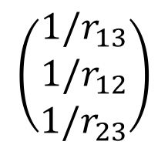
Features
= Invariant descriptions
Simple solution: use interatomic distances
$$\{x_{1},x_{2},x_{3}, y_{1},y_{2},y_{3}\}$$
$$\{r_{12},r_{13},r_{23}\}$$
Translation
Rotation
Reflection
Example 1 – Bag of bonds
List
$$\left(\begin{matrix}1/r_{12} \\ 1/r_{13} \\ 1/r_{23}\end{matrix}\right)$$
Sort
$$\left(\begin{matrix}1/r_{13} \\ 1/r_{12} \\ 1/r_{23}\end{matrix}\right)$$
Permutation

Slide 13
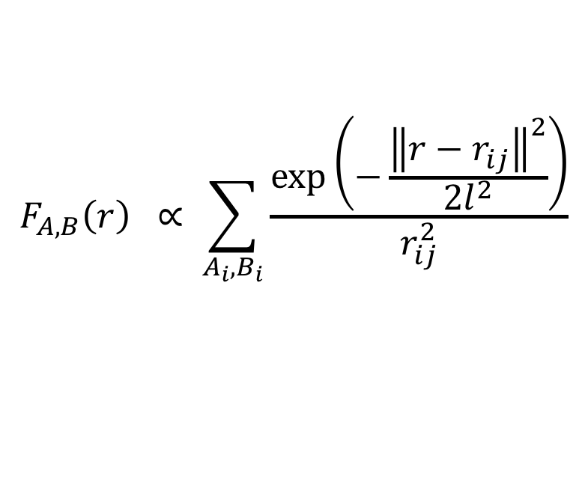
Features
Example 1 – Organov and Valle
$$F_{A,B}\left(r\right) ∝ \sum_{A_{i},B_{i}}{\frac{\exp\left(−\frac{{\left\|r−r_{ij}\right\|}^{2}}{2l^{2}}\right)}{r_{ij}^{2}}}$$

Slide 14

Features
Example 1 – Organov and Valle
$$F_{A,B}\left(r\right) ∝ \sum_{A_{i},B_{i}}{\frac{\exp\left(−\frac{{\left\|r−r_{ij}\right\|}^{2}}{2l^{2}}\right)}{r_{ij}^{2}}}$$
Sum gaussians
$$r_{12}$$

Slide 15

Features
Example 1 – Organov and Valle
$$F_{A,B}\left(r\right) ∝ \sum_{A_{i},B_{i}}{\frac{\exp\left(−\frac{{\left\|r−r_{ij}\right\|}^{2}}{2l^{2}}\right)}{r_{ij}^{2}}}$$
Sum gaussians
$$r_{13}$$
$$r_{12}$$

Slide 16

Features
Example 1 – Organov and Valle
$$F_{A,B}\left(r\right) ∝ \sum_{A_{i},B_{i}}{\frac{\exp\left(−\frac{{\left\|r−r_{ij}\right\|}^{2}}{2l^{2}}\right)}{r_{ij}^{2}}}$$
Sum gaussians
$$r_{13}$$
$$r_{12}$$
$$r_{23}$$

Slide 17
Features
Example 1 – Organov and Valle
$$F_{A,B}\left(r\right) ∝ \sum_{A_{i},B_{i}}{\frac{\exp\left(−\frac{{\left\|r−r_{ij}\right\|}^{2}}{2l^{2}}\right)}{r_{ij}^{2}}}$$
Sum gaussians

Slide 18
Features
Example 2 – Organov and Valle
$$F_{A,B}\left(r\right) ∝ \sum_{A_{i},B_{i}}{\frac{\exp\left(−\frac{{\left\|r−r_{ij}\right\|}^{2}}{2l^{2}}\right)}{r_{ij}^{2}}}$$
Final feature
Sum gaussians
+ scale
Permutation

Slide 19
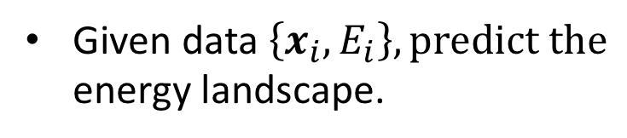
Kernel Regression
Given data $\left\{x_{i}, E_{i}\right\}, predict the$
energy landscape.

Slide 20
Kernel Regression
Given data $\left\{x_{i}, E_{i}\right\}, predict the$
energy landscape.

Slide 21
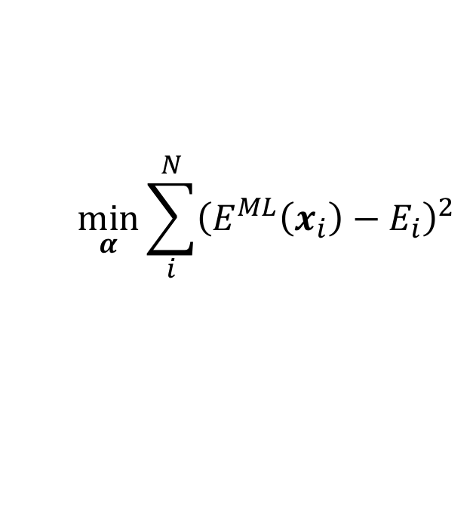
Kernel Regression
Given data $\left\{x_{i}, E_{i}\right\}, predict the$
energy landscape.
$$\min_{α}{\sum_{i}^{N}{{\left(E^{ML}\left(x_{i}\right)−E_{i}\right)}^{2}}}$$

Slide 22
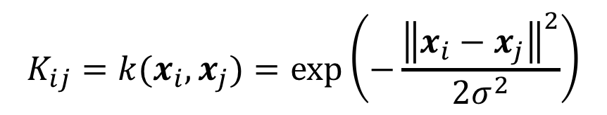
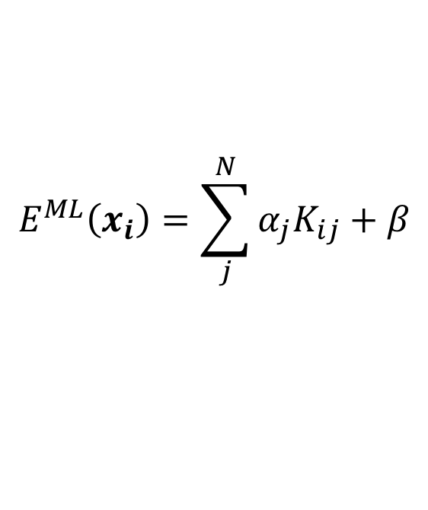
Kernel Regression
Given data $\left\{x_{i}, E_{i}\right\}, predict the$
energy landscape.
$$\min_{α}{\sum_{i}^{N}{{\left(E^{ML}\left(x_{i}\right)−E_{i}\right)}^{2}}}$$
$$E^{ML}\left(x_{i}\right)=\sum_{j}^{N}{α_{j}K_{ij}+β}$$
$$K_{ij}=k(x_{i},x_{j})=\exp\left(−\frac{{\left\|x_{i}−x_{j}\right\|}^{2}}{2σ^{2}}\right)$$

Slide 23
Kernel Regression
Given data $\left\{x_{i}, E_{i}\right\}, predict the$
energy landscape.
$$\min_{α}{\sum_{i}^{N}{{\left(E^{ML}\left(x_{i}\right)−E_{i}\right)}^{2}}}$$
$$E^{ML}\left(x_{i}\right)=\sum_{j}^{N}{α_{j}K_{ij}+β}$$
$$K_{ij}=k(x_{i},x_{j})=\exp\left(−\frac{{\left\|x_{i}−x_{j}\right\|}^{2}}{2σ^{2}}\right)$$

Slide 24
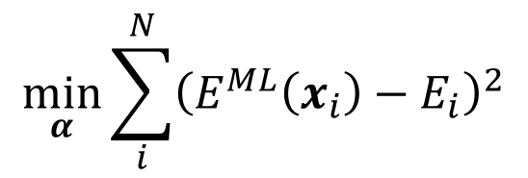
Kernel Regression
Given data $\left\{x_{i}, E_{i}\right\}, predict the$
energy landscape.
$$\min_{α}{\sum_{i}^{N}{{\left(E^{ML}\left(x_{i}\right)−E_{i}\right)}^{2}}}$$
$$E^{ML}\left(x_{i}\right)=\sum_{j}^{N}{α_{j}K_{ij}+β}$$
$$K_{ij}=k(x_{i},x_{j})=\exp\left(−\frac{{\left\|x_{i}−x_{j}\right\|}^{2}}{2σ^{2}}\right)$$

Slide 25
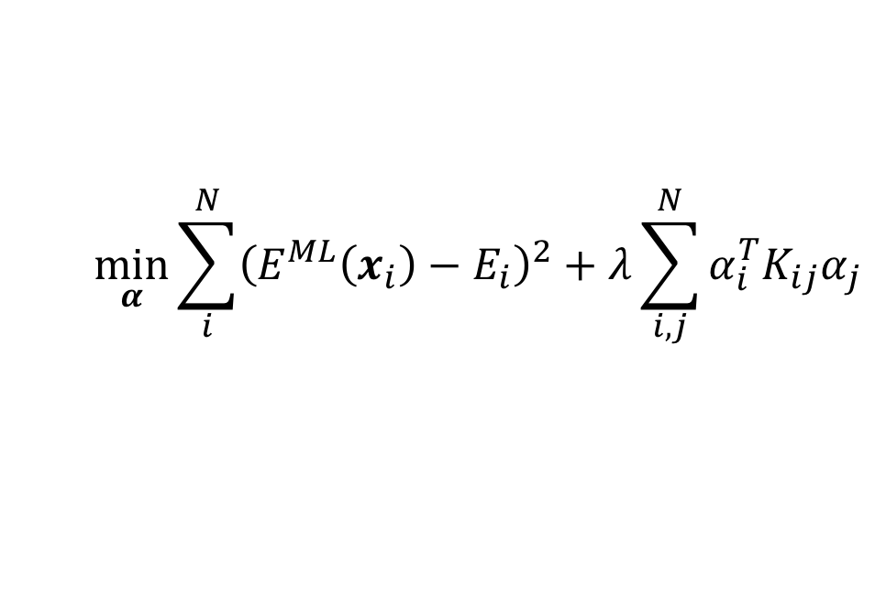
Kernel Ridge Regression
Given data $\left\{x_{i}, E_{i}\right\}, predict the$
energy landscape.
$$\min_{α}{\sum_{i}^{N}{{\left(E^{ML}\left(x_{i}\right)−E_{i}\right)}^{2}+λ}\sum_{i,j}^{N}{α_{i}^{T}K_{ij}α_{j}}}$$
$$E^{ML}\left(x_{i}\right)=\sum_{j}^{N}{α_{j}K_{ij}+β}$$
$$K_{ij}=k(x_{i},x_{j})=\exp\left(−\frac{{\left\|x_{i}−x_{j}\right\|}^{2}}{2σ^{2}}\right)$$

Slide 26
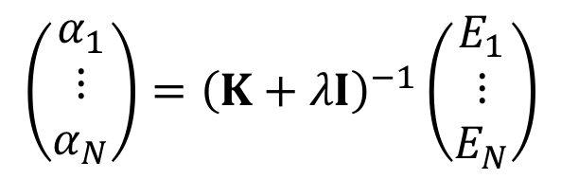
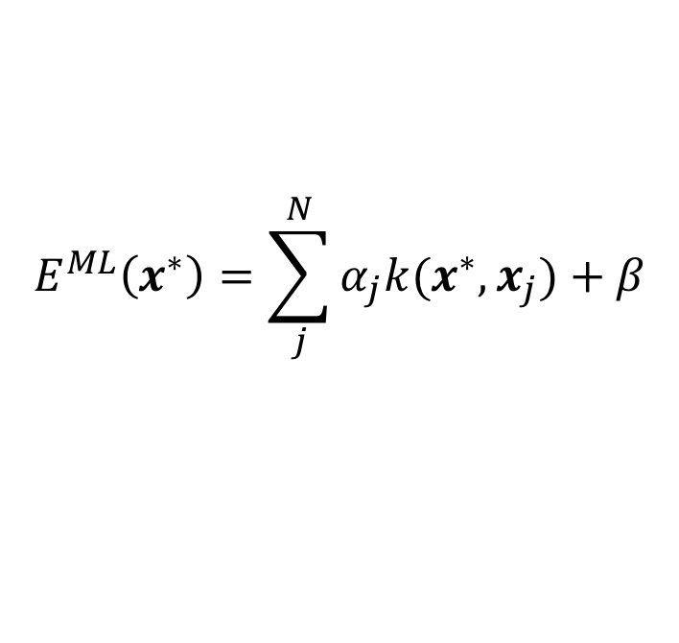
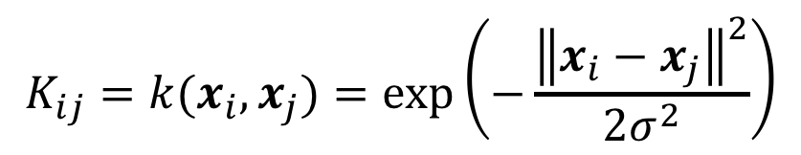
Kernel Ridge Regression
Fit/training:
$$\left(\begin{matrix}α_{1} \\ ⋮ \\ α_{N}\end{matrix}\right)={\left(K+λI\right)}^{−1}\left(\begin{matrix}E_{1} \\ ⋮ \\ E_{N}\end{matrix}\right)$$
Prediction:
$$E^{ML}\left(x^{∗}\right)=\sum_{j}^{N}{α_{j}k(x^{∗},x_{j})+β}$$
where
$$K_{ij}=k(x_{i},x_{j})=\exp\left(−\frac{{\left\|x_{i}−x_{j}\right\|}^{2}}{2σ^{2}}\right)$$

Slide 27
Kernel Ridge Regression
Fit/training:
$$\left(\begin{matrix}α_{1} \\ ⋮ \\ α_{N}\end{matrix}\right)={\left(K+λI\right)}^{−1}\left(\begin{matrix}E_{1} \\ ⋮ \\ E_{N}\end{matrix}\right)$$
Prediction:
$$E^{ML}\left(x^{∗}\right)=\sum_{j}^{N}{α_{j}k(x^{∗},x_{j})+β}$$
where
$$K_{ij}=k(x_{i},x_{j})=\exp\left(−\frac{{\left\|x_{i}−x_{j}\right\|}^{2}}{2σ^{2}}\right)$$

Slide 28
Kernel Ridge Regression
Fit/training:
$$\left(\begin{matrix}α_{1} \\ ⋮ \\ α_{N}\end{matrix}\right)={\left(K+λI\right)}^{−1}\left(\begin{matrix}E_{1} \\ ⋮ \\ E_{N}\end{matrix}\right)$$
Prediction:
$$E^{ML}\left(x^{∗}\right)=\sum_{j}^{N}{α_{j}k(x^{∗},x_{j})+β}$$
Prediction error:
from Gaussian process Regression

Slide 29
Simple example

Slide 30
Simple example

Slide 31
Simple example

Slide 32
Simple example

Slide 33
Simple example

Slide 34
Simple example

Slide 35
Simple example

Slide 36
Simple example

Slide 37
Simple example

Slide 38
Simple example

Slide 39

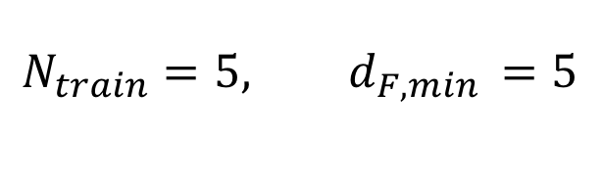
Larger structure – it still works
$$N_{train}=5, d_{F,min }=5$$
x1
4
3
$$d_{F}≈3$$
x2
1
2

Slide 40
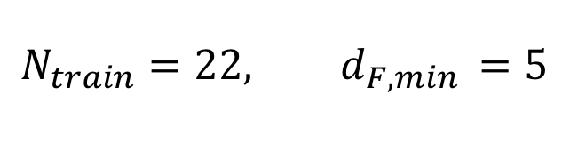
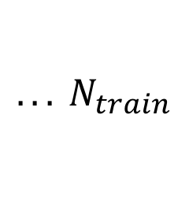
Larger structure – it still works
$$N_{train}=22, d_{F,min }=5$$
x1
4
3
$$d_{F}≈3$$
x2
1
2
$${. . . N}_{train}$$

Slide 41
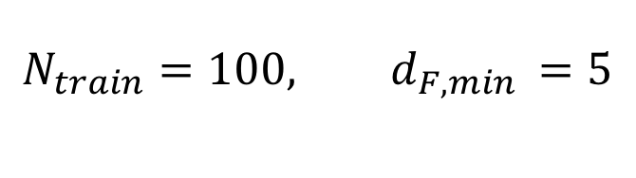
Larger structure – it still works
$$N_{train}=100, d_{F,min }=5$$
x1
4
3
$$d_{F}≈3$$
x2
1
2
$${. . . N}_{train}$$

Slide 42
Thanks!

