Slide 1




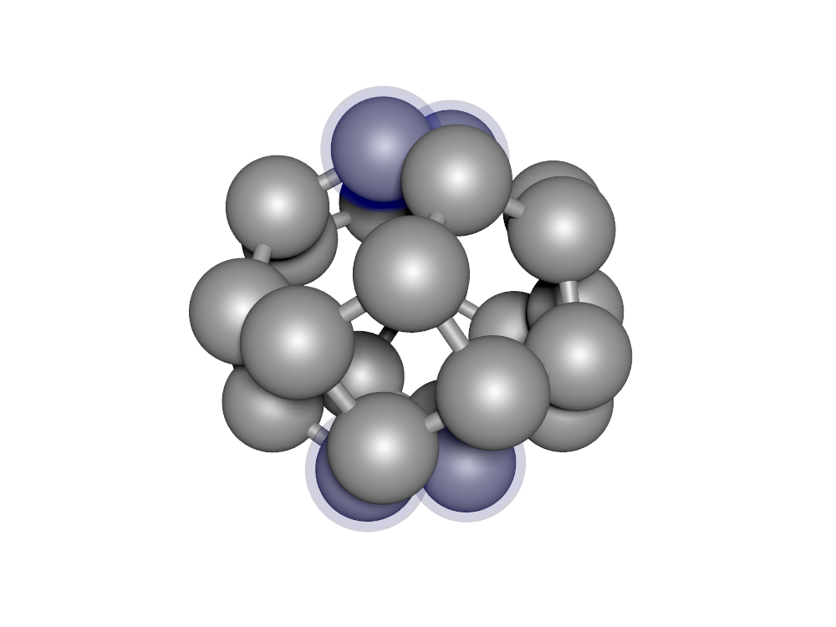
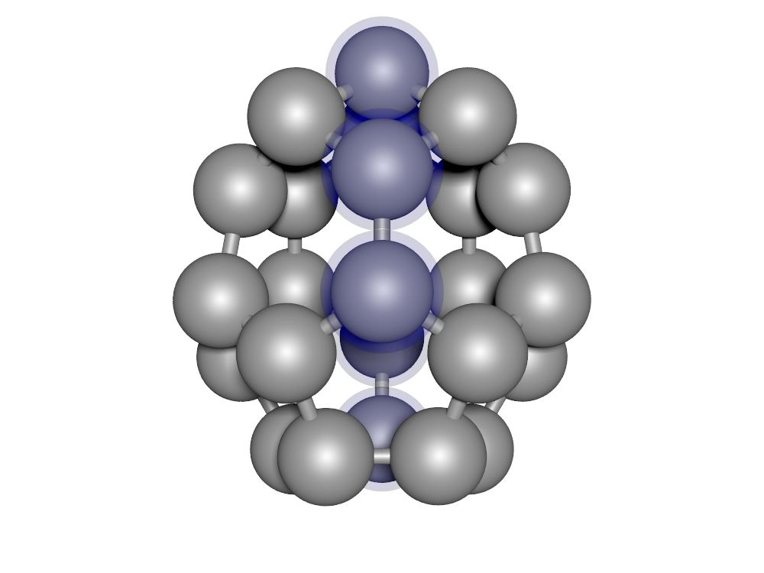
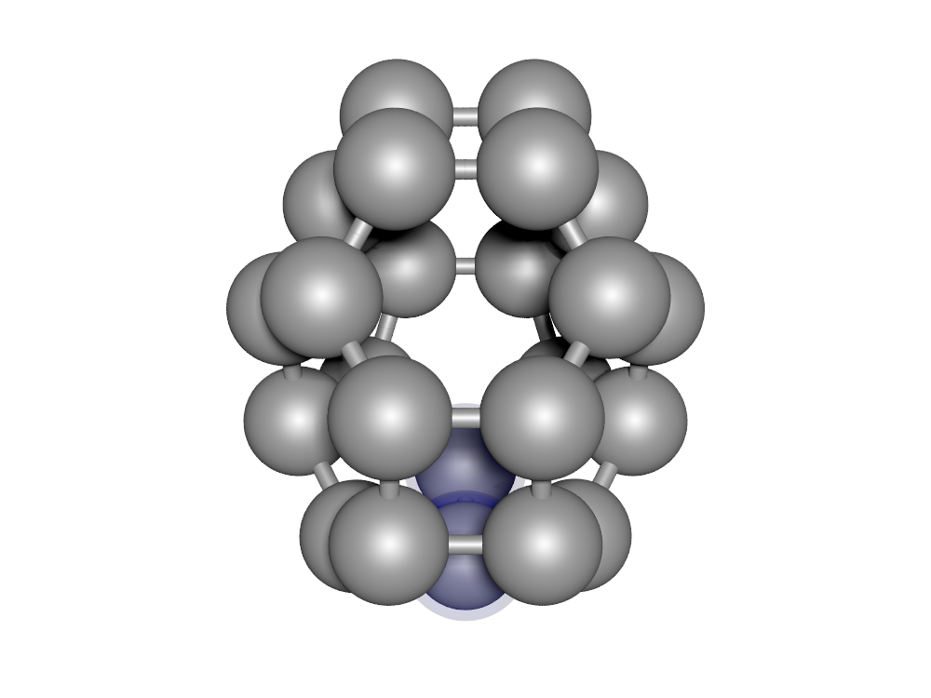
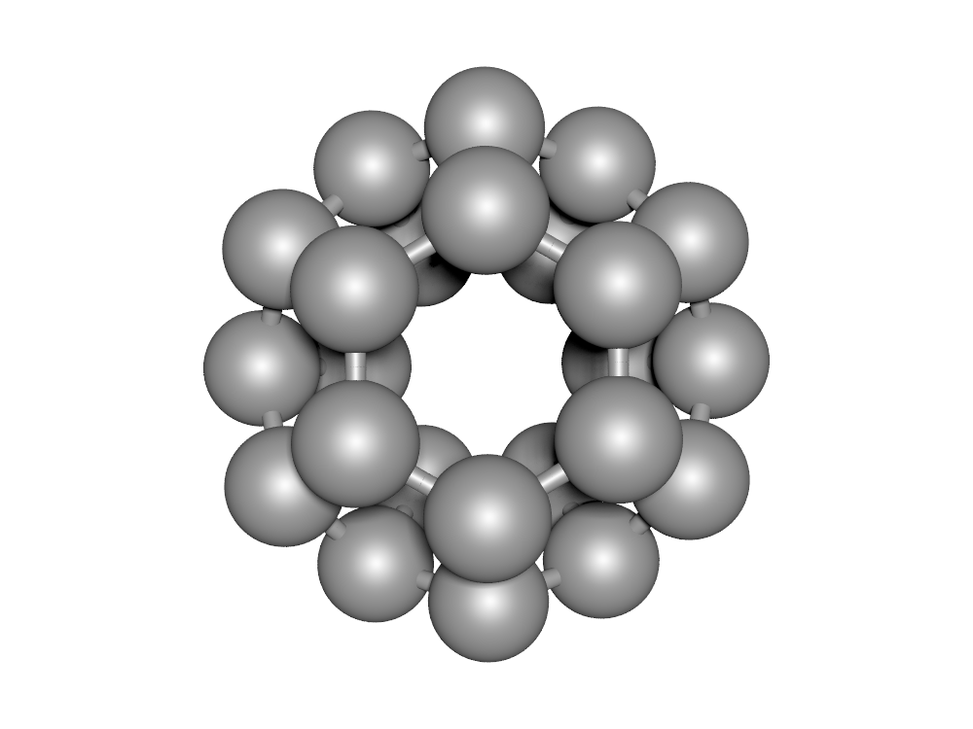




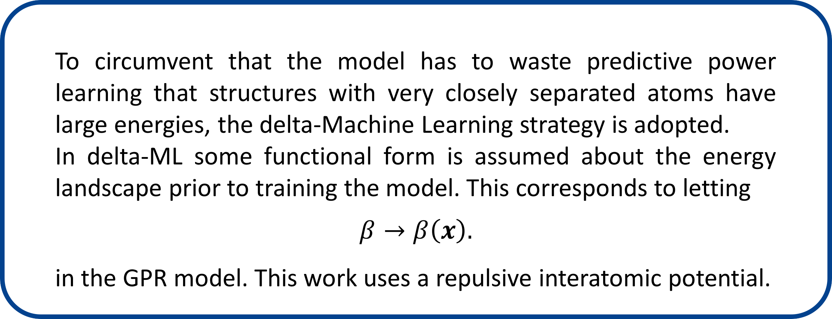
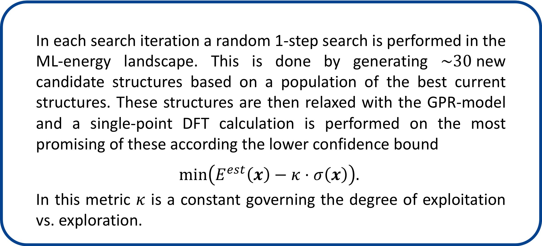







Machine Learning based structure search
Malthe K. Bisboª, Bjørk Hammerª
a Department of Physics and Astronomy, Aarhus University, Denmark
Motivation
Machine Learning (ML) model
The speed of a structure search is generally dominated by the number of expensive energy/force evaluations (ex. DFT) needed.
Typical search methods rely on local relaxation of a new structure in each of $m$ search iterations. Each relaxation requires on average $n$ DFT calculations, where $n$ could be $\sim 50$.
The present method circumvents local relaxation with DFT, by training a cheap model energy landscape on the fly during the search. Local relaxation is then performed using this cheap model.
As the machine learning model for predicting energies and forces, Gaussian Process regression is used. This method has the advantage of being fast to train for moderate sized training sets. Additionally it allows for an analytic estimate of the energy prediction error $σ\left(x\right)$. Model predictions are based on the energy of similar structures:
$$E^{est}\left(x\right)=\sum_{i}{α_{i}K\left(x,x_{i}\right)}+β, K\left(x,x_{i}\right)=exp\left[−\frac{1}{2σ^{2}}d\left(x,x_{i}\right)\right]$$
$$F^{est}\left(x\right)=∇E^{est}\left(x\right)$$
Local relaxations
ML guide single points
$$K\left(x,x_{i}\right)$$
Energy
VS.
$$β$$
$$σ(x)$$
$$2σ$$
$$x_{i}$$
ML-based structure search
Illustration of GPR model.
GPR prediction error.
The workflow of the method is most easily illustrated using a simple example. Consider therefore the following structure, which is constrained only to change according to the two coordinates x1 and x2.
This simple problem allows for a two-dimensional plot of the energy landscape.
As illustrated below, each search iteration consists of:
Train an ML-model of the energy, based on all current data.
Do an extended search in the ML-energy landscape, to find multiple local minima structures. Continue with most promising of these (based on lower confidence bound).
Do a single DFT calculation on the structure from step 2) and add it to the training data.
Delta-Machine Learning
To circumvent that the model has to waste predictive power learning that structures with very closely separated atoms have large energies, the delta-Machine Learning strategy is adopted.
In delta-ML some functional form is assumed about the energy landscape prior to training the model. This corresponds to letting
$$β→β\left(x\right).$$
in the GPR model. This work uses a repulsive interatomic potential.
x1
x2
Searching the ML potential
In each search iteration a random 1-step search is performed in the ML-energy landscape. This is done by generating $\sim 30$new candidate structures based on a population of the best current structures. These structures are then relaxed with the GPR-model and a single-point DFT calculation is performed on the most promising of these according the lower confidence bound
$$min\left(E^{est}\left(x\right)−κ⋅σ\left(x\right)\right).$$
In this metric $κ$ is a constant governing the degree of exploitation vs. exploration.
1
2
3
$${,E}_{1}$$
$${,E}_{2}$$
$${,E}_{3}$$
1
2
3
Initial
structures
Train model
Results
= Current
Training data
The method has been applied to C24 fullerenes. The success rates for 3x30 runs are shown below for the four geometries with lowest energy. The searches required $\sim 1000$search iteration/DFT calculations.
Consult DFT
Search ML potential
-190.11eV
-190.09eV
-189.94eV
-189.91eV
x
x
x
x
x
x

