Slide 2
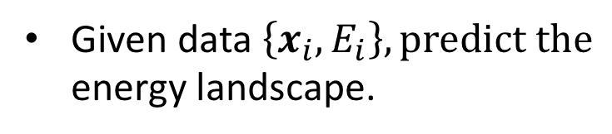
Kernel Regression
Given data $\left\{x_{i}, E_{i}\right\}, predict the$
energy landscape.

Slide 3
Kernel Regression
Given data $\left\{x_{i}, E_{i}\right\}, predict the$
energy landscape.

Slide 4
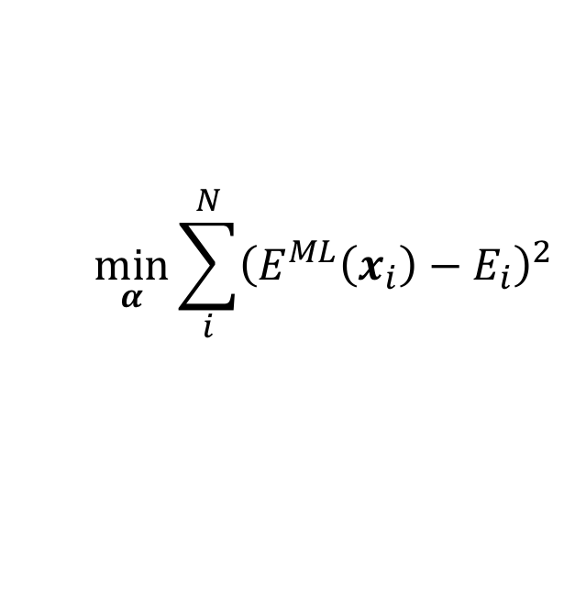
Kernel Regression
Given data $\left\{x_{i}, E_{i}\right\}, predict the$
energy landscape.
$$\min_{α}{\sum_{i}^{N}{{\left(E^{ML}\left(x_{i}\right)−E_{i}\right)}^{2}}}$$

Slide 5
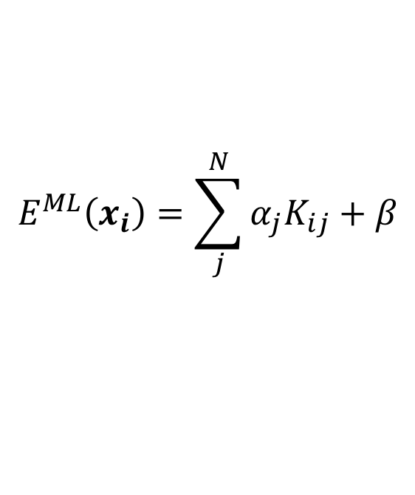
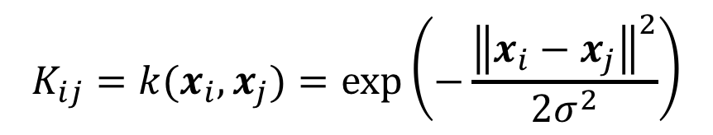
Kernel Regression
Given data $\left\{x_{i}, E_{i}\right\}, predict the$
energy landscape.
$$\min_{α}{\sum_{i}^{N}{{\left(E^{ML}\left(x_{i}\right)−E_{i}\right)}^{2}}}$$
$$E^{ML}\left(x_{i}\right)=\sum_{j}^{N}{α_{j}K_{ij}+β}$$
$$K_{ij}=k(x_{i},x_{j})=\exp\left(−\frac{{\left\|x_{i}−x_{j}\right\|}^{2}}{2σ^{2}}\right)$$

Slide 6
Kernel Regression
Given data $\left\{x_{i}, E_{i}\right\}, predict the$
energy landscape.
$$\min_{α}{\sum_{i}^{N}{{\left(E^{ML}\left(x_{i}\right)−E_{i}\right)}^{2}}}$$
$$E^{ML}\left(x_{i}\right)=\sum_{j}^{N}{α_{j}K_{ij}+β}$$
$$K_{ij}=k(x_{i},x_{j})=\exp\left(−\frac{{\left\|x_{i}−x_{j}\right\|}^{2}}{2σ^{2}}\right)$$

Slide 7
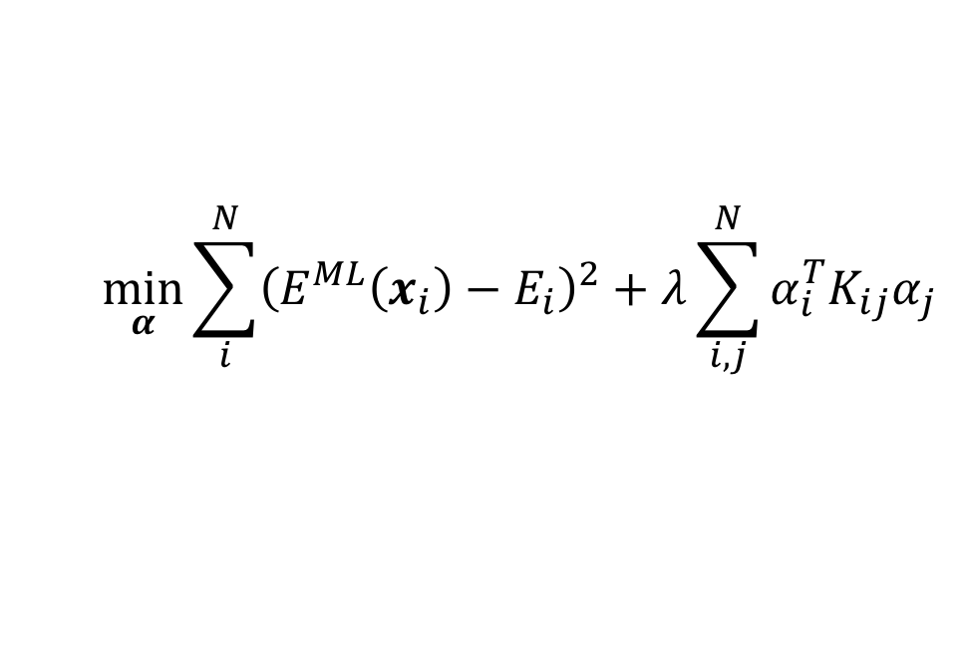
Kernel Ridge Regression
Given data $\left\{x_{i}, E_{i}\right\}, predict the$
energy landscape.
$$\min_{α}{\sum_{i}^{N}{{\left(E^{ML}\left(x_{i}\right)−E_{i}\right)}^{2}+λ}\sum_{i,j}^{N}{α_{i}^{T}K_{ij}α_{j}}}$$
$$E^{ML}\left(x_{i}\right)=\sum_{j}^{N}{α_{j}K_{ij}+β}$$
$$K_{ij}=k(x_{i},x_{j})=\exp\left(−\frac{{\left\|x_{i}−x_{j}\right\|}^{2}}{2σ^{2}}\right)$$

Slide 8
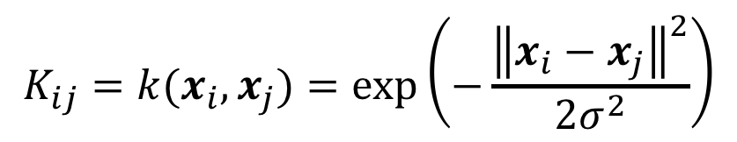
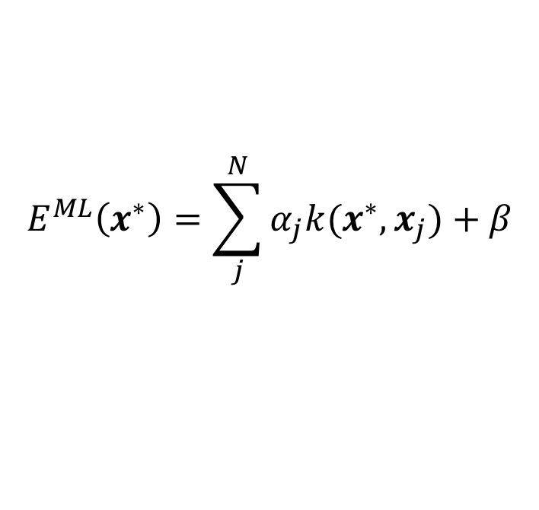
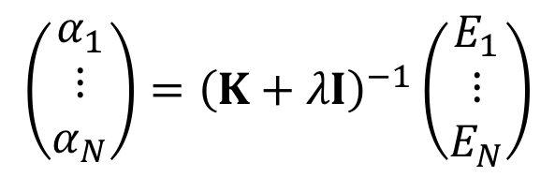
Kernel Ridge Regression
Fit/training:
$$\left(\begin{matrix}α_{1} \\ ⋮ \\ α_{N}\end{matrix}\right)={\left(K+λI\right)}^{−1}\left(\begin{matrix}E_{1} \\ ⋮ \\ E_{N}\end{matrix}\right)$$
Prediction:
$$E^{ML}\left(x^{∗}\right)=\sum_{j}^{N}{α_{j}k(x^{∗},x_{j})+β}$$
where
$$K_{ij}=k(x_{i},x_{j})=\exp\left(−\frac{{\left\|x_{i}−x_{j}\right\|}^{2}}{2σ^{2}}\right)$$

Slide 9
Kernel Ridge Regression
Fit/training:
$$\left(\begin{matrix}α_{1} \\ ⋮ \\ α_{N}\end{matrix}\right)={\left(K+λI\right)}^{−1}\left(\begin{matrix}E_{1} \\ ⋮ \\ E_{N}\end{matrix}\right)$$
Prediction:
$$E^{ML}\left(x^{∗}\right)=\sum_{j}^{N}{α_{j}k(x^{∗},x_{j})+β}$$
where
$$K_{ij}=k(x_{i},x_{j})=\exp\left(−\frac{{\left\|x_{i}−x_{j}\right\|}^{2}}{2σ^{2}}\right)$$

Slide 10
Kernel Ridge Regression
Fit/training:
$$\left(\begin{matrix}α_{1} \\ ⋮ \\ α_{N}\end{matrix}\right)={\left(K+λI\right)}^{−1}\left(\begin{matrix}E_{1} \\ ⋮ \\ E_{N}\end{matrix}\right)$$
Prediction:
$$E^{ML}\left(x^{∗}\right)=\sum_{j}^{N}{α_{j}k(x^{∗},x_{j})+β}$$
Prediction error:
from Gaussian process Regression

