Slide 1
Gaussian process regression for geometry optimization
https://aip.scitation.org/doi/abs/10.1063/1.5017103

Slide 2
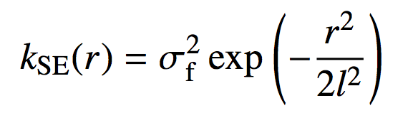
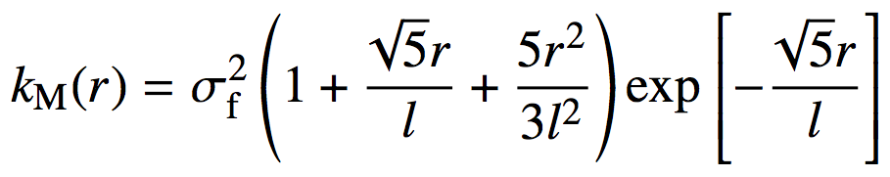
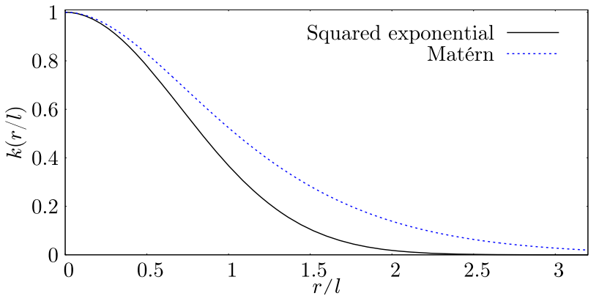
Alternative kernels
Gaussian:
(Infinitely differentiable)
Mercer:
(Two times differentiable)
The gaussian kernel is liable to
because of the constraint on the
smoothness

Slide 3
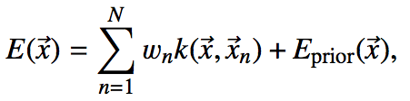
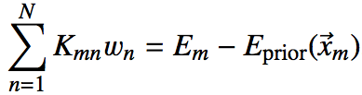

Energy-only KRR/GPR
Prediction:
Training:
where

Slide 4
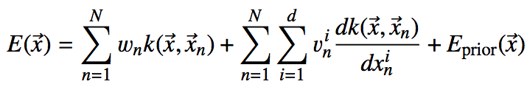
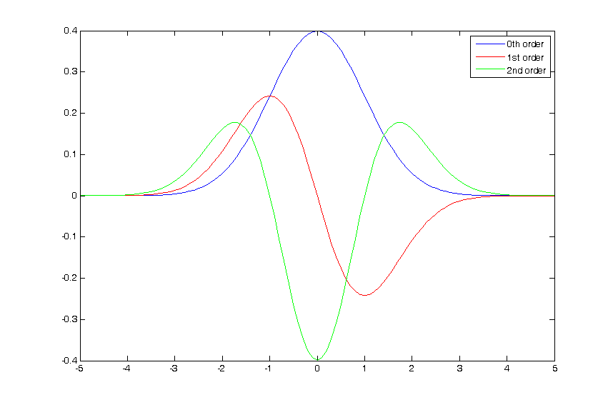
Energy+Force trained KRR/GPR
Energy prediction:
Gaussian + derivatives

Slide 5
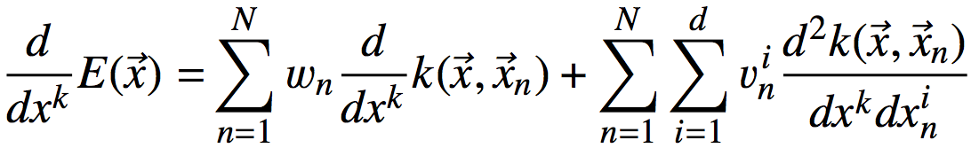
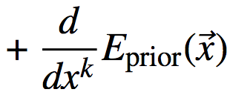
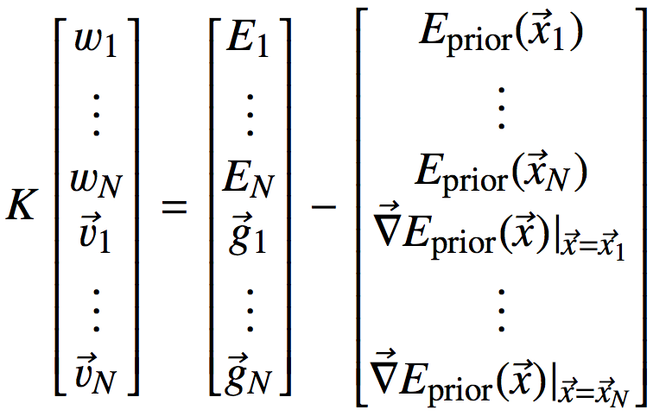
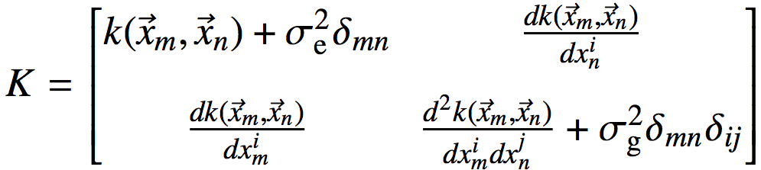
Energy+Force trained KRR/GPR
Energy prediction:
Force prediction:
Training:
, where

Slide 6
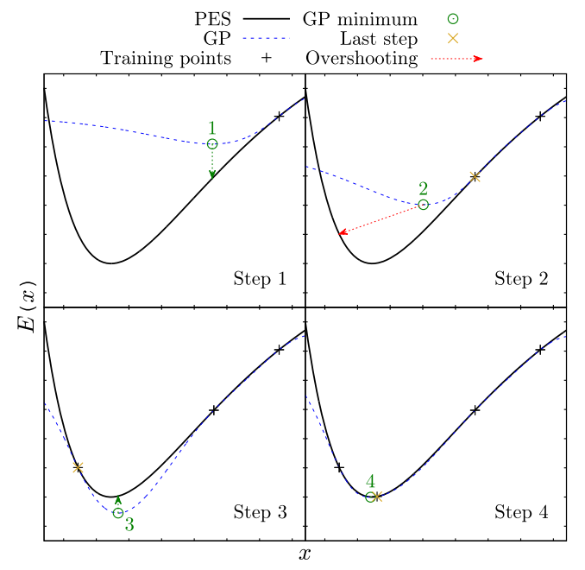
Tactical overshooting
- To adapt to the fact that the model is better at interpolating than extrapolating

