Slide 1
Simple problem
x1
x2

Slide 2
Simple problem
Training data:
1)
x1
x2

Slide 3
Simple problem
Training data:
1)
2)
x1
x2

Slide 4
Simple problem
Training data:
1)
2)
3)
x1
x2

Slide 5
Simple problem
Training data:
1)
2)
3)
4)
x1
x2

Slide 6
Simple problem
Training data:
1)
2)
3)
4)
5)
x1
x2

Slide 7
Simple problem
Training data:
1)
2)
3)
4)
5)
Global minimum

Slide 8


Larger problems
x1
4
3
$$d_{F}≈3$$
x2
1
2

Slide 9

Larger problems
$$N_{train}=5, d_{F,min }=5$$
x1
4
3
$$d_{F}≈3$$
x2
1
2

Slide 10
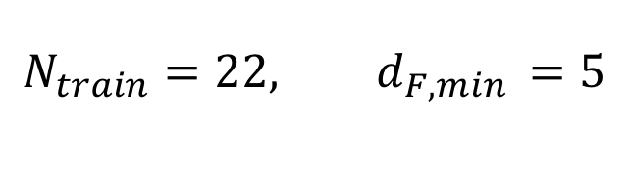
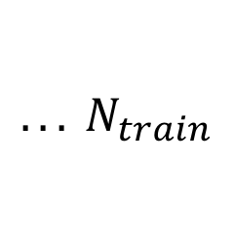
Larger problems
$$N_{train}=22, d_{F,min }=5$$
x1
4
3
$$d_{F}≈3$$
x2
1
2
$${. . . N}_{train}$$

Slide 11
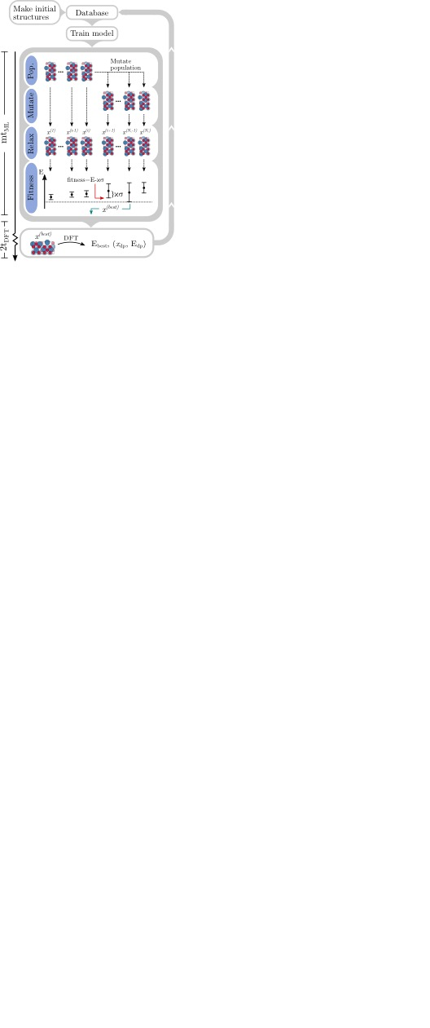
Method

Slide 12
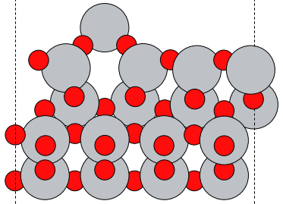
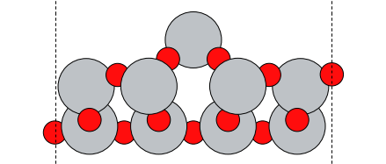
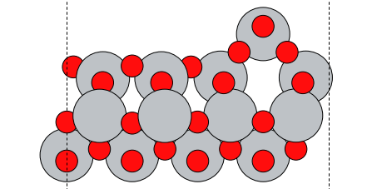
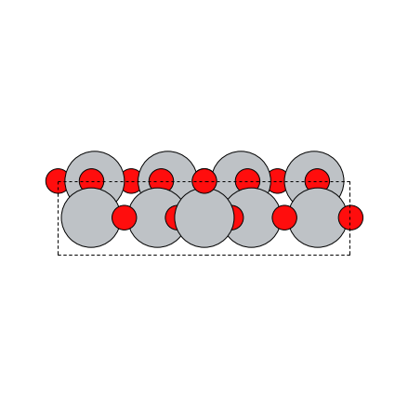
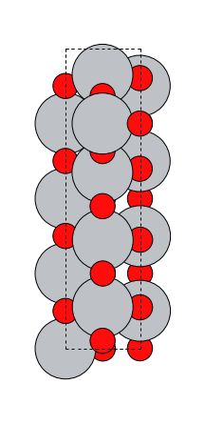
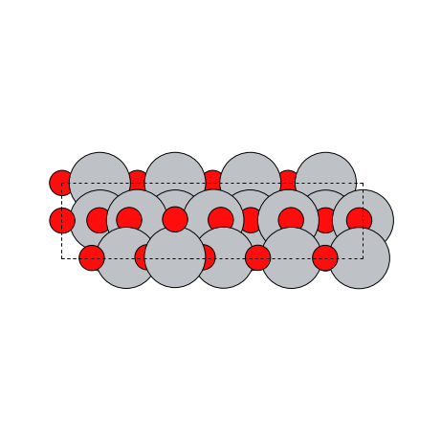
TiO₂(001)
Side:
Fixed
Top:

Slide 13
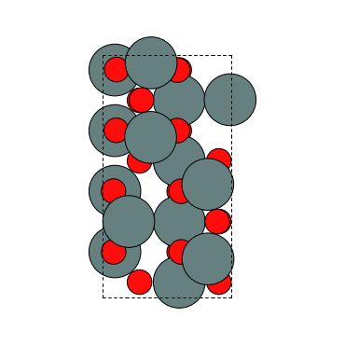
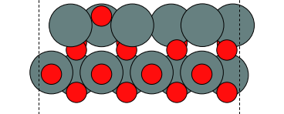

SnO₂(110)
Top:
Side:
Fixed
Fitness
$$f=E^{ML}−κσ^{ML}$$

Slide 14



SnO₂(110) - PCA
$$κ=0.5$$
$$κ=2$$
$$κ=8$$
Search
iteration:
Energy:

Slide 15
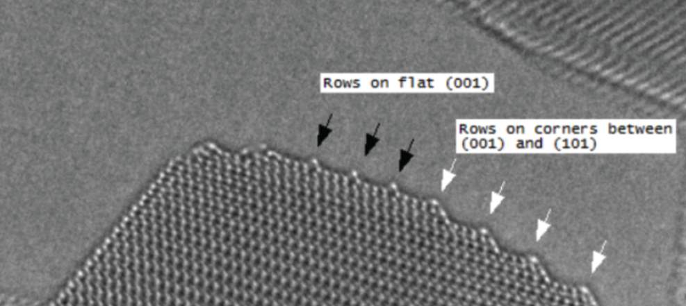
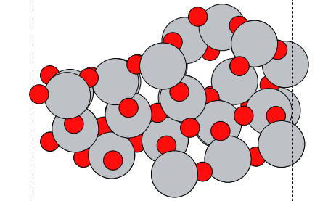
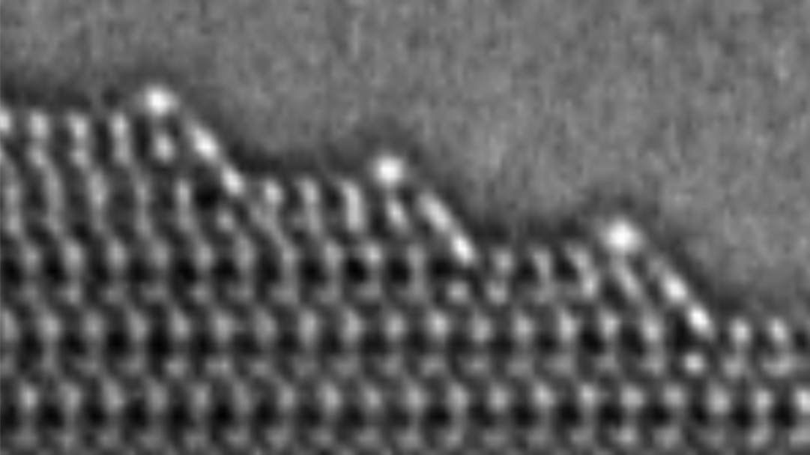
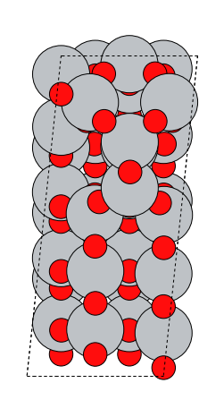
TiO₂ double step
Side:
Top:

