Slide 1
Basin hopping with KRR-relaxation
Global search method
Relationship between target potential
and machine learning potential

Slide 2
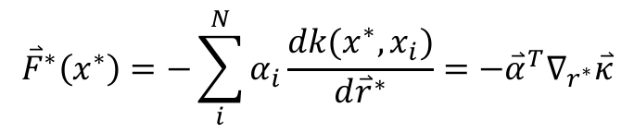

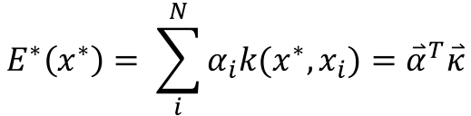
Kernel Ridge Regression
Prediction:
$$E^{∗}\left(x^{∗}\right)= \sum_{i}^{N}{α_{i}k(x^{∗},x_{i})={\overset{⃑}{α}}^{T}\overset{⃑}{κ}}$$
$${\overset{⃑}{F}}^{∗}\left(x^{∗}\right)=−\sum_{i}^{N}{α_{i}\frac{dk(x^{∗},x_{i})}{d{\overset{⃑}{r}}^{∗}}={−\overset{⃑}{α}}^{T}∇_{r^{∗}}\overset{⃑}{κ}}$$
Training:
$$\overset{⃑}{α}={\left(K+λI\right)}^{−1}\overset{⃑}{E}$$
Where $k\left(∙,∙\right)$ is the kernel function and $K_{ij}=k(x_{i},x_{j})$

Slide 3
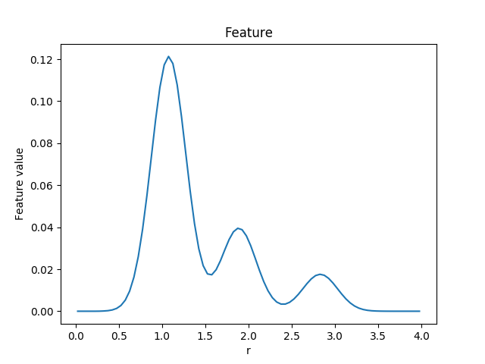

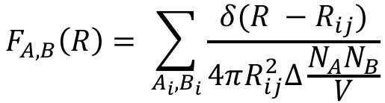
Feature
Organov and Valle:
Example
$$F_{A,B}\left(R\right)= \sum_{A_{i},B_{i}}{\frac{δ(R −R_{ij})}{4πR_{ij}^{2}Δ\frac{N_{A}N_{B}}{V}}}$$
+ angular equivalent

Slide 4
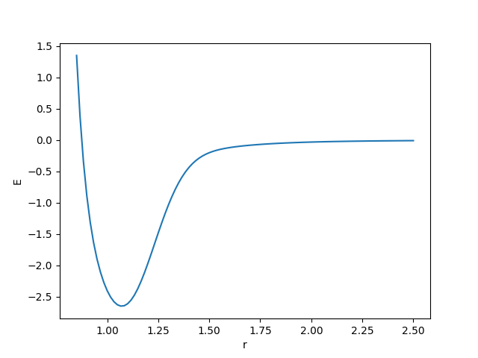
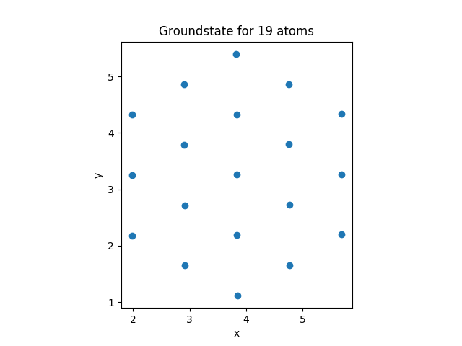
Model system – “Double” Lennard-Jones

Slide 5
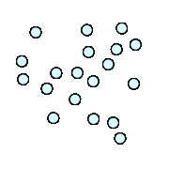
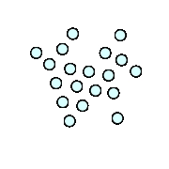
Global search example
Training:
4 Lennard-Jones relaxations
ML-relaxation:
First 2 relaxations

Slide 6
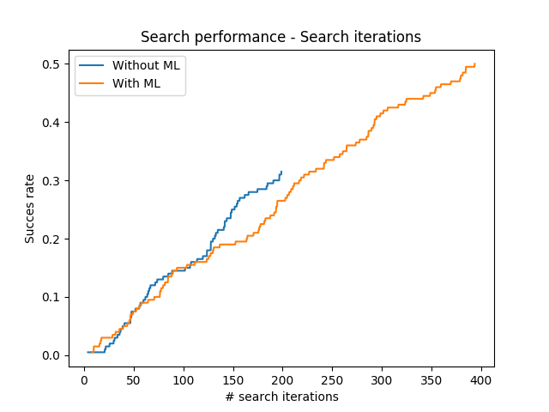
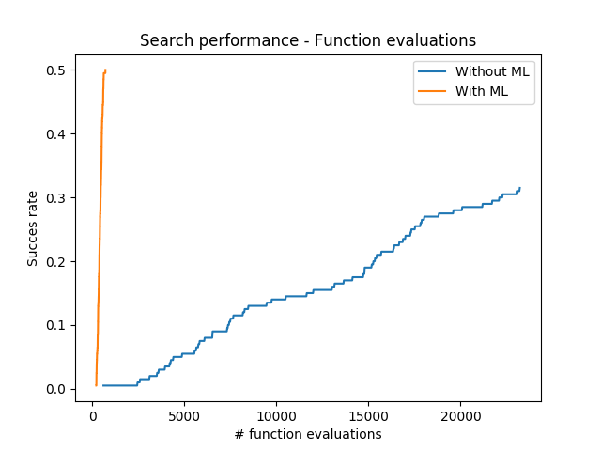
Search results
Average over 200 searches

Slide 7
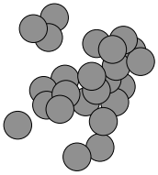
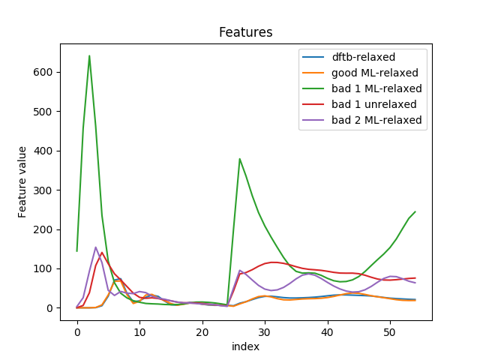
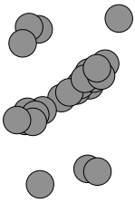
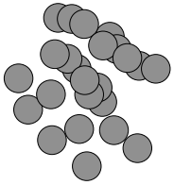
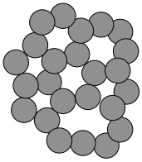
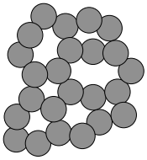
Bad 1 unrelaxed
C24 structures and features
Bad 1 ML-relaxed
Bad 2 ML-relaxed
Good ML-relaxed
Dftb-relaxed

Slide 8
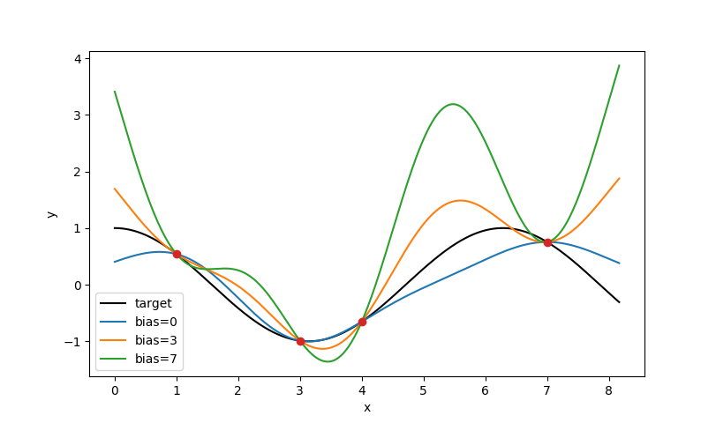
KRR bias

