Slide 1

Learning the potential energy surface
Malthe Kjær Bisbo
1/6-2018

Slide 2

Lets do a quiz
x1
4
3
$$d_{F}≈3$$
x2
1
2

Slide 3
Lets do a quiz
x1
4
3
$$d_{F}≈3$$
x2
1
2
How much data?

Slide 4
Describing atomic structures
Defined by atomic coordinates

Slide 5
Describing atomic structures
Defined by atomic coordinates
Problem!
This description is not invariant

Slide 6
Describing atomic structures
Defined by atomic coordinates
Problem!
This description is not invariant
Translation

Slide 7
Describing atomic structures
Defined by atomic coordinates
Problem!
This description is not invariant
Translation
Rotation

Slide 8
Describing atomic structures
Defined by atomic coordinates
Problem!
This description is not invariant
Translation
Rotation
Reflection

Slide 9
Describing atomic structures
Defined by atomic coordinates
Problem!
This description is not invariant
Translation
Rotation
Reflection
permutation

Slide 10

Descriptors
= Invariant descriptions

Slide 11


Descriptors
= Invariant descriptions
Simple solution: use interatomic distances
$$\{x_{1},x_{2},x_{3}, y_{1},y_{2},y_{3}\}$$
$$\{r_{12},r_{13},r_{23}\}$$

Slide 12

Descriptors
= Invariant descriptions
Simple solution: use interatomic distances
$$\{x_{1},x_{2},x_{3}, y_{1},y_{2},y_{3}\}$$
$$\{r_{12},r_{13},r_{23}\}$$
Translation
Rotation
Reflection

Slide 13
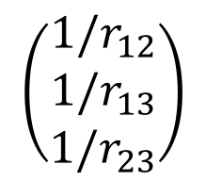
Descriptors
= Invariant descriptions
Simple solution: use interatomic distances
$$\{x_{1},x_{2},x_{3}, y_{1},y_{2},y_{3}\}$$
$$\{r_{12},r_{13},r_{23}\}$$
Translation
Rotation
Reflection
Example 1 – Bag of bonds
List
$$\left(\begin{matrix}1/r_{12} \\ 1/r_{13} \\ 1/r_{23}\end{matrix}\right)$$

Slide 14
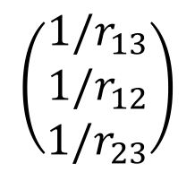
Descriptors
= Invariant descriptions
Simple solution: use interatomic distances
$$\{x_{1},x_{2},x_{3}, y_{1},y_{2},y_{3}\}$$
$$\{r_{12},r_{13},r_{23}\}$$
Translation
Rotation
Reflection
Example 1 – Bag of bonds
List
$$\left(\begin{matrix}1/r_{12} \\ 1/r_{13} \\ 1/r_{23}\end{matrix}\right)$$
Sort
$$\left(\begin{matrix}1/r_{13} \\ 1/r_{12} \\ 1/r_{23}\end{matrix}\right)$$
Permutation

Slide 15
Descriptors
= Invariant descriptions
Simple solution: use interatomic distances
$$\{x_{1},x_{2},x_{3}, y_{1},y_{2},y_{3}\}$$
$$\{r_{12},r_{13},r_{23}\}$$
Translation
Rotation
Reflection
For multiple
species
Example 1 – Bag of bonds
A-A
List
$$\left(\begin{matrix}1/r_{12} \\ 1/r_{13} \\ 1/r_{23}\end{matrix}\right)$$
Sort
$$\left(\begin{matrix}1/r_{13} \\ 1/r_{12} \\ 1/r_{23}\end{matrix}\right)$$
B-B
Permutation
A-B

Slide 16
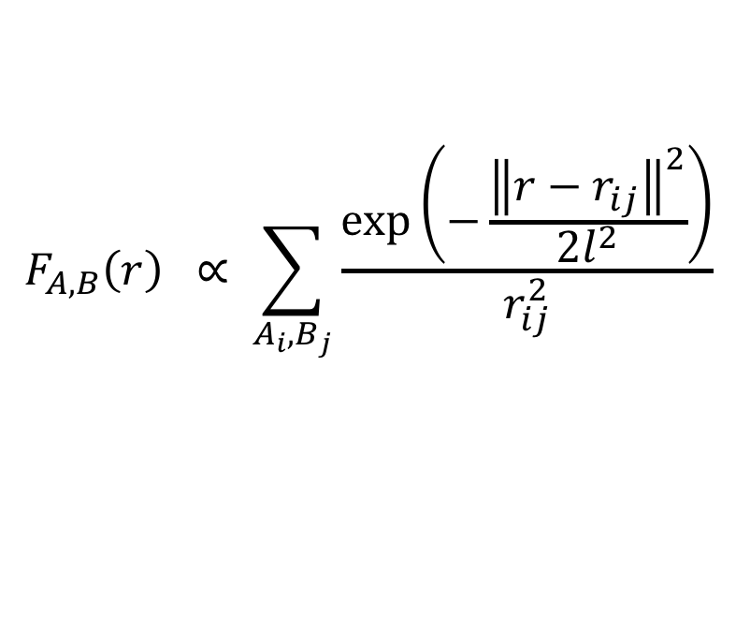
Features
Example 2 – Oganov and Valle
$$F_{A,B}\left(r\right) ∝ \sum_{A_{i},B_{j}}{\frac{\exp\left(−\frac{{\left\|r−r_{ij}\right\|}^{2}}{2l^{2}}\right)}{r_{ij}^{2}}}$$

Slide 17
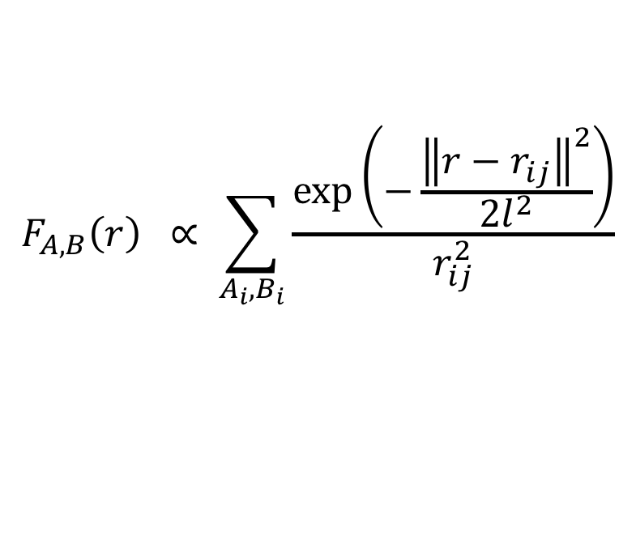

Features
Example 2 – Oganov and Valle
$$F_{A,B}\left(r\right) ∝ \sum_{A_{i},B_{i}}{\frac{\exp\left(−\frac{{\left\|r−r_{ij}\right\|}^{2}}{2l^{2}}\right)}{r_{ij}^{2}}}$$
Sum gaussians
$$r_{12}$$

Slide 18

Features
Example 2 – Oganov and Valle
$$F_{A,B}\left(r\right) ∝ \sum_{A_{i},B_{i}}{\frac{\exp\left(−\frac{{\left\|r−r_{ij}\right\|}^{2}}{2l^{2}}\right)}{r_{ij}^{2}}}$$
Sum gaussians
$$r_{13}$$
$$r_{12}$$

Slide 19

Features
Example 2 – Oganov and Valle
$$F_{A,B}\left(r\right) ∝ \sum_{A_{i},B_{i}}{\frac{\exp\left(−\frac{{\left\|r−r_{ij}\right\|}^{2}}{2l^{2}}\right)}{r_{ij}^{2}}}$$
Sum gaussians
$$r_{13}$$
$$r_{12}$$
$$r_{23}$$

Slide 20
Features
Example 2 – Oganov and Valle
$$F_{A,B}\left(r\right) ∝ \sum_{A_{i},B_{i}}{\frac{\exp\left(−\frac{{\left\|r−r_{ij}\right\|}^{2}}{2l^{2}}\right)}{r_{ij}^{2}}}$$
Sum gaussians

Slide 21
Features
Example 2 – Oganov and Valle
$$F_{A,B}\left(r\right) ∝ \sum_{A_{i},B_{i}}{\frac{\exp\left(−\frac{{\left\|r−r_{ij}\right\|}^{2}}{2l^{2}}\right)}{r_{ij}^{2}}}$$
Final feature
Sum gaussians
+ scale
Permutation

Slide 22
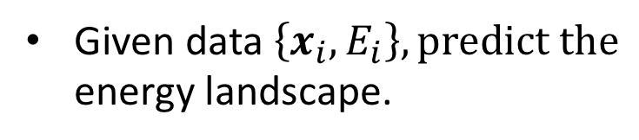
Kernel Regression
Given data $\left\{x_{i}, E_{i}\right\}, predict the$
energy landscape.

Slide 23
Kernel Regression
Given data $\left\{x_{i}, E_{i}\right\}, predict the$
energy landscape.

Slide 24
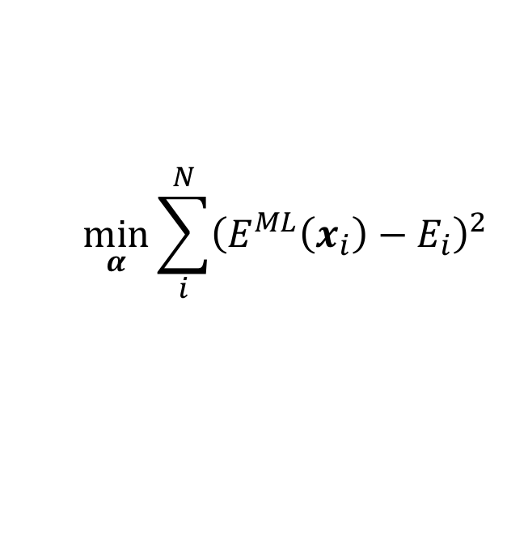
Kernel Regression
Given data $\left\{x_{i}, E_{i}\right\}, predict the$
energy landscape.
$$\min_{α}{\sum_{i}^{N}{{\left(E^{ML}\left(x_{i}\right)−E_{i}\right)}^{2}}}$$

Slide 25
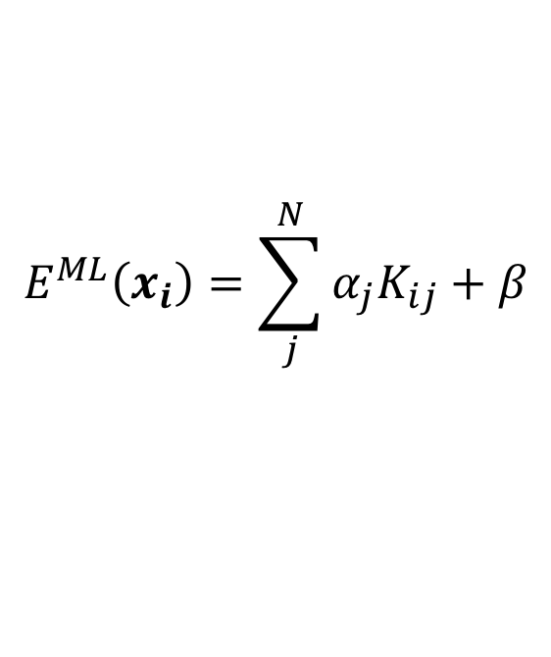
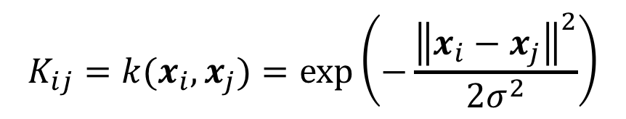
Kernel Regression
Given data $\left\{x_{i}, E_{i}\right\}, predict the$
energy landscape.
$$\min_{α}{\sum_{i}^{N}{{\left(E^{ML}\left(x_{i}\right)−E_{i}\right)}^{2}}}$$
$$E^{ML}\left(x_{i}\right)=\sum_{j}^{N}{α_{j}K_{ij}+β}$$
$$K_{ij}=k(x_{i},x_{j})=\exp\left(−\frac{{\left\|x_{i}−x_{j}\right\|}^{2}}{2σ^{2}}\right)$$
Kernel = similarity measure

Slide 26
Kernel Regression
Given data $\left\{x_{i}, E_{i}\right\}, predict the$
energy landscape.
$$\min_{α}{\sum_{i}^{N}{{\left(E^{ML}\left(x_{i}\right)−E_{i}\right)}^{2}}}$$
$$E^{ML}\left(x_{i}\right)=\sum_{j}^{N}{α_{j}K_{ij}+β}$$
$$K_{ij}=k(x_{i},x_{j})=\exp\left(−\frac{{\left\|x_{i}−x_{j}\right\|}^{2}}{2σ^{2}}\right)$$
Kernel = similarity measure

Slide 27
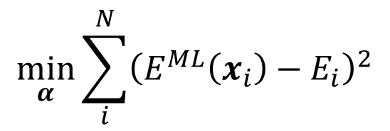
Kernel Regression
Given data $\left\{x_{i}, E_{i}\right\}, predict the$
energy landscape.
$$\min_{α}{\sum_{i}^{N}{{\left(E^{ML}\left(x_{i}\right)−E_{i}\right)}^{2}}}$$
$$E^{ML}\left(x_{i}\right)=\sum_{j}^{N}{α_{j}K_{ij}+β}$$
$$K_{ij}=k(x_{i},x_{j})=\exp\left(−\frac{{\left\|x_{i}−x_{j}\right\|}^{2}}{2σ^{2}}\right)$$

Slide 28
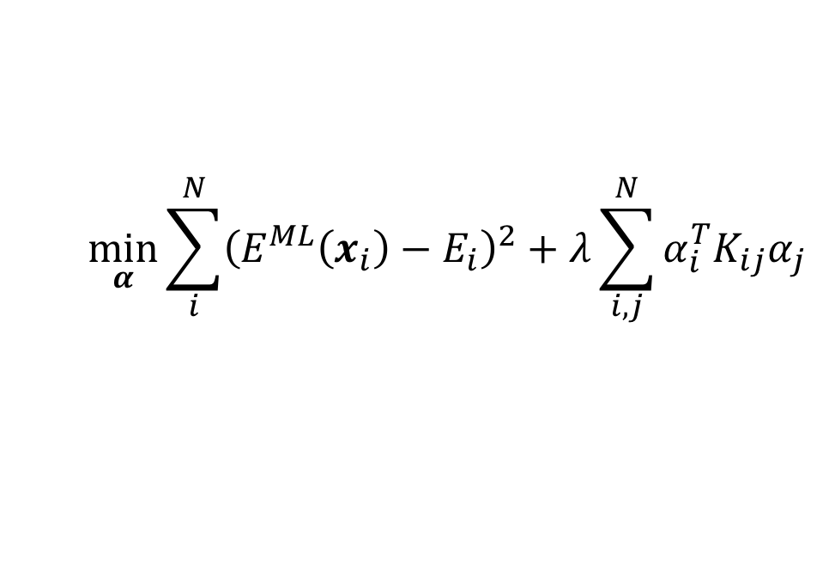
Kernel Ridge Regression
Given data $\left\{x_{i}, E_{i}\right\}, predict the$
energy landscape.
$$\min_{α}{\sum_{i}^{N}{{\left(E^{ML}\left(x_{i}\right)−E_{i}\right)}^{2}+λ}\sum_{i,j}^{N}{α_{i}^{T}K_{ij}α_{j}}}$$
$$E^{ML}\left(x_{i}\right)=\sum_{j}^{N}{α_{j}K_{ij}+β}$$
$$K_{ij}=k(x_{i},x_{j})=\exp\left(−\frac{{\left\|x_{i}−x_{j}\right\|}^{2}}{2σ^{2}}\right)$$

Slide 29
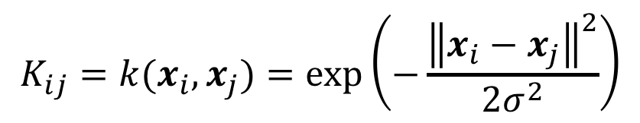
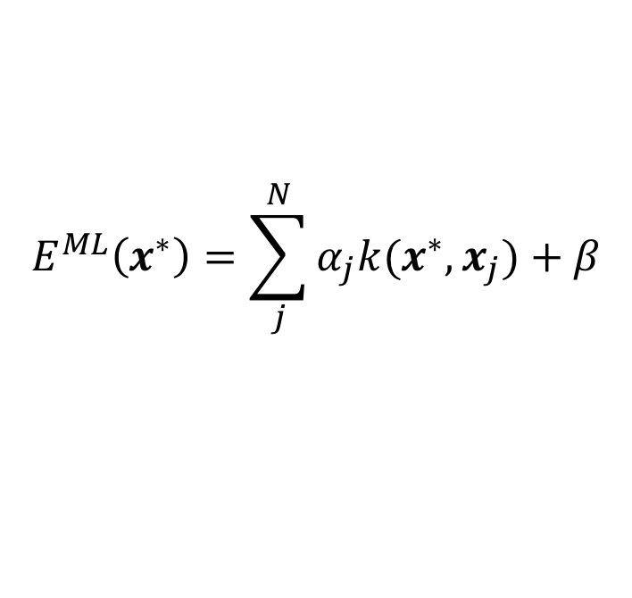
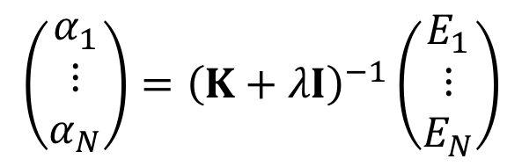
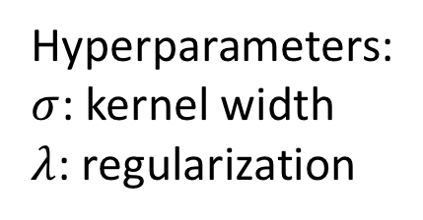
Kernel Ridge Regression
Fit/training:
$$\left(\begin{matrix}α_{1} \\ ⋮ \\ α_{N}\end{matrix}\right)={\left(K+λI\right)}^{−1}\left(\begin{matrix}E_{1} \\ ⋮ \\ E_{N}\end{matrix}\right)$$
Prediction:
$$E^{ML}\left(x^{∗}\right)=\sum_{j}^{N}{α_{j}k(x^{∗},x_{j})+β}$$
Hyperparameters:
$σ$: kernel width
$λ$: regularization
where
$$K_{ij}=k(x_{i},x_{j})=\exp\left(−\frac{{\left\|x_{i}−x_{j}\right\|}^{2}}{2σ^{2}}\right)$$

Slide 30
Kernel Ridge Regression
Fit/training:
$$\left(\begin{matrix}α_{1} \\ ⋮ \\ α_{N}\end{matrix}\right)={\left(K+λI\right)}^{−1}\left(\begin{matrix}E_{1} \\ ⋮ \\ E_{N}\end{matrix}\right)$$
Prediction:
$$E^{ML}\left(x^{∗}\right)=\sum_{j}^{N}{α_{j}k(x^{∗},x_{j})+β}$$
where
$$K_{ij}=k(x_{i},x_{j})=\exp\left(−\frac{{\left\|x_{i}−x_{j}\right\|}^{2}}{2σ^{2}}\right)$$

Slide 31
Kernel Ridge Regression
Fit/training:
$$\left(\begin{matrix}α_{1} \\ ⋮ \\ α_{N}\end{matrix}\right)={\left(K+λI\right)}^{−1}\left(\begin{matrix}E_{1} \\ ⋮ \\ E_{N}\end{matrix}\right)$$
Prediction:
$$E^{ML}\left(x^{∗}\right)=\sum_{j}^{N}{α_{j}k(x^{∗},x_{j})+β}$$
Prediction error:
from Gaussian process Regression

Slide 32
Simple example

Slide 33
Simple example

Slide 34
Simple example

Slide 35
Simple example

Slide 36
Simple example

Slide 37
Simple example

Slide 38
Simple example

Slide 39
Simple example

Slide 40
Simple example

Slide 41
Simple example

Slide 42
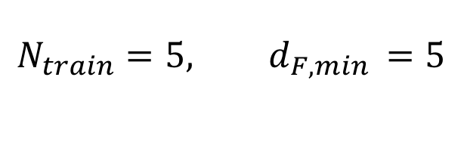
Larger structure – it still works
$$N_{train}=5, d_{F,min }=5$$
x1
4
3
$$d_{F}≈3$$
x2
1
2

Slide 43
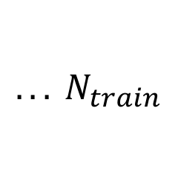
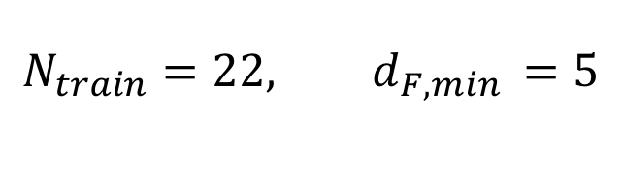
Larger structure – it still works
$$N_{train}=22, d_{F,min }=5$$
x1
4
3
$$d_{F}≈3$$
x2
1
2
$${. . . N}_{train}$$

Slide 44
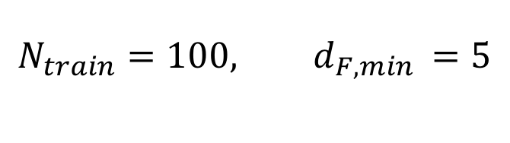
Larger structure – it still works
$$N_{train}=100, d_{F,min }=5$$
x1
4
3
$$d_{F}≈3$$
x2
1
2
$${. . . N}_{train}$$

Slide 45
Thanks!

