Slide 1

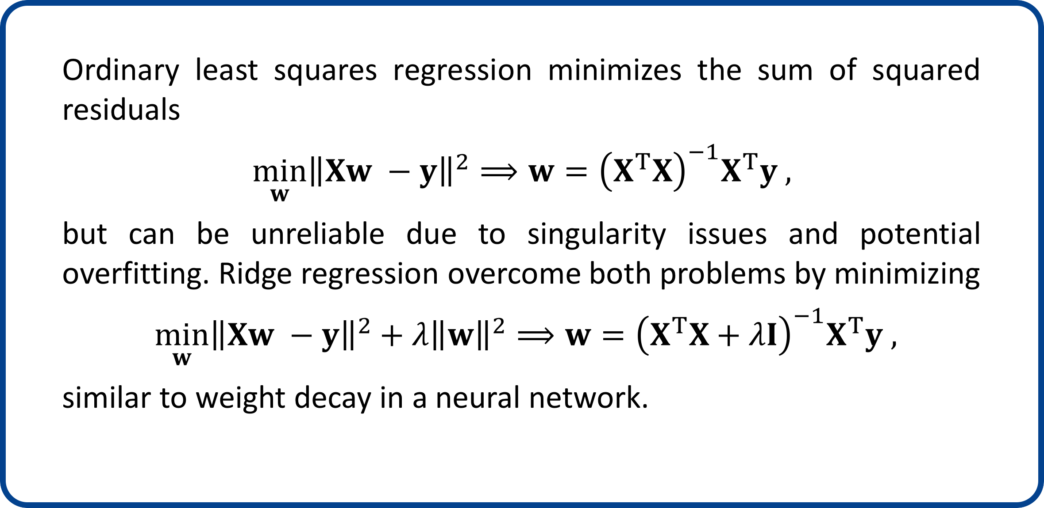
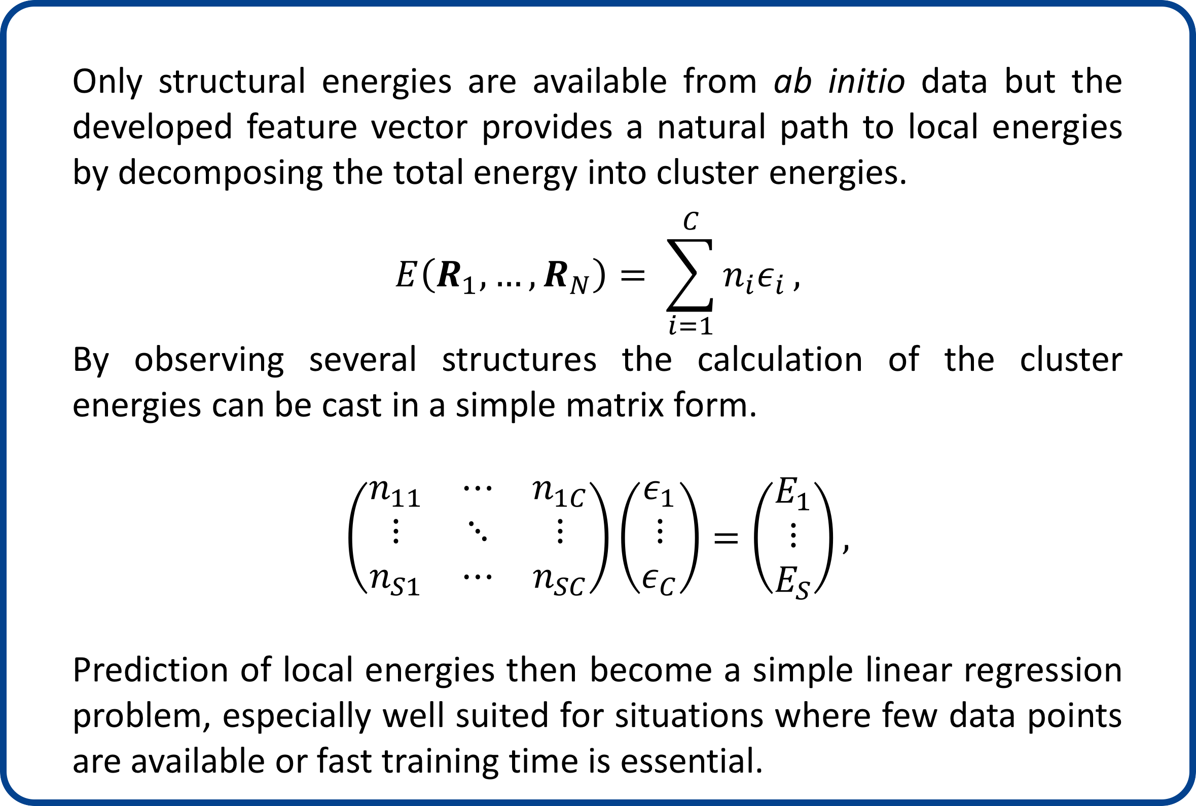
Local Energies From Ridge Regression
Søren A. Meldgaardª, Esben L. Kolsbjerg^{a,b}, Bjørk Hammer^{a,b}
a Department of Physics and Astronomy, Aarhus University, Denmark
b Interdisciplinary Nanoscience Center (iNANO), Aarhus University, Denmark
Introduction
Local Energies in a Structure Search
Due to the immense complexity of the chemical configuration space it is necessary to direct structural search algorithms towards promising areas. In order do achieve this we combine a clustering algorithm with ridge regression to predict the stability of local environments.
Due to the analytical solution of local energies a machine learning model can efficiently be fit on-the-fly to assist a global structure search. An example of local energies fit on-the-fly is seen below.
To investigate the usability of the local energies we adjust the rattle mutation in a Monte Carlo search to preferentially select atoms with high local energies.
Auto-bagging Feature Vector
Behler-Parrinello feature vectors describe the local environment using symmetry functions to facilitate rotational and translational invariance.
A global feature vector can be constructed by clustering the local feature vectors.
The global feature is simply a histogram of atoms in each cluster
$$F\left(f_{1}, …, f_{N}\right)=\left[n_{1}, …, n_{C}\right],$$
Real space Feature space
Feature space Real space
Stability
Clustering
ML
Reference
Local Energy Prediction
Only structural energies are available from ab initio data but the developed feature vector provides a natural path to local energies by decomposing the total energy into cluster energies.
$$E\left(R_{1}, …, R_{N}\right)= \sum_{i=1}^{C}{n_{i}ε_{i}},$$
By observing several structures the calculation of the cluster energies can be cast in a simple matrix form.
$$\left(\begin{matrix}n_{11} & ⋯ & n_{1C} \\ ⋮ & ⋱ & ⋮ \\ n_{S1} & ⋯ & n_{SC}\end{matrix}\right)\left(\begin{matrix}ε_{1} \\ ⋮ \\ ε_{C}\end{matrix}\right)=\left(\begin{matrix}E_{1} \\ ⋮ \\ E_{S}\end{matrix}\right),$$
Prediction of local energies then become a simple linear regression problem, especially well suited for situations where few data points are available or fast training time is essential.
Parallel Tempering
Parallel tempering is used
to prevent stagnation by
executing searches at
different temperatures
simultaneously.
The simulations then swap
temperature depending on
the energy of each search.
See: Earl and Deem,
PCCP 7, 3910 (2005)
Ridge Regression
Ordinary least squares regression minimizes the sum of squared residuals
$$\min_{w}{{\left\|Xw −y\right\|}^{2}}⟹w={\left(X^{T}X\right)}^{−1}X^{T}y ,$$
but can be unreliable due to singularity issues and potential overfitting. Ridge regression overcome both problems by minimizing
$\min_{w}{{\left\|Xw −y\right\|}^{2}+λ{\left\|w\right\|}^{2}}⟹w={\left(X^{T}X+λI\right)}^{−1}X^{T}y ,$
similar to weight decay in a neural network.
Conclusion
By clustering Behler-Parrinello feature vectors a simple global feature vector was built. Using ridge regression local energies were extracted from density functional theory data and used to accelerate a structure search.

