Slide 1
WorkBoard
GameDesign
Paillot Valentin
GD3
2020-2021

Slide 2
GunDev
GunClass
Damage
Fire rate
Impact force
Crit
d.o.t. ?
Ammo
In charger
In reserve
Reload
Time
Fire/sec
Brut – distance to range
Range
Min
max
_damage = Random ( 5 -> 10 )% life * ((100 – Armor) / 100)
If (target dist > min range) then rD = _d – ((dist/(rMax – rmin)) * _d)
Impact force ?
Crit = if(Rand < %critChance) then cD = cMult * _d
d.o.t. ? Bleed / Burn / Poison…
Fire/sec
In charger = ReserveMax/100 ?
In reserve
time
rmin
rMax
Paillot Valentin
GD3
2020-2021

Slide 3
Gravity
“2D gravity Positive and Negative”
“3D gravity P&N on 3 plans”
GravPoint
GravDir
Walkable
playerVector is custom on X and Y same as GravPoint
Gravity = dir(playerVector - GravPoint).normalized x GravDir x GravStrength
Gravity = dir(playerVector - GravPoint).normalized x GravDir x GravStrength
Paillot Valentin
GD3
2020-2021

Slide 4
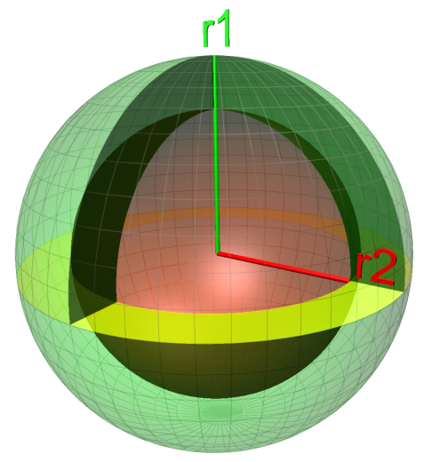
Gravity
DeadZone
Inner sphere example :
G -> r2 = velocity conservation = 0g area
r2 -> r1 = Artificial gravity zone
G
Paillot Valentin
GD3
2020-2021

