Slide 1
Claims System — Part 3: Updates & Key Features
PROG6212 — Visual walkthrough of implemented requirements
Khensani Maluleke
ST10451309

Slide 2

What you'll see
1. Summary of lecturer feedback & how I addressed it
2. Key features implemented (HR, Lecturer, Coordinator, Manager)
3. Design & UX decisions (screenshots placeholders)
4. Important code snippets & explanations (only key parts)
Notes:
Use this slide to orient the examiner. Keep it brief.

Slide 3
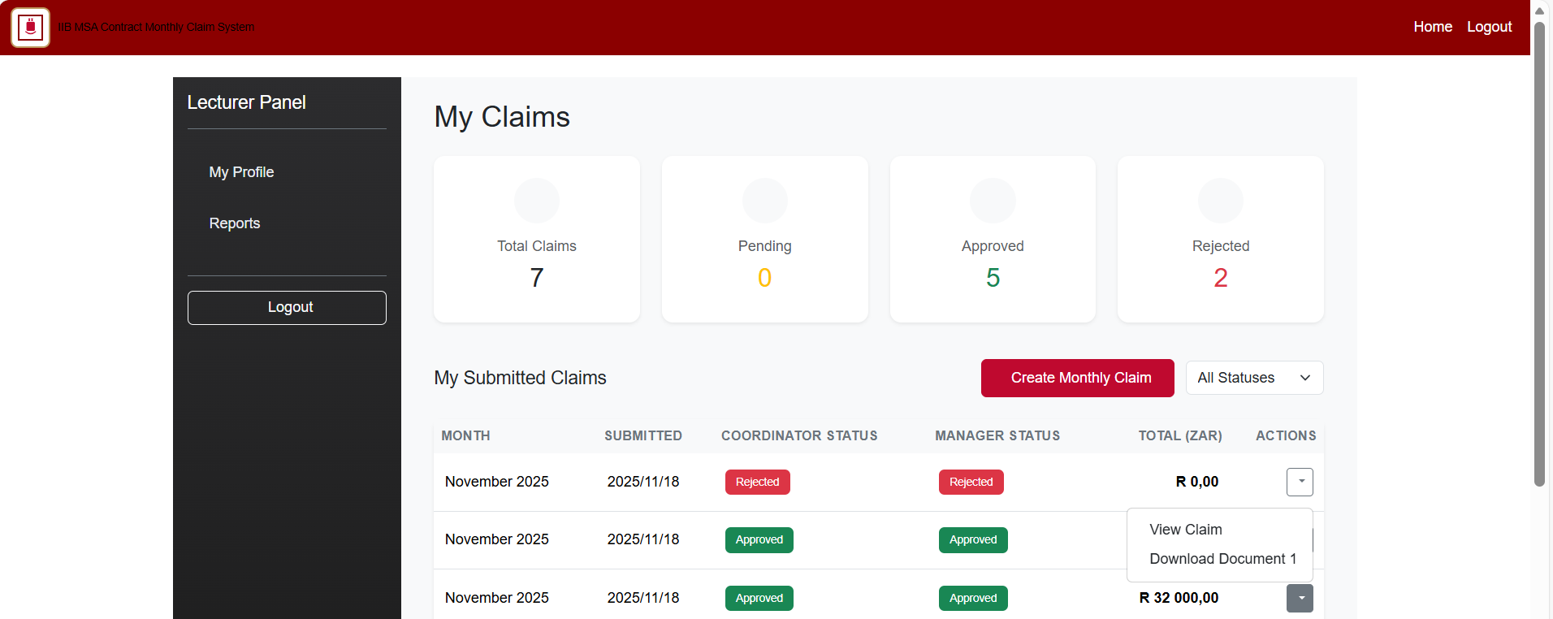
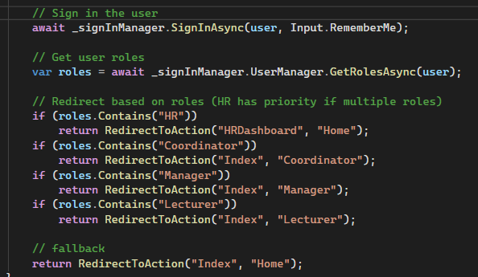
Updates from Lecturer Feedback — Make it more user friendly
Lecturer dashboard
Simplified forms and labels — fewer fields, clearer helpers
Prefill fields (name, surname, hourly rate) from HR data when lecturer logs in
Progress indicators for claim status (text label + progress bar placeholder)
Improved upload flow: file validation, size/type limits, and clearer error messages
Added sessions and role-based access to prevent unauthorized pages
My Lecturer Dashboard in part 2 lacked a navigation system- updated
Notes:
Explain briefly how each change improves usability.

Slide 4
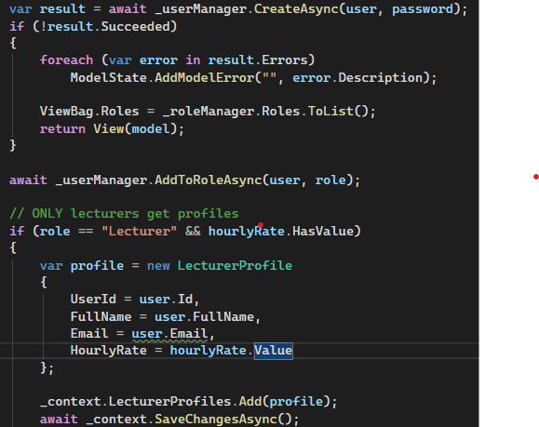
HR (Super User) — Key Capabilities
Create user profiles (name, surname, email, hourly rate, role)
  “await _userManager.AddToRoleAsync(user, role)”- added the newly created use to th NetRole table
  “_context.LecturerProfiles.Add(profile);”Only Lecturer users get added to the LecturerProfile table
Update any user information (edit form + audit-friendly fields)
Generate reports / invoices via LINQ queries; PDF export available
No public registration — HR provisions accounts and credentials
Notes:
Mention how HR is the single source of truth for lecturer rates.

Slide 5
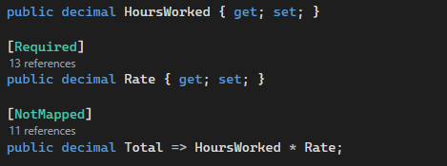
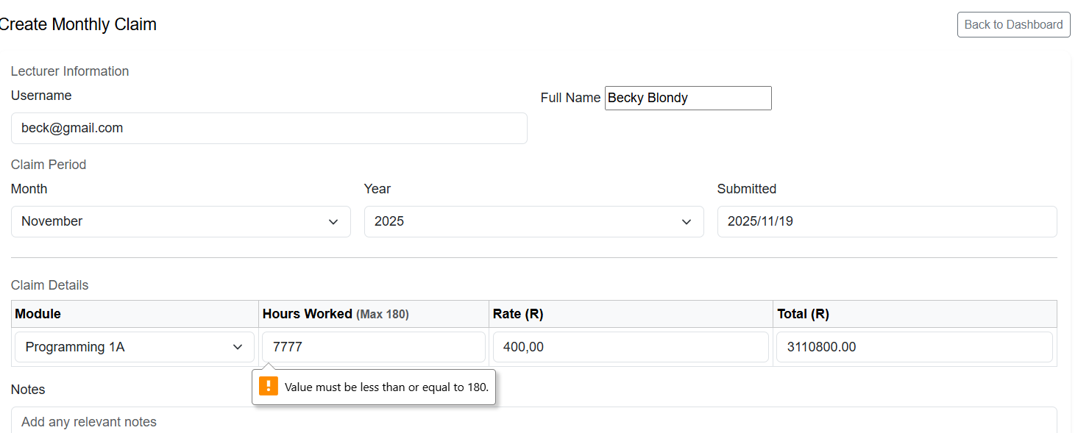
Lecturer View — Workflow & UX
Insured auto calculation
Login -> Lecturer dashboard lists claims and statuses
When submitting: name/surname/hourly rate auto-populated from HR data
Auto-calculation: Enter hours -> system computes payable amount (hours * rate)
Validation: reject unrealistic hours (e.g., > 180 per month) with friendly error messages
File upload tied to claim, limited types (.pdf, .docx, .xlsx) and size limit enforced
Claim form (Lecturer’s View )
Notes:
Point out how auto-fill + auto-calc reduces errors and speeds up claims.

Slide 6
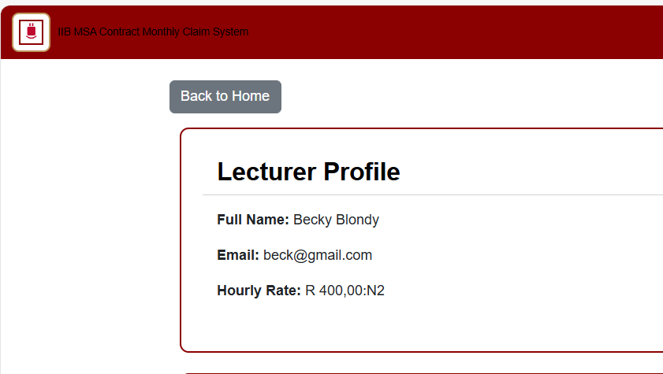
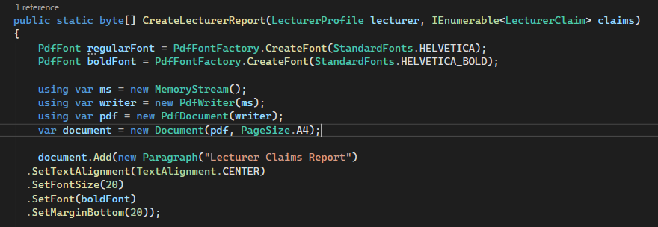
Lecturer Panel and claims
Panel includes:
  Lecturer Profile so view email, name and hourly Rate
  Report consist of a downloadable report of all claims summed up with a grand total.
    Used LINQ to create downloadable pdf, in result it create a auto generated report.
    I manually wrote to the pdf, and create a templet for when a Report is requested
List of all lecturer claims with status of both Manager and Coordinator
  Option to View claim, Delete claim
Method used to create pdf

Slide 7
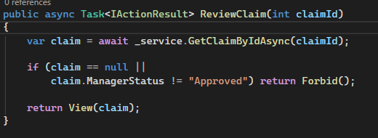
Programme Coordinator & Academic Manager (Admin Views)
Separate views for each admin with appropriate buttons:
Coordinator: Verify / Reject pending claims; view documents inline/download
Manager: Approve / Reject (final step); view claim history
Session usage ensures actions are tied to logged-in admin and role checks prevent unauthorized access
Forbids Coordinator from review rejected claims from Manager
Notes:
Explain the two-step approval flow and how state updates propagate to lecturer view.

Slide 8
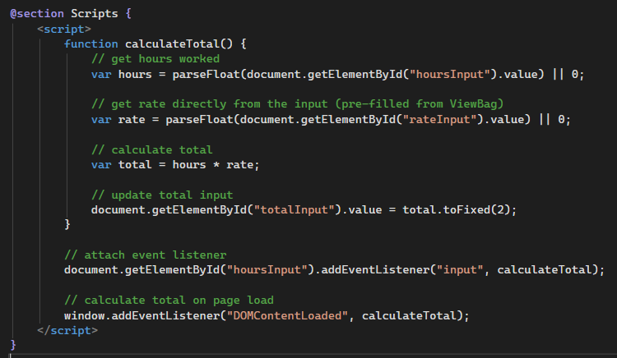
Key Implementation Snippets (high-level)
Prefill Lecturer data: Query user table in controller when building the claim form
Auto-calculation: client-side JS or server-side computation on POST to compute amount
Upload handling: form enctype, server validation, file size/type checks, store encrypted blob or filesystem
PDF reports: LINQ query to collect claim data - used PDF library to generate invoice/download
Notes:
On the live demo, show the controller method for prefill and the upload helper.

Slide 9
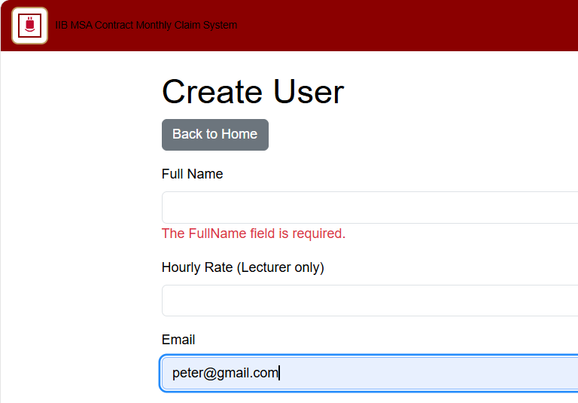
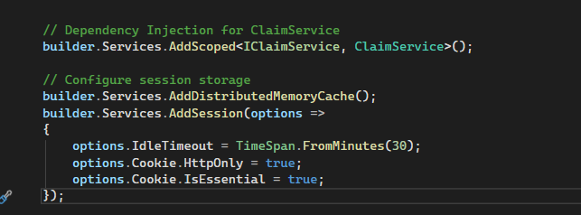
Validation, Error Handling & Security
Model validation attributes (Required, Range) for key fields
Session-based auth and role checks in controllers/filters
Error handling: user-friendly messages, TempData alerts, and logs for exceptions
Notes:
Mention unit tests that verify core validation rules.

Slide 10
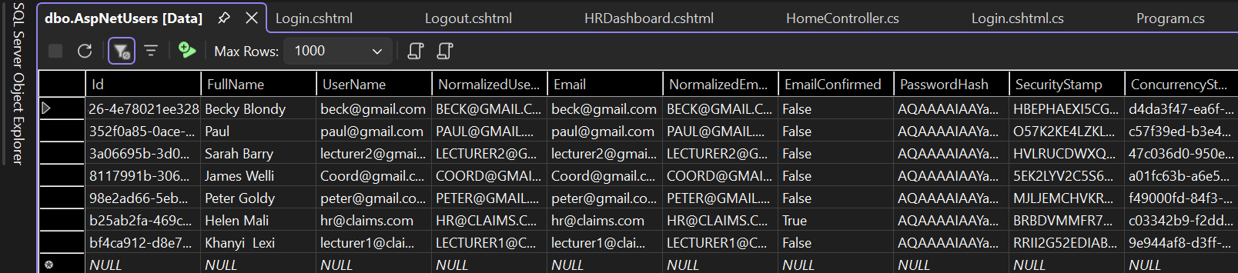
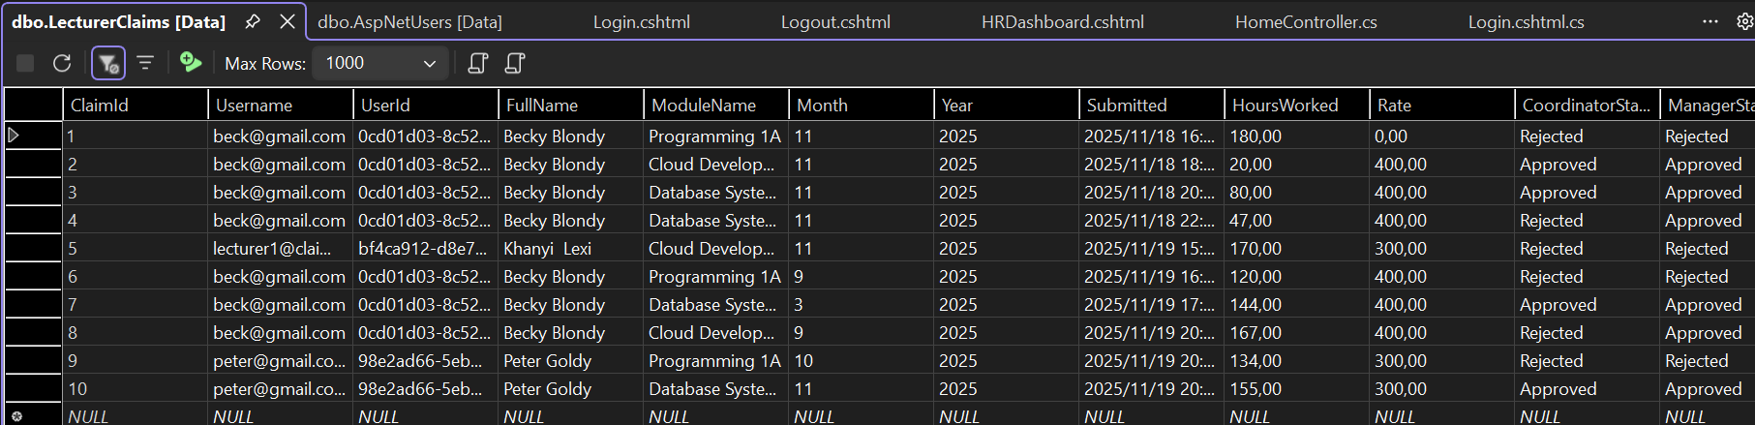
SQL Server Main Tables Shown
AspNetUser: Lsit of all Registered users, with passwordhashing and unique identifiers. This table is needed for the login process. It will be used to compare the stored login data to the data being inputted when logging in
LecturerCLaims: List of all claims submitted by all lecturer users with unique identifiers. All UI retrieve data form this table

Slide 11
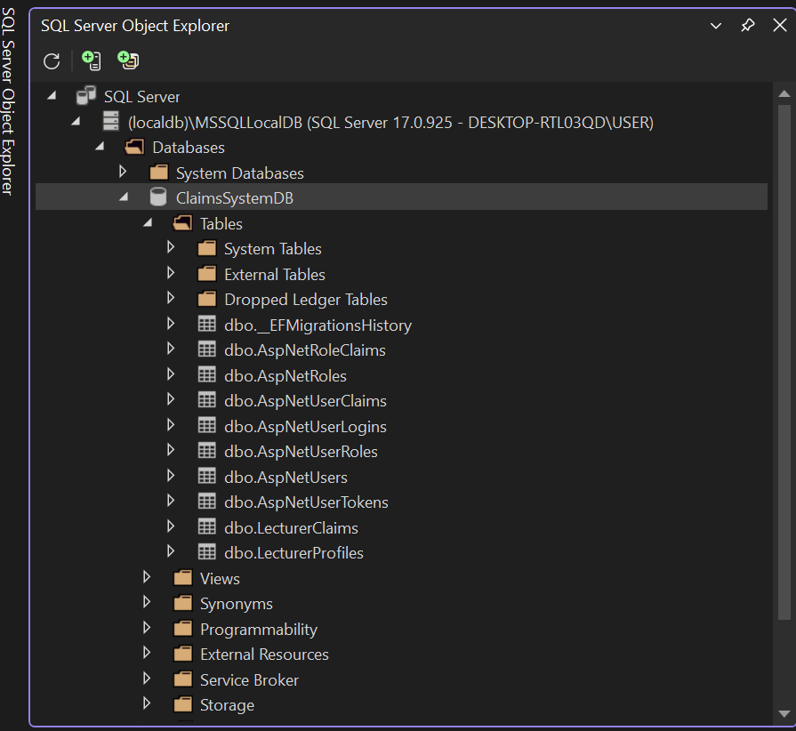
Overview of SQL Databse

