Slide 1






2025/2028
IKHWEZI FINANCIAL HEALTH REPORT
IKHWEZI FARM GREENHOUSE FARMING
Plot 83, 359 JR
Boschkop
oo56
.
s_sabela@hotmail.com
1

Slide 2


Ikhwezi Farm Financial Health Report
Prepared By:
Prepared For:
Business address: 1692
Telephone: +27 67 834 4035
Website:www.TekSAholdings.co.za
Ikhwezi Greenhouse Farming
1st Floor, 101 Commissioner St., Johannesburg, SA 2001
info@ikhwezi.co.za

Slide 3


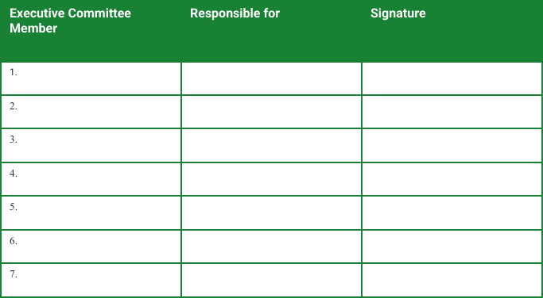
LVF Financial Health Report
May 05, 2025
Signature page
The Financial Health Report has been developed, agreed to and signed off by the following stakeholders of Local Village Foods Pty Ltd:
Date: __________________
2

Slide 4




LVF Financial Health Report
May 05, 2025
Table of Contents
3

Slide 5
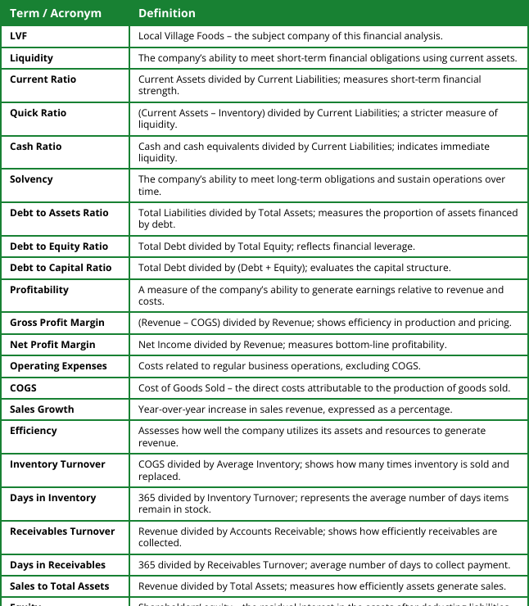
LVF Financial Health Report
May 05, 2025
Definitions
4

Slide 6
LVF Financial Health Report
May 05, 2025
Executive Summary
1.1. About The Company
Local Village Foods (LVF) is an African wholefood premium brand that specializes in ethical sourcing, sustainability, and healthy nutritional focus. As the trend for organic, functional, and ethically produced food continues to rise across the world, LVF has a unique chance of being a primary contender in the African superfood industry. Consumer preferences are moving towards gluten-free, plant-based, and nutrient-dense foods, offering LVF a big opportunity to take advantage of its core products—Roselle, Sorghum, Honey, and Teff-based products. Additionally, sustainability and traceability are becoming major drivers of buying behavior, as they enable the need for open sourcing, clean-label brands, and eco-friendly packaging solutions.
1.2. Report Summary
This analysis offers a complete financial overview of Local Village Foods (LVF) for the period of five years, highlighting four basic areas: liquidity, solvency, profitability, and efficiency. The findings represent a firm with good financial bases and a transparent trend of development and strategic adherence.
1.3 Profitability
LVF's profitability has also grown significantly, with revenues growing at a steady 23% annually and net margin growth from 7% in Year 1 to 37.3% in Year 5. This was driven by widening gross margins and declining operating costs as a percentage of revenue.
5

Slide 7

LVF Financial Health Report
May 05, 2025
Executive Summary
1.4 Solvency
On the solvency front, LVF successively reduced its debt burden to zero, being fully equity-funded by Year 5. This renders the firm financially healthy and well-buffered against long-term risk.
1.5 Liquidity
LVF's Liquidity ratios improved up to Year 4, with current and quick ratios reflecting better short-term financial health. The fall to zero in Year 5 results from the full settlement of current liabilities, not reduced liquidity.
1.6 Efficiency
Efficiency was consistent for asset utilization, but fluctuating inventory turnover and consistently zero receivables show areas where operating controls can be enhanced.
Financially, LVF is sound overall, founded on excellent profitability and sound capital structure. Enhanced management of receivables and inventory will remain the foundation upon which the company's sustainability and growth are founded.
6

Slide 8

LVF Financial Health Report
May 05, 2025
2.Liquidity Analysis
2.1. Introduction
Liquidity ratios evaluate LVF's ability to settle its short-term financial obligations. They include current ratio, quick ratio, and cash ratio—all key indicators of the company's immediate financial health.
2.2. Detailed Analysis
LVF's liquidity has improved considerably between Year 1 and Year 4. Current ratio has improved from 0.3 to 7.7, and quick ratio from 0.0 to 7.6, indicating higher ability to settle current liabilities using liquid funds.
The cash ratio, though, was 0.0 throughout, reflecting reliance on non-cash assets. In Year 5, all the ratios dropped to 0.0 because the company settled all of its liabilities—this is not a lack of cash but the absence of liabilities to measure liquidity against.
7

Slide 9
LVF Financial Health Report
May 05, 2025
2.Liquidity Analysis
Table 1: Liquidity Ratios
Metric | Year 1 | Year 2 | Year 3 | Year 4 | Year 5
Current Ratio | 0.309 | 0.474 | 0.878 | 2.225 | 0.000
Quick Ratio | 0.134 | 0.398 | 0.624 | 2.129 | 0.000
Cash Ratio | 0.000 | 0.000 | 0.000 | 0.000 | 0.000
2.3. Conclusion
Liquidity position strengthened steadily for four years, and the Year 5 decline was due to liability elimination. This strategic move enhances the company's ability to manage its obligations prudently.
8

Slide 10

LVF Financial Health Report
May 05, 2025
3.Solvency Analysis
3.1. Introduction
Solvency ratios examine a company's capacity to meet long-term obligations. The most significant indicators are debt to assets, debt to equity, and debt to capital.
3.2. Detailed Analysis
LVF continuously reduced its leverage throughout the years. At Year 5, all debt ratios reached zero. This indicates complete debt settlement and transition to an all-equity-financed firm—a remarkable feat that testifies to good financial prudence and trivial solvency risk.
Table 2: Solvency Ratios
Metric | Year 1 | Year 2 | Year 3 | Year 4 | Year 5
Debt to Assets | 0.495 | 0.465 | 0.387 | 0.238 | 0.000
Debt to Equity | 0.981 | 0.867 | 0.630 | 0.312 | 0.000
Debt to Capital | 0.495 | 0.465 | 0.387 | 0.238 | 0.000
9

Slide 11


LVF Financial Health Report
May 05, 2025
3.Solvency Analysis
3.3. Conclusion
LVF's solvency picture is superb. The absence of long-term obligations in Year 5 shows, in addition to good cash flow management, an intentional effort towards maintaining financial independence and solidity.
10

Slide 12

LVF Financial Health Report
May 05, 2025
4.Profitability Analysis
4.1. Introduction
Profitability ratios indicate the ability of a firm to generate earnings. Indicators include sales growth, gross margin, and net margin.
4.2. Detailed Analysis
LVF exhibited strong profitability improvement. Sales increased by 23% annually on average, with gross margins rising from 53.7% to 73.5%. Operating expenses as a percentage of sales decreased, increasing net profit margins from 7.0% to 37.3%. These trends reflect improved pricing strategy, cost control, and operating efficiency.
Table 3: Profitability Ratios
Metric | Year 1 | Year 2 | Year 3 | Year 4 | Year 5
Sales Growth (%) | 15.0% | 9.0% | 9.0% | 9.0% | 9.0%
COGS to Sales (%) | 66.9% | 64.5% | 60.97% | 57.69% | 54.62%
Gross Profit Margin (%) | 33.1% | 35.5% | 39.03% | 42.31% | 45.38%
Operating Expenses to Sales (%) | 37.69% | 36.43% | 35.21% | 34.05% | 32.94%
Sales Growth (%) | 15.0% | 9.0% | 9.0% | 9.0% | 9.0%
11

Slide 13

LVF Financial Health Report
May 05, 2025
4.Profitability Analysis
4.3. Conclusion
The profitability path of LVF is outstanding. All the key indicators' improvements reveal a scalable business with good management.
12

Slide 14

LVF Financial Health Report
May 05, 2025
5.Efficiency Analysis
5.1. Introduction
Efficiency ratios assess whether LVF employs its assets and resources effectively in generating revenues. They comprise inventory turnover, days in inventory, and sales to assets.
5.2. Detailed Analysis
LVF had steady asset utilization with sales to total assets at approximately 1. Inventory management was volatile, with turnover and days in inventory varying. Receivables were zero across the board, indicating either instant cash sales or restrictions on tracking receivables.
Table 4: Efficiency Ratios
Metric | Year 1 | Year 2 | Year 3 | Year 4 | Year 5
Days in Receivables | 0.0 | 0.0 | 0.0 | 0.0 | 0.0
Accounts Receivable Turnover | 0.0 | 0.0 | 0.0 | 0.0 | 0.0
Days in Inventory | 37.81 | 1.80 | 36.78 | 3.56 | 36.45
13

Slide 15

LVF Financial Health Report
May 05, 2025
5.Efficiency Analysis
5.3. Conclusion
Asset utilization is strong, but LVF should stabilize its inventory practices and investigate the absence of receivables for better operational transparency.
14

Slide 16
LVF Financial Health Report
May 05, 2025
6.Recommendations
Local Village Foods (LVF) has demonstrated remarkable financial progress over the past five years. Its performance is defined by outstanding profitability, driven by sustained revenue growth, expanding profit margins, and effective cost control.
Also impressive is the firm's complete removal of long-term debt, showing prudent financial management and deliberate policy to build a solid equity foundation.
LVF's liquidity position also improved consistently until Year 4, reflecting improved working capital management, with the fall in Year 5 liquidity ratios being due to the strategic payment of all liabilities instead of insufficient cash flows.
Despite these strengths, tracking and inventory control are two of the most critical areas that need closer inspection. Fluctuations in inventory turnover and days in inventory could be indicative of a requirement for better demand planning and tighter stock management.
Similarly, consistently zero receivables could be indicative of gaps in reporting or insufficient formalized credit terms, which would limit scalability in broader retail or distribution setups.
15

Slide 17


LVF Financial Health Report
May 05, 2025
6.Recommendations
To continue to drive growth and operational excellence, the following are suggested:
A. Adopt inventory management systems with forecasting capabilities to reduce stock variance and improve turnover.
B. Improve credit and receivables policies to better reflect trade terms and improve cash flow visibility.
C. Practice strict cost discipline while reinvesting in systems and capabilities that facilitate scale.
D. Strengthen financial reporting mechanisms to provide transparency and accuracy for all ratio inputs.
With these enhancements, LVF is well-positioned to cement its gains and pursue sustainable, scalable growth in local and regional markets.
Thank you for your interest!
16

