Slide 1






2025/2028
GAP
ANALYSIS
REPORT
IKHWEZI FARM GREENHOUSE FARMING
Plot 83, 359 JR
Boschkop
oo56
.
s_sabela@hotmail.com

Slide 2


Ikhwezi Farming
Gap Analysis
Prepared By:
Prepared For:
22 On Sloane
Bryanston., Johannesburg,
SA 2000
info@22onsloane.com
Ikhwezi Greenhouse Farming
1st Floor, 101 Commissioner St., Johannesburg, SA 2001
info@ikhwezi.co.za
2

Slide 3




Gap Analysis
May 05, 2025
Table of Contents
3

Slide 4



Organization Gap Analysis
Financial
Medium Priority
45.0%
80.0%
35.0%
Current Score
Target Score
Gap
0%
25%
50%
75%
100%
Key Intervention Required:
Develop integrated financial forecast linked to operational targets and funding strategy
Operational
High Priority
40.0%
80.0%
40.0%
Current Score
Target Score
Gap
0%
25%
50%
75%
100%
Key Intervention Required:
Standardize SOPs and implement KPI dashboard with quarterly reviews
Technology
High Priority
20.9%
75.0%
54.1%
Current Score
Target Score
Gap
0%
25%
50%
75%
100%
Key Intervention Required:
Deploy CRM, cloud accounting, and introduce cybersecurity protocols
Market & Customer
High Priority
42.7%
85.0%
42.3%
Current Score
Target Score
Gap
0%
25%
50%
75%
100%
Key Intervention Required:
Build GTM strategy, define customer segments, and strengthen branding
Governance & Compliance
Medium Priority
42.0%
80.0%
38.0%
Current Score
Target Score
Gap
0%
25%
50%
75%
100%
Key Intervention Required:
Formalize strategy, board governance charter, risk register, and compliance policy suite
Gap Analysis Summary - Organization Maturity Assessment

Slide 5










Strategic KPI Matrix
Initiative
Strategic Domain
KPI (Target Output)
Baseline (%)
Target (%)
Weight (%)
Status
Financial Forecast & Variance Reporting
Financial
Monthly variance reports delivered & reviewed
45.0
80.0
15
Not Started
SOP Development & KPI Dashboard Implementation
Operational
All core processes documented; KPIs tracked quarterly
40.0
80.0
25
Not Started
CRM & Digital Systems Deployment
Technology
CRM & accounting tools active; backups and access controls in place
20.9
75.0
15
Not Started
Customer Segmentation & GTM Strategy
Market & Customer
Personas, GTM funnel, and brand assets published
42.7
85.0
25
Not Started
Governance Charter & Risk Framework
Governance & Compliance
Strategy, board charter signed; risk register and compliance policies implemented
42.0
80.0
20
Not Started
Financial Domain
15%
Operational Domain
25%
Financial Forecast & Variance Reporting
SOP Development & KPI Dashboard
45%
40%
Current: 45%
Target: 80%
Current: 40%
Target: 80%
Technology Domain
15%
Market & Customer Domain
25%
CRM & Digital Systems Deployment
Customer Segmentation & GTM Strategy
20.9%
42.7%
Current: 20.9%
Target: 75%
Current: 42.7%
Target: 85%
Governance & Compliance
20%
Governance Charter & Risk Framework
42%
Current: 42%
Target: 80%
All initiatives are currently in "Not Started" status. The Strategic KPI Matrix tracks 5 key domains with assigned strategic weights and targets. The highest weighted domains (25% each) are Operational and Market & Customer, highlighting their importance to organizational priorities. Technology initiatives show the lowest baseline scores, indicating the greatest improvement opportunity.

Slide 6

















Roadmap for Gap Closure
Five strategic initiatives have been identified to address critical readiness gaps, scheduled to begin in Q2 2025 through Q4 2025, with a combined budget of R420,000.
1
Financial
3-year forecasting & variance reporting implementation to improve financial planning and performance tracking.
Budget: R60,000
Timeline: Q2–Q3 2025
2
Operational
SOP development and KPI implementation to standardize processes and measure operational effectiveness.
Budget: R80,000
Timeline: Q2–Q4 2025
3
Technology
Implementation of CRM system, cloud accounting system, and cybersecurity baseline to modernize technology infrastructure.
Budget: R120,000
Timeline: Q2–Q4 2025
4
Market & Customer
Customer segmentation, Go-To-Market strategy development, and brand development to strengthen market position.
Budget: R90,000
Timeline: Q2–Q4 2025
5
Governance & Risk
Development of strategy, Board charter, risk register, and compliance SOPs to strengthen governance framework.
Budget: R70,000
Timeline: Q2–Q3 2025
Combined budget: R420,000 | Implementation period: Q2-Q4 2025 | Strategic initiatives for long-term business sustainability and growth

Slide 7


Gap Analysis
May 05, 2025
Gap Analysis Summary
A domain-level gap analysis is presented in this section, contrasting Ikhwezi's present capabilities with reasonable standards for operational and investment readiness. The size of the gap and how urgently it needs to be closed determine how each domain is assessed.
Ikhwezi should strive to meet the target scores used in the gap analysis in each domain in order to attain strategic alignment, obtain institutional funding, and function at a level that is ready for scale. These scores were not determined at random; rather, they represent a combination of investor expectations unique to South African agribusiness SMEs, industry norms, and business growth goals.
Defining a Practical Readiness Baseline:
An 85% target was set for Market & Customer, recognizing the critical role that market reach, customer acquisition, and brand presence play in driving Ikhwezi’s growth.
The Operational, Financial, and Governance areas were each assigned an 80% target, aligning with standard expectations from development finance institutions and blended capital programs, particularly for businesses operating in rural supply chains.
Technology was given a 75% benchmark—acknowledging that while core digital tools like CRM systems, accounting platforms, and cybersecurity are essential, they don’t need to be fully scaled or enterprise-grade at this point.
Strategic Philosophy Behind These Targets
These are "readiness thresholds", not perfection scores.
They are set at a level that is:
Realistically achievable within 6–12 months
Sufficient to pass due diligence by most public and private funders
High enough to indicate professionalization of internal systems
4

Slide 8

22 On Sloane Proposal
May 05, 2025
1.1.Gap Matrix
1.1.1. Insight
While the difference from the flat-weighted score (38.12%) is modest, this refined view provides a more strategically accurate picture of where Ikhwezi must focus its improvement efforts — with the Market, Operations, and Governance domains being most critical to unlock growth and funding.
Table 1: Gap Matrix
Domain | Current Score | Target Score | Gap (%) | Priority | Key Intervention
Financial | 45.0% | 80% | 35.0% | Medium | Develop integrated financial forecast linked to operational targets and funding strategy
Operational | 40.0% | 80% | 40.0% | High | Standardize SOPs and implement KPI dashboard with quarterly reviews
Technology | 20.9% | 75% | 54.1% | High | Deploy CRM, cloud accounting, and introduce cybersecurity protocols
Market & Customer | 42.7% | 85% | 42.3% | High | Build GTM strategy, define customer segments, and strengthen branding
Governance | 42.0% | 80% | 38.0% | Medium | Formalize strategy, board governance charter, risk register, and compliance policy suite
5

Slide 9



Gap Analysis Report
May 05, 2025
2.Insights
2.1. Key Insights
The most significant shortfall is in Technology, scoring just 54.1%, highlighting an urgent need to establish core digital systems.
Notable gaps also appear in the Operational and Market areas—both of which could undermine efficiency and commercial potential if left unaddressed.
While Governance and Financial Planning show solid starting points, they still need additional structure to fully support growth and sustainability.
While the difference from the flat-weighted score (38.12%) is modest, this refined view provides a more strategically accurate picture of where Ikhwezi must focus its improvement efforts — with the Market, Operations, and Governance domains being most critical to unlock growth and funding
2.2. Interpretation
A readiness score below 40% signals that while the business has articulated vision and intent, it lacks the structural, operational, and digital capacity needed to scale effectively or satisfy most investor due diligence requirements.
The most critical readiness gaps lie in technology (only 20.9%) and operational process formalization.
Improvements in financial planning and documentation have contributed positively to the score after validating the cash flow assumptions
6

Slide 10


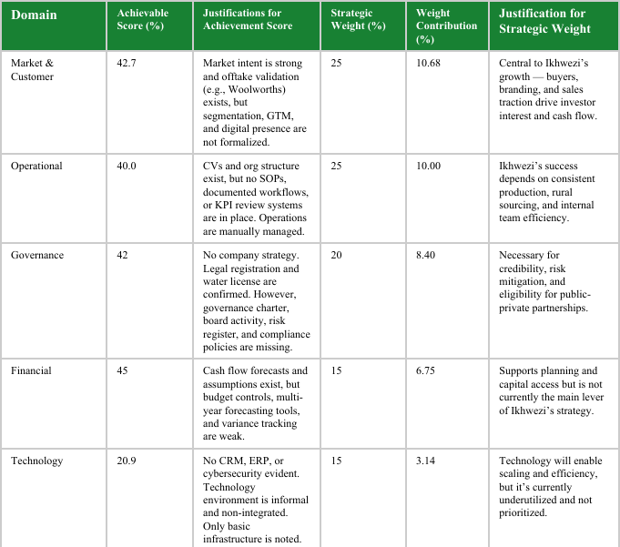
Gap Analysis Report
May 05, 2025
3. Readiness Scorecard
3.1 Scorecard Summary
The readiness framework initially gave equal 20% weight to each of the five domains for balance. On Ikhwezi’s business plan and strategy, it’s clear that some areas hold more strategic weight—especially those tied to stakeholder goals and rural supply chain priorities.
Table 2: Ikhwezi’s actual growth levers and risk exposures.
7

Slide 11
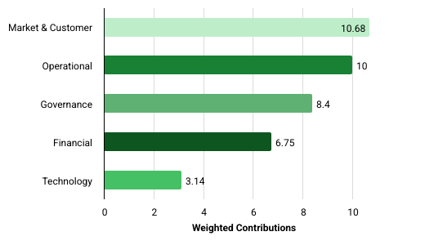



22 On Sloane Proposal
May 05, 2025
4.Business Readiness Score
Strategically Weighted Readiness Score Contributions by Domain
Execution Plan
4.1. Interpretation:
A readiness score below 40% signals that while the business has articulated vision and intent, it lacks the structural, operational, and digital capacity needed to scale effectively or satisfy most investor due diligence requirements.
The most critical readiness gaps lie in technology (only 20.9%) and operational process formalization.
Improvements in financial planning and documentation have contributed positively to the score after validating the cash flow assumptions.
8

Slide 12


22 On Sloane Proposal
May 05, 2025
5. Methodology
5.1 Summary
This section outlines the structured process followed to assess Ikhwezi’s desired state, current state, gap analysis, and roadmap design.
The evaluation was designed to be objective, evidence-based, and aligned with both South African SME development standards and global enterprise readiness frameworks.
The primary goal is to determine how well-positioned the business is to scale, attract funding, and operate efficiently
5.2 Gap Analysis and Roadmap Design
This diagnostic process used a clear, structured approach to evaluate Ikhwezi’s readiness as an institution, highlight key capability gaps, and create a costed and prioritized roadmap for transformation.
The approach was grounded in evidence and built on the company’s submitted strategy documents, operational data, and narrative inputs
9

Slide 13


22 On Sloane Proposal
May 05, 2025
5. Methodology
5.4. Establishing the Desired State
The first step was to define the maturity level Ikhwezi must achieve to execute its growth strategy and meet institutional funding standards.
This “To-Be” state was based on: The company’s business plan outlining growth, funding, and scale-up strategies, Strategic themes like market expansion, rural sourcing, and public-private collaboration and benchmarks from similar agribusinesses preparing for institutional investment.
Each key was given a target score (e.g., 80–85%) representing the minimum capability needed to meet goals and engage top-tier funders
5.6. Designing Interventions to Close the Gap
Based on the prioritized gaps, a set of strategic interventions was defined. These included:
Practical, funder-aligned steps such as developing SOPs, deploying CRM software, drafting board governance policies, or building a GTM strategy, outputs framed as measurable KPIs to enable milestone tracking and progress reporting and Interventions tailored to Ikhwezi’s current level of institutional maturity, resources, and stated ambitions.
10

Slide 14


Gap Analysis
May 05, 2025
5. Methodology
5.7 Scoring the As-Is Analysis
This is Ikhwezi’s actual performance and was assessed based on the evidence submitted via the ZOHO form and supplementary documentation, including:
Financial spreadsheets (cash flow forecasts, assumptions)
Organizational structure charts, CVs, and team descriptions
Company registration and compliance documents
Strategic briefs, market summaries, and partner letters
Informal declarations and supplementary descriptions (including where information was marked “Not Applicable”)
Each business domain was broken down into key initiatives. For every initiative, a score from 0 to 100% was assigned based on:
Presence, quality, and relevance of supporting documents
Level of implementation (conceptual, drafted, in-use)
Alignment with best practices and funder expectations
This resulted in a quantified baseline (As-Is) scorecard, reinforced by qualitative assessment narratives.
11

Slide 15


Gap Analysis
May 05, 2025
5. Methodology
5.8. Conducting the Gap Analysis
Once both the Current (As-Is) and Target (To-Be) scores were defined, the gap for each initiative and domain was calculated using the following formula:Gap (%) = Target Score – Current Score
Each gap percentage served as a signal of strategic deficiency, execution risk, or unrealized opportunity. To support prioritization, each gap was categorized as:
High Priority – Gaps of 40% or more
Medium Priority – Gaps between 25% and 39%
Low Priority – Gaps less than 25%
This ranking helped guide attention to the most urgent institutional gaps that could affect scalability, investment-readiness, or compliance
5.9. Frameworks used
The analysis applies a blended evaluation framework combining elements from:
TOGAF (The Open Group Architecture Framework) — for structuring business capability domains, CMMI (Capability Maturity Model Integration) — to rate process maturity and documentation and SME Benchmarking Standards — adapted to reflect South African operational realities.
Each business area (Finance, Operations, Technology, Market, and Governance) is assessed across key initiatives, with a defined set of criteria for success. These criteria are matched to the business’s stage of growth and type of industry (agribusiness)
12

Slide 16


22 On Sloane Proposal
May 05, 2025
5. Methodology
5.10. Prioritizing, Ranking and Budgeting Interventions
All interventions were assessed using a structured prioritization matrix, evaluating:
Impact on business outcomes and investor appeal, Urgency based on operational risk or time-sensitive opportunities, Ease of Execution, considering available resources and internal capacity, Cost of delivery, benchmarked against South African market rates and Strategic Fit with Ikhwezi’s growth model and stated intentions
The most important initiative from each domain was selected to form a 5 part implementation roadmap, supported by:
Assigned roles and responsibilities, Estimated implementation timeframes (6–9 months), KPI milestone indicators and A total projected budget of R420,000
The result is a costed, time-bound Growth Plan designed to close Ikhwezi’s most critical capability gaps and position it for institutional investment, market expansion, and scalable operations
13

Slide 17

Gap Analysis
May 05, 2025
5. Methodology
5.11. Document Review Process
More than 100 documents were submitted through Zoho and manually reviewed.
These were organized into domain-specific categories, with duplicate or redundant files removed. Each document was evaluated based on:
Completeness and relevance
Clear evidence of implementation (not just stated intentions)
Recency and alignment with the project’s objectives
When information was unclear, assumptions were noted and partial credit was applied. For instance, a cash flow spreadsheet initially lacked supporting data, but a later review uncovered a validated “Assumptions” tab, which was then factored into the scoring.
This re-validation process helps ensure that materials are assessed fairly, based on their content—not just their presentation.
5.12. Use of Results
The results of this As-Is Analysis will:
Inform the Gap Analysis Matrix
Shape the Growth Plan and Roadmap
Populate a KPI Dashboard for progress tracking
Feed into investment readiness assessments and stakeholder decision making
The methodology ensures alignment between current capabilities and the strategic requirements for scale, resilience, and funding eligibility
14

Slide 18




Business Plan
May 05, 2025
6. Conclusion
6.1. CONCLUSION AND CALL TO ACTION
Ikhwezi Farm represents a unique convergence of proven agricultural experience, market demand, and social impact. The farm’s revival and expansion are grounded in a robust operational plan, a diversified product portfolio, and an established track record of supplying premium markets.
More than just a farming venture, Ikhwezi Farm embodies empowerment, resilience, and sustainability — values that resonate with both commercial partners and development-focused investors. With the right funding, Ikhwezi Farm will not only generate solid financial returns but also create meaningful employment, promote environmentally responsible farming practices, and contribute to national food security and export growth.
Thank you for your interest!
15

Slide 19


Business Plan
May 05, 2025
6. Conclusion
6.2. Value Proposition for Funders
Funders and investors are presented with a compelling opportunity to support a business that combines financial viability with measurable social and environmental benefits.
Key value propositions include:
Established Market Access: Proven history of supplying high-end retail chains and restaurants, with prior clients willing to re-engage.
Growth Potential: Clear roadmap for production scaling, value-added product development, and market expansion, including exports.
Social Impact: Creation of jobs, skills development, and community empowerment, particularly for youth and women.
Sustainability: Commitment to environmentally friendly farming practices and Global GAP certification.
Strong Management: Experienced leadership, supported by consultants and professional advisors, with a legally documented succession plan.
Thank you for your interest!
16

