Slide 1



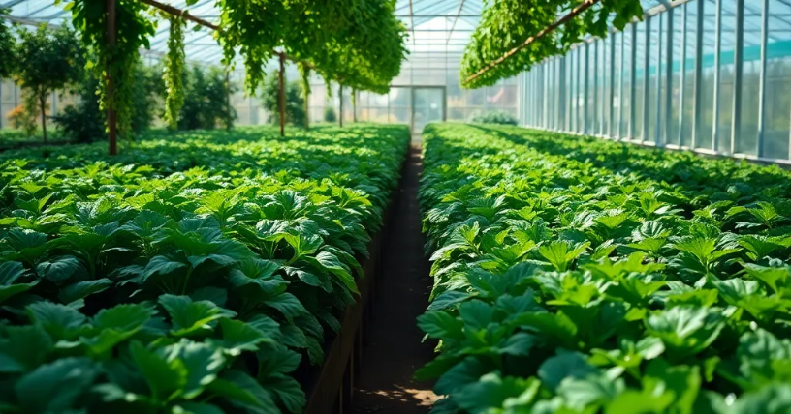


2025/2028
IKHWEZI FARM MARKET ANALYSIS
IKHWEZI FARM GREENHOUSE FARMING
Plot 83, 359 JR
Boschkop
oo56
.
s_sabela@hotmail.com
1

Slide 2
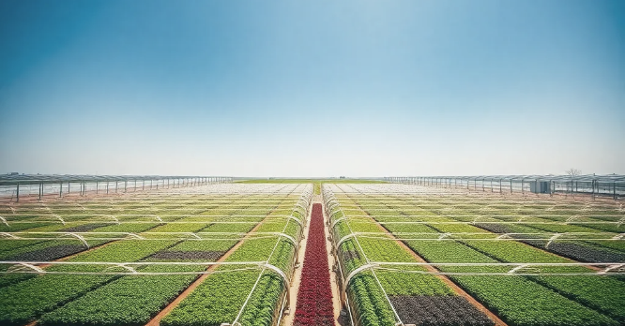

Ikhwezi Farm
Market Analysis Report
Prepared By:
Prepared For:
22 On Sloane
Bryanston., Johannesburg,
SA 2000
info@22onsloane.com
Ikhwezi Greenhouse Farming
1st Floor, 101 Commissioner St., Johannesburg, SA 2001
info@ikhwezi.co.za
2

Slide 3




Market Analysis Report
May 05, 2025
Table of Contents
3

Slide 4

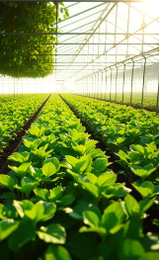
Market Analysis Report
May 05, 2025
Executive Summary
Purpose of the Report
Understanding the market is crucial for Ikhwezi Farm as it establishes itself in South Africa’s dynamic agricultural sector. This report explores local and export opportunities for its main products: baby marrow, tomatoes, lettuce, spring onions, and various herbs (basil, wild rocket, coriander, and fennel). It examines market size, trends, consumer preferences, and competition to inform production planning, marketing strategies, and investment decisions.
Key Findings
South Africa’s fresh produce industry, worth over USD 3.5 billion, is steadily growing. Consumers prefer locally grown, sustainable produce, aligning with Ikhwezi Farm’s strengths. Despite competition, growth opportunities exist through major retailers, restaurants, informal traders, and direct sales. Export demand is also rising in Africa, Europe, and the Middle East, offering further potential for the farm.
Summary of Opportunities and Risks
Ikhwezi Farm has a strong foundation with established customers and a diverse product range. Key opportunities include re-entering premium retail, expanding high-value herb packaging, and accessing export markets with certified produce. While risks like high greenhouse costs, unpredictable inputs, and changing regulations exist, careful planning and investment can help manage them and unlock growth.
.
4

Slide 5

Market Analysis Report
May 05, 2025
2. Industry
Overview
SA Produce Industry Overview
South Africa’s fresh produce industry is crucial to national food supply and economic activity, serving households, restaurants, manufacturers, and export markets. Valued at over USD 3.54 billion in 2020, the vegetable segment is projected to reach USD 3.90 billion by 2028. The sector spans smallholder to large-scale farms, creating strong competition. For Ikhwezi Farm, this offers opportunity—but also the challenge of strategic positioning in a busy market.
Greenhouse Farming Market Landscape
Greenhouse farming is gaining traction in South Africa for its ability to ensure year-round, high-quality crop production, weather protection, and efficient water use. Despite high setup costs, it offers major benefits, especially for farmers targeting premium markets. As consumers favor sustainable practices, greenhouse farming gives Ikhwezi Farm a competitive edge through consistency, quality, and better market access.
Compliance & Global GAP
Farming in South Africa requires meeting strict regulations to ensure food safety, environmental protection, and fair trade. Certifications like Global GAP are essential for accessing top retailers and export markets. Ikhwezi Farm’s previous certification is a key asset, and maintaining it will be vital for buyer trust and competitiveness locally and internationally.
5

Slide 6
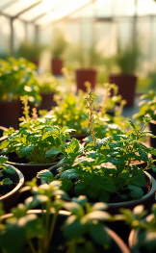
Market Analysis Report
May 05, 2025
3. Market Trends &
Growth Drivers
Understanding market shifts is crucial for Ikhwezi Farm to stay competitive. In South Africa’s fresh produce sector—especially greenhouse farming—emerging trends are influencing consumer demand, pricing, and new opportunities. These, along with broader economic and demographic changes, present both challenges and growth potential.
Consumer Trends (Health
Consumers are increasingly focused on healthy eating and are favoring sustainably grown, low-pesticide, and locally sourced produce. Buyers want traceable food and support eco-friendly practices. With its Global GAP certification and strong community ties, Ikhwezi Farm is well-aligned with these shifting consumer values.
Technological Trends
Technology is transforming greenhouse farming through tools like automated climate control, drip irrigation, and Integrated Pest Management. These innovations boost efficiency and resilience. Ikhwezi Farm’s investment in modern irrigation and sustainable pest control aligns with industry trends and appeals to buyers focused on sustainability.
.
6

Slide 7
Market Analysis Report
May 05, 2025
3. Market Trends & Growth Drivers
Economic and Demographic Drivers
Big-picture shifts in the economy and society are also fueling demand for fresh produce. As more people move to cities and middle-class incomes rise, there’s a growing appetite for high-quality, convenient, and health-conscious food. Products like specialty herbs and value-added veggies are especially in demand. Despite financial pressures in the economy, vegetables remain a staple in most households because they’re affordable and essential to healthy diets. Plus the South African government continues to support inclusive agricultural growth particularly for black-owned and historically disadvantaged enterprises like Ikhwezi Farm.
Export Market Trends
South Africa’s vegetable and herb exports are holding steady and even showing signs of growth. Right now, most of these exports ,around 64% go to other African countries (HortiDaily, 2024). But there’s increasing interest from buyers in the Middle East and Europe who want sustainably grown, high-quality produce. Herbs, in particular, are becoming more popular worldwide, driven by chefs and health-conscious consumers. Exporting can be complex , with lots of paperwork and logistics but it also offers better prices and market diversity. With past experience in export compliance and a strong chance to renew its Global GAP certification, Ikhwezi Farm is in a great position to tap into these opportunities.
7

Slide 8
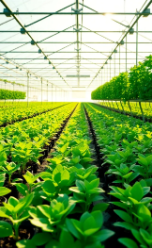
Market Analysis Report
May 05, 2025
4. Product-Specific Market Analysis
Not all vegetables and herbs are created equal but each one has its own unique market potential, pricing trends, and buyer expectations. For Ikhwezi Farm, knowing exactly how each product performs locally and internationally is crucial for smart production planning and sales strategy. This section takes a closer look at the market outlook for each of the farm’s main crops, highlighting opportunities and challenges across both domestic and export markets.
Baby Marrow (Zucchini)
Local Market
Baby marrow is a household favorite in South Africa — loved for its mild taste, versatility, and health benefits. It’s a regular on supermarket shelves and in foodservice kitchens. While exact figures for baby marrow are often grouped under broader vegetable stats (valued at USD 3.54 billion in 2020), demand is steady and price-resilient, even in tough economic times. Retailers like Pick ’n Pay and Woolworths consistently stock it, making it a reliable crop for producers.
Export Market
South Africa exports baby marrow mainly to nearby African markets. It’s not a top performer in European exports, but there’s still room for growth in premium niches — especially for producers who offer top-grade, certified greenhouse produce.
8

Slide 9
Market Analysis Report
May 05, 2025
4. Product-Specific Market Analysis
Tomatoes
Local Market
Tomatoes are among the most widely consumed vegetables in the country. Although it’s a competitive space, producers who offer consistent quality especially those growing in greenhouses have an edge. Prices can swing depending on the season and weather, so controlled-environment growers like Ikhwezi Farm have an advantage when field-grown supply drops.
Export Market
South Africa exports tomatoes primarily to SADC countries. While Europe isn’t a major destination due to stiff competition, there’s still a niche for premium, traceable varieties particularly those grown in greenhouses.
Lettuce
Local Market
Retailers and restaurants buy lettuce in large volumes and there’s a growing preference for pre-packed and pre-washed options. The inconsistency of outdoor supply especially due to weather, has opened the door for reliable greenhouse producers to shine.
Export Market
While lettuce exports aren’t massive, there’s a steady market in neighboring African countries. Exporting premium-grade lettuce can offer better prices, especially with the right certifications.
9

Slide 10
Market Analysis Report
May 05, 2025
4. Product-Specific Market Analysis
Spring Onions
Local Market
Demand is stable, especially from retail and hospitality buyers who look for uniformity, freshness, and long shelf life — all strengths of greenhouse-grown produce.
Export Market
These are exported in moderate volumes to SADC countries. While not a big money-maker in terms of export quantity, spring onions offer consistent returns when backed by strong logistics and certifications.
Herbs (Basil, Wild Rocket, Coriander, Fennel)
Local Market
South Africa’s herb market is booming, currently valued at USD 35 million and expected to grow to nearly USD 58 million by 2030 (CAGR of 8.7%). Basil leads the way, but there’s also solid demand for wild rocket, coriander, and fennel. Upscale restaurants and health-conscious shoppers are key drivers of this growth.
Export Market
This is one of the most promising segments for Ikhwezi Farm. Herbs are increasingly popular in European and Middle Eastern markets, where quality and sustainability matter. While exports require careful handling and compliance, the rewards are high and offer both strong margins and brand recognition
10

Slide 11


Market Analysis Report
May 23, 2025
5. Target Market
To grow smartly and profitably, Ikhwezi Farm needs to understand exactly who its customers are and what they care about. Different buyers value different things. Some want premium, certified produce. Others are driven by affordability or convenience. By breaking the market down into clear segments, the farm can tailor its offerings, messaging, and sales efforts more effectively. Below is a breakdown of Ikhwezi Farm’s main customer groups and how the business can meet their unique needs.
Retail Chains
Context and Opportunity
Major supermarket chains like Pick ’n Pay, Woolworths, Checkers, and Spar dominate the fresh produce space. They are selective about who they buy from and look for suppliers that can guarantee quality, consistency, and compliance with strict safety and sustainability standards — including Global GAP.
Market Dynamics
These retailers are shifting toward local, sustainable sources that can offer reliable, year-round supply. There’s also growing demand for traceable produce. Ikhwezi Farm’s past relationships with top retailers give it a solid starting point to re-enter and expand in this segment.
Value Proposition
Year-round availability through greenhouse farming
Compliance with high-level food safety standards (Global GAP)
Custom packaging and consistent quality to match retail needs
12

Slide 12


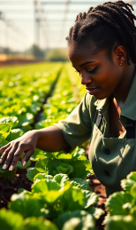
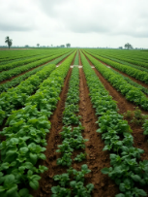
Market Analysis Report
May 05, 2025
5. Target Market Segmentation
Restaurants and Hospitality
Context and Opportunity
Hotels, restaurants, and catering services are always on the lookout for fresh, top-quality produce especially unique herbs and vegetables that enhance flavor and presentation.
Market Dynamics
The rise in gourmet and healthy dining is driving demand for premium produce. Chefs and buyers increasingly seek direct relationships with farmers for fresher, more reliable supply.
Value Proposition
Buyers in the gourmet and hospitality sector are looking for premium produce tailored to chef preferences, including specialty herbs and consistently sized vegetables. They also value flexible delivery schedules and quantities to suit their dynamic needs.
.
13

Slide 13
Market Analysis Report
May 05, 2025
5. Target Market Segmentation
Informal Traders
Context and Opportunity
Street vendors and small market sellers are the backbone of food access for many South Africans, especially in townships and peri-urban areas.
Market Dynamics
These traders prioritize price, freshness, and reliability. They’re less concerned about certifications and more about value for money. The informal sector accounts for a large share of fresh produce sales.
Value Proposition
Efficient greenhouse production enables competitive pricing and a steady supply of staple vegetables like tomatoes and baby marrow. This approach also reinforces community relationships and supports local food security
Export Buyers
Context and Opportunity
Export markets especially within Africa, the Middle East and parts of Europe are looking for reliable suppliers of fresh vegetables and herbs.
Market Dynamics
Export buyers demand strict quality and compliance standards, but they also pay premium prices for the right product. With the right logistics and certifications, export can be a highly profitable space.
13

Slide 14
Market Analysis Report
May 05, 2025
5. Target Market Segmentation
Value Proposition
Ikhwezi Farm offers consistent, high-quality produce from controlled environments, backed by Global GAP certification that meets international standards. Its ability to supply niche herbs and specialty vegetables gives it strong appeal in premium markets.
General Public (Direct Consumers)
Context and Opportunity
Selling directly to everyday consumers through farm stalls, farmer’s markets, or online builds brand loyalty and opens up additional revenue channe
Market Dynamics
People are looking for affordable, healthy, and local produce. There’s also a growing appreciation for knowing where food comes from and who grows it.
Value Proposition
Ikhwezi Farm provides fresh, sustainably grown produce at competitive prices, with the added value of sharing its social mission with consumers. The farm also offers flexibility for seasonal promotions and value-added products, enhancing its market appeal.
14

Slide 15


Market Analysis Report
May 05, 2025
6. Competitive Landscape
Ikhwezi Farm operates in a fast-paced, competitive environment. Whether supplying to local markets or aiming for export, it’s important to know who else is out there, what they offer, and how Ikhwezi can stand apart. This section explores the main players in the fresh produce space and highlights what gives Ikhwezi Farm its edge — as well as what it takes to stay ahead.
Key Competitors (Local and Regional)
South Africa’s fresh produce market is made up of a wide range of players:
Large operations serve retail and export markets with cost and distribution advantages. Medium-sized, often family-run greenhouses supply retailers and restaurants with flexibility but may lack certifications. Smallholders focus on informal markets, competing on price and location. Importers also play a role in market supply.
For certain niche herbs or vegetables, imported goods create competition — especially in high-end stores or restaurants.
The market is crowded, but also fragmented.
Execution Plan
Competitive Advantages of Ikhwezi Farm
Ikhwezi Farm isn’t starting from scratch, it already has several strengths that help it stand out:
Greenhouse and controlled-environment farming
This enables year-round growing, protects against crop loss, and ensures consistent quality — all of which are important to big buyers.
Global GAP certification history
Even if renewal is pending, having previously met this gold-standard certification proves Ikhwezi can operate at international quality levels.
Track record with top buyers
The farm has successfully supplied Pick ’n Pay, Woolworths, and other premium clients before — showing that it can meet strict requirements.
Diverse product range
From everyday vegetables to specialty herbs, the farm can serve a wide mix of customer needs.
Social impact positioning
As a black woman-owned and differently-abled enterprise, Ikhwezi aligns well with transformation goals in both corporate and government procurement.
These advantages give the farm a strong foundation for growth and credibility with high-value buyers.
15

Slide 16

Market Analysis Report
May 05, 2025
6. Competitive Landscape
Barriers to Entry
The fresh produce market may look open, but getting in and staying takes real commitment. Key barriers include:
High startup costs
Greenhouse infrastructure, modern equipment, and certifications don’t come cheap.
Technical expertise
It takes know-how to run a greenhouse effectively — from pest control to nutrient management.
Building trust with buyers
Retailers and exporters need to see consistent delivery and quality before committing to new suppliers.
Regulatory complexity
Complying with safety, environmental, and export rules can be overwhelming, especially for newcomers. Ikhwezi Farm has already overcome many of these hurdles through experience, systems, and existing relationships making it more resilient and better positioned than most new entrants.
16

Slide 17

Market Analysis Report
May 05, 2025
7. Market Outlook
For Ikhwezi Farm to grow sustainably, it needs a clear picture of how big the market is — and where it’s headed. Understanding the size and growth of each product category helps the farm plan what to grow, how much to produce, and where to focus its sales and investment efforts. This section breaks down the size of the domestic and export markets, along with five-year growth forecasts using the latest available data.
Local Market Size per Product
Introduction
South Africa’s fresh produce market is large and growing, driven by rising urban populations, healthier eating habits, and steady demand from homes, restaurants, and retail. For Ikhwezi Farm’s crops — like baby marrow, tomatoes, lettuce, spring onions, and herbs — the opportunity is split between high-volume staples and high-value niche products.
17

Slide 18
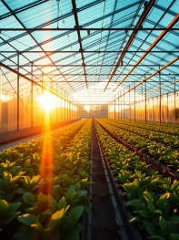
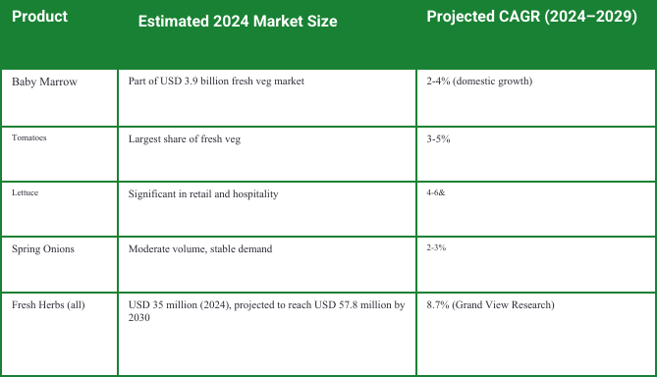
Market Analysis Report
May 05, 2025
7. Market Outlook
Table Key Insights
Tomatoes and lettuce present high-volume opportunities, while baby marrow and spring onions serve steady niche markets with potential for supplier differentiation. Fresh herbs are also growing in demand, particularly in premium retail and hospitality sectors.
Table 1: Market Size and Growth Projections for Ikhwezi Farm Products (2024–2029
18

Slide 19
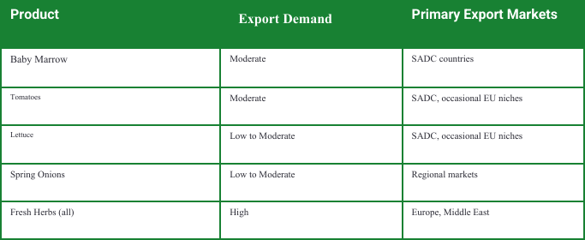
Market Analysis Report
May 05, 2025
7. Market Outlook
Export Market Potential
Introduction
South African vegetables and herbs are in demand across Africa, the Middle East, and parts of Europe. Export markets offer higher margins but also require strict compliance with standards and logistics efficiency..
Table 2: Export Demand and Key Markets for Ikhwezi Farm Products
19

Slide 20

Market Analysis Report
May 05, 2025
7. Market Outlook
Table Key Insights
With 64% of South Africa’s vegetable exports staying within Africa, SADC countries offer a practical entry point with simpler logistics. Meanwhile, herbs are in rising demand in Europe and the Middle East, creating premium export opportunities for certified producers like Ikhwezi Farm.
Projected Growth Rates
Market growth projections provide a foundation for Ikhwezi Farm’s production and sales planning. Growth rates vary by product and market segment but overall indicate positive trends.
20

Slide 21
Market Analysis Report
May 05, 2025
7. Market Outlook
Key Drivers
Rising health awareness and urban growth are driving demand for fresh, premium produce. As middle-class incomes increase, so does interest in quality vegetables and herbs. Government support for black-owned agricultural exports and advances in greenhouse technology are further boosting efficiency and market potential.
.
Segment | Projected Growth Rate
Retail chains | 8-10% annually (fresh produce category)
Restaurants | 10-15% (driven by tourism and health trends)
Informal traders | 5-7% (population growth and urbanization)
Export (veg) | 3-5%
Export (herbs) | 8-10%
Table 3: Projected Growth Rates by Market Segment for Fresh Produce and Herbs
21

Slide 22
Market Analysis Report
May 05, 2025
7. Market Outlook
Table Data Sources
Grand View Research (2024) offers insights into the South African fresh vegetable and herb markets.
HortiDaily (2024) highlights the latest trends in South Africa’s vegetable exports.
Adama South Africa (2024) provides in-depth reports on tomato and general vegetable farming.
FreshPlaza and MarketLine (2024) share valuable perspectives on global trade in herbs.
22

Slide 23
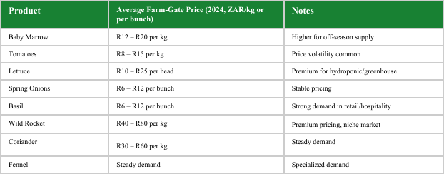
Market Analysis Report
May 05, 2025
8. Pricing & Profit Drivers
Historical and Current Pricing Data
Introduction
Pricing and profitability are at the heart of any successful farming enterprise. For Ikhwezi Farm, understanding how prices are determined, how they fluctuate, and what drives profitability across products and market segments is essential for setting realistic financial targets. This section reviews recent pricing trends, input cost patterns, and the factors that will influence profitability as the business scales.
Table 4: Average Farm-Gate Prices and Market Notes for Key Ikhwezi Products (2024)
23

Slide 24


Market Analysis Report
May 05, 2025
8. Pricing & Profit Drivers
Product | Average Farm-Gate Price (2024, ZAR/kg) | Notes
Baby Marrow | R12 – R20 per kg | Higher for off-season supply
Tomatoes | R8 – R15 per kg | Price volatility common
Lettuce | R10 – R25 per head | Premium for hydroponic/greenhouse
Spring Onions | R6 – R12 per bunch | Stable pricing
Basil | R50 – R100 per kg | Strong demand in retail/hospitality
Wild Rocket | R40 – R80 per kg | Premium pricing, niche market
Coriander | R30 – R60 per kg | Steady demand
Fennel | R25 – R50 per kg | Specialized demand
Table 4: Average Farm-Gate Prices and Market Notes for Key Ikhwezi Products (2024)
24

Slide 25
Market Analysis Report
May 05, 2025
8. Pricing & Profit Drivers
Table Key Insights
Greenhouse farmers often earn higher prices, especially in the off-season. Herbs are highly profitable per kilogram, despite lower volumes. Tomatoes and lettuce sell consistently, but price fluctuations demand efficient production and cost control.
Input Cost Trends
Input costs are a critical factor in determining profitability. For greenhouse farming, costs include infrastructure maintenance, seedlings, fertilizers, labor, water, and energy.
Cost Drivers
Seed and seedling costs are rising 5–8% annually due to demand and supply issues. Fertilizer prices are volatile, affected by global markets. While drip irrigation requires initial investment, it reduces water use and long-term costs. Labour costs are increasing in line with inflation, but smart, efficient farming practices can help manage these expenses.
Mitigation Strategies
Ikhwezi Farm’s plan to produce its own seedlings from Year 2 and implement efficient irrigation systems will help control input costs over time.
25

Slide 26
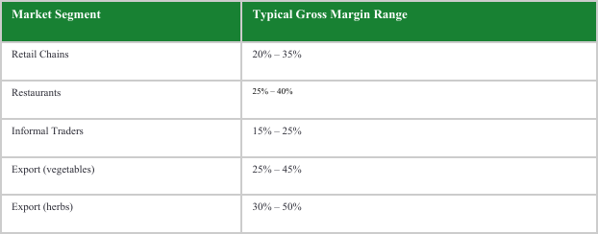
Market Analysis Report
May 05, 2025
8. Pricing & Profit Drivers
Margin Analysis
Profit margins vary by product and market channel. Generally, niche and premium products offer higher margins but may involve smaller volumes or stricter quality demands.
Table 5: Typical Gross Margin Ranges by Market Segment
26

Slide 27
Market Analysis Report
May 05, 2025
8. Pricing & Profit Drivers
Table Key Insights
Supplying herbs and premium vegetables to high-end retailers and hospitality offers strong profit potential. Exports can be lucrative but involve added logistics and compliance costs. Bulk sales to informal traders or retailers provide steady demand with lower margins.
Profitability Outlook for Ikhwezi Farm
Path to Sustainable Profitability
Greenhouse technology ensures consistent, high-quality produce that attracts better prices. Diversifying products balances high-value and volume sales, while reconnecting with past buyers can unlock profitable opportunities. Managing input costs through in-house seedling production and efficient water use helps maintain strong margins.
With these factors in place, the farm’s projected gross margins align well with industry benchmarks, supporting both short-term financial stability and long-term growth.
27

Slide 28
Market Analysis Report
May 05, 2025
9.Risks Analysis
Introduction
Ikhwezi Farm has several strong cards to play. Its diverse product offering, strategic market positioning, and operational model open up multiple pathways for growth not just hypothetically, but based on real interest from past clients and strong market trends.
Growth Opportunities
Key Opportunities
Reconnecting with Premium Retailers
Major chains like Woolworths and Pick ’n Pay have shown interest in working with Ikhwezi Farm again. They’re actively sourcing from local, sustainable farms — and Ikhwezi’s greenhouse produce fits the bill.
Scaling Herb Production
The fresh herbs market is growing fast. Herbs like basil, wild rocket, coriander, and fennel bring in higher prices and are in strong demand, especially from restaurants and health-focused retailers.
Tapping into Export Markets
There’s demand for high-quality, certified produce in neighboring SADC countries and even in Europe and the Middle East. With its export experience and Global GAP background, Ikhwezi can compete in these markets.
Direct-to-Consumer Sales
Selling through farm stalls, markets, or even online opens a direct line to customers, higher margins, and brand loyalty — especially for a socially driven farm like Ikhwezi.
Training and Community Development Expanding training programs supports social goals and builds local talent. It also opens doors for external funding and partnerships, while strengthening Ikhwezi’s workforce.
28

Slide 29
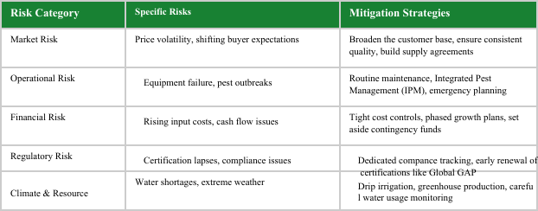
Market Analysis Report
May 05, 2025
9. Risks Analysis
Summary
Like any farming business, Ikhwezi must navigate real risks — from price swings to infrastructure breakdowns. But with good planning and the right systems in place, most of these risks can be reduced or even turned into advantages.
Table 6: Key Business Risks and Mitigation Strategies
29

Slide 30
Market Analysis Report
May 05, 2025
9. Risks Analysis
Table Key Insight
Ikhwezi Farm’s existing infrastructure, past certifications, and experience already reduce many of these risks. What’s needed now is vigilance, investment in best practices, and a strong risk management mindset.
Summary Perspective
In short, the growth opportunities for Ikhwezi Farm clearly outweigh the risks — as long as the team stays proactive. With disciplined management, strong market relationships, and a focus on consistent quality, the farm is well-positioned to grow, re-enter premium channels, and expand into new markets. Its competitive strengths — from greenhouse capacity to social impact credentials — provide a solid foundation for both profitability and long-term sustainability
.
30

Slide 31
Market Analysis Report
May 05, 2025
10. Strategic Implications
A good market analysis is only useful if it leads to action. For Ikhwezi Farm, the insights gathered in this report point to clear and achievable next steps. These recommendations are designed to guide the farm’s growth journey — from regaining market presence to scaling new value-added opportunities and strengthening partnerships.
Market Entry and Growth Recommendations
Introduction
Ikhwezi Farm has strong fundamentals — a good product mix, greenhouse capacity, and proven market relationships. What’s needed now is a steady, phased approach to re-entering the market, growing capacity, and building long-term resilience.
Recomendations
Re-establish Retail Relationships
Finalize agreements with top retailers like Pick ’n Pay and Woolworths, using past experience and the renewal of Global GAP certification as proof of credibility.
Target High-Value Buyers
Focus on restaurants, boutique retailers, and hospitality clients who prioritize traceability, freshness, and quality.
Diversify Market Channels
Balance wholesale with direct-to-consumer and export sales. This spreads risk and ensures that the farm isn’t overly dependent on one buyer type.
31

Slide 32
Market Analysis Report
May 05, 2025
10. Strategic Implications
Opportunities
Pre-packaged Herbs
Offer herbs in ready-to-sell packaging for grocery stores and foodservice clients.
Salad Mixes and Prepared Veg
Create ready-to-use mixes combining lettuce, baby marrow, and herbs — perfect for health-conscious consumers.
Custom Crop Lines for Buyers
Work with high-value clients to grow specific produce types or offer exclusive packaging formats tailored to their needs.
Continuous Market Monitoring
Quarterly Market Reviews
Track pricing, trends, and competitor movements regularly to adjust production and sales strategies.
Customer Engagement
Maintain open lines of communication with buyers to understand changing needs and stay top-of-mind.
Product Innovation
Keep testing new packaging, product formats, and farming techniques in response to consumer trends and sustainability goals.
32

Slide 33
Market Analysis Report
May 05, 2025
10. Strategic Implications
.
Partnership and Distribution Strategies
Ikhwezi doesn’t have to do everything alone. By building the right partnerships, the farm can scale faster, reach more customers, and stay focused on what it does best — growing quality produce. Strategies:
Retail and Hospitality Procurement Partners
Move beyond one-off sales and build long-term, strategic relationships with key buyers.
Logistics Providers
Secure reliable partners to help with cold-chain storage and delivery — especially for export clients who require efficiency and traceability.
Agricultural Development Programs
Tap into private and public initiatives that support black-owned farms through funding, training, or market access.
Community Organizations
Collaborate with local groups to deliver training and job opportunities — aligning the farm’s growth with broader community upliftment.

Slide 34

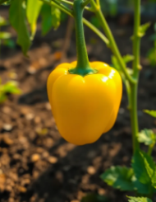

Market Analysis Report
May 05, 2025
11. Conclusion
Success in agriculture requires a clear view of the market. This analysis gives Ikhwezi Farm a practical roadmap—highlighting demand, buyer needs, competition, and strategic positioning for growth. The farm is well-aligned with market trends, offering in-demand products like baby marrow, tomatoes, lettuce, spring onions, and herbs. Its past experience and certifications give it a strong head start.
However, execution is key. Ikhwezi should reconnect with past buyers, build new partnerships, and invest in greenhouse efficiency and value-added products. By focusing on quality, consistency, and its social mission, the farm can achieve sustainable growth and contribute meaningfully to its community.
Thank you for your interest!

