Slide 1






2025/2028
ROADMAP REPORT
IKHWEZI FARM GREENHOUSE FARMING
Plot 83, 359 JR
Boschkop
oo56
.
s_sabela@hotmail.com

Slide 2
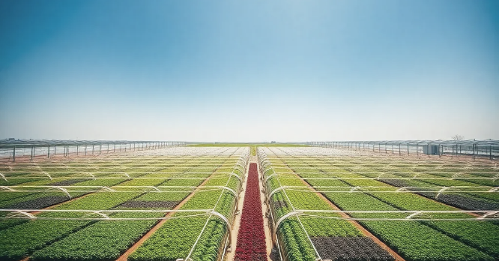

Ikhwezi Farming Roadmap Report
Prepared By:
Prepared For:
22 On Sloane
Bryanston., Johannesburg,
SA 2000
info@22onsloane.com
Ikhwezi Greenhouse Farming
1st Floor, 101 Commissioner St., Johannesburg, SA 2001
info@ikhwezi.co.za
2

Slide 3




Roadmap Report
May 05, 2025
Table of Contents
3

Slide 4

















Roadmap for Gap Closure
Five strategic initiatives have been identified to address critical readiness gaps, scheduled to begin in Q2 2025 through Q4 2025, with a combined budget of R420,000.
1
Financial
3-year forecasting & variance reporting implementation to improve financial planning and performance tracking.
Budget: R60,000
Timeline: Q2–Q3 2025
2
Operational
SOP development and KPI implementation to standardize processes and measure operational effectiveness.
Budget: R80,000
Timeline: Q2–Q4 2025
3
Technology
Implementation of CRM system, cloud accounting system, and cybersecurity baseline to modernize technology infrastructure.
Budget: R120,000
Timeline: Q2–Q4 2025
4
Market & Customer
Customer segmentation, Go-To-Market strategy development, and brand development to strengthen market position.
Budget: R90,000
Timeline: Q2–Q4 2025
5
Governance & Risk
Development of strategy, Board charter, risk register, and compliance SOPs to strengthen governance framework.
Budget: R70,000
Timeline: Q2–Q3 2025
Combined budget: R420,000 | Implementation period: Q2-Q4 2025 | Strategic initiatives for long-term business sustainability and growth

Slide 5


Roadmap Report
May 05, 2025
Executive Summary
1.1 Roadmap and KPI Framework
Following the diagnostic assessment of Ikhwezi’s current state, a targeted Strategic Roadmap has been developed to close critical capability gaps and advance the enterprise toward fundability, scalability, and institutional resilience.
The roadmap focuses on five weighted strategic pillars and prioritizes high-impact, costed initiatives for execution over a 6–9-month horizon. A complementary KPI Scorecard provides a performance monitoring framework to track progress, ensure accountability, and quantify business readiness improvements
1.2 Strategic Pillars Defined and Prioritized
Ikhwezi’s growth journey is anchored by five interdependent strategic pillars:
Market Expansion (25% weight) — Immediate priority due to its direct link to revenue growth and fundability.
Operational Efficiency (25%) — Essential for process discipline and internal accountability.
Governance & Compliance (20%) — Necessary to build trust and mitigate institutional risks.
Financial Strengthening (15%) — Critical for transparency, resource alignment, and funding readiness.
Digital Enablement (15%) — Acts as a cross-cutting enabler for efficiency and reporting.
4

Slide 6


Roadmap Report
May 05, 2025
Executive Summary
1.2. Actionable, Costed Initiatives Identified
Five key initiatives have been scoped, each directly addressing the highest-priority gaps identified in the diagnostic:
Market Segmentation, GTM Strategy, and Branding — R90,000
SOP Development and KPI Tracking — R80,000
Governance Charter, Risk Register, and Policies — R70,000
3-Year Financial Model and Variance Reporting — R60,000
CRM, Accounting System, and Cybersecurity Setup — R120,000
Total Budget: R420,000
1.3. KPI Framework Aligned to Roadmap
Each initiative is linked to a KPI with a baseline score, target score, and strategic weight. The scorecard methodology enables:
Progress tracking against defined milestones.
Score-based readiness assessments over time.
Transparent performance reviews with assigned initiative owners.
1.4. Sequencing and Weighting Reflect Strategic Imperatives
Commercial traction (Market and Operations) takes precedence as it directly impacts income generation, scalability, and external investor appeal.
Foundational enablers (Governance, Finance, and Technology) are sequenced to provide early-stage institutional support while allowing commercial initiatives to drive momentum.
Technology investment is focused and pragmatic, supporting—not leading—the broader growth trajectory.
1.5. Change Management Considered Essential
Recognizing potential barriers to adoption, the roadmap incorporates change management principles, including stakeholder engagement, team readiness assessment, and phased rollouts.
5

Slide 7


Roadmap Report
May 05, 2025
Executive Summary
1.6. Summary of Financial Projections
Robust financial projections are essential in indicating the potential of the farm for growth and success. They give funders confidence that the business plan is realistic, achievable, and will be able to yield a return on investment. The most critical projections over the next few years are:
Break-even point: Expected within the first 9 months of operation.
Profitability in Year 1: Anticipated based on confirmed market demand.
Annual revenue growth: Projected at 10% per year.
Operational cost management: Aiming for no more than 20% growth in costs.
Efficiency gains: Starting in Year 2 with in-house seedling production.
1.6 Value Proposition for Investors/Funders
To funders and investors, Ikhwezi Farm offers more than financial returns. An investment in the farm is also an investment in tangible social and economic progress. With its mix of profitability, growth potential, and community gains, Ikhwezi Farm is an attractive investment prospect.
6

Slide 8

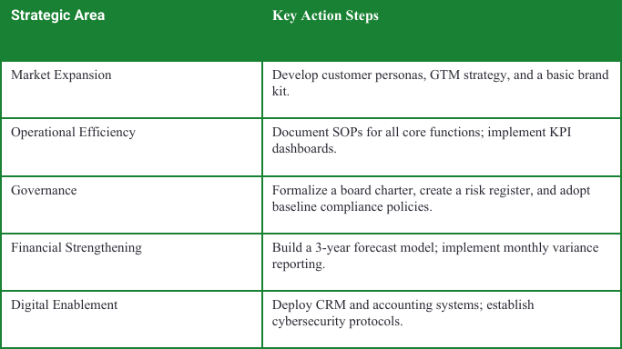
22 On Sloane Proposal
May 05, 2025
2. Priority Recommendations
The proposed Strategic Roadmap and KPI Scorecard together offer a practical, phased, and cost-effective pathway for Ikhwezi to transition from early-stage operations to a scalable and fundable enterprise. By prioritizing market engagement and operational excellence—while concurrently strengthening governance, financial oversight, and digital systems—Ikhwezi can significantly enhance its commercial readiness, attract investment, and deliver on its mission of inclusive agricultural development.
Table 1: Ikhwezi Priority Recommendations
7

Slide 9
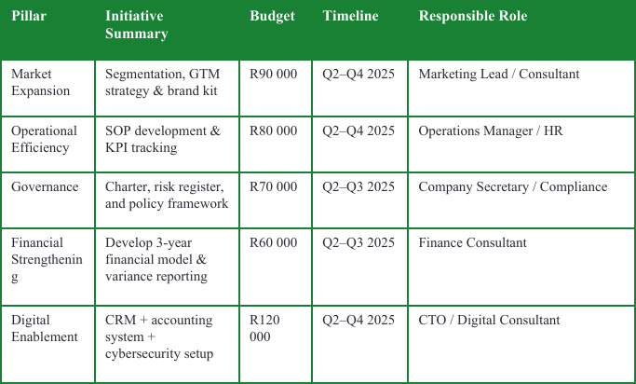
22 On Sloane Proposal
May 05, 2025
3.Implementation Roadmap
The roadmap that follows details a set of high-impact initiatives—complete with budgets, timelines, and designated implementation leads—set to roll out over a 6- to 9-month window starting in Q2 2025.
Table 1: Ikhwezi's Implementation Roadmap with Total Estimated Budget: R420,000
8

Slide 10
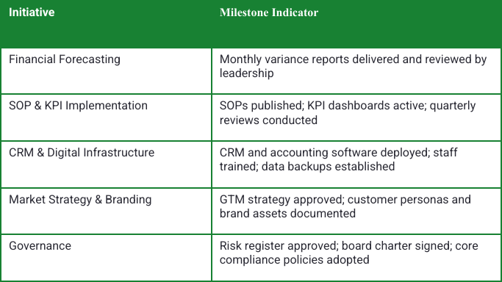
22 On Sloane Proposal
May 05, 2025
4.Milestone Indicators
Execution should start with high-impact Market and Operations initiatives, followed by Governance and Finance as enablers. Technology supports scale but comes later. Strong change management and monthly KPI reviews are key to staying on track.
Each initiative will be monitored through key output indicators to ensure progress tracking and performance accountability:
Table 3: Ikhwezi Milestone Indicators
9

Slide 11

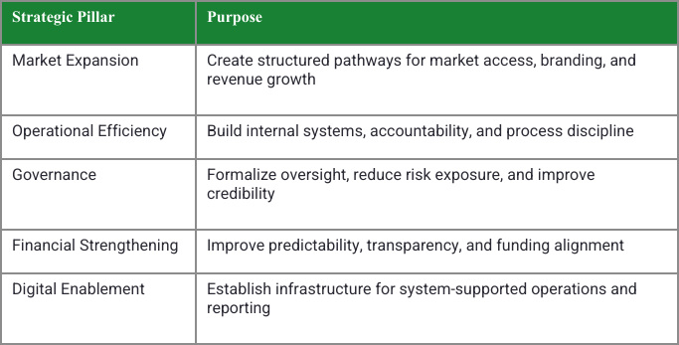
22 On Sloane Proposal
May 05, 2025
5.Strategic Roadmap
This section outlines practical, costed recommendations aimed at closing the key gaps flagged in Section 6. Each proposed action targets a domain where Ikhwezi shows both performance challenges and strategic reliance.
The order and emphasis of these initiatives reflect updated priorities tied closely to the organization’s growth strategy and operational roadmap.
Summary of Strategic Priorities
The following five strategic pillars form the backbone of Ikhwezi’s journey toward scale, investment readiness, and institutional resilience. The order reflects strategic weighting, not chronology.
Table 2:Strategic Priorities
10

Slide 12


22 On Sloane Proposal
May 05, 2025
6.KPI Scorecard
4.3.1 Summary
This section outlines a performance measurement framework to track Ikhwezi’s progress toward closing the capability gaps defined in the strategic gap analysis.
Each KPI is tied to a specific initiative, domain, and strategic pillar, and has a baseline (current score), a target (desired readiness), and a weight indicating its importance to overall business transformation.
The weights reflect the strategic significance of each domain to Ikhwezi’s commercial success, operational resilience, and investor-readiness trajectory.
4.3. How to use KPI scorecard
The KPI Scorecard is designed to serve as a performance monitoring and decision-support tool throughout the implementation of Ikhwezi’s growth plan. It provides a quantifiable way to measure the completion and effectiveness of key strategic initiatives and links directly to the company’s readiness assessment.
Below is a practical guide to interpreting and applying the scorecard:
Track Progress Over Time
Baseline Score (%) reflects the company’s starting position (from the As-Is Analysis)
Target Score (%) defines the desired maturity level for that domain
At regular intervals (monthly or quarterly), update the Status and adjust the Current Score (%) based on evidence of implementation (e.g., SOP documents delivered, CRM system active)
11

Slide 13
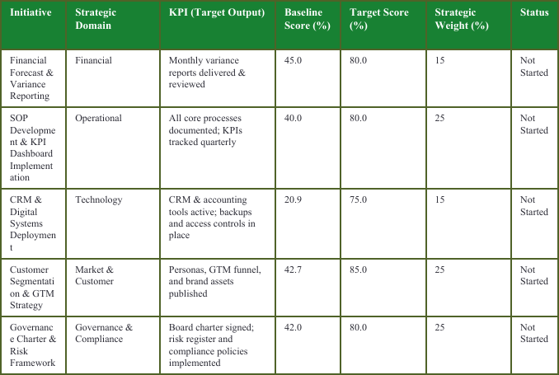
Roadmap
May 05, 2025
7.Strategic KPI Matrix
Each initiative will be reviewed quarterly, with updates made to reflect:
Degree of completion
Quality of outputs delivered
Operational usage or institutional adoption
Score improvement against the readiness baseline
KPI updates will feed into the composite readiness scorecard to show overall business progress.
Note: Ikhwezi KPI Matrix
12

Slide 14



Roadmap
May 05, 2025
8. Conclusion
8.1. CONCLUSION AND CALL TO ACTION
Ikhwezi Farm represents a unique convergence of proven agricultural experience, market demand, and social impact. The farm’s revival and expansion are grounded in a robust operational plan, a diversified product portfolio, and an established track record of supplying premium markets.
More than just a farming venture, Ikhwezi Farm embodies empowerment, resilience, and sustainability — values that resonate with both commercial partners and development-focused investors. With the right funding, Ikhwezi Farm will not only generate solid financial returns but also create meaningful employment, promote environmentally responsible farming practices, and contribute to national food security and export growth.
Thank you for your interest!
13

Slide 15

Roadmap
May 05, 2025
8. Conclusion
8.2. Value Proposition for Funders
Funders and investors are presented with a compelling opportunity to support a business that combines financial viability with measurable social and environmental benefits.
Key value propositions include:
Established Market Access: Proven history of supplying high-end retail chains and restaurants, with prior clients willing to re-engage.
Growth Potential: Clear roadmap for production scaling, value-added product development, and market expansion, including exports.
Social Impact: Creation of jobs, skills development, and community empowerment, particularly for youth and women.
Sustainability: Commitment to environmentally friendly farming practices and Global GAP certification.
Strong Management: Experienced leadership, supported by consultants and professional advisors, with a legally documented succession plan.
Thank you for your interest!
14

