Slide 1



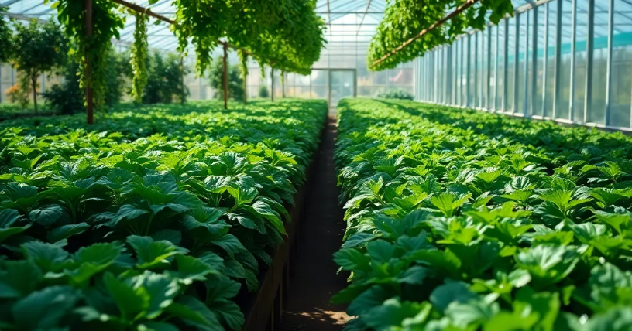


2025/2028
IKHWEZI FARM STRATEGY
IKHWEZI FARM GREENHOUSE FARMING
Plot 83, 359 JR
Boschkop
oo56
.
s_sabela@hotmail.com
1

Slide 2
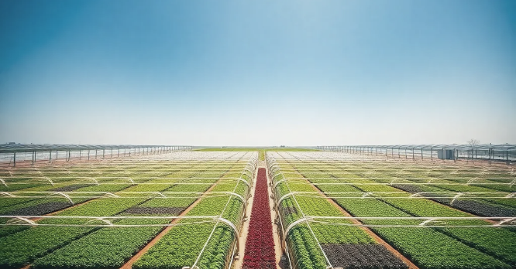

Ikhwezi Farm
Corporate Strategy
Prepared By:
Prepared For:
22 On Sloane
Bryanston., Johannesburg,
SA 2000
info@22onsloane.com
Ikhwezi Greenhouse Farming
1st Floor, 101 Commissioner St., Johannesburg, SA 2001
info@ikhwezi.co.za
2

Slide 3

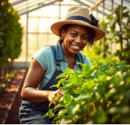


Strategy Report
May 05, 2025
Table of Contents
3

Slide 4


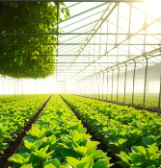
Strategy Report
May 05, 2025
Executive Summary
Company Background
Ikhwezi Farm is rekindling its heritage in sustainable greenhouse agriculture with Ms. Sindisiwe Sabela at the helm. This strategy is the blueprint to complete recuperation, market growth, and long-term expansion. It is a symbol of a dominant combination of farming excellence and the empowerment of the people.
Purpose of this Strategy
The aim of the strategy document is to offer a structured guide in reviving and expanding Ikhwezi Farm into a competitive & sustainable greenhouse farming enterprise
Following a halt in operations, the farm is poised to return to the market based on its rich heritage and existing physical assets. The plan aligns Ikhwezi’s purpose with the available opportunities so that it grows financially, operates more effectively, and has profound societal impact.
It also seeks to align stakeholders, attract partners and be in compliance with standards such as Global GAP. Pivotal to that strategy is commitment to creating employment and agriculture training that empowers women and the youth.
4

Slide 5

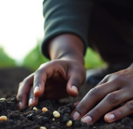

Strategy Report
May 05, 2025
Executive Summary
Strategic Overview
Ikhwezi Farm aims to lead in sustainable, high-quality vegetable production in South Africa and select international markets, restoring its position as a trusted supplier to premium retailers. It plans to diversify through value-added products and exports, focusing on ethical sourcing.
Driven by a passion for inclusive growth, the farm prioritizes empowering women, youth, and disabled individuals, while promoting ecosystem stewardship, social justice, and environmentally friendly agriculture.
Summary of Key Goals
The strategic priorities of Ikhwezi Farm include restoring peak production by upgrading greenhouses, tunnels, and irrigation systems. The farm aims to regain its Global GAP certification and reconnect with former clients while expanding into informal and international markets.
A new 1-hectare net-house will boost yields and consistency. Financial goals include breaking even in 9–12 months and achieving 10% annual growth. Training programs for women and youth will support local employment and skills development.
Ms. Sindisiwe Sabela is also mentoring her daughter Kuhle to ensure stable, long-term leadership.
5

Slide 6
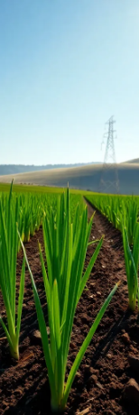

Strategy Report
May 05, 2025
2. Company Overview
Background
Ikhwezi Farm is a Black woman-owned commercial greenhouse agriculture business in Pretoria, South Africa. Established in 2005 in its initial entity as a cooperative in a programme of community upliftment, it was subsequently registered and named Ikhwezi HR Training & Consulting (PTY) Ltd and re-registered in 2022.
Strategic Focus
Located on 8.65 hectares of privately owned property, Ikhwezi Farm has greenhouses, tunnels, boreholes, and a packhouse that is compliant with Global GAP standards. Having a vision to rehabilitate and enhance operations, the farm is committed to expanding production, re-opening primary markets, and initiating value-added processing. Its main objective is to rehabilitate and expand operations and to empower youths and women through training and job creation in agriculture.
2.3 Leadership
Under the leadership of Ms. Sindisiwe Sabela, she has developed a reputation of excellence and innovation and has in the past supplied high-profile retailers like Woolworths and Pick ’n Pay. Her vision continues to guide the farm's vision of making a difference and promoting sustainable food production.
6

Slide 7

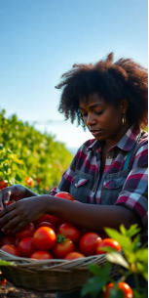
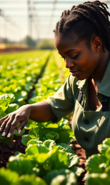
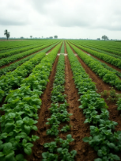
Strategy Report
May 05, 2025
3. Vision, Mission & Values
Vision
Ikhwezi Farm envisions becoming a leading name in sustainable, high-quality greenhouse farming, delivering fresh produce while driving community empowerment and environmental responsibility in South Africa and beyond.
Mission
Ikhwezi Farm is committed to growing premium vegetables using climate-smart practices while uplifting women, youth, and marginalized groups through employment, training, and agricultural education. The farm’s mission is to achieve commercial success while creating lasting social impact.
Core Values
Ikhwezi Farm is guided by sustainability, empowering people, operating with integrity, striving for excellence, and embracing innovation. Every action is focused on responsible farming, ethical business practices, and building a future where agriculture uplifts communities.
7

Slide 8

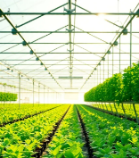
Strategy Report
May 05, 2025
Strategic Objectives
Ikhwezi Farm’s strategic objectives focus on revitalizing operations, expanding. production, and ensuring long-term sustainability while driving meaningful social impact..
Strategic Focus
Ikhwezi Farm focuses on restoring critical infrastructure tunnels and irrigation systems to get back to large-scale production. Sustained Global GAP certification continues to be crucial to maintain access to retail markets. The farm will reconnect to previous customers and increase sales to informal and export markets.
The introduction of a new 1-hectare net-house will facilitate sustained, annual production. The financial targets include reaching break-even within 9–12 months and attaining 10% growth annually. Women and youths' training programmes will be instituted to advance inclusive agricultural participation.
Leadership
Led by Ms. Sindisiwe Sabela, has built a strong reputation for quality and innovation, previously supplying premium retailers such as Woolworths and Pick ’n Pay. Her leadership continues to inspire the farm’s mission of social impact and sustainable food production.
8

Slide 9
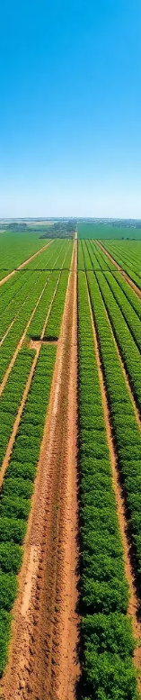
Strategy Report
May 05, 2025
5. Market and Industry Analysis
Industry Overview
South Africa’s agriculture is embracing climate-smart practices, with greenhouse farming growing in popularity for its year-round production, higher yields, and weather resilience. As demand for sustainable, traceable produce increases and government support for emerging farmers expands, greenhouse agriculture offers a timely opportunity particularly for mission-driven ventures like Ikhwezi Farm.
Market Overview and Trend
Consumers and retailers increasingly prefer locally produced, certified, and ethical goods. While Global GAP certification is key for premium and export markets, growing informal and local markets offer affordable alternatives. Ikhwezi is well-positioned to tap into all these opportunities due to its socially and environmentally conscious model.
Ikhwezi Farm's Market Positioning
Domestic Market: Lettuce is an intermediary vegetable in South Africa with both domestic consumption driven as well as the hotel industry demand.
Export Market: One of the vegetables being exported is lettuce, which contributes towards the earnings of vegetables exported from South Africa in total.
9

Slide 10












Strategy Report
May 05, 2025
Strengths
Weaknesses
•Established Reputation: Proven history of supplying premium retailers such as Woolworths and Pick ’n Pay.
•Experienced Leadership: Led by an award-winning, differently-abled entrepreneur with strong industry relationships.
Certified Infrastructure: Equipped with a Global GAP-compliant packhouse and well-developed greenhouse facilities
S
W
•Operational Downtime: Temporary closure has impacted market presence and momentum.
•Financial Constraints: Limited funding restricts the speed and scale of restoration and expansion.
•Dependence on Key Individuals: Heavy reliance on the founder for strategic direction and relationship management.
•Aging Infrastructure: Tunnels and irrigation systems require repair and modernization.
Personal Swot Analysis Template
Opportunities
O
T
Threats
•Growing Demand for Organic and Greenhouse Produce: Rising consumer preference for sustainable, fresh, and local food.
•Market Expansion: Potential to re-enter retail markets and grow into informal and export markets.
•Youth and Women Empowerment Programs: Government and donor support for inclusive agricultural training.
•Value-Added Processing: Opportunity to diversify product offerings through packaging and processing
•Competitive Pressure: Increased interest in greenhouse farming from new and established players.
•Rising Input Costs: Fluctuating prices for agricultural inputs and energy may affect profitability.
•Climate and Water Risks: Although greenhouse systems mitigate climate issues, prolonged droughts or water restrictions may impact irrigation.
•Regulatory and Compliance Challenges: Reinstating certifications and adhering to food safety standards requires time and investment.
PLOT 83, 359 JR, BOSCHKOP, 0056.
10

Slide 11
Strategy Report
May 05, 2025
7. Competitive Advantage
Proven Market Track Record
Ikhwezi Farm has a strong history of supplying top retailers like Woolworths and Pick ’n Pay with high-quality products. With its Global GAP-compliant packhouse and controlled production systems, the farm is well-equipped to regain market share and enter new segments confidently.
Purpose Driven Brand Identity
What distinguishes Ikhwezi is its distinct character of being differently-abled and black woman-owned with a solid commitment to a social mission. This is very appealing in today's marketplace where buyers want ethical sourcing, empowerment, and sustainability. Its additional focus on training young people and women creates another stream of social value with which to attract partners that share inclusive development aspirations.
Operation Flexibility and Stragetic Focus
Ikhwezi merges effective operational systems with a transparent growth plan that prioritizes production efficiency and social impact. Its capacity to achieve commercial aspirations and empower people together enhances its attractiveness in a competitive market of agriculture. This double strategy, quality agriculture and inclusive leadership, creates a strong and persistent advantage in Ikhwezi Farm's capacity to scale sustainably.
11

Slide 12

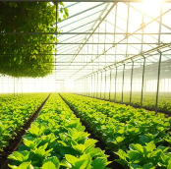
Strategy Report
May 05, 2025
8. Market and Sales Strategy
Greenhouse farming is rising in South Africa as a solution to climate and food security challenges, enabling year-round, quality production. For Ikhwezi Farm, this presents a timely opportunity to re-enter a market that values both sustainability and social impact.
Strategic Focus
Ikhwezi Farm is well-positioned to re-enter the market by leveraging its existing infrastructure, ethical business model, and brand reputation. With certified production facilities and a history of supplying retail markets, the farm is addressing financial, input, and skills challenges through funding, process improvements, and training. Its strategy includes renewing Global GAP certification, expanding into export and informal markets, and initiating training programs for women and youth, aligning with both financial goals and social impact.
Market Focus
Current market trends favor locally produced, certified, and eco-friendly fruit and vegetables. Farmers aiming for premium markets prioritize Global GAP certification. Meanwhile, informal markets continue to grow rapidly, offering flexibility and high-volume opportunities. Ikhwezi Farm’s experience with premium retailers and its community-focused approach align well with these evolving demands. Increasing consumer interest in empowerment, sustainability, and social value gives Ikhwezi a competitive edge in a market leaning toward mission-driven producers.
12

Slide 13
Strategy Report
May 05, 2025
9. Human Resources
Workforce and Inclusive Hiring
Ikhwezi Farm realises that long-term sustainability relies on solid human capital. It will start with a five-member core of permanent personnel to manage the day-to-day operations supported by seasonal employees during peak production seasons. Local community members with a focus on youth and women will be the primary focus of the recruitment to reflect the farm's commitment to employment equity.
Training and Skills Development
To build a skilled workforce, Ikhwezi will partner with agricultural consultants to deliver structured training in greenhouse farming, post-harvest practices, and food safety. Collaborations with institutions like AgriSETA will also be explored to provide formal skills certification and promote long-term professional development.
Successions and Leadership Continuity
Ikhwezi has a clear succession plan in place, with founder Ms. Sindisiwe Sabela mentoring her daughter, Kuhle, to eventually take over the farm’s leadership. Kuhle’s active involvement in daily operations and structured mentorship ensures continuity, preserves institutional knowledge, and supports the farm’s future sustainability.
13

Slide 14
Strategy Report
May 05, 2025
10. Financial Projections
Funding and Start-up Needs
Ikhwezi Farm enters its next phase with a strong foundation of agricultural expertise, market credibility, and a clear vision for sustainable farming. With its renewed infrastructure, Global GAP compliance, and premium-quality produce, the farm is well-positioned to re-establish itself in both domestic and international markets
Revenue Growth and Cost Managemnt
The farm targets break-even within 9 to 12 months, based on reliable production and renewed demand from former buyers. A 10% annual revenue growth is projected, supported by efficiency gains, in-house seedling production, and sales expansion into export and informal markets. Most capital costs are once-off, with operating expenses stabilizing after year one
Diversified Income and Long-Term Outlook
In addition to produce sales, monthly training programs will create a steady income stream and support Ikhwezi’s social mission. This balanced model supports long-term growth through quality production and community impact.
14

Slide 15
Strategy Report
May 05, 2025
11. Milestones &
Implementation Plan
Infrastructure Restoration
The first milestone involves repairing and upgrading existing infrastructure. This includes replacing plastic coverings on tunnels, restoring the irrigation system, and servicing boreholes. These repairs will enable the farm to resume production at full capacity and meet Global GAP facility standards.
Certification and Compliance
Ikhwezi will work toward regaining its Global GAP certification, essential for accessing high-end retail and export markets. This will involve documentation, system reviews, staff training, and an official audit. Having previously held this certification, the farm is well-positioned to complete the process quickly.
Net-House Construction
IA 1-hectare net-house will be constructed to expand production capacity and support year-round cultivation. This structure will enable Ikhwezi to increase output and crop variety while managing climate risk more effectively
15

Slide 16
Strategy Report
May 05, 2025
12. Monitoring and Evaluation
Approach and Purpose
Ikhwezi Farm’s M&E approach is built to support transparency, informed decision-making, and continuous improvement. It ensures that both financial and social goals are tracked against clear benchmarks, allowing the team to identify progress and respond to challenges efficiently.
Key Metrics
The farm will track KPIs such as production volume, yield per square meter, revenue, cost-efficiency, delivery consistency, and compliance with food safety standards. Monthly reviews will monitor breakeven progress and growth, while training impact will be measured through participant numbers and knowledge assessments.
Implementation and Accountability
Domestic Market: Lettuce is an intermediary vegetable in South Africa with both domestic consumption driven as well as the hotel industry demand.
Export Market: One of the vegetables being exported is lettuce, which contributes towards the earnings of vegetables exported from South Africa in total.rs.
16

Slide 17

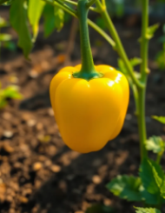

Strategy Report
May 05, 2025
13. Conclusion
Position for Growth
IIkhwezi Farm enters its next phase with a strong foundation of agricultural expertise, market credibility, and a clear vision for sustainable farming. With its renewed infrastructure, Global GAP compliance, and premium-quality produce, the farm is well-positioned to re-establish itself in both domestic and international markets
Commitment for Impact
Beyond commercial success, Ikhwezi Farm is deeply committed to creating lasting social value. Through targeted training programs for youth and women, the farm will foster local economic growth and empowerment, proving that farming can be both profitable and transformative for communities.
Future Outlook
By focusing on quality, innovation, and relationship-driven growth, Ikhwezi Farm will serve as a model for resilient, ethical agriculture. Its renewed operations are poised to deliver consistent value to stakeholders while contributing to broader goals of sustainability, inclusivity, and economic development in South Africa.
Thank you for your interest!
17

