Slide 1
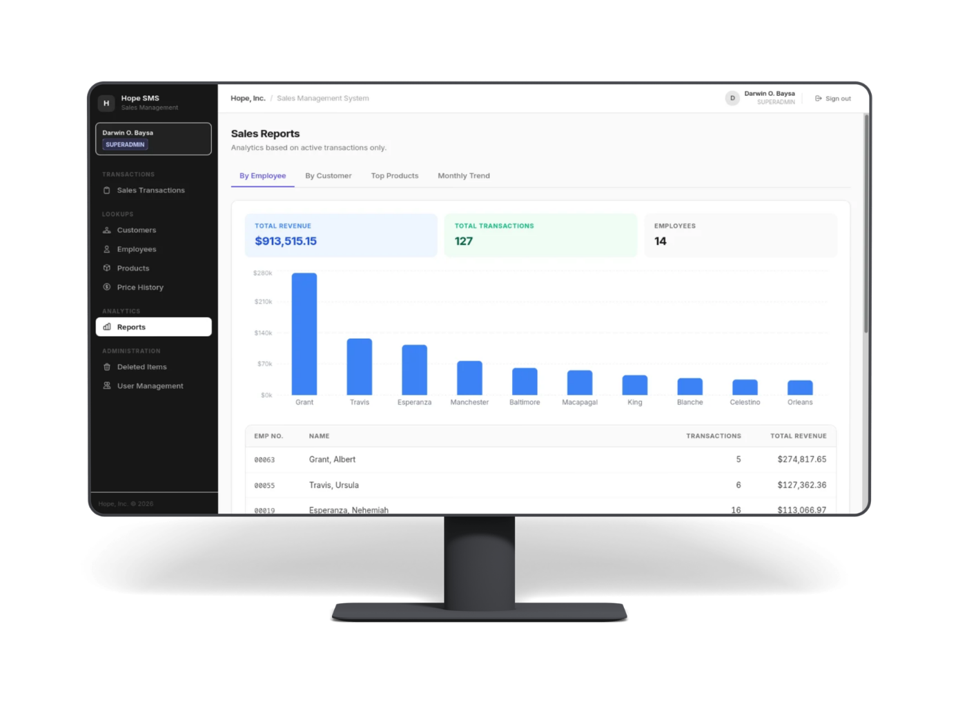
Hope Inc. Sales Management System
Developed by Group 5
M1 - Lance Dwight Aguilar
M2 - Jan Neo Gloria
M3 - Erick Ian Litao
M4 - Jun Angelo Uri
M5 - Darwin Baysa

Slide 2

Overview
HOPE-SMS is a web-application made to streamline sales transactions, while enforcing strict data management and access governance
Objective: To provide a centralized platform for managing sales, customers, and employees, with a real-time analytics reporting
Automated Pricing: Features a pricing logic that fetches unit prices from price listing to prevent manual entry erros
Data Integrity: Implements a “Soft-Delete” policy to transactions and line items,
using ACTIVE/INACTIVE toggle
Security: Driven by a granular 13-point Rights Matrix and Supabase
Row Level Security (RLS) to protect sensitive business data in a production environment.

Slide 3
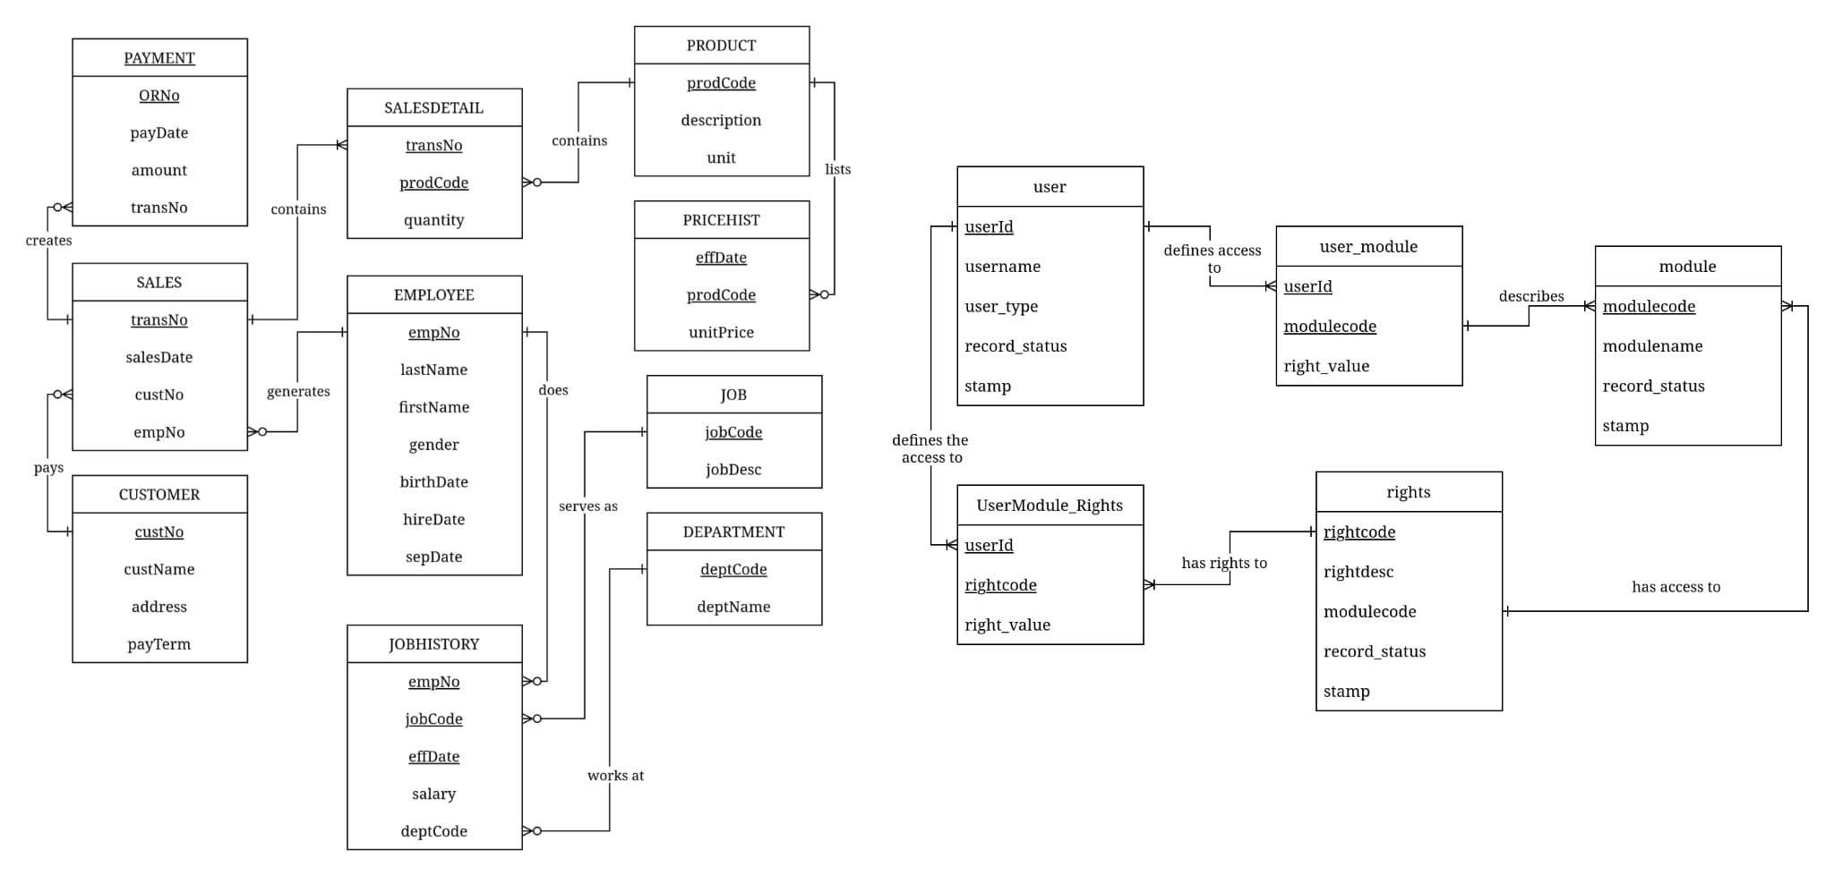

Table Architecture
Notes:
Shows the table stucture of the project , and it's connection to each other

Slide 4
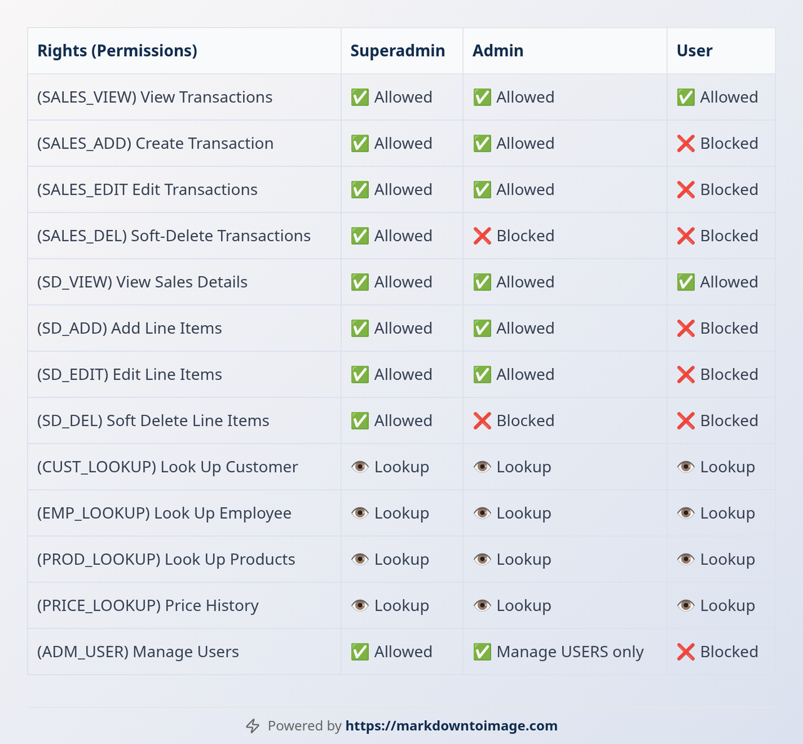

Rights Matrix
Notes:
Shows the rights matrix of the project, where access were defined to a 13-point access toggle

Slide 5
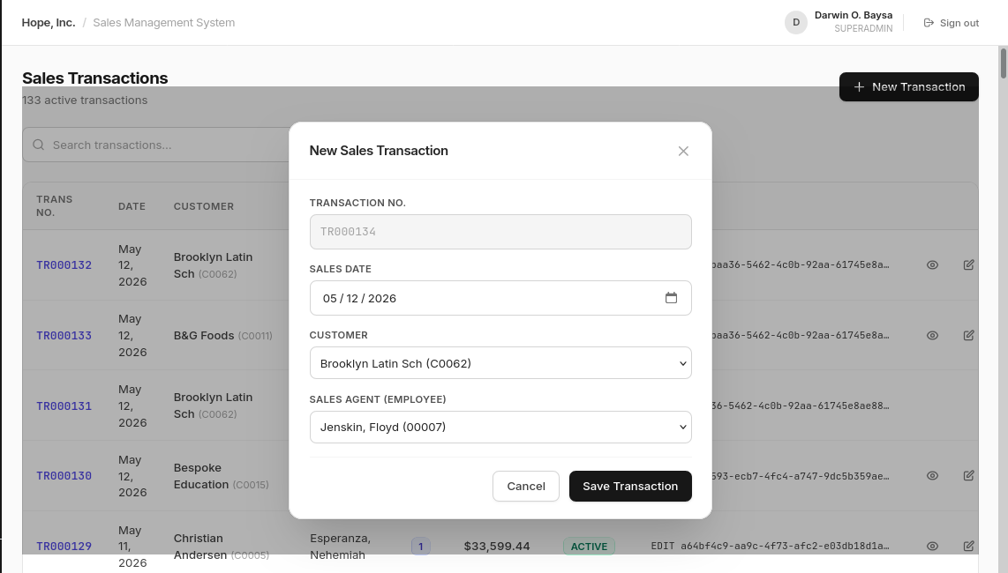
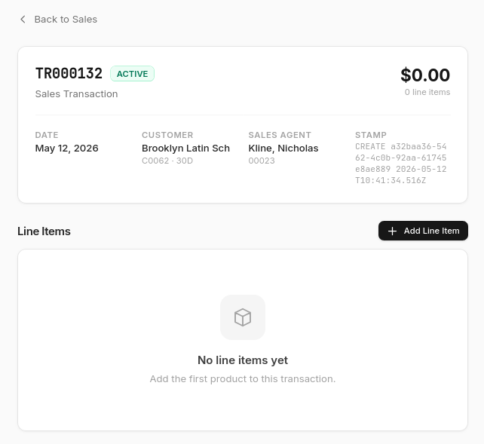

Sales CRUD demo
New Sales Modal
After Transaction creation
Notes:
Shows the Create and Read feature of the Sales Transaction Page.

Slide 6
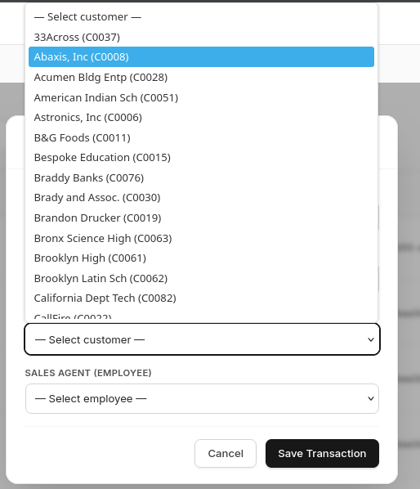
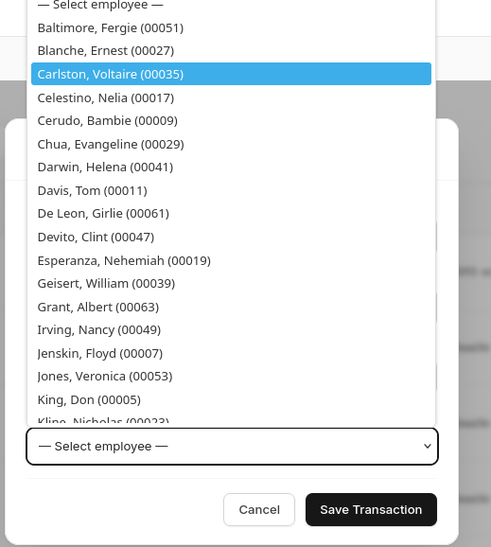
Lookup Integration
Customer Lookup
Employee Lookup
Notes:
Datas were fetched from Customer and Employee Table

Slide 7
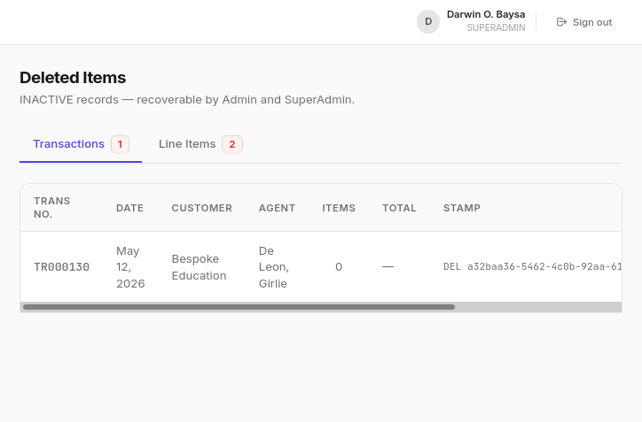
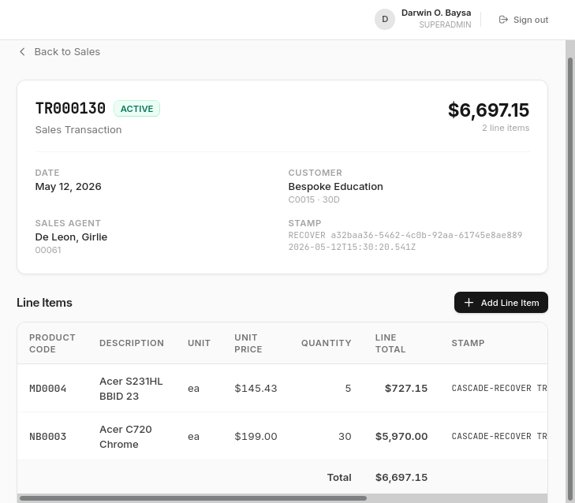
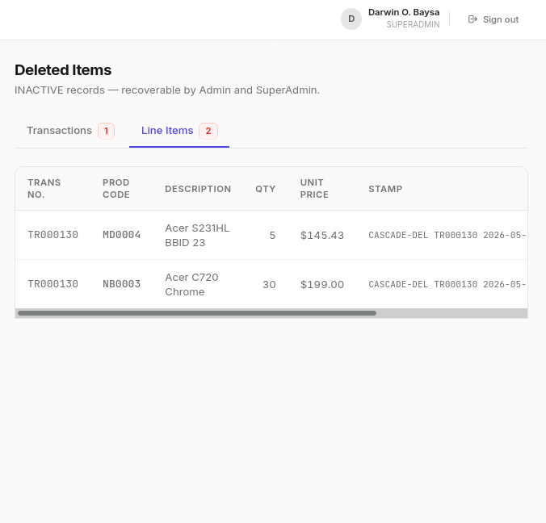
Cascade
After deletion
Before Deletion
Notes:
Focuses on Cascade, where if a Sale Transaction were deleted, it's Line Items will be deleted also. If it's restored, items will also be restored

Slide 8
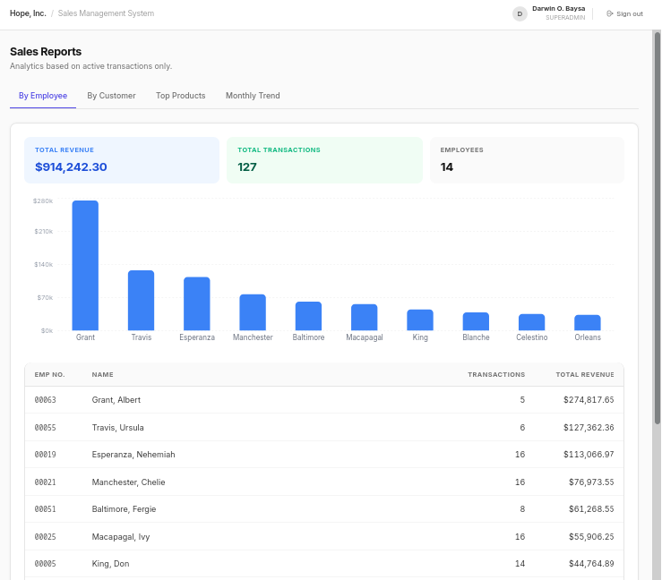

Reports
Notes:
By Employee

Slide 9
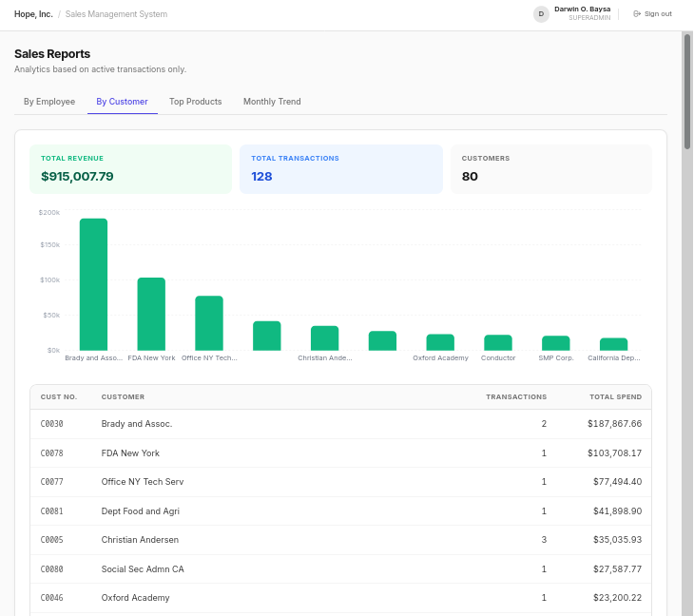
Reports
Notes:
By Customer

Slide 10
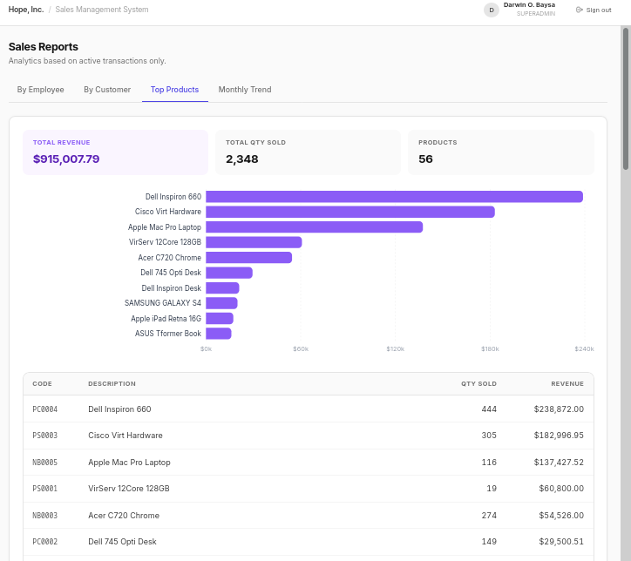
Reports
Notes:
Top Products

Slide 11
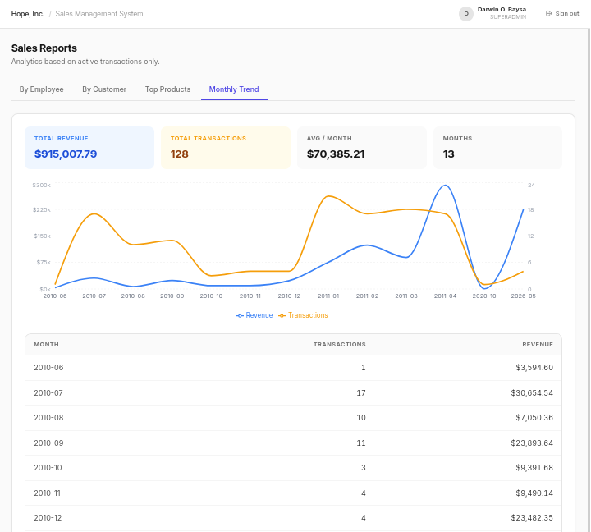
Reports
Notes:
Monthly Trend

Slide 12
Lessons Learned
Challenges of State Synchronization: Implementing Cascade Logic taught us that deactivating a parent record (Sales) requires a robust synchronization strategy to ensure child records (SalesDetail) follow the same governance state without causing data drift.
Granular vs. Generic Permissions: We learned that mapping access to 13 specific functional rights is far superior to using generic role labels. This granularity allows for precise auditing and prevents "privilege creep" within the organization.
Temporal Data Management: Separating the priceHist table from the products table was vital. This taught us how to handle time-sensitive data, ensuring that historical sales reflect the price at the time of purchase, even if current inventory prices change.
Fail-Safe Governance Guards: Implementing the "Superadmin Protection" guard (preventing Admins from disabling the system owner) highlighted the necessity of "hard-coded" safety nets to prevent accidental or malicious system lockouts.
Notes:
Shares what the team learned

Slide 13
Thank you!
Notes:
Adios

