Slide 1
Overall rating of 2019 FIFA Players
Objectives
Questions of interest :
● What is the most significant predictor variable in particular position?
● How does the absence of one predictor variable affect their overall rating?
● Are there situations where player rating have relative higher chances of higher rating with lower numbers in each predictor variable? Does this mean that the predictor variable is not important?
● Are there predictor variables that are redundant to the model?

Slide 2
Response and predictor variables
Response variable:
Overall rating : possible max rating of 100
Predictor variables :
● Crossing, LongPassing, Acceleration, Sprint Speed, Reactions, Positioning
● Jumping, Heading accuracy, Strength, Interceptions, Positioning, Standing tackles, Sliding tackles
● Ball control, Agility, Positioning, LongPassing, ShortPassing
● GKDiving, GKhandling, GKKicking, GKPositioning, GKReflexes
Number of observations: 18205

Slide 3
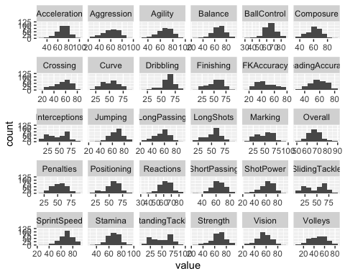

Distributions and Correlations
Overall rating is mostly correlated with:
ShortPassing, Dribbling, BallControl, Reactions and Composure.

Slide 4
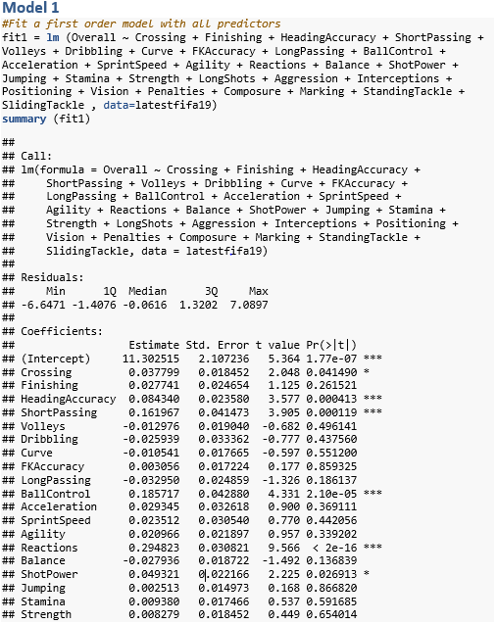
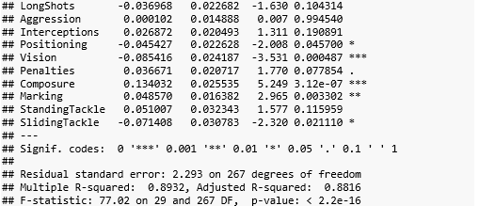
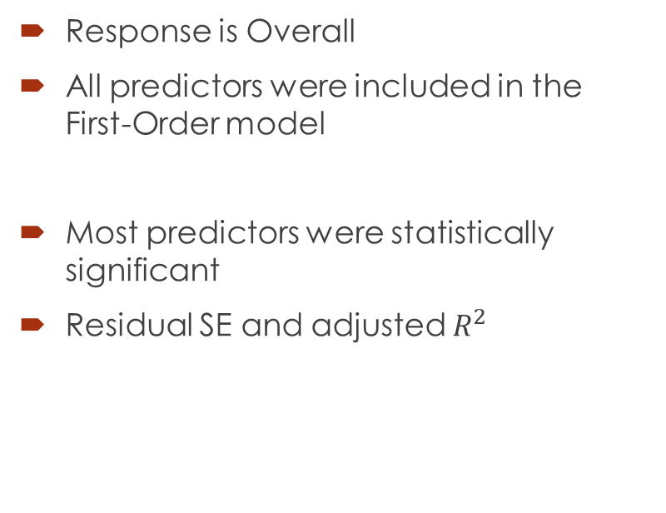
First-order Model
Response is Overall
All predictors were included in the First-Order model
Most predictors were statistically significant
Residual SE and adjusted $R^{2}$

Slide 5
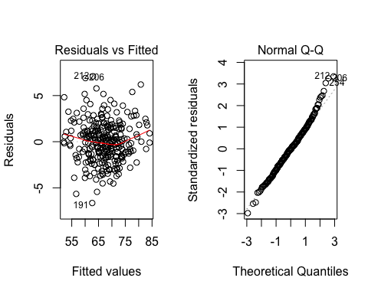
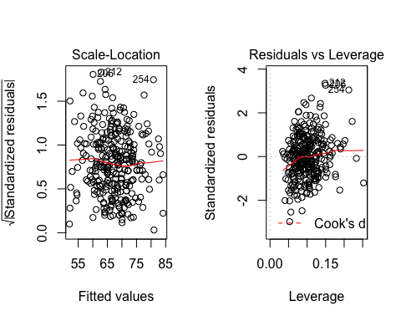
First-order Model: Residual analysis
Residual vs Fitted plot and Normal Q-Q plot:
Consistent with normal sample
Scale-location and Residuals vs Leverage:

Slide 6
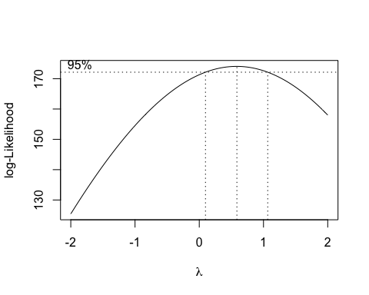
First-order Model: Box-cox

