Slide 1


Information Fusion-Based Model for Lung Nodule Characterization
Master's in Informatics and Computing Engineering
​SUPERVISOR: HÉLDER OLIVEIRA​
CO-SUPERVISOR: TÂNIA PEREIRA​
CO-SUPERVISOR: EDUARDO RODRIGUES
AUTHOR:
JOÃO MALVA​

Slide 2
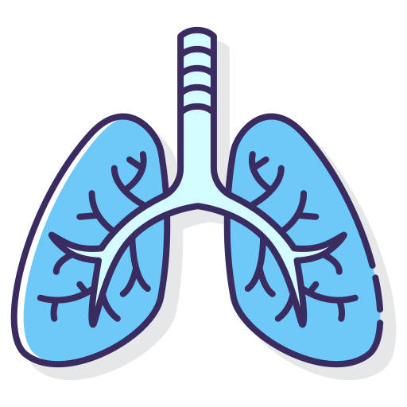


CONTEXT
Leading cause of cancer-related deaths
Growing need to support clinical decision-making
Medical imaging with DL leads to safer diagnosis
Notes:
Lung Cancer is Leading Cause of cancer related deaths
Resulting in a low 5 year survival rate at advanced stages
Could be avoided with early diagnosis
Additionaly, with medical data becoming more complex
There is a need for tools that would better support clinical decision-making
There are already solutions that use medical image with DL models to perform safer diagnosis

Slide 3
PROBLEM
Pure DL-based models have certain limitations regarding:
Accuracy
Generalization
Lack of Explainability
This research aimed to use modern technologies to address a key diagnostic issue in oncology and promote health.

Slide 4
HYPOTHESIS
Information fusion-based model approaches, with shallow and deep features, will result in a more accurate and reliable model for lung cancer characterization, making it better suited for early detection and precise diagnosis
Notes:
For Characterization we focus on malignancy

Slide 5
THEORETICALLY
Information
ML
Prevision
-
DL has better performance
Loss of information usage
Black-box Problem
performance
Image
DL
Prevision
Image
Fusion
Combination of DL representation with image’s extracted information may increase performance
Prevision
+
Information

Slide 6
RESEARCH QUESTIONS
01
Does fusing information from shallow and deep feature extractors improve classification or generalization performance when compared to using a deep approach only?
02
How does the fusion approach behave under varying dataset conditions, such as different sample sizes, bounding‐box definitions, and image representations?
03
In what ways does information fusion contribute to the explainability of lung nodule malignancy predictions?

Slide 7
EXPERIMENTAL PROCEDURE
Preprocessing & Data Preparation
0
1
2
3
4
5
6

Slide 8
DATASET
LIDC-IDRI
Nodule Centroid
Nodule Outlines
Lung Nodule Visual Attributes
Lung Nodule Malignancy
LIDC-IDRI
Nodule Centroid
Nodule Outlines
Lung Nodule Visual Attributes
Lung Nodule Malignancy
Written down by experts
1 = Highly Unlikely
2 = Moderately Unlikely
3 = Indeterminate
4 = Moderately Suspicious
5 = Highly Suspicious
Notes:
LNM Reflects malignancy likelihood for a 60-year-old male smoker

Slide 9
LIDC-IDRI
Normalize HU values to [0, 1]
Resample slice thickness and pixel spacing to 1.0 mm
Extract
2D & 2.5D representations
Clip HU within [-1000, 400]

Slide 10
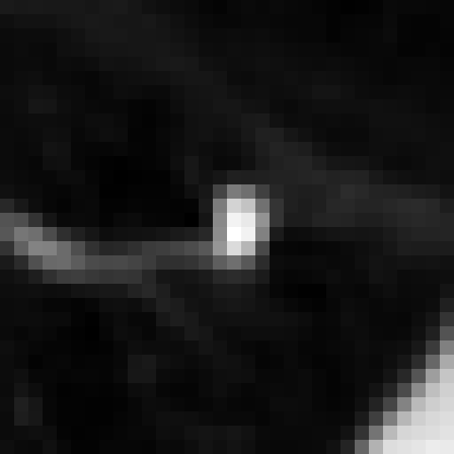
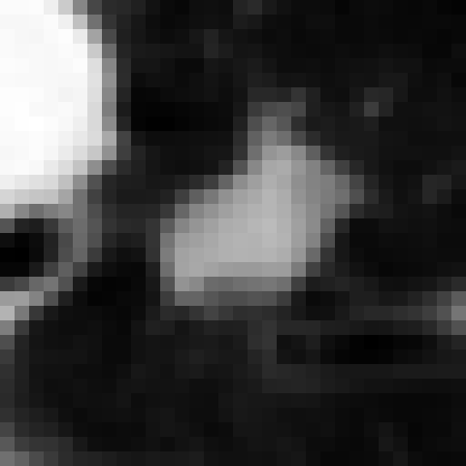
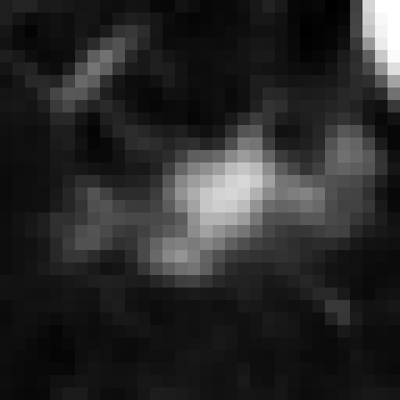
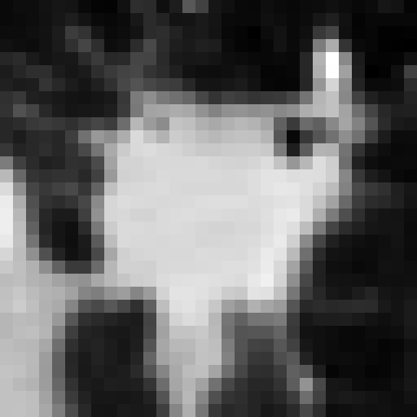
LIDC-IDRI
Image Resolution
32x32 (2D)
Filter LNM
LNM ≠ 3
64x64 (2D)
32x32 (2.5D)
Binary Problem
LNM < 3 then 0
LNM > 3 then 1
Fig. 1: Nodules Samples Characterized as Benign (0)
Fig. 2: Nodules Samples Characterized as Malignant (1)

Slide 11
EXPERIMENTAL PROCEDURE
Preprocessing & Data Preparation
0
1
2
3
4
5
6
Baseline Selection

Slide 12


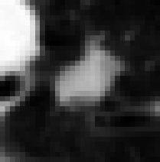
TRAIN SET
(72%)
BASELINE SELECTION
TRAIN SET (72%)
…
TEST SET
(20%)
5-Fold Cross-Validation
100 Max Epochs
Adam as the Optimizer
Binary Cross-Entropy as Loss Function
VALIDATION SET
(8%)

Slide 13
BASELINE SELECTION
MODEL | AUC | ACCURACY | PRECISION | SENSITIVITY
Resnet-18 | 0.82 ± 0.01 | 0.82 ± 0.02 | 0.82 ± 0.05 | 0.77 ± 0.04
Resnet-50 | 0.81 ± 0.02 | 0.81 ± 0.02 | 0.80 ± 0.05 | 0.78 ± 0.07
Resnet-101 | 0.79 ± 0.02 | 0.80 ± 0.02 | 0.76 ± 0.04 | 0.79 ± 0.05
EfficientNet-B0 | 0.80 ± 0.03 | 0.80 ± 0.03 | 0.78 ± 0.04 | 0.76 ± 0.07
EfficientNet-B1 | 0.80 ± 0.03 | 0.80 ± 0.04 | 0.81 ± 0.08 | 0.74 ± 0.05
EfficientNet-B2 | 0.79 ± 0.04 | 0.79 ± 0.04 | 0.77 ± 0.06 | 0.76 ± 0.07
ConvNeXt-Tiny | 0.78 ± 0.02 | 0.79 ± 0.02 | 0.79 ± 0.03 | 0.71 ± 0.06
Table 1: Comparison of Baseline Architectures on the Base Dataset
Notes:
18, 50, 101 -> Deeper: more number of layers
b0, b1, b2 -> Compound Scaling
ConvNeXt -> Bring a CNN inpered by ViT

Slide 14
EXPERIMENTAL PROCEDURE
Single Fusion
Preprocessing & Data Preparation
0
1
2
3
4
5
6
Baseline Selection

Slide 15
FEATURE EXTRACTION
First-Order
Haralick
2D Shape
Gabor Filters
Histogram of Oriented Gradients*
Local Binary Pattern

Slide 16
FEATURE EXTRACTION
Image
Data Conversion
Mask Application
Image
DataConversion: numpy array
Mask Application
Feature Computation
Shape: Area, Perimeter, Sphericity, Elongation…
FOF: Mean, Variance, Skewness, Kurtosis….
Extracted 1D vector
Array
Extracted 1D vector
Feature Computation
Shape: Area, Perimeter…
FOF: Mean, Variance...
…

Slide 17
SINGLE FUSION
Image
Convolution
Max Pooling
ResNet Block
ResNet Block
ResNet Block
ResNet Block
Average Pooling
FC
Output

Slide 18
SINGLE FUSION
Feature
Vector
Image
Convolution
FC
Max Pooling
Normalization
ResNet Block
Stage 1
ResNet Block
Activation
Stage 2
ResNet Block
Channel
Adapter
Stage 3
ResNet Block
Stage 4
Average Pooling
FC
Output

Slide 19
SINGLE FUSION EVALUATION
FEATURE | AUC | ACCURACY | PRECISION | SENSITIVITY
Baseline | 0.82 ± 0.01 | 0.82 ± 0.02 | 0.82 ± 0.05 | 0.77 ± 0.04
FOF | 0.83 ± 0.03 | 0.83 ± 0.03 | 0.82 ± 0.06 | 0.79 ± 0.08
LBP | 0.83 ± 0.01 | 0.83 ± 0.01 | 0.82 ± 0.06 | 0.79 ± 0.06
HOG | 0.82 ± 0.01 | 0.83 ± 0.01 | 0.81 ± 0.03 | 0.80 ± 0.03
Gabor | 0.82 ± 0.01 | 0.82 ± 0.01 | 0.80 ± 0.04 | 0.79 ± 0.07
Shape | 0.84 ±0.02 | 0.84 ± 0.02 | 0.84 ± 0.04 | 0.80 ± 0.05
Haralick | 0.82 ± 0.02 | 0.82 ± 0.01 | 0.81 ± 0.03 | 0.80 ± 0.06
Table 2: Performance of Single Feature Fusion with ResNet-18 at Stage 1
Notes:
Why are only presented Stage 1 fusion?

Slide 20
SINGLE FUSION EVALUATION
FEATURE | AUC | ACCURACY | PRECISION | SENSITIVITY
Baseline | 0.82 ± 0.01 | 0.82 ± 0.02 | 0.82 ± 0.05 | 0.77 ± 0.04
FOF | 0.83 ± 0.03 | 0.83 ± 0.03 | 0.82 ± 0.06 | 0.79 ± 0.08
LBP | 0.83 ± 0.01 | 0.83 ± 0.01 | 0.82 ± 0.06 | 0.79 ± 0.06
HOG | 0.82 ± 0.01 | 0.83 ± 0.01 | 0.81 ± 0.03 | 0.80 ± 0.03
Gabor | 0.82 ± 0.01 | 0.82 ± 0.01 | 0.80 ± 0.04 | 0.79 ± 0.07
Shape | 0.84 ±0.02 | 0.84 ± 0.02 | 0.84 ± 0.04 | 0.80 ± 0.05
Haralick | 0.82 ± 0.02 | 0.82 ± 0.01 | 0.81 ± 0.03 | 0.80 ± 0.06
Table 2: Performance of Single Feature Fusion with ResNet-18 at Stage 1

Slide 21
SINGLE FUSION EVALUATION
FEATURE | AUC | ACCURACY | PRECISION | SENSITIVITY
Baseline | 0.82 ± 0.01 | 0.82 ± 0.02 | 0.82 ± 0.05 | 0.77 ± 0.04
FOF | 0.83 ± 0.03 | 0.83 ± 0.03 | 0.82 ± 0.06 | 0.79 ± 0.08
LBP | 0.83 ± 0.01 | 0.83 ± 0.01 | 0.82 ± 0.06 | 0.79 ± 0.06
HOG | 0.82 ± 0.01 | 0.83 ± 0.01 | 0.81 ± 0.03 | 0.80 ± 0.03
Gabor | 0.82 ± 0.01 | 0.82 ± 0.01 | 0.80 ± 0.04 | 0.79 ± 0.07
Shape | 0.84 ±0.02 | 0.84 ± 0.02 | 0.84 ± 0.04 | 0.80 ± 0.05
Haralick | 0.82 ± 0.02 | 0.82 ± 0.01 | 0.81 ± 0.03 | 0.80 ± 0.06
Table 2: Performance of Single Feature Fusion with ResNet-18 at Stage 1

Slide 22
SINGLE FUSION EVALUATION
FEATURE | AUC | ACCURACY | PRECISION | SENSITIVITY
Baseline | 0.82 ± 0.01 | 0.82 ± 0.02 | 0.82 ± 0.05 | 0.77 ± 0.04
FOF | 0.83 ± 0.03 | 0.83 ± 0.03 | 0.82 ± 0.06 | 0.79 ± 0.08
LBP | 0.83 ± 0.01 | 0.83 ± 0.01 | 0.82 ± 0.06 | 0.79 ± 0.06
HOG | 0.82 ± 0.01 | 0.83 ± 0.01 | 0.81 ± 0.03 | 0.80 ± 0.03
Gabor | 0.82 ± 0.01 | 0.82 ± 0.01 | 0.80 ± 0.04 | 0.79 ± 0.07
Shape | 0.84 ±0.02 | 0.84 ± 0.02 | 0.84 ± 0.04 | 0.80 ± 0.05
Haralick | 0.82 ± 0.02 | 0.82 ± 0.01 | 0.81 ± 0.03 | 0.80 ± 0.06
Table 2: Performance of Single Feature Fusion with ResNet-18 at Stage 1

Slide 23
EXPERIMENTAL PROCEDURE
Preprocessing & Data Preparation
Single
Fusion
0
1
2
3
4
5
6
Baseline Selection
Feature Selection

Slide 24
FEATURE SELECTION
Predictive Power
FEATURE | AUC | ACCURACY | PRECISION | SENSITIVITY
FOF | 0.57 ± 0.08 | 0.53 ± 0.11 | 0.51 ± 0.10 | 0.85 ± 0.13
LBP | 0.55 ± 0.06 | 0.54 ± 0.09 | 0.42 ± 0.23 | 0.65 ± 0.37
HOG | 0.57 ± 0.06 | 0.55 ± 0.09 | 0.52 ± 0.09 | 0.79 ± 0.16
Gabor | 0.65 ± 0.03 | 0.65 ± 0.04 | 0.61 ± 0.05 | 0.64 ± 0.09
Shape | 0.62 ± 0.12 | 0.58 ± 0.14 | 0.54 ± 0.11 | 0.93 ± 0.07
Haralick | 0.57 ± 0.13 | 0.54 ± 0.15 | 0.42 ± 0.25 | 0.77 ± 0.39
Table 3: Performance of Individual Radiomics Feature Vectors with Linear SVM

Slide 25
FEATURE SELECTION
FOF
Batch Size | LEARNING RATE
 | 10⁻³ |  | 10⁻⁴ |  | 10⁻⁵
 | AUC | Stage | AUC | Stage | AUC | Stage
32 | 0.82 ± 0.02 | 1 | 0.81 ± 0.01 | 2* | 0.80 ± 0.01 | 1
64 | 0.83 ± 0.03 | 1 | 0.82 ± 0.02 | 2 | 0.80 ± 0.01 | 2
128 | 0.82 ± 0.02 | 1 | 0.80 ± 0.01 | 1 | 0.79 ± 0.01 | 2**
Table 4: Best AUC and Stage for FOF Fusion
Notes:
*Layer 1,2 and 3 Have the very similar results, the untie is made on the Precsion
**Untie against Layer 1 is made on Precision since all other metrics are the same

Slide 26
FEATURE SELECTION
LBP
Batch Size | LEARNING RATE
 | 10⁻³ |  | 10⁻⁴ |  | 10⁻⁵
 | AUC | Stage | AUC | Stage | AUC | Stage
32 | 0.83 ± 0.01 | 1 | 0.81 ± 0.02 | 1 | 0.81 ± 0.01 | 1
64 | 0.82 ± 0.02 | 1 | 0.82 ± 0.00 | 2 | 0.81 ± 0.01 | 1
128 | 0.81 ± 0.01 | 4 | 0.82 ± 0.00 | 1 | 0.81 ± 0.02 | 2*
Table 5: Best AUC and Stage for LBP Fusion
Notes:
*Untie against Layer 1 is made with Sensitivity although layer 1 very robust results (low std)

Slide 27
FEATURE SELECTION
First-Order
Haralick
2D Shape
Gabor Filters
Histogram of Oriented Gradients
Local Binary Pattern
Low standard deviation
Relatively high increments
Relatively high predictive power
Highest increments
Very stage stable
Low standard deviation
Second highest increments
Notes:
Higlight the selected ones and why

Slide 28
EXPERIMENTAL PROCEDURE
Multi-Feature Fusion
Preprocessing & Data Preparation
Single
Fusion
0
1
2
3
4
5
6
Baseline Selection
Feature Selection

Slide 29
MULTI-FEATURE FUSION
Each
Vector
Image
Convolution
FC
Max Pooling
Normalization
ResNet Block
ResNet Block
Activation
ResNet Block
Channel
Adapter
ResNet Block
Average Pooling
FC
Output

Slide 30
MULTI-FEATURE FUSION
Each
Vector
Image
Convolution
FC
Max Pooling
Normalization
ResNet Block
LBP + FOF + Shape
ResNet Block
Activation
ResNet Block
Channel
Adapter
ResNet Block
Average Pooling
FC
Output

Slide 31
MULTI-FEATURE FUSION
Each
Vector
Image
Convolution
FC
Max Pooling
Normalization
ResNet Block
LBP + FOF
ResNet Block
Activation
ResNet Block
Shape
Channel
Adapter
ResNet Block
Average Pooling
FC
Output

Slide 32
MULTI-FEATURE FUSION
FEATURE | AUC | ACCURACY | PRECISION | SENSITIVITY
Baseline | 0.82 ± 0.01 | 0.82 ± 0.02 | 0.82 ± 0.05 | 0.77 ± 0.04
FOF + LBP | 0.83 ± 0.01 | 0.84 ± 0.01 | 0.83 ± 0.03 | 0.79 ± 0.02
FOF + Shape | 0.84 ± 0.02 | 0.84 ± 0.03 | 0.86 ± 0.07 | 0.78 ± 0.02
LBP + Shape | 0.84 ± 0.02 | 0.85 ± 0.02 | 0.85 ± 0.03 | 0.80 ± 0.02
FOF + LBP + Shape | 0.86 ± 0.01 | 0.86 ± 0.01 | 0.89 ± 0.03 | 0.79 ± 0.04
Table 6: Comparative Performance of ResNet-18 Backbone with Fused Features.
Notes:
Also tested on EffNet and ConvNext
Not presented for simplicity

Slide 33
EXPERIMENTAL PROCEDURE
Preprocessing & Data Preparation
Single
Fusion
Multi-Feature Fusion
0
1
2
3
4
5
6
Baseline Selection
Feature Selection
Dataset Ablation

Slide 34
DATASET ABLATION
Set Name | Dimension | Image Shape | Channels | Filter
Base | 2D | 32x32 | 1 | -
Extreme Scores | 2D | 32x32 | 1 | LNM < 2 ∪ LNM > 4
Central Scores | 2D | 32x32 | 1 | 2 ≤ LNM ≤ 4
High Resolution | 2D | 64x64 | 1 | -
2.5D Multi-Plane | 2.5D | 32x32 | 3 | -
Table 7: Summary of LIDC-IDRI Dataset Variants Used in Experiments
Notes:
Explain the usage of extreme and central scores
Sparce Data

Slide 35
DATASET ABLATION
Set Name | Dimension | Image Shape | Channels | Filter
Base | 2D | 32x32 | 1 | -
Extreme Scores | 2D | 32x32 | 1 | LNM < 2 ∪ LNM > 4
Central Scores | 2D | 32x32 | 1 | 2 ≤ LNM ≤ 4
High Resolution | 2D | 64x64 | 1 | -
2.5D Multi-Plane | 2.5D | 32x32 | 3 | -
Table 7: Summary of LIDC-IDRI Dataset Variants Used in Experiments
Notes:
Sparce Data

Slide 36
DATASET ABLATION
Set Name | Dimension | Image Shape | Channels | Filter
Base | 2D | 32x32 | 1 | -
Extreme Scores | 2D | 32x32 | 1 | LNM < 2 ∪ LNM > 4
Central Scores | 2D | 32x32 | 1 | 2 ≤ LNM ≤ 4
High Resolution | 2D | 64x64 | 1 | -
2.5D Multi-Plane | 2.5D | 32x32 | 3 | -
Table 7: Summary of LIDC-IDRI Dataset Variants Used in Experiments
Notes:
Sparce Data

Slide 37
DATASET ABLATION
Set Name | Dimension | Image Shape | Channels | Filter
Base | 2D | 32x32 | 1 | -
Extreme Scores | 2D | 32x32 | 1 | LNM < 2 ∪ LNM > 4
Central Scores | 2D | 32x32 | 1 | 2 ≤ LNM ≤ 4
High Resolution | 2D | 64x64 | 1 | -
2.5D Multi-Plane | 2.5D | 32x32 | 3 | -
Table 7: Summary of LIDC-IDRI Dataset Variants Used in Experiments

Slide 38
DATASET ABLATION
Set Name | Dimension | Image Shape | Channels | Filter
Base | 2D | 32x32 | 1 | -
Extreme Scores | 2D | 32x32 | 1 | LNM < 2 ∪ LNM > 4
Central Scores | 2D | 32x32 | 1 | 2 ≤ LNM ≤ 4
High Resolution | 2D | 64x64 | 1 | -
2.5D Multi-Plane | 2.5D | 32x32 | 3 | -
Table 7: Summary of LIDC-IDRI Dataset Variants Used in Experiments

Slide 39
DATASET ABLATION
Dataset | Model | AUC | Accuracy | Precision | Sensitivity
Base | Baseline | 0.82 ± 0.01 | 0.82 ± 0.02 | 0.82 ± 0.05 | 0.77 ± 0.04
 | Fusion | 0.86 ± 0.01 | 0.86 ± 0.01 | 0.89 ± 0.03 | 0.79 ± 0.04
Extreme Scores | Baseline | 0.97 ± 0.02 | 0.97 ± 0.02 | 0.97 ± 0.03 | 0.97 ± 0.02
 | Fusion | 0.98 ± 0.01 | 0.98 ± 0.01 | 0.99 ± 0.02 | 0.97 ± 0.00
Central Scores | Baseline | 0.76 ± 0.04 | 0.76 ± 0.05 | 0.72 ± 0.07 | 0.73 ± 0.05
 | Fusion | 0.80 ± 0.01 | 0.81 ± 0.01 | 0.81 ± 0.03 | 0.73 ± 0.04
High Resolution | Baseline | 0.81 ± 0.02 | 0.81 ± 0.02 | 0.80 ± 0.02 | 0.77 ± 0.03
 | Fusion | 0.85 ± 0.03 | 0.85 ± 0.02 | 0.86 ± 0.03 | 0.79 ± 0.04
2.5D Multi-Plane | Baseline | 0.81 ± 0.02 | 0.82 ± 0.02 | 0.80 ± 0.02 | 0.77 ± 0.05
 | Fusion | 0.84 ± 0.01 | 0.84 ± 0.01 | 0.84 ± 0.04 | 0.80 ± 0.03
Table 8: Comparison of ResNet-18 vs. Fused ResNet-18 Across Subsets of Data

Slide 40
EXPERIMENTAL PROCEDURE
Explainability
Preprocessing & Data Preparation
Single
Fusion
Multi-Feature Fusion
0
1
2
3
4
5
6
Baseline Selection
Feature Selection
Dataset Ablation

Slide 41
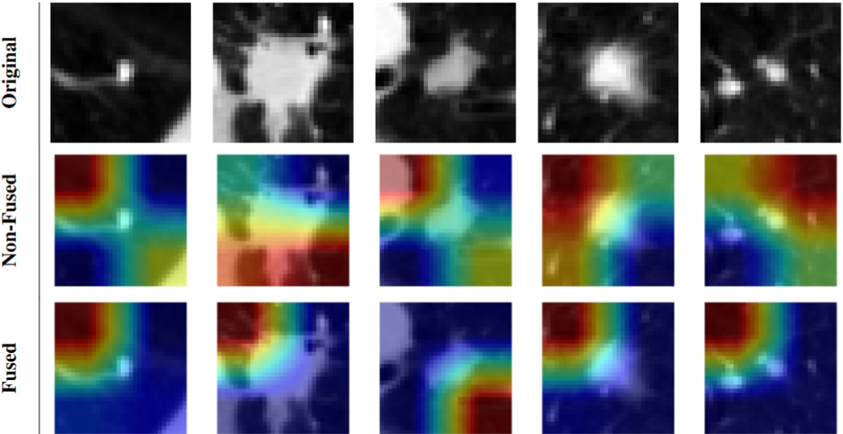
GRAD-CAM
Fusion representations improve model interpretability
Without fusion:
Activation patterns more difuse
Captures more background
With fusion:
Activation patterns more focused
Nodules captured more consistently
Low
Activation Intensity
High
Notes:
Interpretação pessoal
Future work
Localization metrics
clinical valifation

Slide 42
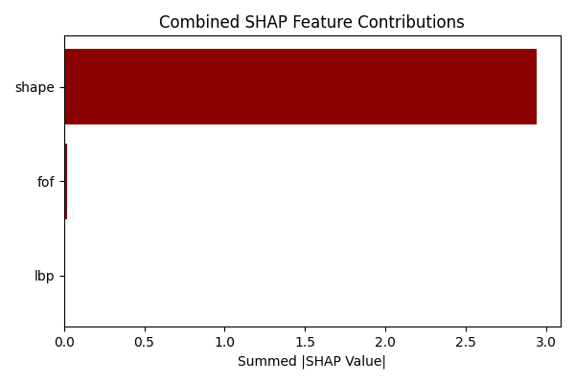
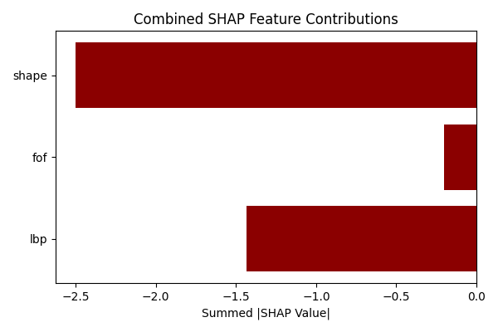
SHAP
Across all 4 categories:
Shape values strongly contribute
FOF and LBP exhibit small contributions
In FP and TN:
LBP contributes more to characterizing non-malignant nodules
True Positive
False Positive
Incorporating features, specially Shape, leans the model to a better decision
False Negative
True Negative

Slide 43
RESEARCH QUESTIONS
01
Does fusing information from shallow and deep feature extractors improve classification or generalization performance when compared to using a deep approach only?
02
How does the fusion approach behave under varying dataset conditions, such as different sample sizes, bounding‐box definitions, and image representations?
03
In what ways does information fusion contribute to the explainability of lung nodule malignancy predictions?

Slide 44
RESEARCH QUESTIONS
01
Does fusing information from shallow and deep feature extractors improve classification or generalization performance when compared to using a deep approach only?
Best fused ResNet-18 models outperform non-fused baselines
Specially, 2D Shape-based features complement deep representations
Improvements are consistent across ResNet, EfficientNet, and ConvNeXt, showing generalizability

Slide 45
RESEARCH QUESTIONS
01
02
How does the fusion approach behave under varying dataset conditions, such as different sample sizes, bounding‐box definitions, and image representations?
In various datasets conditions, performance metrics are higher than respective baseline
Fusion compensates for data sparsity
Fusion strategies adapt better to input variability than pure DL

Slide 46
RESEARCH QUESTIONS
03
In what ways does information fusion contribute to the explainability of lung nodule malignancy predictions?
Grad-CAM heatmaps for fused models show more focused and more clinically meaningful activations
SHAP analysis highlights the importance of handcrafted features in influencing the model towards the right decision
Fused models provide a better rationale for predictions, which supports clinical trust and decision-making

Slide 47
HYPOTHESIS
Information fusion-based model approaches, with shallow and deep features, will result in a more accurate and reliable model for lung cancer characterization, making it better suited for early detection and precise diagnosis
01
02
03
Performance
Robustness
&
Generalization
Explainability

Slide 48
FINAL STATEMENT
The proposed fusion approach leads to more accurate, robust, and interpretable models for lung nodule characterization, making it better suited for early detection and clinical application

Slide 49
Information Fusion-Based Model for Lung Nodule Characterization
Master's in Informatics and Computing Engineering
​SUPERVISOR: HÉLDER OLIVEIRA​
CO-SUPERVISOR: TÂNIA PEREIRA​
CO-SUPERVISOR: EDUARDO RODRIGUES
AUTHOR:
JOÃO MALVA​

Slide 50
MAIN CONTRIBUTIONS
1
Development of a Fusion-Based Diagnostic Framework
2
Systematic Evaluation of Fusion Strategies
3
Enhanced Explainability in AI-Driven Diagnostics
4
Empirical Validation Across Diverse Data Conditions
5
Contribution to Sustainable Development Goal 3

Slide 51
FUTURE WORK
1
Application to 3D and Temporal Data
2
Automated Feature Selection and Optimization
3
Hyperparameter Tuning of Feature Extractors
4
Multi-Label Classification
5
Clinical Validation and Deployment
6
Benchmarking Against Multicenter Datasets

Slide 52
FEATURE EXTRACTION
FOF
Mean
Variance
Haralick
Angular Second Moment
Shape
Mesh Surface
Sphericity
Median
Root Mean Squared
Interquartile Range
Range
Mean Absolute Deviation
Robust Mean Absolute Deviation
Skewness
Kurtosis
Energy
Total Energy
Uniformity
Entropy
Minimum
Maximum
10th Percentile
90th Percentile
Variance
Contrast
Correlation
Inverse Difference Moment
Sum Average
Sum Variance
Sum Entropy
Entropy
Difference Variance
Difference Entropy
Information Measure Of Correlation I
Information Measure Of Correlation II
Maximum Diameter
Perimeter
Perimeter-surface Ratio
Major Axis Length
Minor Axis Length
Elongation
…

Slide 53
MULTI-FEATURE FUSION
Fused EfficientNet-B0 Model: FOF, LBP, and Shape
FEATURE | AUC | ACCURACY | PRECISION | SENSITIVITY
Baseline | 0.80 ± 0.03 | 0.80 ± 0.03 | 0.78 ± 0.04 | 0.76 ± 0.07
FOF + LBP | 0.82 ± 0.02 | 0.82 ± 0.02 | 0.80 ± 0.02 | 0.80 ± 0.05
FOF + Shape | 0.82 ± 0.03 | 0.82 ± 0.03 | 0.80 ± 0.03 | 0.80 ± 0.04
LBP + Shape | 0.83 ± 0.03 | 0.84 ± 0.02 | 0.86 ± 0.02 | 0.75 ± 0.06
FOF + LBP + Shape | 0.81 ± 0.02 | 0.81 ± 0.02 | 0.81 ± 0.03 | 0.75 ± 0.04

Slide 54
MULTI-FEATURE FUSION
Fused ConvNeXt (Tiny) Model: FOF, LBP, and Shape
FEATURE | AUC | ACCURACY | PRECISION | SENSITIVITY
Baseline | 0.78 ± 0.02 | 0.79 ± 0.02 | 0.79 ± 0.03 | 0.71 ± 0.06
FOF + LBP | 0.78 ± 0.01 | 0.79 ± 0.01 | 0.79 ± 0.04 | 0.73 ± 0.04
FOF + Shape | 0.79 ± 0.02 | 0.79 ± 0.02 | 0.76 ± 0.04 | 0.77 ± 0.04
LBP + Shape | 0.79 ± 0.01 | 0.79 ± 0.01 | 0.76 ± 0.01 | 0.77 ± 0.04
FOF + LBP + Shape | 0.79 ± 0.01 | 0.80 ± 0.01 | 0.83 ± 0.05 | 0.69 ± 0.05

Slide 55
FEATURE SELECTION
Shape
Batch Size | LEARNING RATE
 | 10⁻³ |  | 10⁻⁴ |  | 10⁻⁵
 | AUC | Stage | AUC | Stage | AUC | Stage
32 | 0.84 ± 0.02 | 1 | 0.83 ± 0.01 | 2 | 0.81 ± 0.01 | 2
64 | 0.83 ± 0.02 | 1 | 0.82 ± 0.01 | 1 | 0.81 ± 0.01 | 2
128 | 0.82 ± 0.01 | 1 | 0.82 ± 0.01 | 2 | 0.81 ± 0.00 | 2
Best AUC and Stage for Shape Fusion

Slide 56
FEATURE SELECTION
Gabor
Batch Size | LEARNING RATE
 | 10⁻³ |  | 10⁻⁴ |  | 10⁻⁵
 | AUC | Stage | AUC | Stage | AUC | Stage
32 | 0.81 ± 0.01 | 4 | 0.81 ± 0.01 | 3* | 0.80 ± 0.01 | 2
64 | 0.82 ± 0.01 | 1 | 0.81 ± 0.01 | 2 | 0.81 ± 0.01 | 2
128 | 0.82 ± 0.02 | 4 | 0.81 ± 0.01 | 1 | 0.80 ± 0.01 | 2
Best AUC and Stage for Gabor Fusion
Notes:
*Untie against Layers 1 and 2 based on Sensitivity since is usually more important we want to catch all possible positives, even at the cost of some false alarms.

Slide 57
FEATURE SELECTION
Haralick
Batch Size | LEARNING RATE
 | 10⁻³ |  | 10⁻⁴ |  | 10⁻⁵
 | AUC | Stage | AUC | Stage | AUC | Stage
32 | 0.82 ± 0.02 | 1 | 0.81 ± 0.02 | 2 | 0.80 ± 0.01 | 2
64 | 0.81 ± 0.02 | 2 | 0.81 ± 0.01 | 2 | 0.78 ± 0.01 | 1*
128 | 0.81 ± 0.01 | 3 | 0.82 ± 0.01 | 2 | 0.79 ± 0.01 | 2
Best AUC and Stage for Haralick Fusion
Notes:
*Althoug every layer performs the same in all metrics

Slide 58
FEATURE SELECTION
HOG
Batch Size | LEARNING RATE
 | 10⁻³ |  | 10⁻⁴ |  | 10⁻⁵
 | AUC | Stage | AUC | Stage | AUC | Stage
32 | 0.81 ± 0.02 | 1 | 0.81 ± 0.01 | 4 | 0.81 ± 0.02 | 1
64 | 0.81 ± 0.01 | 4 | 0.80 ± 0.01 | 3 | 0.80 ± 0.02 | 1
128 | 0.82 ± 0.01 | 1 | 0.81 ± 0.01 | 1 | 0.79 ± 0.01 | 1
Best AUC and Stage for HOG Fusion

Slide 59
DATASET ABLATION
Dataset | Model | AUC | Accuracy | Precision | Sensitivity
Base | Baseline | 0.82 ± 0.01 | 0.82 ± 0.02 | 0.82 ± 0.05 | 0.77 ± 0.04
 | Fusion | 0.86 ± 0.01 | 0.86 ± 0.01 | 0.89 ± 0.03 | 0.79 ± 0.04
Extreme Scores | Baseline | 0.97 ± 0.02 | 0.97 ± 0.02 | 0.97 ± 0.03 | 0.97 ± 0.02
 | Fusion | 0.98 ± 0.01 | 0.98 ± 0.01 | 0.99 ± 0.02 | 0.97 ± 0.00

Slide 60
DATASET ABLATION
Dataset | Model | AUC | Accuracy | Precision | Sensitivity
Base | Baseline | 0.82 ± 0.01 | 0.82 ± 0.02 | 0.82 ± 0.05 | 0.77 ± 0.04
 | Fusion | 0.86 ± 0.01 | 0.86 ± 0.01 | 0.89 ± 0.03 | 0.79 ± 0.04
Central Scores | Baseline | 0.76 ± 0.04 | 0.76 ± 0.05 | 0.72 ± 0.07 | 0.73 ± 0.05
 | Fusion | 0.80 ± 0.01 | 0.81 ± 0.01 | 0.81 ± 0.03 | 0.73 ± 0.04

Slide 61
DATASET ABLATION
Dataset | Model | AUC | Accuracy | Precision | Sensitivity
Base | Baseline | 0.82 ± 0.01 | 0.82 ± 0.02 | 0.82 ± 0.05 | 0.77 ± 0.04
 | Fusion | 0.86 ± 0.01 | 0.86 ± 0.01 | 0.89 ± 0.03 | 0.79 ± 0.04
High Resolution | Baseline | 0.81 ± 0.02 | 0.81 ± 0.02 | 0.80 ± 0.02 | 0.77 ± 0.03
 | Fusion | 0.85 ± 0.03 | 0.85 ± 0.02 | 0.86 ± 0.03 | 0.79 ± 0.04

Slide 62
DATASET ABLATION
Dataset | Model | AUC | Accuracy | Precision | Sensitivity
Base | Baseline | 0.82 ± 0.01 | 0.82 ± 0.02 | 0.82 ± 0.05 | 0.77 ± 0.04
 | Fusion | 0.86 ± 0.01 | 0.86 ± 0.01 | 0.89 ± 0.03 | 0.79 ± 0.04
2.5D Multi-Plane | Baseline | 0.81 ± 0.02 | 0.82 ± 0.02 | 0.80 ± 0.02 | 0.77 ± 0.05
 | Fusion | 0.84 ± 0.01 | 0.84 ± 0.01 | 0.84 ± 0.04 | 0.80 ± 0.03

