Slide 1
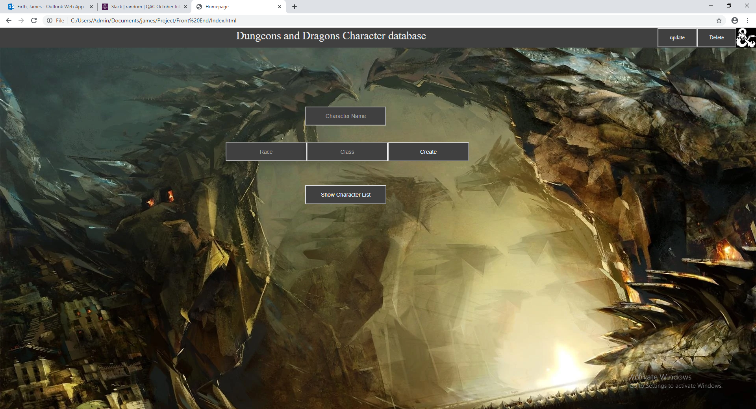
Dungeons and dragons character database

Slide 2
User Stories
As a user I want to add characters so that I can make my character.
As an admin I want to delete characters so that I can remove unused/deceased characters.
As an admin I want to update character names so that I can correct spelling errors or add character titles.
As a user I want to view characters so that I know who my party members are.

Slide 3
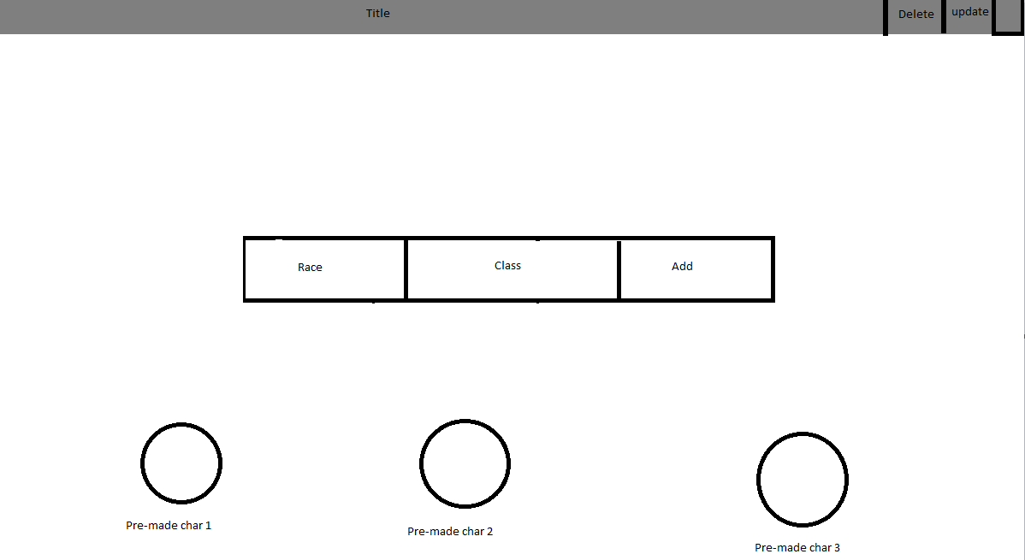
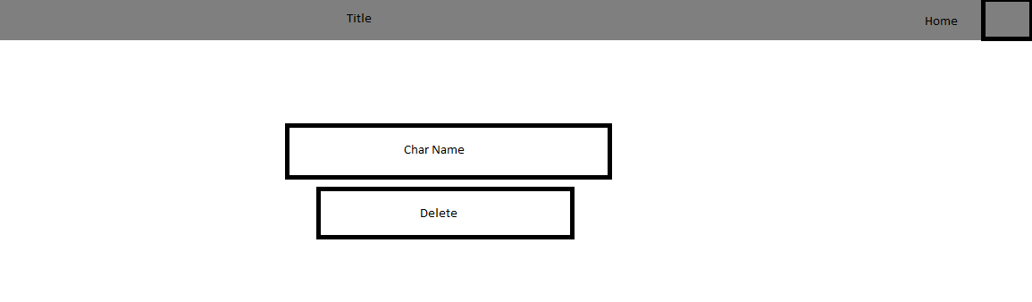
Wire frames

Slide 4
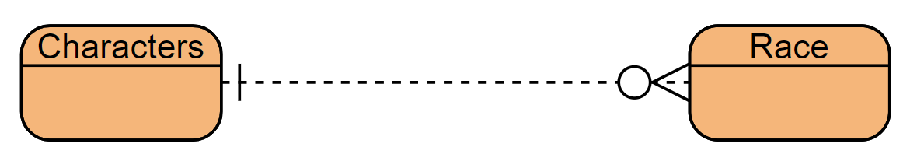
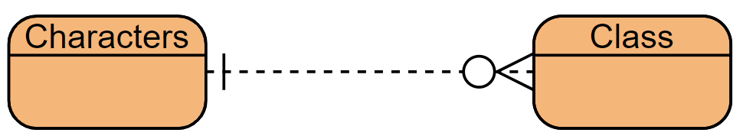
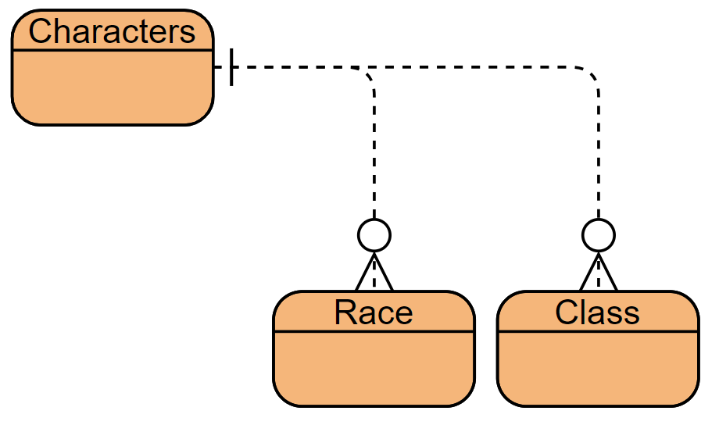
Entity relationship diagrams (ERD)

Slide 5
What did/didn’t go well
The API worked well with postman upon initial completion but struggled to get the fetch statements working.
Using drop down menu’s for race and class was a convenient solution to the problem of typing errors.
Update character name is fiddly and doesn’t work very well due to being case sensitive.

Slide 6
What had to be abandoned or pushed back
Login function
Racial and Class bonus stats, character stat pages
Class icon on the show characters
Items
Full Race list
Full Class list

Slide 7
Must have, should have, could have, won’t have.
Must have, a way to add characters.
Must have, a way to remove characters.
Must have, a way to update character names.
Must have, a way to view characters.
Should have, a choice of at least 2 races or classes.
Should have, multiple pages to navigate through.
Should have, a stat page for the characters.
Could have, bonus stats tied to races and or classes.
Could have, stat roll function and character creation screen.
Won’t have, current/completed campaign names.
Won’t have, current character status.

