Slide 1
Lending Club Case Study

Slide 2
Objective of the exercise
The basic objective of this case study is to implement exploratory data analysis techniques on a real world scenario and understand how banks use these techniques to minimize their risk of lending money and optimize recoveries. This example utilizes data rendered in a csv file and how to consume that via various python libraries.
Benefits derived from the case study:-
Basic understanding how the banking and financial services work and minimize the loss of money while lending it to the clients.
Gives a basic idea about how the EDA is implemented in real – life problems.
Gives a very critical insight into how visualization part through different types of graphs and charts give an essential role in analysing real – life data.
Gives a chance to understand how large amount of data is handled in real-life and how analytics play an important role in identifying the critical benefactors for achieving a said goal.

Slide 3
Step 1 – Data cleansing & standardization
Understanding Data
Data Consumption
Missing Values
Outliers treatment
Standardization
Data cleansing & standardization:-
Understanding Data – The data is analysed by using human intelligence and analytical skills.
Data Consumption – Data is then consumed via python libraries such as Numpy and Pandas so as to prepare data to be analysed through code. Typically, the excel/csv data is consumed in a dataframe which is then utilised for the entire length of the code cycle.
Missing Values– The data is then cleansed after identifying the columns and rows with 100% null values which are useless for any analysis. Furthermore the data is then trimmed down where in columns containing more than 50% null or 0 values are removed.
Standardization –Data is throughly, standardized using various techniques available in the libraries offered by Python. E.g. columns and rows with lot of missing values or only 1 values, irrelavent data are deleted & values are standardised in format.
Outliers treatment – Finally the values that are out of range e.g. too high or too low and can mess up the data are cleansed.

Slide 4
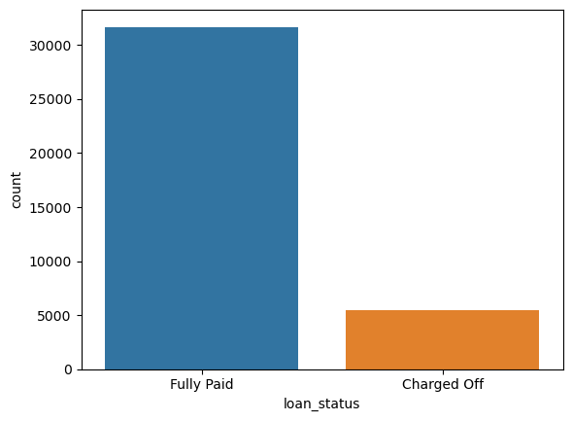
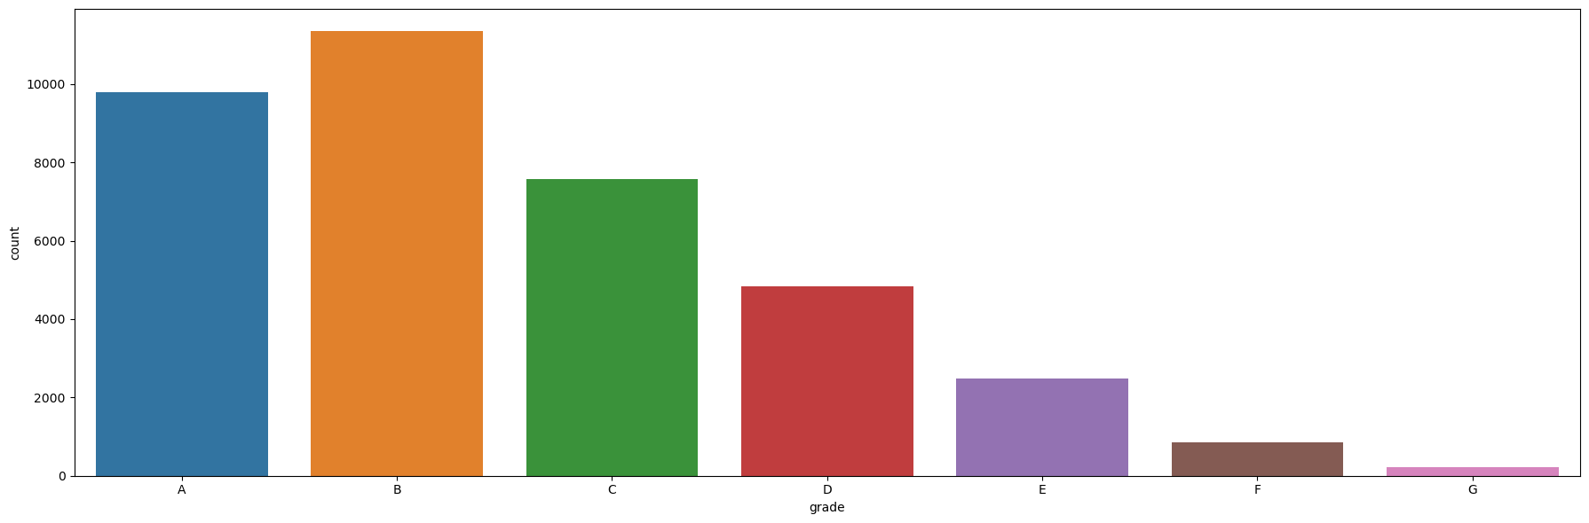
Step 2 – Univariate analysis
Loan Status
Charged off people are less than fully paid
Grades
Grade B showcasing the highest count of people with loans and G being the lowest in count

Slide 5
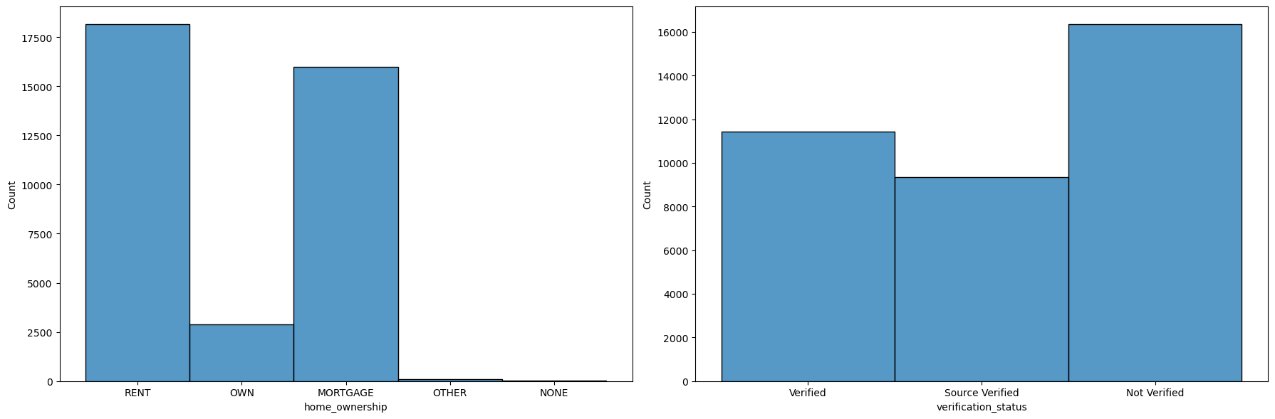
Home ownership & verification status
Home Ownership – People with the accommodation status as Rent or Mortgage have the highest number of loans
Verification Status – Number of unverified people is the highest as seen above.

Slide 6
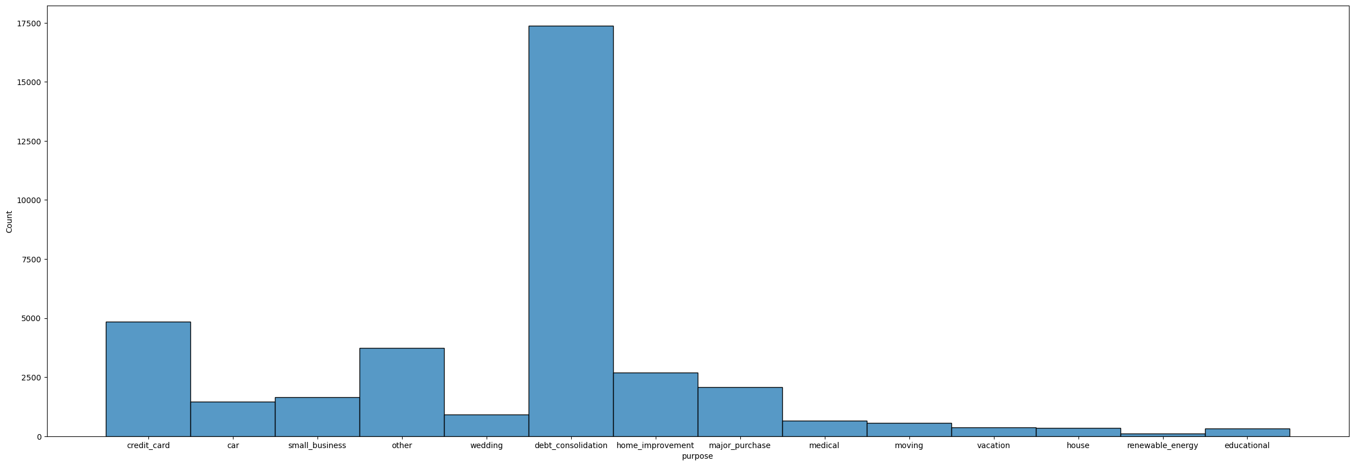
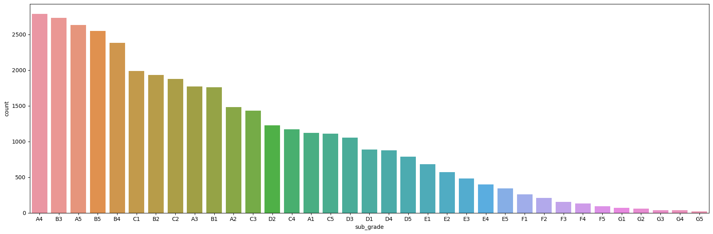
Purpose & Sub-grade count
Sub-Grade count
Most people having loans lie in the sub-grade parents A and C as shown below.
Purpose
Most people have taken loan for another debt repayment. Habitual loan takers/defaulters can be identified here.

Slide 7
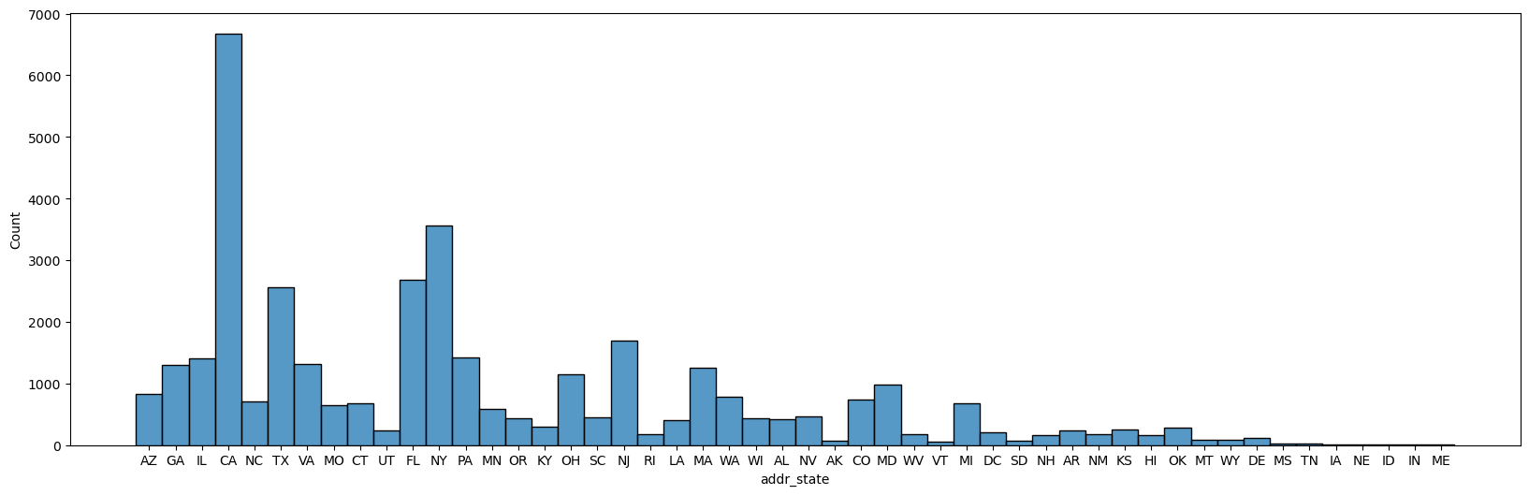
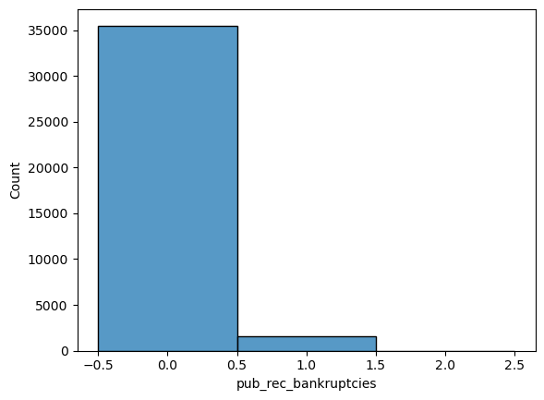
Address state and public record of bankrupcies
Public state of bankruptcies
Most people have 0 or close to 0 state of bankruptcy.
Address state
Most people residing in big cities e.g.(CA and NY)

Slide 8
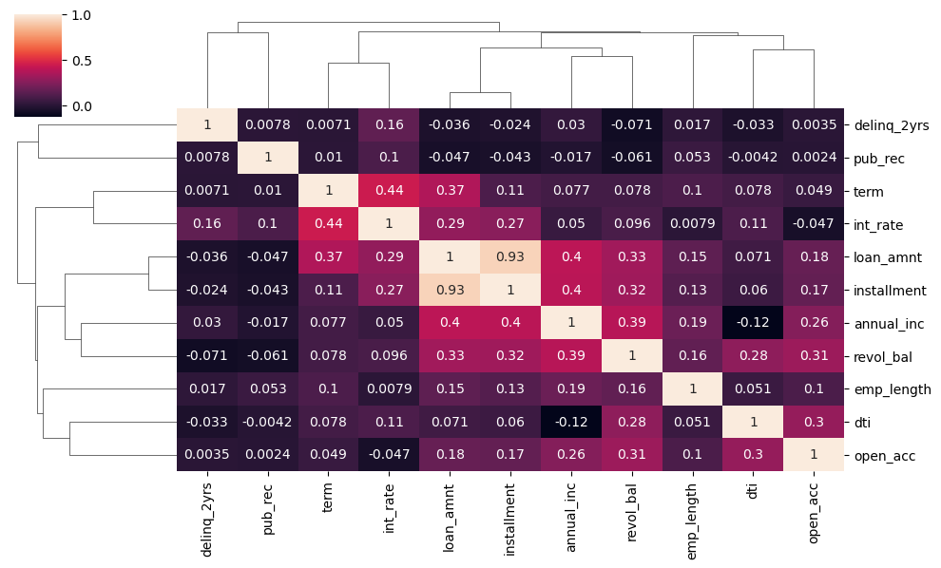
Numerical columns analysis with a heat map
Observations:
Loan amount and Installment are highest correlated - means higher loan amount - higher installment.
Loan amount annual income also have positive correlation.
Term and interest rate also have positive correlation.
Loan-amount and public record have negative correlation and hence are inversely proportional.

Slide 9
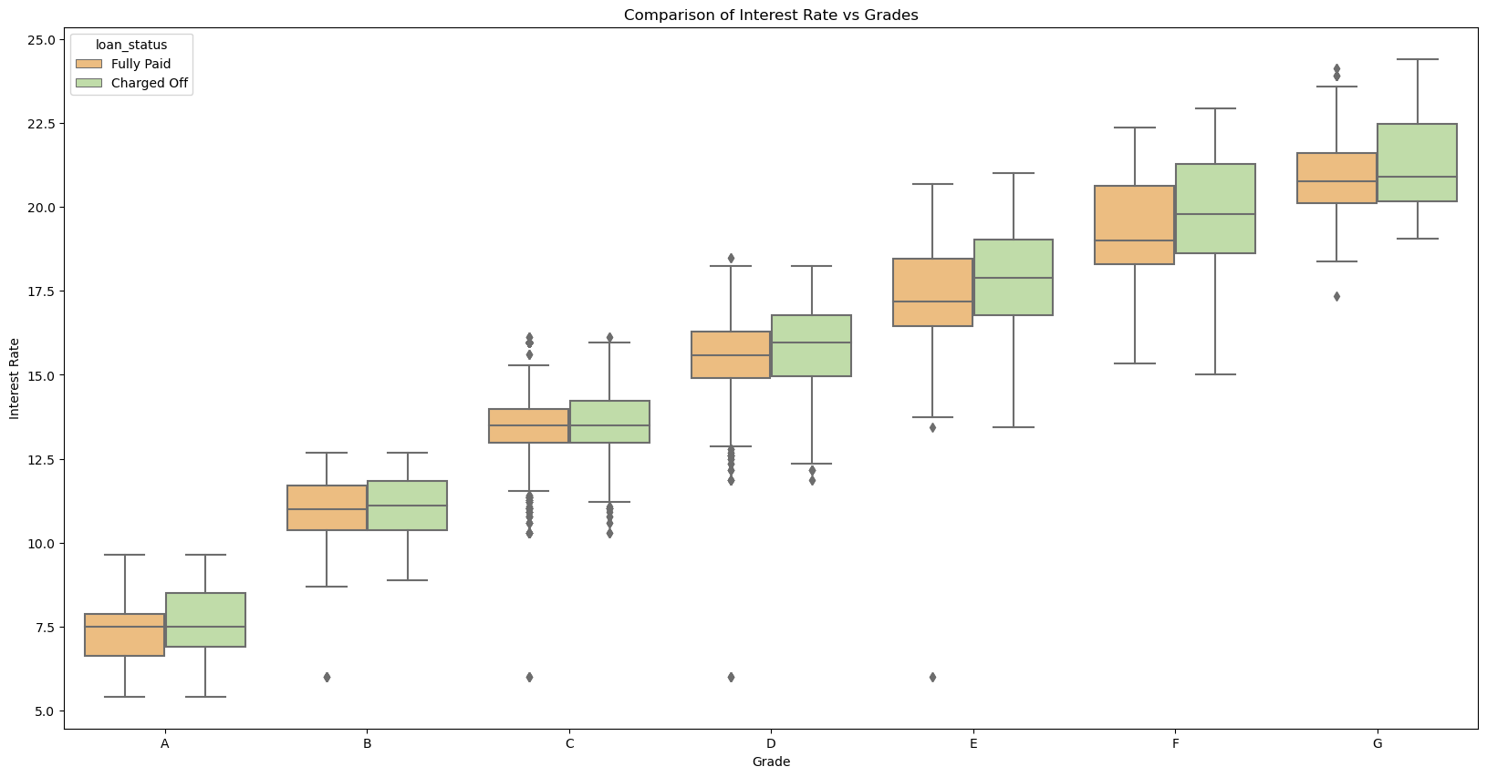
Step 3 – Bivariate analysis Loan status vs Interest rate and grades
Observation :- The above box plotting clearly indicates the that interest rate keep on increasing as the grade decreases . We also see that E-G have wider box plots means more charge off than compared to other grades. Lets visualize better picture to confirm using percentage.

Slide 10
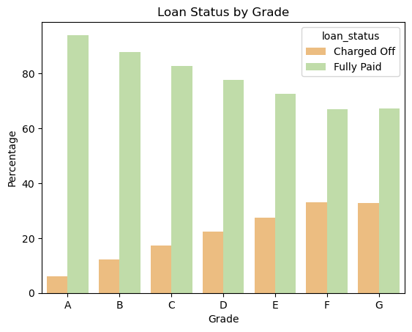
Loan Status by Grades
Observation :- Through the above plotting we clearly see that the higher the grade i.e. A is higher than B,C, D etc. lower the chances of defaulting and vice versa people with grade G are at the highest risk of defaulting.

Slide 11
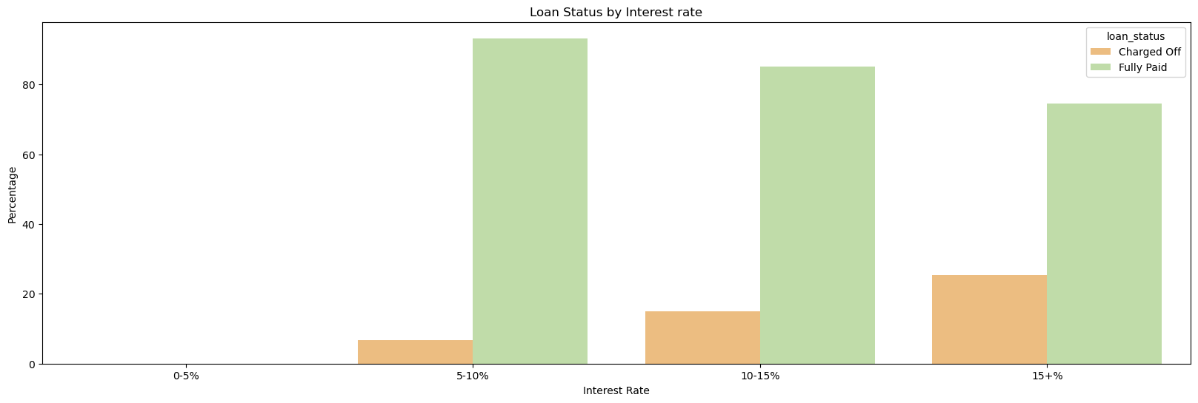
Interest rate vs Loan status
Observation :- It can be clearly seen that people borrowing at higher rate of interest have higher chances of defaulting as we can see the charged off ratio gradually increasing with the rate of interest.

Slide 12
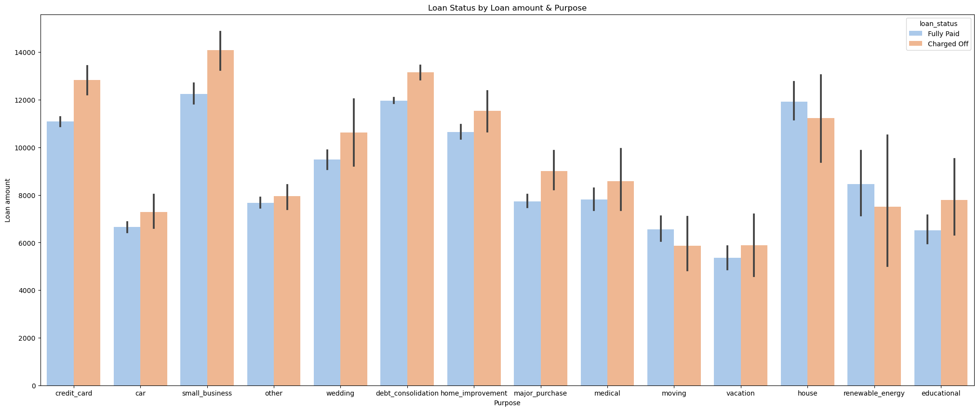
Loan status vs Loan amount & purpose
Observation :- Customers are taking larger amount of loans for either small businesses, credit card or for debt consolidation. Also in terms of Loan status we can see that higher number of loans is being charged-off rather than being fully paid in small_business , credit cards and debt_consolidation scenarios.This shows higher risk for the bank to invest money in these 3 areas.

Slide 13
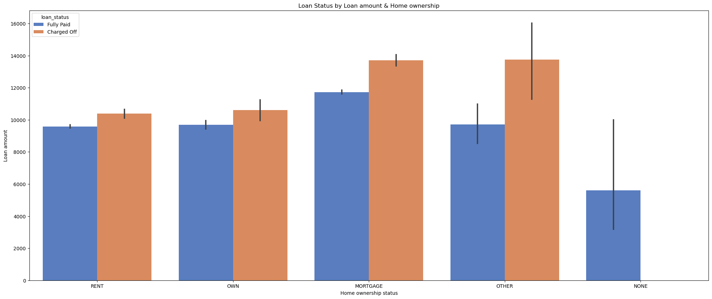
Loan status vs Loan amount & Home ownership
Observation :- It is seen that the customers having home ownership status as Mortgage or derived from other sources
are more likely to default or get their loans charged off rather than people with owned accomodations or rented ones.

Slide 14
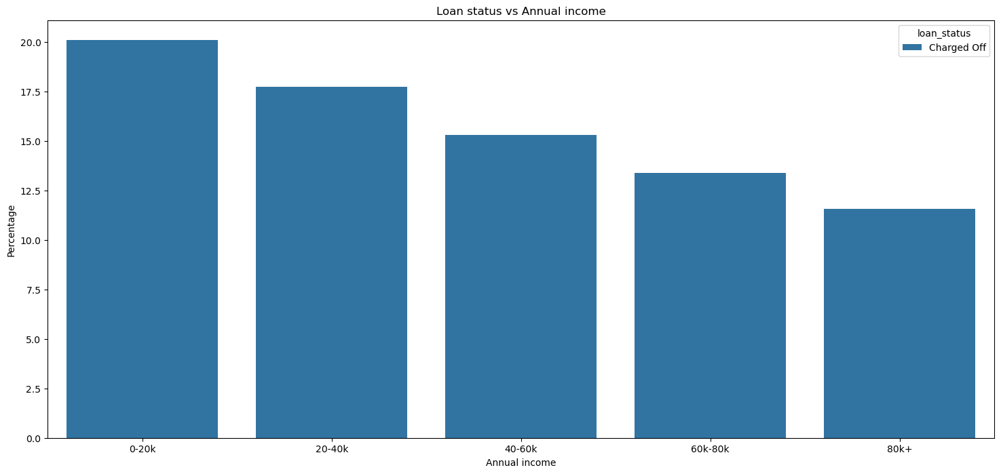
Loan status vs Annual income
Observation :- It is seen through the above graph that with the increase in the annual income the chances of defaulting or the loan being charged off decreases considerably.

Slide 15
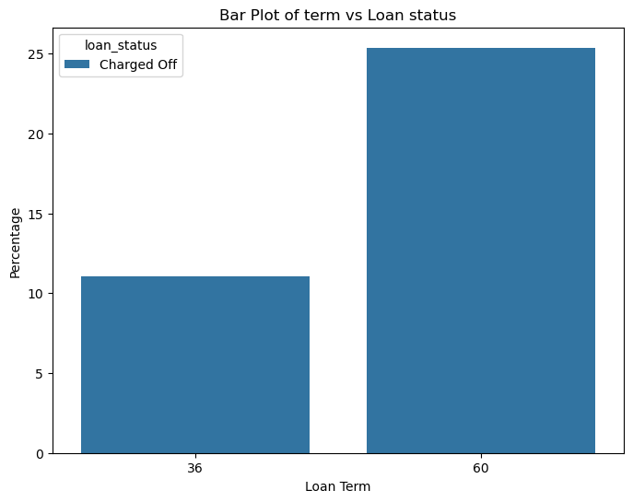
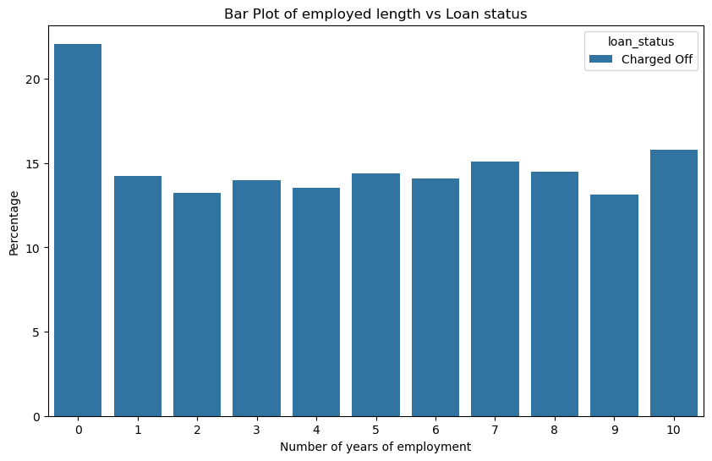
Loan status against Employed length and Term (duration of loan)
Loan status vs Employed length
It is observed people with higher employed
Lengths are at a lower risk of defaulting with lower charged-off ratios.
Loan status vs duration of loan
It is observed below that the people with higher duration of loan are expected to default more than the smaller ones.

Slide 16
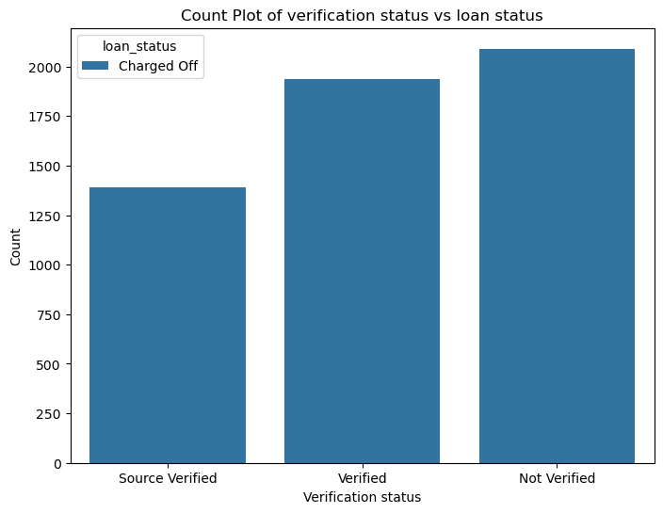
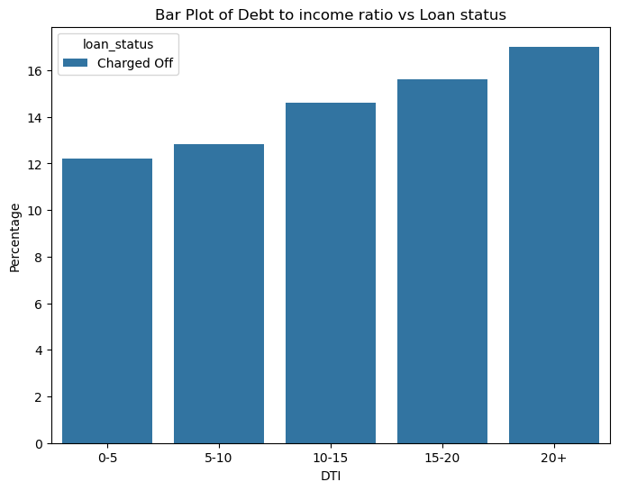
Loan status vs DTI(Debt to income ratio) and Verification status
Loan status vs DTI
It is observed that the people with “NOT verified” status are the ones with the most charged off loans and hence are at a higher risk of being defaulters.
Loan status vs Verification status
It is observed that the people with a higher debt to income ratio are at a higher risk of defaulting.

Slide 17
Final outcome
Critical factors that should affect the decision-making process of the bank :-
Grades & Subgrade
Interest rates
Purpose
Home ownership
Annual income
Debt to Income ratio
Duration of loan
Verification status

Slide 18
Recommendations to the bank after analysis of the data
1: People having higher grades e.g. A being higher than B,C,D have lesser chances of defaulting and can be seen as a profitable strata of loan takers.
2: People getting loans at higher rates of interest (more 10%) are at a greater chance of defaulting. Hence can be identified as a potential risk for the banks.
3: People living in Mortgaged and other sources are more likely to default rather than those having their own accommodations or rented ones.
4: People having a higher annual income (mostly 40K+) are less likely to default and hence can be put in the green zone for the bank while allocating loans.
5: People that are employed are less likely to default.
6: As the duration (term) of the loan increases the risk of loan defaulting also increases hence the bank can take a note of this.
7: The bank should always grant loans to properly verified Income people as it was seen during this exercise that the people with NOT Verified status were the most risky ones as they had the highest charged-off ratios.
8: The bank should be cautious of people purpose for debt consolidation, small buisnesses or credit card payments as risky & more prone to defaulting

