Slide 1


Slide 2


Slide 3
JS Runtime
Browser
Server
App
Desktop

Slide 4
Object
var person = new Object();
person.name = 'Johnny';
person.sayName = function(){alert(this.name)};
var person = {
name : 'Johnny';
sayName : function(){alert(this.name)};
} //Object Literal

Slide 5
Constructor
Function Person(name){ this.name = name; this.sayName = function(){
alert(this.name);
}
}
var p1 = new Person(‘johnny’);
var p2 = new Person(‘sunny’);

Slide 6
function Person(name){ this.name = name; this.sayName = function(){
console.log(this.name);
}
}
var p1 = new Person('johnny');
var p2 = new Person('sunny');
console.log(p1.sayName === p2.sayName);
function Person(name){ this.name = name; this.sayName = sayName }
function sayName(){console.log(this.name); }
var p1 = new Person('johnny');
var p2 = new Person('sunny');
console.log(p1.sayName === p2.sayName);

Slide 7
Prototype

Slide 8
function Person(name){ this.name = name; }
Person.prototype.sayName = function sayName(){ console.log(this.name); }
var p1 = new Person('johnny');
var p2 = new Person('sunny');
console.log(p1.sayName === p2.sayName);

Slide 9
function Person(){ }
Person.prototype.name = 'johnny'
Person.prototype.sayName = function sayName(){ console.log(this.name); }
var p1 = new Person();
var p2 = new Person();
p1.sayName ();
p2.sayName ();

Slide 10
p1
name = Sunny
_proto_
Person
constructor
name = Johnny
sayName()
prototype
_proto_

Slide 11



Objects are pass by

Slide 12
var obj = {member : "abc"};
;!function test(a){
a.member = "cde";
}(obj);
console.log(obj.member);
var obj = {member : "abc"};
;!function test(a){
a = {member : "cde"};
}(obj);
console.log(obj.member);

Slide 13
var obj = {member : "abc"};
;!function test(a){
a = {member : "cde"};
}(obj);
console.log(obj.member);
var obj = {member : "abc"};
obj = function(){
return {member : "cde"};
}(obj);
console.log(obj.member);

Slide 14
Non-Intrusive JS
<input type=“text” name=“date” onchange=“validateDate()”/>
<!--HTML-->
<input type=“text” name=“date” id=“date”/>
<!--JS-->
Window.onload=function(){
document.getElementById(‘date’).onchange = validateDate;
};

Slide 15

Principle
Behavior-JS
Perform-HTML

Slide 16
Code Block
var foo = function(){}
function a(){}
if(){}

Slide 17
var scope="global";
function t(){
console.log(scope);
var scope="local"
console.log(scope);
}
t();

Slide 18
Immediately Invoked Function Expression

Slide 19
var currTime = (function(){
var time = new Date()
var year = time.getFullYear()
var month = time.getMonth()
var date = time.getDate()
return year + '/' + month + '/' + date})();

Slide 20
Closure and Modular

Slide 21
var foo = 1;
function add() {
foo++;
console.log(foo)
}
add();
add();
function init() {
var foo =1;
function add(){
foo++;
console.log(foo);
}
add();
}
init();
init();
function init(){
var foo = 1;
function add(){
foo++;
console.log(foo);
}
return add;
}
var a = init();
a();
a();

Slide 22
Modular
CommonJS
AMD
UMD

Slide 23
JS Asynchronous Programming

Slide 24
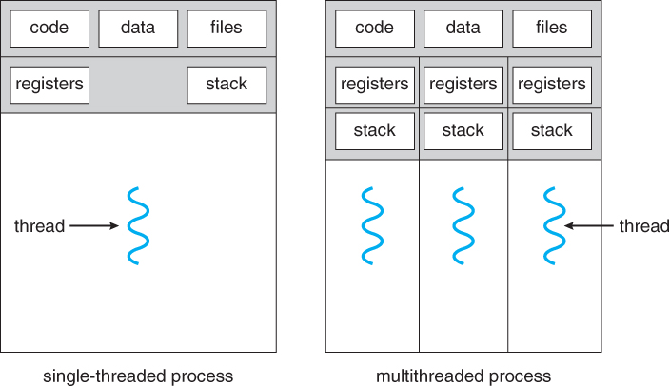

Slide 25
Callback Function

Slide 26
setTimeout setInterval
function f2 (){console.log("f2");};
function f1(callback){
setTimeout(function(){
callback();
}, 1000);
};
f1(f2);
console.log ("f3");

Slide 27
Event Listeners
$("#su").on("click",onClickHandler);
function onClickHandler(){
alert("btn Clicked!");
}

Slide 28
Observer Pattern
var pubsub = (function(){
var q = {};
topics = {};
subUid = -1;
q.publish = function(topic, args) {
if(!topics[topic]) {return;}
var subs = topics[topic],
len = subs.length;
while(len--) {
subs[len].func(topic, args);
}
return this;
};
q.subscribe = function(topic, func) {
topics[topic] = topics[topic] ? topics[topic] : [];
var token = (++subUid).toString();
topics[topic].push({
token : token,
func : func });
return token; };
return q;})();
var f2 = function(topics, data) {console.log("this is function2");}
function f1(){
console.log("this is function1");
pubsub .publish('done', 'hello world');
}
pubsub.subscribe('done', f2);
f1();

Slide 29
Promises Object
function f1(){
var def = $.Deferred();
setTimeout(function () {
console.log("this is f1");
def.resolve();
}, 500);
return def.promise();
}
function f2(){ console.log("this is f2");}
f1().then(f2);

Slide 30
ES6 Promise
var f1 = new Promise(function(resolve, reject) { setTimeout(function () {
console.log("this is f1");
resolve("Success");
}, 500); });
function f2(val){ console.log(val + ":" + "this is f2"); } function f3(){ console.log("this is f3") }
f1.then(f2);
f3();

Slide 31


Slide 32
.nonConflict()
$.noConflict();
jQuery(document).ready(function($) {
// 使用 jQuery $ 的代码
});
// 使用其他库的 $ 的代码
var jq=$.noConflict();

Slide 33
Selector
*
#id
.class
Element
:first
:odd
:eq(index)
:header
:contains(text)
[attribute=value]
:text

Slide 34
var $products = $("div .products")
var $products = $(".products")
var $products = $("#div1").find(".products")
var $products = $(".products", "#div1")

Slide 35
var $myList = $(“#list”);
for (var i = 0;i<10000;i++){
$myList.append(“<li>”+ i + “</li>”)
}

Slide 36
var $myList = $(“#list”);
Var list = “”;
for (var i = 0;i<10000;i++){
list += (“<li>”+ i + “</li>”);
}
$myList.html(list)

Slide 37
var $myList = $(“#list”);
var array=[];
for (var i = 0;i<10000;i++){
array[i] = (“<li>”+ i + “</li>”);
}
$myList.html(array.join(‘’))

Slide 38
var $myList = $(“#list”).detach();
for (var i = 0;i<10000;i++){
$myList.append(“<li>”+ i + “</li>”)
}
$myList.appendTo(“#divList”)

Slide 39
<a id = “myLink” href = “#” onclick = “myFunc()”> my link </a>
<a id = “myLink” href = “#”> my link </a>
$(“#myLink”).on(“click”,myFunc)

Slide 40
$(“#myLink”).on(“click”,function(){…})
$(“#myLink”).on(“click”,myFunc)
function myFunc() {…}

Slide 41
$(“#list a”).on(“click”, myFunc)
$(“#list”).on(“click”, “a”, myFunc)

Slide 42
$(“#list a”).on(“click”, myFunc)
$(“#list”).on(“click”, “a”, myFunc)

Slide 43
$.ajax({
url : “page.php?para1 = value1&para2=value 2”
});
$.ajax({
url : “page.php”
data : {para1 : value1, para2 : value2}
});

Slide 44
$.ajax({
url : “page.php?para1 = value1&para2=value 2”
});
$.ajax({
url : “page.php”
data : {para1 : value1, para2 : value2}
});

Slide 45
$.ajax({…}).then(successHandler,failureHandler)
var aj = $.ajax({…});
aj.done(successHandler)
aj.fail(failureHandler)

Slide 46
$(“#elem”).attr(“title”,$(“#elem”).text()); $(“#elem”).css(“color”, “red”);
$(“#elem”).fadeOut();

Slide 47
var $elem = $(“#elem”)
$elem.attr(“title”, $elem.text()); .addClass(“important”);
.fadeOut();

Slide 48
var localArr = ["Sunny","Johnny","Cindy"];
var list = $("ul.people");
$.each(localArr ,function(index,value){
list.append("<li id = " + index + ">" + value + "</li>");
});
});

Slide 49
var localArr = ["Sunny","Johnny","Cindy"];
var arrLi = [];
$.each(localArr , AddLi);
$("ul.people").append(arrLi.join(''));
function AddLi(i, value){
arrLi[i] = ("<li id = " + i + ">" + value+ "</li>");
}

Slide 50


