Slide 1

ICG In Country Team
Past – presence - future
Of
Lambda Expression
Marten

Slide 2

C# 1.0
How to use function as a parameter?
Delegate

Slide 3
C# 2.0
Generics
What will happen to delegate?
Action/Func
Action:No params/void
Action<T1, ..., T16>:16 params at most/void
Func<T1, ..., T16, Tout>：16 params at most/output

Slide 4

Make some Improvement?
1958
LISP
WITH NO FUNC NAME …
Something named
anonymous !!!

Slide 5
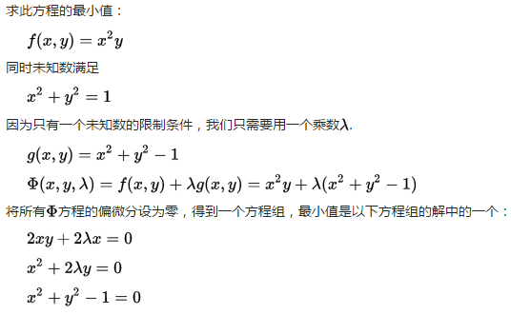

C# 3.0
Action dota5 = () =>
{
Console.WriteLine("Which hero does Elajia use?");
};

Slide 6
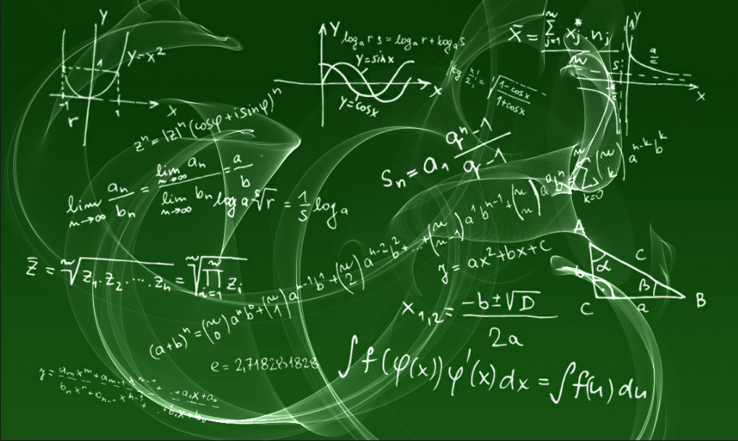


Slide 7
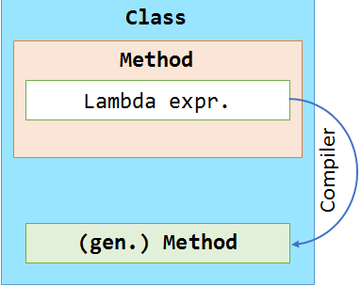
void Main()
{
DoSomethingLambda("some example");
DoSomethingNormal("some example");
}
IL_0001: ldarg.0
IL_0002: ldfld
UserQuery.DoSomethingLambda
IL_0007: ldstr "some example"
IL_000C: callvirt System.Action<System.String>.Invoke
IL_0011: nop
IL_0012: ldarg.0
IL_0013: ldstr "some example"
IL_0018: call UserQuery.DoSomethingNormal
DoSomethingNormal:
IL_0000: nop
IL_0001: ldarg.1
IL_0002: call System.Console.WriteLine
IL_0007: nop
IL_0008: ret
Action<string> DoSomethingLambda = (s) => {
Console.WriteLine(s);// + local
};
void DoSomethingNormal(string s)
{
Console.WriteLine(s);
}

Slide 8

C# 4.0
Expression tree
Go To See What Happened In CARS

Slide 9
C# 5.0
Use loop variables in lambda expressions
foreach (var item in enumerable)
{
Action lambda = () =>
{
var result = 2 * item;
Console.WriteLine(result);
};
list.Add(lambda);
}

Slide 10
C# 6.0
prop/method/class
public string OldName
{
get
{
return “Elajia Shaker”;
}
}
public string NewName => “Elajia Shaker”;
public int Contribute(int kill, int assist)
{
return kill + assit;
}
public string Contribute (int kill, int assit )=>
kill + assist;

Slide 11


C# 7.0
2. 其次，Lambda表达式的使用，非常有局限，它不允许在参数中添加行为修饰 out, ref, params, 以及可选参数，均不能在Lambda表达式的参数表中出现。参数无法使用泛型。
http://blog.jobbole.com/102439/

Slide 12
About the title: http://www.cnblogs.com/gaochundong/p/way_to_lambda.html Expression tree in c# 4.0: https://msdn.microsoft.com/zh-cn/library/bb397951(v=vs.120).aspx Ｎｅｗ ｆｅａｔｒｕｅｓ ｉｎ ｃ＃5.0: https://blogs.msdn.microsoft.com/mvpawardprogram/2012/03/26/an-introduction-to-new-features-in-c-5-0/ Ｕsing loop variable in c#５.０: https://netmatze.wordpress.com/2012/05/11/using-loop-variables-in-lambda-expressions-in-c-5/ Ｎｅｗ ｆｅａｔｒｕｅｓ ｉｎ ｃ＃ ６.０: https://msdn.microsoft.com/en-us/magazine/dn802602.aspx Ｎｅｗ ｆｅａｔｒｕｅｓ ｉｎ ｃ＃ ７.０: https://msdn.microsoft.com/en-us/magazine/mt595758.aspx
Useful links

Slide 13


