Slide 1
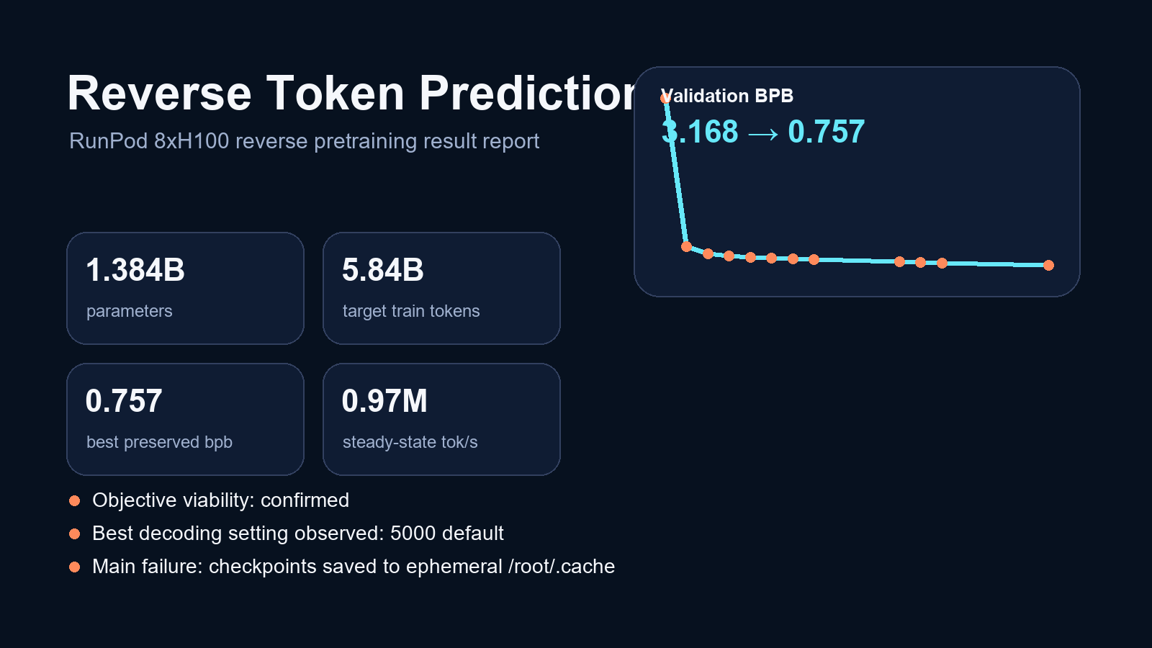

Slide 2
Experiment Setup
What actually ran on the 8xH100 node
Preserved launch metrics
Vendored nanochat reverse run on 8x NVIDIA H100 80GB HBM3.
1.384B-parameter causal transformer trained on BOS + reversed token rows.
Target budget: 5.84B train tokens, 2,048 context, depth 24, 12 heads, 1,536 embedding width.
Checkpoints saved every 1,000 steps, validation every 250 steps.
Later transcript shows steady-state throughput near 0.97M tok/s and about 58-59% BF16 MFU.
PARAMS
1.384B
TARGET TOKENS
5.84B
EARLY MEDIAN TOK/S
560.7k
LATER TRANSCRIPT BAND
0.95M-0.98M
BEST SAVED BPB
0.757 at step 4500

Slide 3
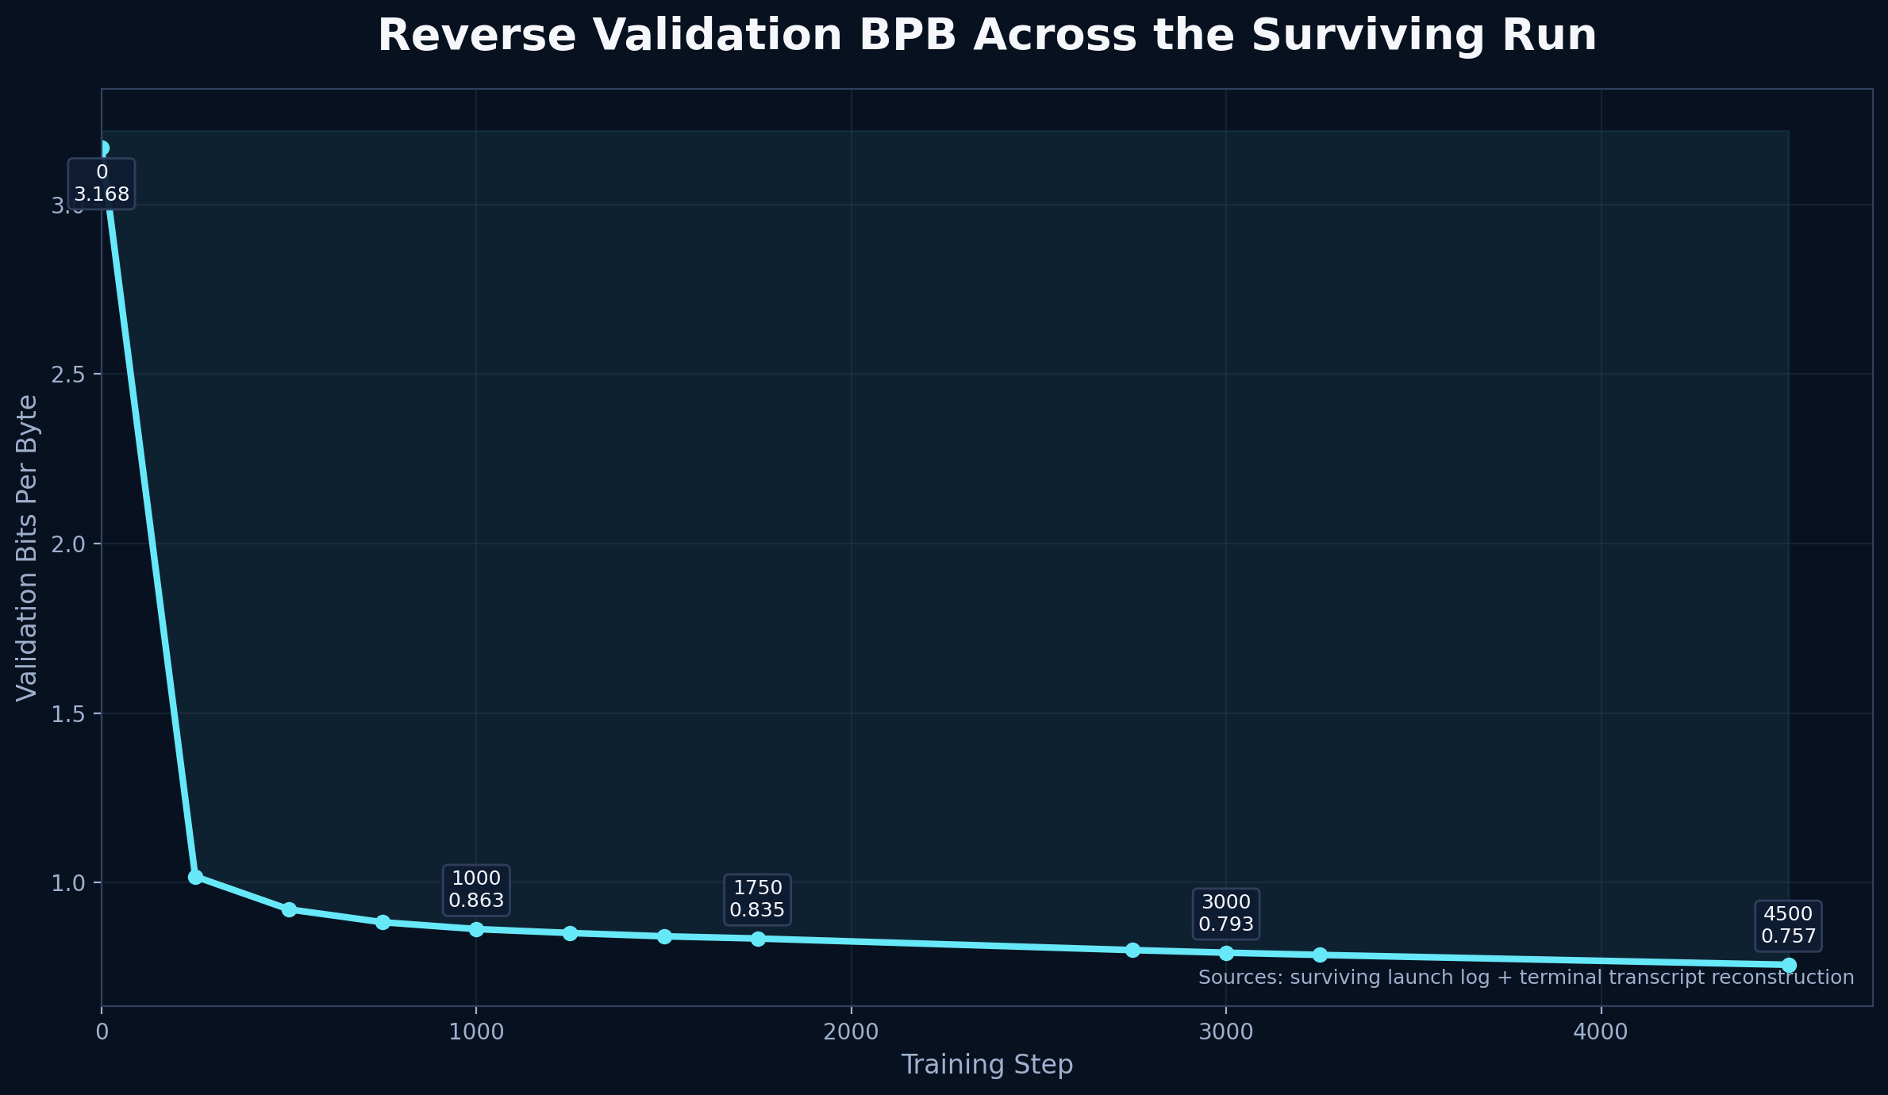
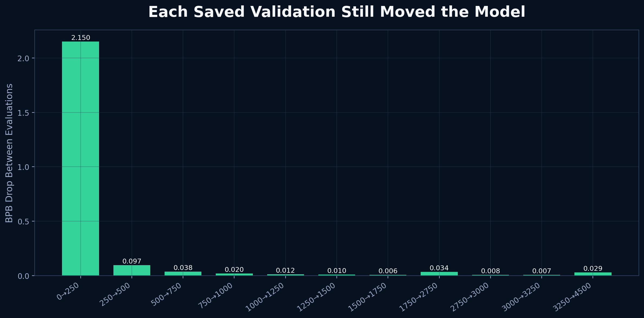
Validation Curve
The run kept improving deep into the schedule.

Slide 4
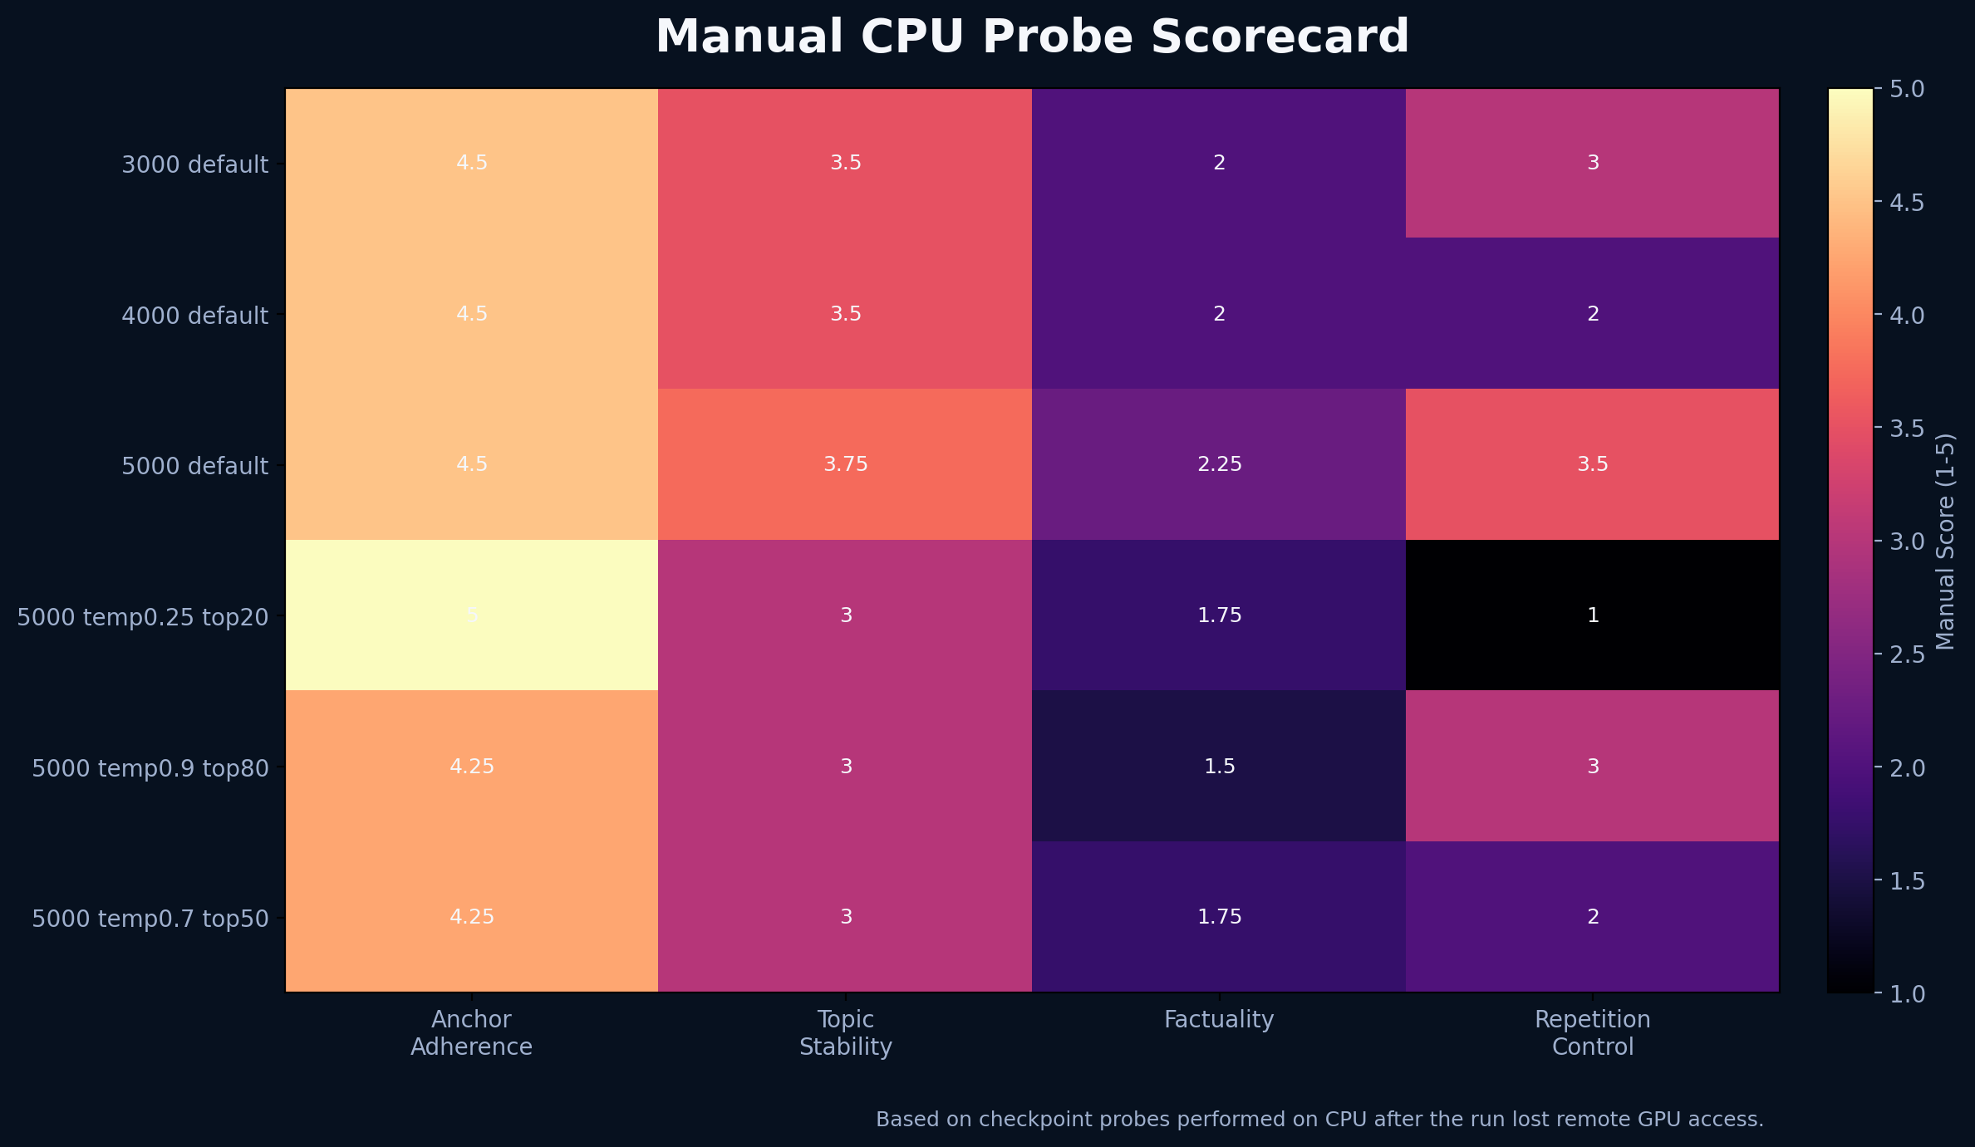
Generation Quality Trade-off
CPU probes showed the objective worked, but truthfulness lagged behind anchor landing.
3000 default: first checkpoint that looked genuinely useful.
4000 default: better on some anchors, but repetition got worse.
5000 default: best overall compromise.
0.25 temperature: strongest loops.
0.9 temperature: less looping, more hallucination.
Bottom line: decoding needs repetition control, not just temperature tuning.

Slide 5
What the Run Proved
Reverse-only pretraining is viable at nanochat scale: the model learned to generate plausible lead-ins for fixed suffix anchors.
Validation BPB kept falling from 3.168 at step 0 to 0.757 at step 4500.
The reverse objective improved topic steering and anchor adherence before it improved factual reliability.
Hallucination was still expected at this parameter/data scale, so the right next move is better decoding or forward-model reranking, not abandoning the objective.
Best concise read
The run learned reverse landing behavior. It did not learn factual reconstruction. That is still a strong result, because it upgrades the idea from speculation to a working training objective.

Slide 6
Failure and Fix
The remote run reached roughly 99.69% before the container restart wiped the weights.
Root cause
Repo fix committed
Checkpoints were written to /root/.cache/nanochat_reverse.
The persistent volume and downloaded workspace only covered /workspace.
When the container restarted, /root/.cache vanished and the trained weights were unrecoverable.
Reverse scripts now default to /workspace/nanochat_reverse when /workspace is writable.
nanochat common utilities now prefer /workspace on Linux hosted environments before ~/.cache.
Future RunPod launches will persist checkpoints by default instead of relying on ephemeral home storage.

