Slide 1
Make Your Body the Controller
Adina Shanholtz
@FeyTechnologist
Kat Harris
@KatVHarris
Tobiah Zarlez
@TobiahZarlez

Slide 2

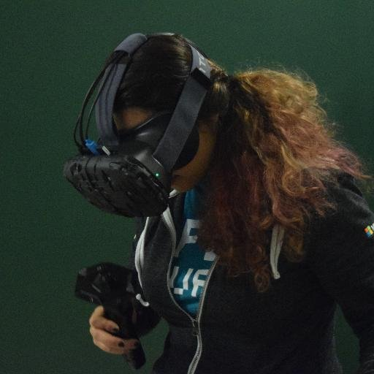


Who are we?
Tobiah Zarlez
Twitter: @TobiahZarlez
Blog: www.TobiahZ.com
Podcast: www.BeIndieNow.com
Katherine Harris
Twitter: @KatVHarris
Blog: www.Kaharri.com
Adina Shanholtz
Twitter: @FeyTechnologist
Blog: www.AdinaShanholtz.com
Notes:
Technical Evangelist, call myself a “Game Evangelist” at Microsoft.

Slide 3
You have a game… Now what?
Download
Kinect SDK Browser
Kinect Studio
Kinect Gesture Builder

Slide 4
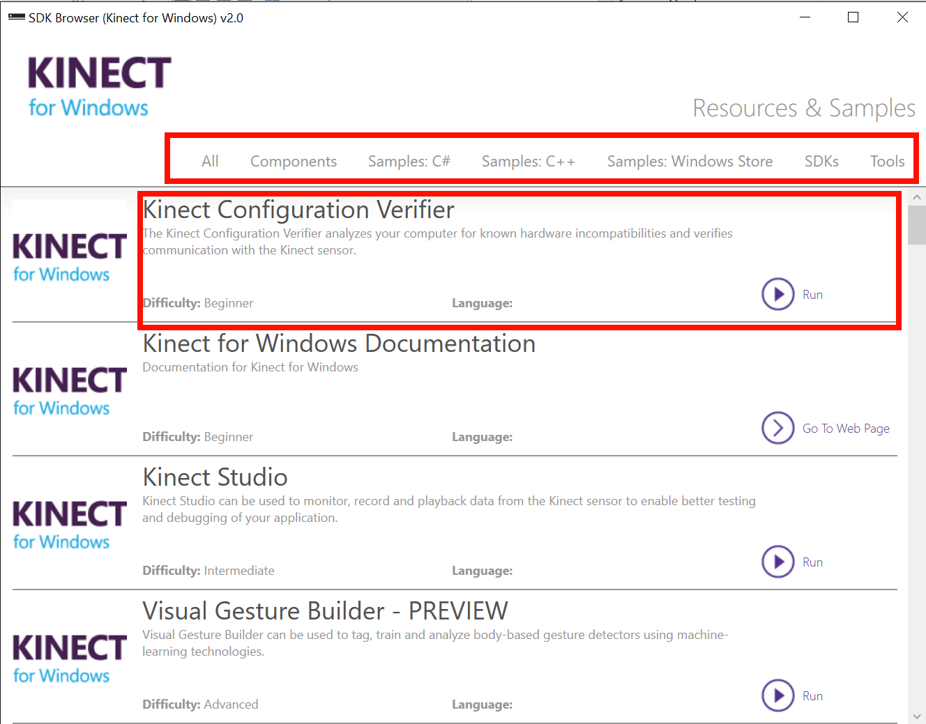
Kinect SDK Browser
Gives access to configure Kinect Sensor
Tutorials on C# and C++
Sample code for sensor manipulation and access

Slide 5
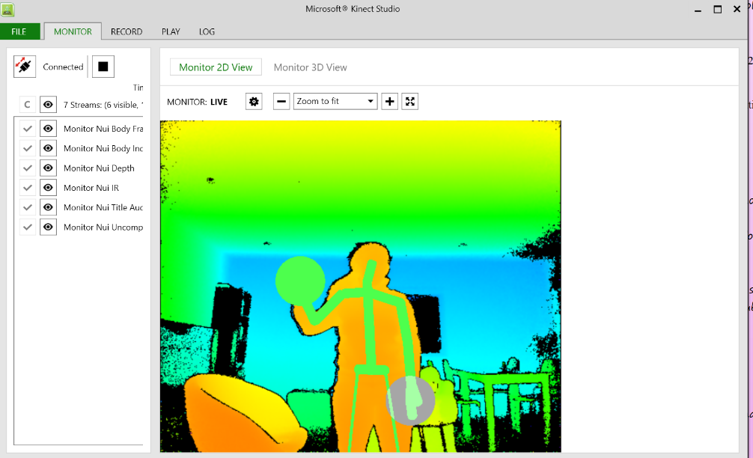
Kinect Studio
View specific sensor data
Record movement and gestures

Slide 6
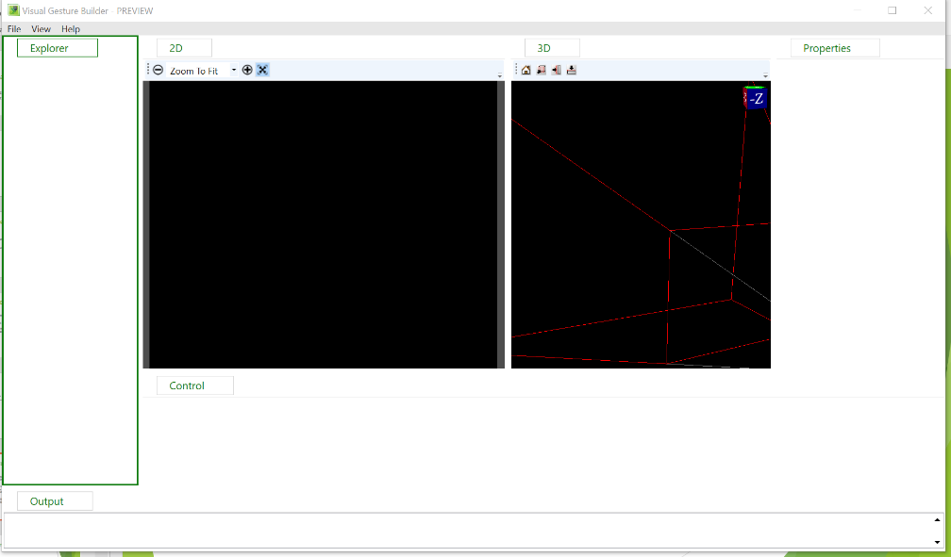
Gesture Builder
Process recordings from Kinect Studio for testing or learning
Train the Kinect to recognize specific movements for the entire body, specific side, upper or lower.
Test the Kinect’s confidence and accuracy of detecting gestures.

Slide 7
Kinect Prerequisites
USB 3 port
Kinect SDK - https://www.microsoft.com/en-us/kinectforwindows/develop/downloads-docs.aspx
Unity Plugins (which I provide in the git repo) – https://github.com/KatVHarris/Unity5-KinectGestures
Kinect Setup Instructions - http://bit.ly/UnityKinect

Slide 8
More Resources
Unity Plugins - https://github.com/carmines/workshop/tree/master/Unity
Kinect Gestures Video – https://channel9.msdn.com/Blogs/k4wdev/Custom-Gestures-End-to-End-with-Kinect-and-Visual-Gesture-Builder

Slide 9
Questions?
Tobiah Zarlez
Twitter: @TobiahZarlez
Blog: www.TobiahZ.com
Podcast: www.BeIndieNow.com
Katherine Harris
Twitter: @KatVHarris
Blog: www.Kaharri.com
Adina Shanholtz
Twitter: @FeyTechnologist
Blog: www.AdinaShanholtz.com
Notes:
Technical Evangelist, call myself a “Game Evangelist” at Microsoft.

