Slide 1
MVP

Slide 2

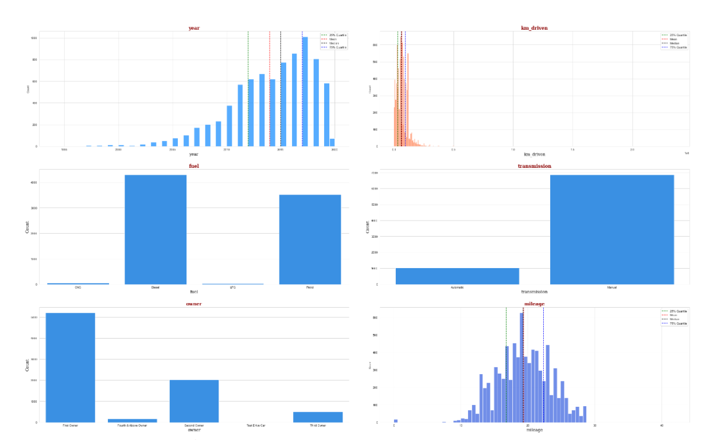
Some graph that show the difference between the data

Slide 3
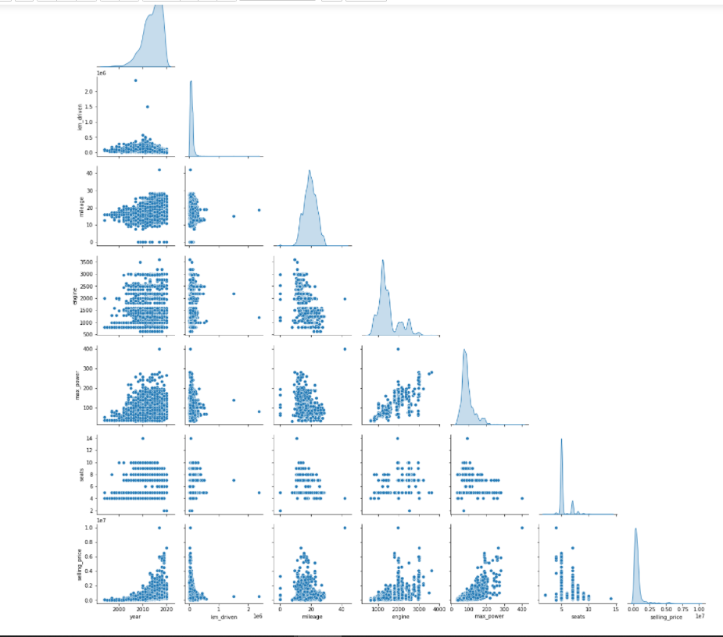
Pairplot

Slide 4
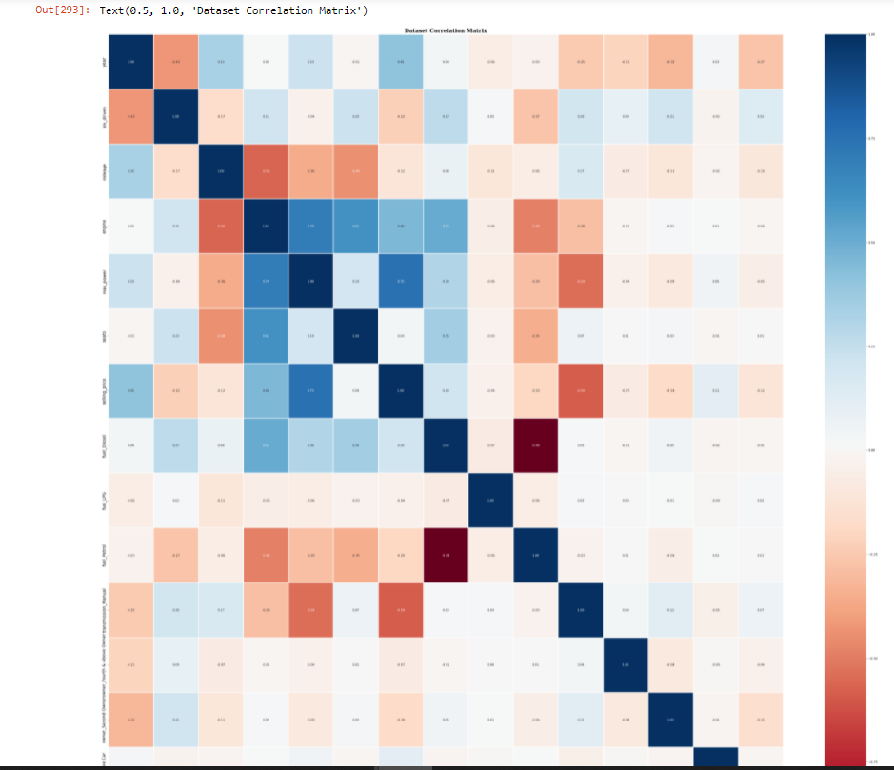
There are some variables have high correlation and will need to be dealt with before building the model

Slide 5
The next step is building a model for know the accuracy of model

