Slide 1
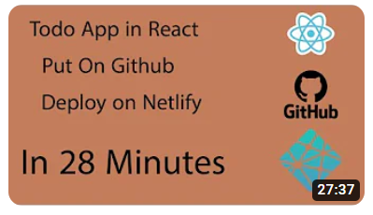
React to-do App project Tutorial for Beginners
What we will cover in this video:
Manage Our Project using Trello
Git branches for different Sprints
Complete some tasks based on our board

Slide 2
React to-do App project Tutorial for Beginners
Sprint 03

