Slide 1
DEEP INTO JVM

Slide 2
Agenda
Introduction
Memory Sections
Auto Memory Management
Class Loader
Compilation Optimizing
Concurrent Task

Slide 3
Agenda
Introduction
Memory Sections
Auto Memory Management
Class Loader
Compilation Optimizing
Concurrent Task

Slide 4
Why Java
Write once, run anywhere
Safe memory manegement and utilization
Hot-spot check and JIT
Many many 3rd libs

Slide 5
History - I
1991.4 – James Gosling – Green Project -Oak
1995.5 – Java is born
1996.4 – JDK1.0 (JVM, Applet, AWT)
1997.2 – JDK1.1(JAR, JDBC, JavaBeans ,RMI)
1998.12 – JDK1.2(J2SE, J2EE, J2ME, EJB, Plug-in, IDL ,Swing, JIT)
2000.5 – JDK1.3(HotSpot, JNDI)

Slide 6
History - II
2002.9 – JDK1.4(RE, NIO, LOG, XML Parser, XSLT Converter, Exception Link)
2004.9 – JDK1.5(Annotation, ENUM, Auto-boxing, Generics)
2006.12 – JDK1.6(Dynamic Language Support, Micro HTTP Server API, JVM Refactor)
2009.4 – Orcacle purchase Sun – Combine Jrockit + HotSpot
2011 – JDK1.7(G1 Collector, ClassLoader Refactor)

Slide 7
Future - I
Modularize
OSGI
Hybrid Languages
Clojure: a functional Lisp dialect
Groovy: a programming and scripting language
Scala: an object-oriented and functional programming language
JRuby: an implementation of Ruby
Jython: an implementation of Python

Slide 8
Future - II
Concurrent Support
Grammar Expansion

Slide 9
Agenda
Introduction
Memory Sections
Auto Memory Management
Class Loader
Compilation Optimizing
Concurrent Task

Slide 10
Runtime Data Areas
Method area
Store loaded classes, contants, static variables, JIT codes…
VM stack
Create Stack Frame to store local variables, operation stack, dynamic links, method exit … for each method call
Native method stack
Heap
Store objects and vectors
Program counter register
“Undefined” for native method
Direct memory
Note
Red : shared by all threads
Blue: private for each thread

Slide 11
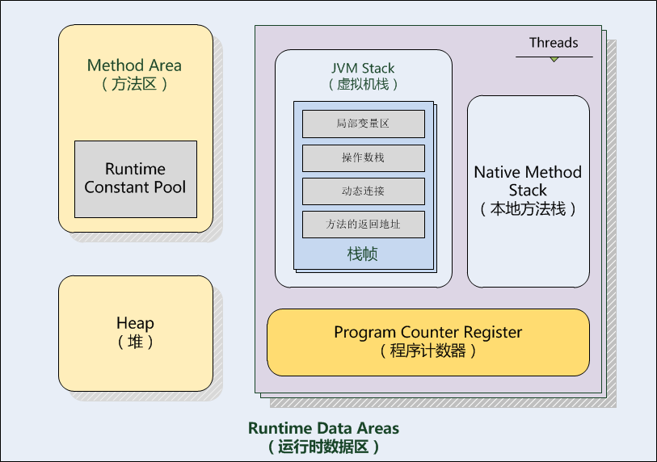

Slide 12
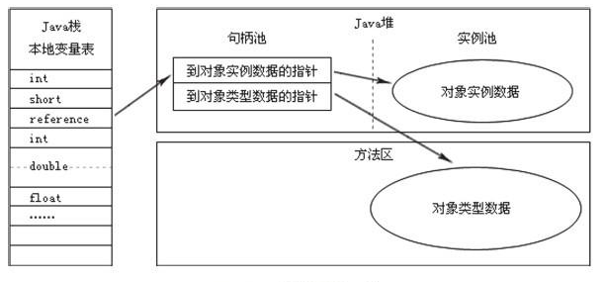
Object Access – Handler Reference

Slide 13
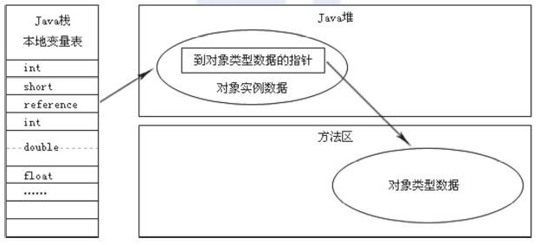
Object Access – Direct Pointer Reference (HotSpot)

Slide 14
OOM – Java Heap
How to produce
Avoid heap auto-expanding by setting “–Xms” the same as “-Xmx”
Add “-XX:+HeapDump OnOutOfMemoryError”
Create enough new objects
Result
java.lang.OutOfMemoryError: Java heap space

Slide 15
OOM – VM Stack & Local Method Stack
How to produce
StackOverflowError Exception
Set “-Xss128k”
Define and run recursive function endlessly
OutOfMemoryError Exception
Never occur in single thread
Create enough threads

Slide 16
OOM – Constant Pool
How to produce
Set “-XX:PermSize” and “-XX:MaxPermSize”
Use String.intern() to add the string into Constant Pool
Use List to keep using the strings, to avoid Full GC
Result
java.lang.OutOfMemoryError: PermGen space

Slide 17
OOM – Method Area
How to produce
Set “-XX:PermSize” and “-XX:MaxPermSize”
Use CGLib to load dynamic-generated classes
Result
java.lang.OutOfMemoryError: PermGen space
at java.lang.ClassLoader.defineClass1(Native Method)
at java.lang.ClassLoader.defineClassCond (ClassLoader.java:632)

Slide 18
OOM – Direct Memory
How to produce
Set “-XX:MaxDirectMemorySize”
Use unsafe.allocateMemory() to allocate direct memory
Result
java.lang.OutOfMemoryError
at sun.misc.Unsafe.allocateMemory(Native Method)
Notes:
“-XX:MaxDirectMemorySize” has by default the same value as “-Xmx”

Slide 19
Agenda
Introduction
Memory Sections
Auto Memory Management
Class Loader
Compilation Optimizing
Concurrent Task

Slide 20
GC – Reference Counter
Principle
Add a ref_counter for each object and update it. Release it when counter becomes 0
(+) Easy to implement
(+) High performance
(-) Cannot resolve
objA.instance = objB;
objB.instance = objA;
Used by
COM
Python
Squirrel

Slide 21
GC – Roots Tracing
Principles
Init a series of objects with the name “GC Roots” as starting points
Search along the roots, each path is called “Reference Chain”
When an object has no path to reach any root, the object is useless

Slide 22
GC – Roots Tracing
Which object can be used as GC Roots?
Object ref by VM Stack
Object ref by class static attribute in Method Area
Object ref by constant in Method Area
Object ref by JNI in Native Method Stack

Slide 23
Reference Type
Strong
Never reclaim
Soft
Reclaim only when “OutOfMemory” is ready to occur
Weak
Reclaim each time GC works
Phantom
Reclaim at any time
Notes:
Examples :
Strong
Counter counter = new Counter();
Weak
Counter counter = new Counter();
WeakReference<Counter> wc = new WeakReference<Counter>(counter);
Counter = null;
Soft
Counter counter = new Counter();
SoftReference sc = new SoftReference(counter);
Counter = null;
Phantom (must be used with a ref queue)
ReferenceQueue refQueue = new ReferenceQueue(); //reference will be stored in this queue for cleanup
DigitalCounter digit = new DigitalCounter();
PhantomReference<DigitalCounter> phantom = new PhantomReference<DigitalCounter>(digit, refQueue);

Slide 24
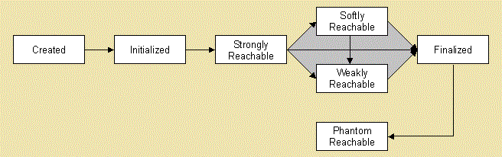
Reference Type
Notes:
=======Example code====
public class FinalizeGC {
public static FinalizeGC hook = null;
public void isAlive(int n) {
System.out.println("yes, i'm alive: " + n);
}
@Override
protected void finalize() throws Throwable {
super.finalize();
System.out.println("finalize is executing!!");
hook = this;
}
public static void main(String[] args) throws Throwable {
hook = new FinalizeGC();
hook.isAlive(1);
hook = null;
System.gc();
Thread.sleep(500);
if (hook != null) {
hook.isAlive(2);
} else {
System.out.println("dead!");
}
hook = null;
System.gc();
Thread.sleep(500);
if (hook != null) {
hook.isAlive(3);
} else {
System.out.println("really dead!");
}
}
}
=======Result=========
yes, i'm alive: 1
finalize is executing!!
yes, i'm alive: 4
really dead!

Slide 25
Reclaim Method Area
Useless Constant?
Useless class?
All of its objects have been reclaimed
ClassLoader who loads the class has been reclaimed
No ref in anywhere for “java.lang.Class” related to the class, which means there’s no way to call its function by reflection
Notes:
HotSport provides “-Xnoclassgc” to control class GC.
provides “-verbose:class”, “-XX:+TraceClassLoading”, “-XX:+TraceClassUnLoading” to check class loading&unloading

Slide 26
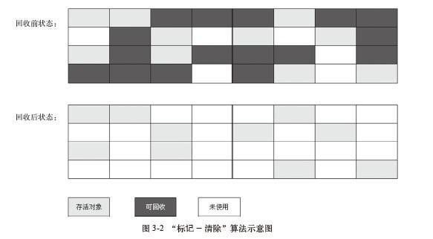
Mark-Sweep
Steps
Mark all objects that need to reclaim
Reclaim all after marking is over
Characteristics
Low efficiency for marking & reclaiming(-)
Too many discontinuous mem fragments(-)

Slide 27
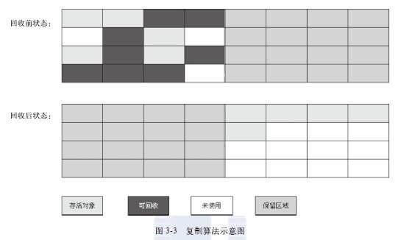
Improvement - Copying

Slide 28
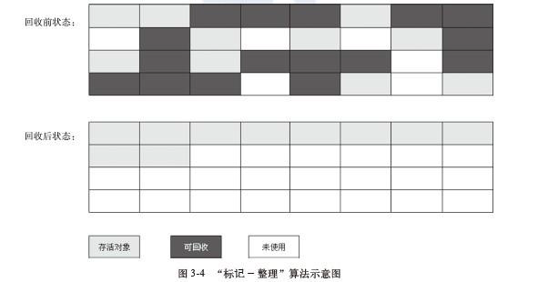
Improvement – Mark - Compact

Slide 29
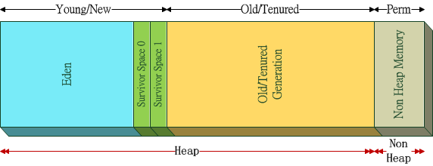
What are we using
Generational Collection
Notes:
Heap Memory 又被分为两大区域：
- Young/New Generation 新生代
新生对象放置在新生代中，新生代由Eden 与Survivor Space 组成。
- Old/Tenured Generation 老年代
老年代用于存放程序中经过几次垃圾回收后还存活的对象
1.Young/New Generation 新生代 程序中新建的对象都将分配到新生代中，新生代又由Eden(伊甸园)与两块Survivor(幸存者) Space 构成。Eden 与Survivor Space 的空间大小比例默认为8:1，即当Young/New Generation 区域的空间大小总数为10M 时，Eden 的空间大小为8M，两块Survivor Space 则各分配1M，这个比例可以通过-XX:SurvivorRatio 参数来修改。Young/New Generation的大小则可以通过-Xmn参数来指定。
Eden：刚刚新建的对象将会被放置到Eden 中，这个名称寓意着对象们可以在其中快乐自由的生活。
Survivor Space：幸存者区域是新生代与老年代的缓冲区域，两块幸存者区域分别为s0 与s1，当触发Minor GC 后将仍然存活的对象移动到S0中去(From Eden To s0)。这样Eden 就被清空可以分配给新的对象。 当再一次触发Minor GC后，S0和Eden 中存活的对象被移动到S1中(From s0To s1)，S0即被清空。在同一时刻, 只有Eden和一个Survivor Space同时被操作。所以s0与s1两块Survivor 区同时会至少有一个为空闲的，这点从下面的图中可以看出。
当每次对象从Eden 复制到Survivor Space 或者从Survivor Space 之间复制，计数器会自动增加其值。 默认情况下如果复制发生超过16次，JVM 就会停止复制并把他们移到老年代中去。如果一个对象不能在Eden中被创建，它会直接被创建在老年代中。

Slide 30
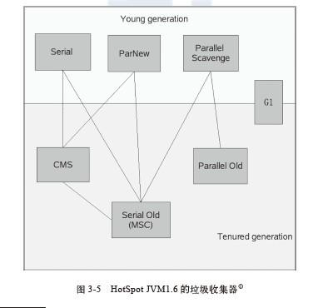
Garbage Collectors
Notes:
如果两个收集器之间存在连线，就说明它们可以搭配使用。

Slide 31
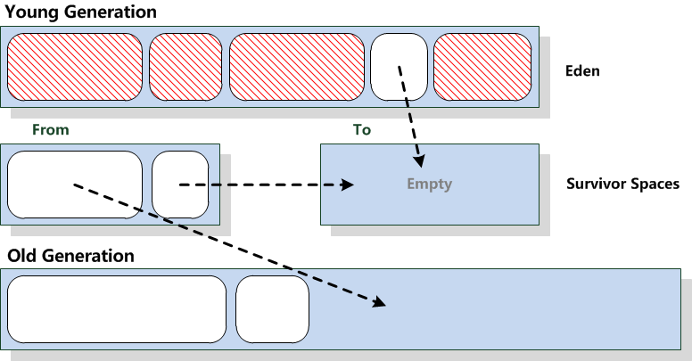
Minor GC – I
Before collecting
Notes:
新生代GC(Minor GC)：指发生在新生代的垃圾收集动作，因为 Java 对象大多都具备朝生夕灭的特性，通常很多的对象都活不过一次GC，所以Minor GC 非常频繁，一般回收速度也比较快。

Slide 32
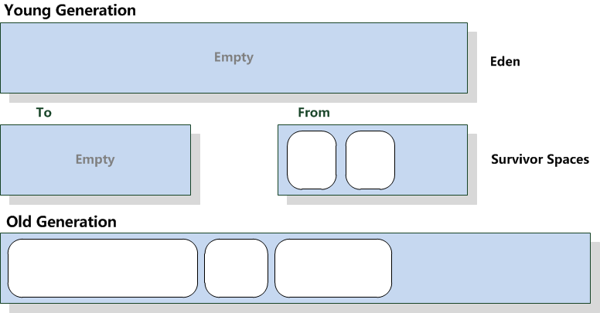
Minor GC -II
After collecting

Slide 33
Major GC/Full GC - I
Notes:
老年代用于存放程序中经过几次垃圾回收后还存活的对象，例如缓存的对象等，老年代所占用的内存大小即为-Xmx 与-Xmn 两个参数之差。 堆是JVM 中所有线程共享的，因此在其上进行对象内存的分配均需要进行加锁，这也导致了new 对象的开销是比较大的，鉴于这样的原因，Hotspot JVM 为了提升对象内存分配的效率，对于所创建的线程都会分配一块独立的空间，这块空间又称为TLAB（Thread Local Allocation Buffer），其大小由JVM 根据运行的情况计算而得，在TLAB 上分配对象时不需要加锁，因此JVM 在给线程的对象分配内存时会尽量的在TLAB 上分配，在这种情况下JVM 中分配对象内存的性能和C 基本是一样高效的，但如果对象过大的话则仍然是直接使用堆空间分配，TLAB 仅作用于新生代的Eden，因此在编写Java 程序时，通常多个小的对象比大的对象分配起来更加高效，但这种方法同时也带来了两个问题，一是空间的浪费，二是对象内存的回收上仍然没法做到像Stack 那么高效，同时也会增加回收时的资源的消耗，可通过在启动参数上增加 -XX:+PrintTLAB来查看TLAB 这块的使用情况。
老年代GC(Major GC/Full GC)：指发生在老年代的GC，出现了Major GC，通常会伴随至少一次Minor GC（但也并非绝对，在ParallelScavenge 收集器的收集策略里则可选择直接进行Major GC）。MajorGC 的速度一般会比Minor GC 慢10倍以上。
虚拟机给每个对象定义了一个对象年龄(age)计数器。如果对象在 Eden 出生并经过第一次 Minor GC 后仍然存活，并且能被 Survivor 容纳的话，将被移动到 Survivor 空间中，并将对象年龄设为 1。对象在 Survivor 区中每熬过一次 Minor GC，年龄就增加 1 岁，当它的年龄增加到一定程度（默认为 15 岁）时，就会被晋升到老年代中。对象晋升老年代的年龄阈值，可以通过参数 -XX:MaxTenuringThreshold 来设置。

