Slide 1

Distributed and Fault-tolerant Realtime Computation System
Led Xu
1/29/2015

Slide 2

Hadoop Part

Slide 3
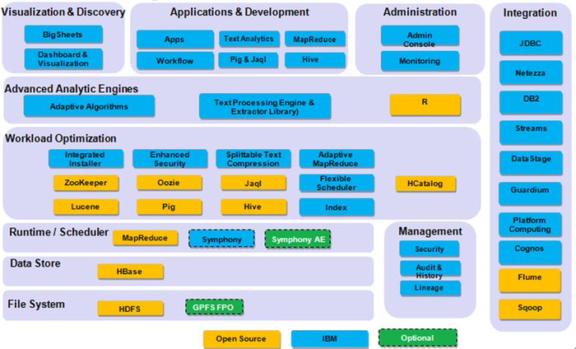
Hadoop Family

Slide 4
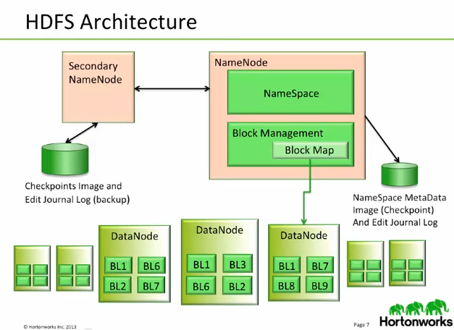
HDFS Architecture

Slide 5
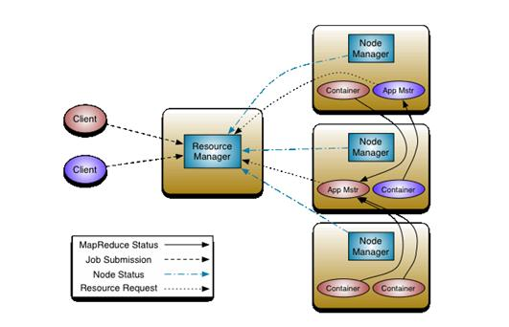
YARN Architecture

Slide 6
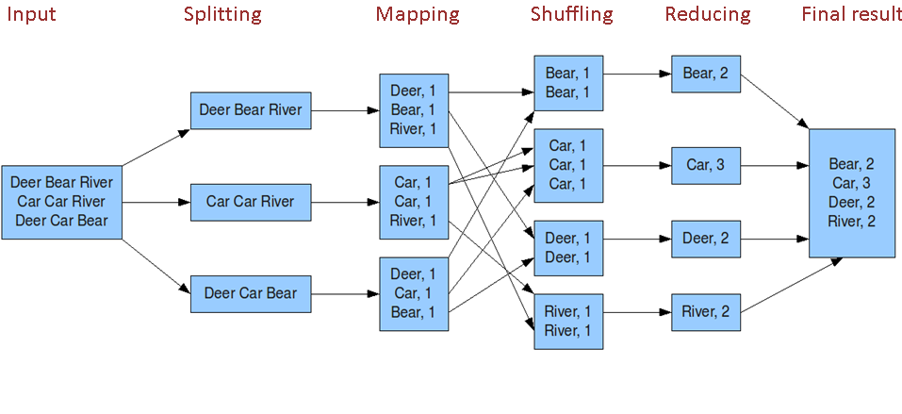
Hadoop Job Example

Slide 7
HDFS Characteristics
Fault tolerance by detecting faults and applying quick, automatic recovery
Data access via MapReduce streaming
Simple and robust coherency model
Processing logic close to the data, rather than the data close to the processing logic
Portability across heterogeneous commodity hardware and operating systems
Scalability to reliably store and process large amounts of data
Economy by distributing data and processing across clusters of commodity personal computers
Efficiency by distributing data and logic to process it in parallel on nodes where data is located
Reliability by automatically maintaining multiple copies of data and automatically redeploying processing logic in the event of failures

Slide 8
Storm Part

Slide 9
Storm Introduction
Apache Storm is a free and open source distributed realtime computation system.
Storm makes it easy to reliably process unbounded streams of data, doing for realtime processing what Hadoop did for batch processing.
Storm is simple, can be used with any programming language, and is a lot of fun to use!

Slide 10
Storm Background
Created by Nathan Marz @BackType/Twitter
Analyze twits, links, users on Twitter
Opensourced at Sep 2011
Eclipse Public License 1.0
Storm 0.5.2
16k java and 7k Clojure Loc
Current stable release: 0.9.3

Slide 11

Companies & Projects Using Storm

Slide 12
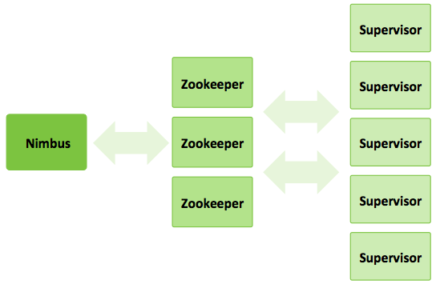
Storm Architecture I

Slide 13
Storm Architecture II
Master Node - Nimbus
Uploads computations for execution
Distributes code across the cluster
Launches workers across the cluster
Monitors computation and reallocates workers as needed
Worker Nodes – Supervisor
Listen for work assigned to its machine
Start & stop worker processes as necessary
Coordination Nodes – Zookeeper
Keep all states on local disk

Slide 14
Storm Application
Data source
Stream : an unbounded sequence of tuples
Tuples : an ordered list of elements. For example, a “4-tuple” might be (7, 1, 3, 7)
Job : Topology
Spout : sources of streams in a computation
Bolt : process input streams and produce output streams. They can: run functions; filter, aggregate, or join data; or talk to databases.

Slide 15
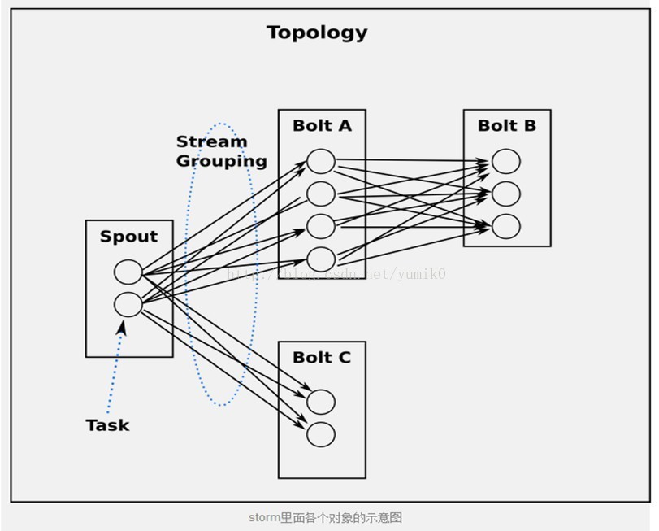
Storm Topology I

Slide 16
Storm Topology II
TopologyBuilder builder = new TopologyBuilder();
builder.setSpout("words", new TestWordSpout(), 10);
builder.setBolt("exclaim1", new ExclamationBolt(), 3) .shuffleGrouping("words");
builder.setBolt("exclaim2", new ExclamationBolt(), 2) .shuffleGrouping("exclaim1");

Slide 17
Storm Streaming Groups
Shuffle Grouping : random & evenly
Fields Grouping : grouping by fields
All Grouping : broadcast to all bolts
Global Grouping : always send to one task in one node
Non Grouping : almost the same as shuffle
Direct Grouping : only used for “direct stream”

Slide 18
Storm Example - Reporting
Broadcast Filter Bolt
Grouped by
Broadcast Id
Reporting Rawdata
Files
Rawdata Spout
Parse Bolt
Read
file
Parse
lines
Grouped by
Client Id
Client Filter Bolt

Slide 19
Storm Characteristics
Fast : benchmarked as processing one million 100 byte messages per second per node
Scalable : with parallel calculations that run across a cluster of machines
Fault-tolerant : when workers die, Storm will automatically restart them. If a node dies, the worker will be restarted on another node.
Reliable : Storm guarantees that each unit of data (tuple) will be processed at least once or exactly once. Messages are only replayed when there are failures.
Easy to operate : standard configurations are suitable for production on day one. Once deployed, Storm is easy to operate

Slide 20
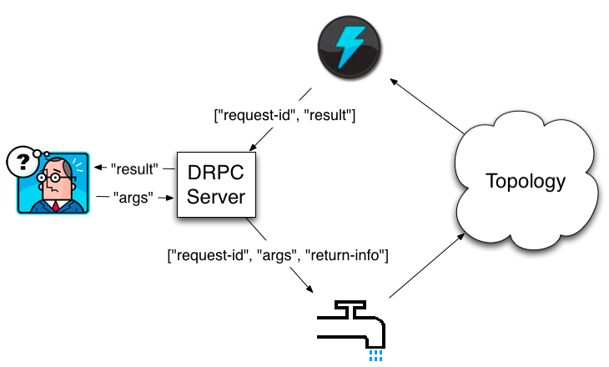
Storm DRPC

Slide 21
Improved Reporting
ADF-DB
2. Request
RR logs info
5. Download RR logs
.
.
.
.
.
1. Inform
Broadcast
over
Scheduler
3. Trigger DRPC
task with
BC_ID and
logs info
DRPC
Server
Spout
Topology
BMC
4
6
2. Request RR
Logs info
ADF-DB
5. Download RR logs

Slide 22
Storm VS Hadoop ?
Data Model
Real-time processing VS Batch processing
Performance
Memory calculating VS HDFS calculating

Slide 23
Storm -> Trident
Trident is a high-level abstraction for doing realtime computing on top of Storm. It allows you to seamlessly intermix high throughput (millions of messages per second), stateful stream processing with low latency distributed querying.
Trident provides embedded Joins, Aggregations, Grouping, Functions, Filters.

Slide 24
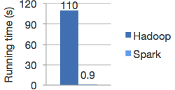
Hadoop -> Spark
Apache Spark is a fast and general-purpose cluster computing system.
It provides high-level APIs in Java, Scala and Python, and an optimized engine that supports general execution graphs.
How fast?

Slide 25
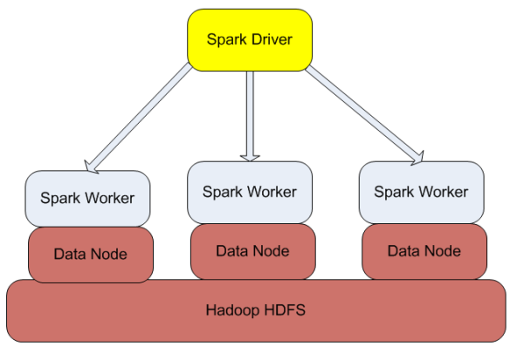
Spark Structure

Slide 26
TO BE CONTINUED

