Slide 1
CAPSTONE PROJECT
HOTEL BOOKING ANALYSIS
Presented By:
YOUR NAME -THANTHAI PERIYAR GOVTB INSTITUTE OF TECHNOLOGY VELLORE -CIVIL
Presented By:
MAMALLAN S -THANTHAI PERIYAR GOVTB INSTITUTE OF TECHNOLOGY VELLORE -CIVIL

Slide 2
OUTLINE
Problem Statement
Proposed System/Solution
System Development Approach
Algorithm & Deployment
Result
Conclusion
References

Slide 3
PROBLEM STATEMENT
Have you ever wondered when the best time of year to book a hotel room is? Or the optimal length of stay in order to get the best daily rate? What if you wanted to predict whether or not a hotel was likely to receive a disproportionately high number of special requests? This hotel booking dataset can help you explore those questions! This data set contains booking information for a city hotel and a resort hotel, and includes information such as when the booking was made, length of stay, the number of adults, children, and/or babies, and the number of available parking spaces, among other things. All personally identifying information has been removed from the data. Explore and analyse the data to discover important factors that govern the bookings.

Slide 4
PROPOSED SOLUTION
Data Collection and Preparation:
Gather booking information for city and resort hotels.
Remove personally identifying information to ensure privacy.
Handle missing values and encode categorical variables.
Exploratory Data Analysis (EDA):
Visualize booking trends over time (e.g., monthly or seasonal variations).
Analyze correlations between variables (e.g., length of stay, number of guests) and booking patterns.
Identify any outliers or anomalies in the data.
Determining Optimal Booking Time:
Analyze average daily rates across different months or seasons.
Identify periods with the lowest rates for cost-effective bookings.
Consider factors such as location, events, and holidays that may influence booking trends.
Optimizing Length of Stay:
Explore the relationship between length of stay and daily rate.
Identify optimal lengths of stay for maximizing cost savings.
Consider guest preferences and destination characteristics when determining ideal durations.

Slide 5
Predicting Special Requests:
Identify types of special requests in the dataset (e.g., room preferences, amenities).
Utilize classification algorithms to predict the likelihood of receiving special requests based on booking attributes.
Evaluate model performance using metrics such as accuracy, precision, and recall.
Insights and Recommendations:
Summarize key findings and insights from the analysis.
Provide actionable recommendations for hotel management, including pricing strategies, promotional campaigns, and service enhancements.
Emphasize the importance of data-driven decision-making in optimizing hotel operations and enhancing guest experiences.
Deployment and Monitoring:
Integrate predictive models into hotel management systems for real-time decision support.
Monitor model performance and update algorithms as needed to adapt to changing market conditions.
Foster a culture of continuous improvement and innovation within the organization.

Slide 6
SYSTEM APPROACH
Define Objectives
Identify key questions: Best booking time, optimal length of stay, predicting special requests.
Clarify goals: Enhance revenue, improve customer experience.
Data Collection
Gather booking information for city and resort hotels.
Ensure data integrity and privacy: Remove personally identifying information.
Data Preprocessing
Handle missing values: Imputation or removal.
Encode categorical variables: One-hot encoding or label encoding.
Feature engineering: Create new features if necessary (e.g., total number of guests).
Exploratory Data Analysis (EDA)
Visualize booking trends: Monthly, seasonal variations.
Analyze correlations: Length of stay vs. daily rate, special requests vs. other variables.
Identify outliers and anomalies: Investigate unusual booking patterns.

Slide 7
Predictive Modeling
Feature selection: Identify relevant predictors for each objective.
Model selection: Choose appropriate algorithms (e.g., regression, classification).
Train and test models: Evaluate performance using metrics (e.g., accuracy, RMSE).
Interpretation and Insights
Extract insights: Determine best booking time, optimal length of stay, factors influencing special requests.
Translate findings: Provide actionable recommendations for hotel management.
Implementation and Monitoring
Deploy predictive models: Integrate into booking systems for real-time decision-making.
Monitor performance: Regularly evaluate model accuracy and effectiveness.
Adaptation: Update models based on evolving booking patterns and guest preferences.

Slide 8
ALGORITHM & DEPLOYMENT
Algorithm Selection
Regression for Daily Rate Optimization:
Linear Regression: Predict daily rate based on features like booking time, length of stay, and hotel type.
Decision Trees: Capture non-linear relationships between predictors and daily rate.
Classification for Special Request Prediction:
Logistic Regression: Predict likelihood of receiving a high number of special requests based on booking characteristics.
Random Forest: Handle complex interactions between features to improve prediction accuracy.
Model Training & Evaluation
Train models using historical booking data.
Split data into training and testing sets.
Evaluate model performance using metrics such as Mean Absolute Error (MAE) for regression and F1-score for classification.

Slide 9
Deployment
Integrate models into hotel booking systems:
API integration for real-time predictions during booking process.
Dashboard for hotel management to track predictions and insights.
Ensure scalability and reliability of deployed models:
Regular updates based on new data and evolving trends.
Monitoring for model drift and performance degradation.
Benefits of Predictive Modeling
Optimize revenue: Identify best booking times and lengths of stay for maximum profitability.
Enhance guest satisfaction: Anticipate and fulfill special requests, improving overall experience.
Improve operational efficiency: Streamline resource allocation based on predicted booking patterns.

Slide 10
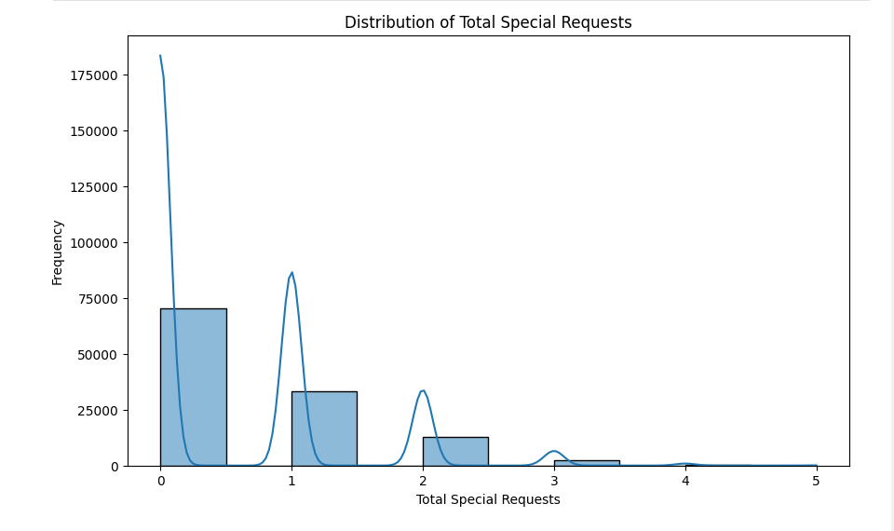
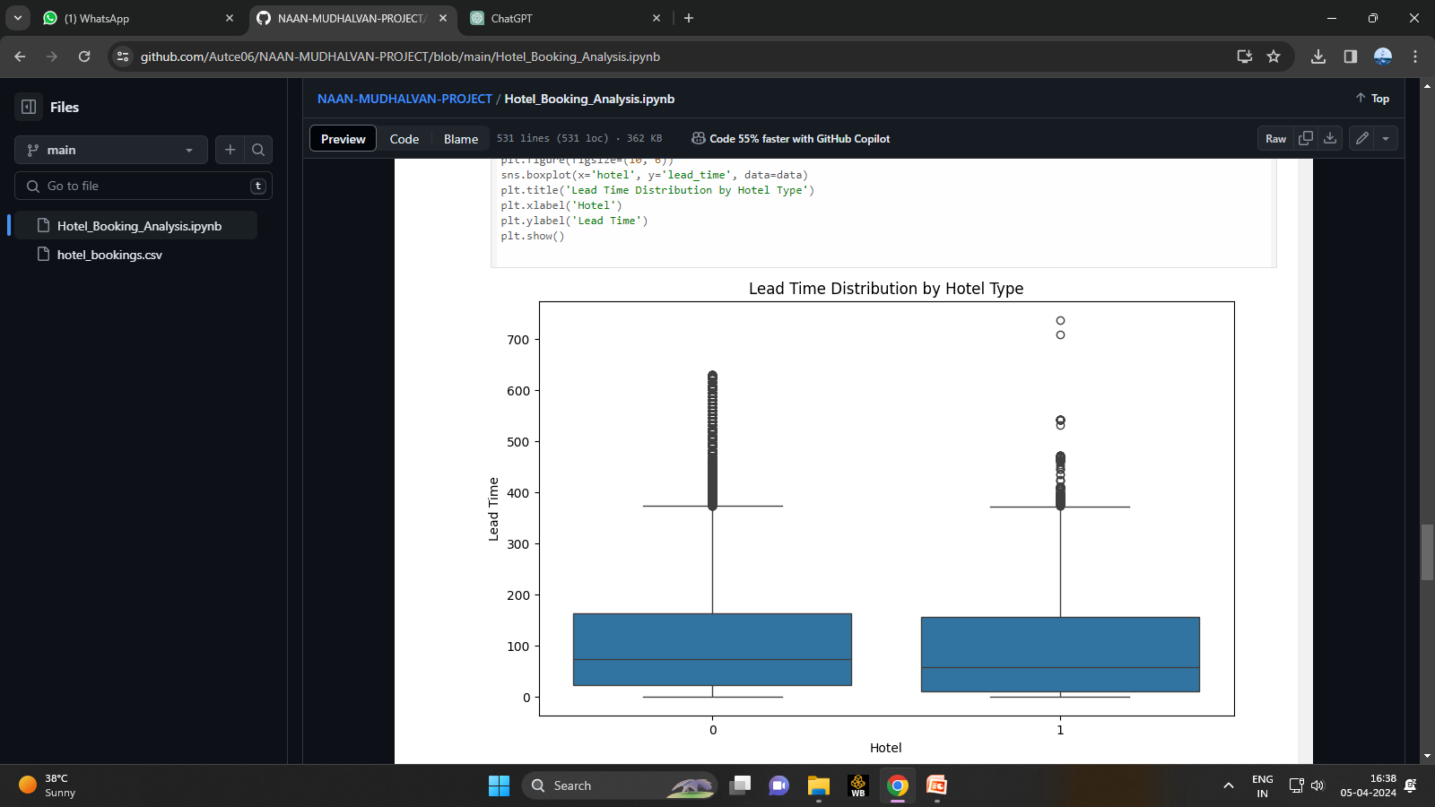
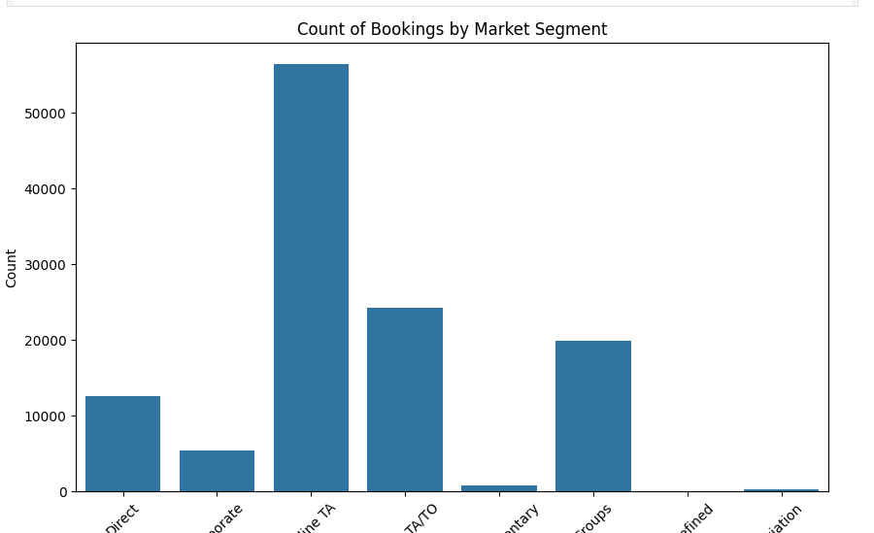
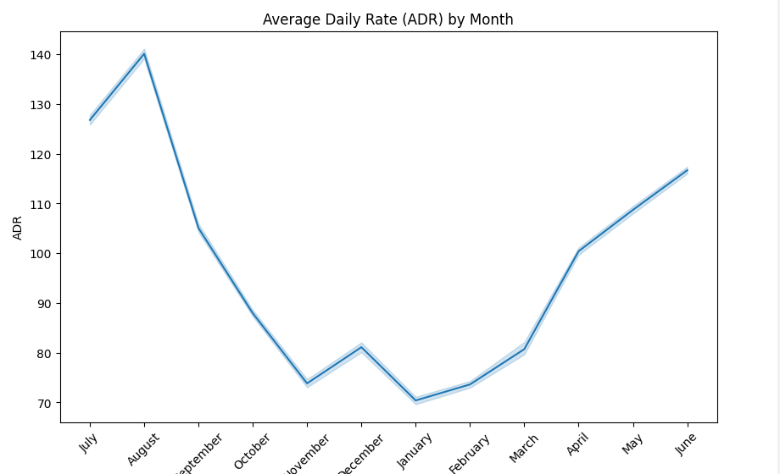
RESULT

Slide 11
CONCLUSION
Key Findings
The best time to book a hotel room varies depending on factors such as location, seasonality, and demand.
Longer lengths of stay may result in lower daily rates, but optimal durations differ based on destination and hotel type.
Predictive modeling can accurately forecast the likelihood of receiving a disproportionately high number of special requests based on booking attributes.
Actionable Insights
Hotel managers can leverage insights from the analysis to strategically adjust pricing and promotional strategies throughout the year.
Understanding optimal lengths of stay enables hotels to offer tailored packages and incentives to attract guests.
Proactively addressing potential special requests enhances guest satisfaction and loyalty.

Slide 12
Impact on Hospitality Industry
Data-driven decision-making empowers hotels to optimize revenue, enhance guest experiences, and improve operational efficiency.
Continuous analysis and adaptation are crucial for staying competitive in a dynamic market environment.
Next Steps
Implement predictive models into hotel management systems to operationalize insights in real-time.
Explore additional datasets and advanced analytical techniques to further refine predictive capabilities.
Foster a culture of data-driven decision-making across the organization to drive continuous improvement and innovation.

Slide 13
REFERENCES
https://www.kaggle.com/datasets
https://skills.yourlearning.ibm.com/activity/PLAN-D0B733510535
https://youtube.com/playlist?list=PLy3lFw0OTlutzXFVwttrtaRGEEyLEdnpy&si=fAkzJPfvwbT0xEnw
https://www.youtube.com/watch?v=GsfT2sv_zCo
https://www.youtube.com/watch?v=ABu8o3d1998&t=12s
https://www.youtube.com/watch?v=ABu8o3d1998&t=2s
https://www.youtube.com/watch?v=WIbq5CsAPRA&t=1s

Slide 14
THANK YOU

