Slide 1

Customer churn Prediction
Mamata Dhakal

Slide 2
Team members
Mamata Dhakal(Team Lead / Data Scientist) – Builds churn & CLV prediction models.
Big Data Engineer ( Sabina Mishra) – Prepares and manages customer data pipelines.
Business Analyst (Manish Karki) – Turns results into business strategies.
Project Manager ( Mohit Dhakal)– Oversees timelines, budget, and coordination.

Slide 3
Problem statement
Customer churn is costly. We need to predict which active customers are likely to leave in the next billing cycle so the retention team can intervene before they churn.
Project objective
Predict customer churn and/or related continuous outcomes for business insight.
Build clean data pipelines, train competitive models, and evaluate with appropriate metrics.
Deplyoment in flask

Slide 4
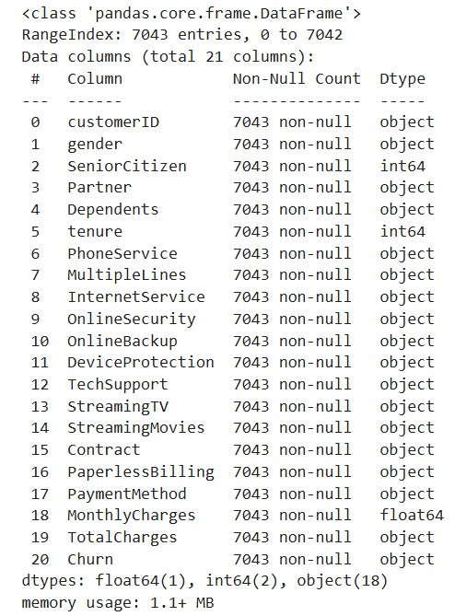
Data set link - https://www.kaggle.com/datasets/blastchar/telco-customer-churn

Slide 5
Feature Engineering
What We Did in This Project
Dropped ID-like columns
Created AvgChargesPerMonth.
Created MultipleServicesCount
Converted categories to numeric (One-Hot Encoding)
Handled missing values
Notes:
Creating or modifying features (columns) in the dataset to helpthe model find better patterns.
What We Did in This Project
Dropped ID-like columns
Removed customerID — it’s just an identifier, no predictive power.
Created AvgChargesPerMonth
Formula: TotalCharges / tenure
Captures how much a customer pays on average each month.
Created MultipleServicesCount
Counted how many services (e.g., Internet, Streaming, TechSupport) a customer has.
More services can indicate lower churn risk.
Converted categories to numeric (One-Hot Encoding)
Example: Contract → Contract_Month-to-month, Contract_One year, etc.
Allows models to understand text-based columns.
Handled missing values
Replaced missing TotalCharges with the median.
Ensures model can train without errors.
Preserved both human-readable & numeric churn columns
Churn (Yes/No) for easy analysis.
Churn_Flag (1/0) for model training.
We did one-hot encoding because:
Machine learning models (like Logistic Regression, Random Forest, etc.) can’t work directly with text labels like "Month-to-month" or "Fiber optic". They only understand numbers.
One-hot encoding converts each category into its own column with 1 or 0 indicating if that row belongs to that category.
In churn project, one-hot encoding was applied to all categorical columns except:
customerID (dropped earlier because it’s just an identifier)
Churn_Flag (our target, we don’t encode it — we predict it)
That means columns like these got encoded:
Contract (Month-to-month, One year, Two year)
InternetService (DSL, Fiber optic, No)
PaymentMethod (Electronic check, Mailed check, etc.)
gender (Male, Female)
Partner (Yes, No)
Dependents (Yes, No)
PhoneService, MultipleLines, PaperlessBilling
And other service-related columns (OnlineSecurity, OnlineBackup, TechSupport, etc.)

Slide 6
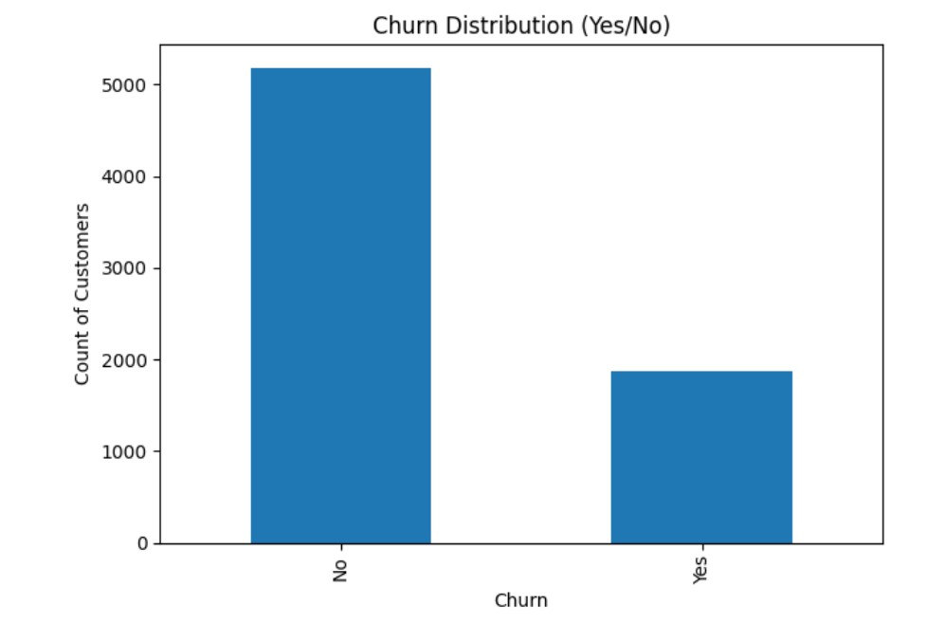
Notes:
What bar is showing
X-axis → The two categories from the Churn column:
"No" → Customers who stayed.
"Yes" → Customers who left (churned).
Y-axis → How many customers are in each category (the count).
So "No" is much taller than "Yes", it means most customers stayed, and only a smaller portion left.

Slide 7
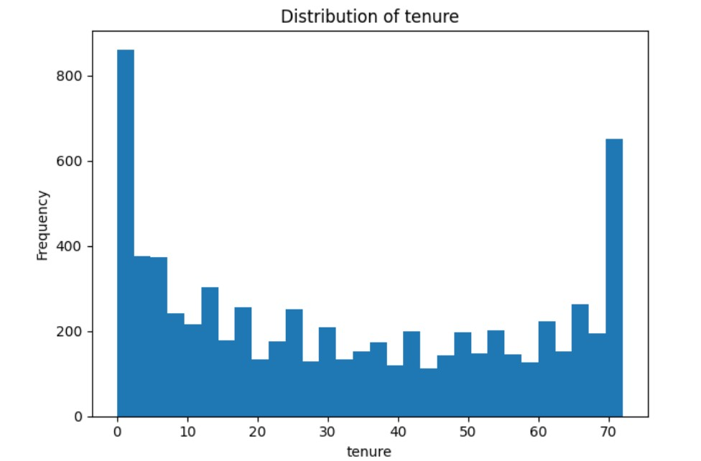
Notes:
Tenure – leghth of time the costomer is with the company

Slide 8
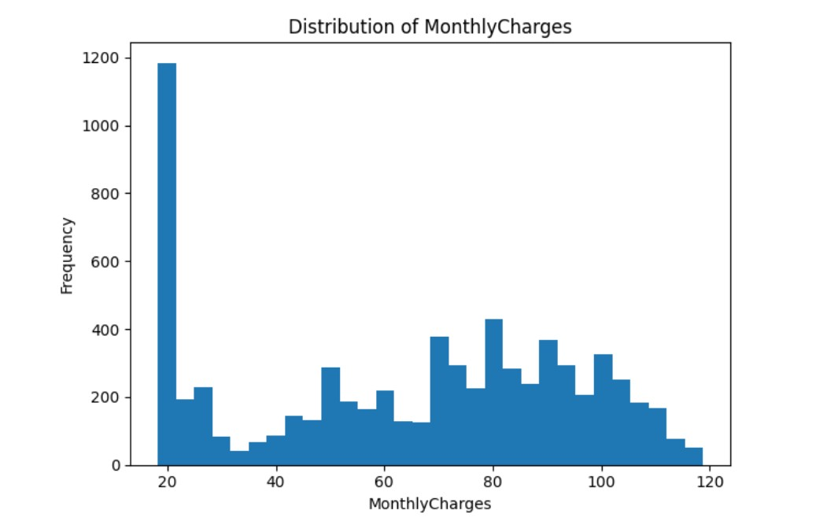

Slide 9
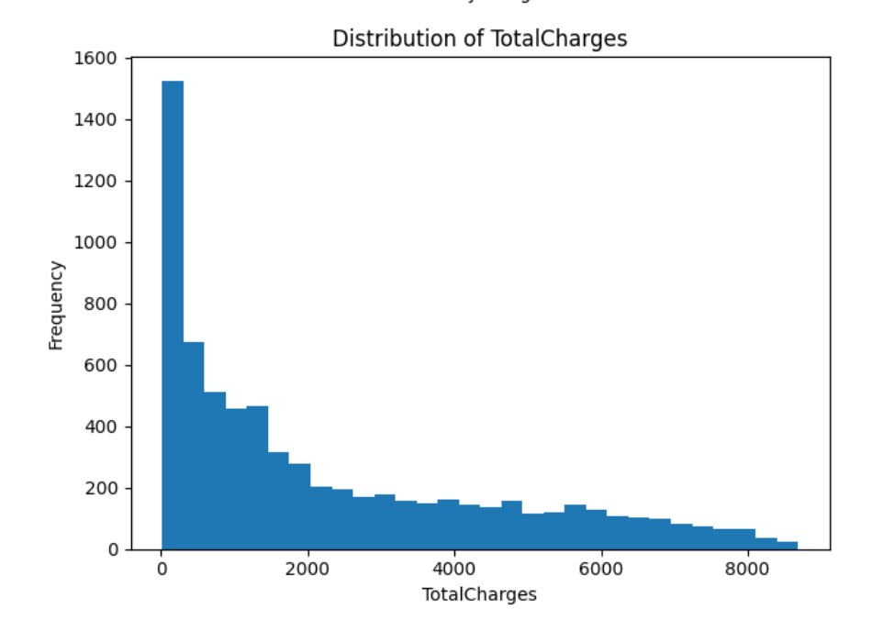

Slide 10
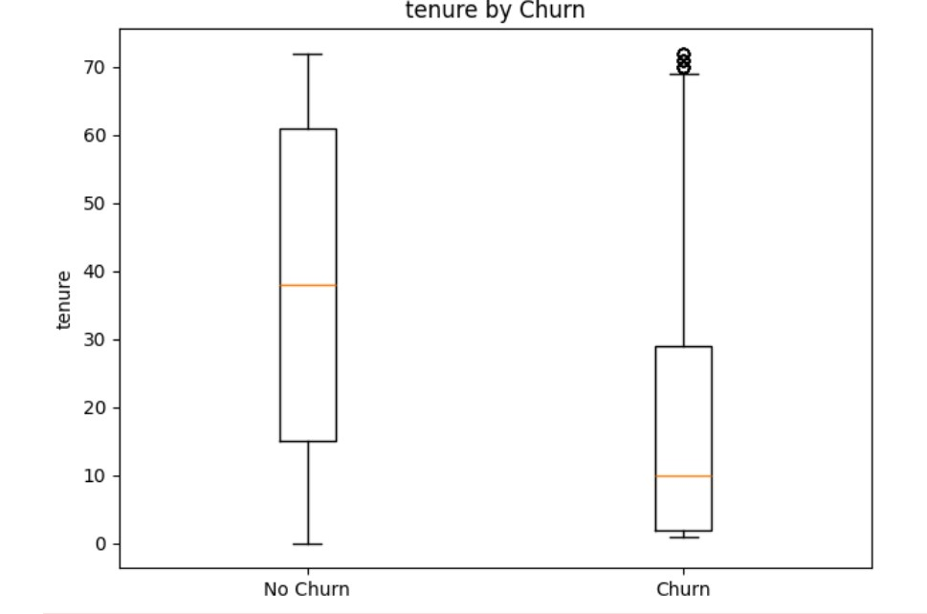
Notes:
Observation:
No Churn customers have much longer tenure
Churn customers tend to leave early, often within the first year.
Interpretation:
Early-stage customers are at a higher risk of churning — onboarding and early customer experience may be critical.
Longer-tenure customers are more “loyal” and less likely to leave.

Slide 11
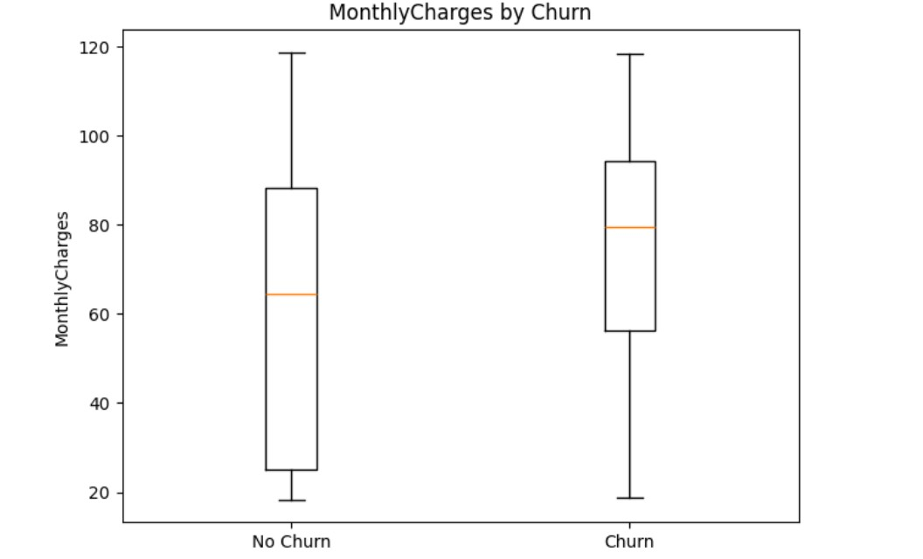
Notes:
MonthlyCharges by Churn
Observation:
Churn customers have slightly higher median than No Churn customer
Higher monthly charges might be linked to customers leaving — possibly due to cost sensitivity or dissatisfaction with expensive plans.
This aligns with churn risk being higher in high-bill segments.

Slide 12
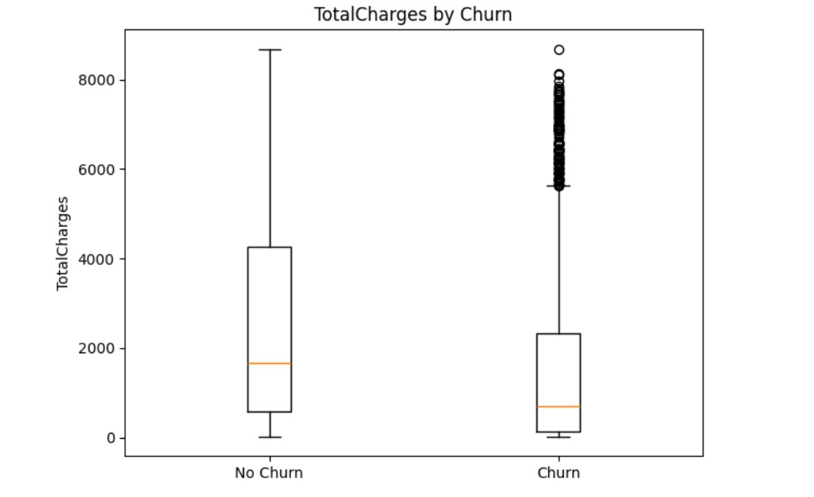
Notes:
1. TotalCharges by Churn
Observation:
No Churn customers generally have higher median around ~1700) compared to Churn customers (median below ~700).
Churn customers often have lower total charges, suggesting they leave earlier in their subscription period.
Customers with low TotalCharges might be newer customers who didn’t stay long enough to accumulate high bills.
Retained customers tend to have stayed longer, hence higher cumulative charges.

Slide 13
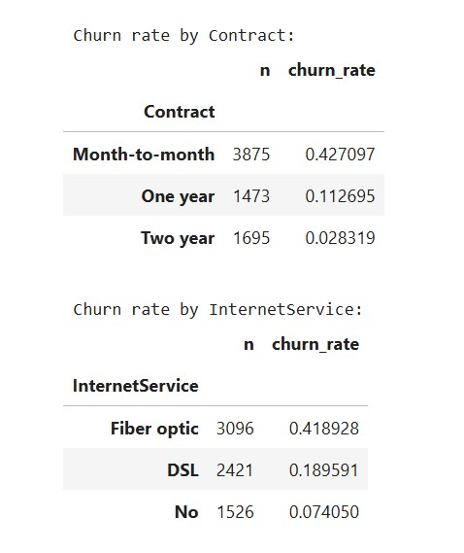
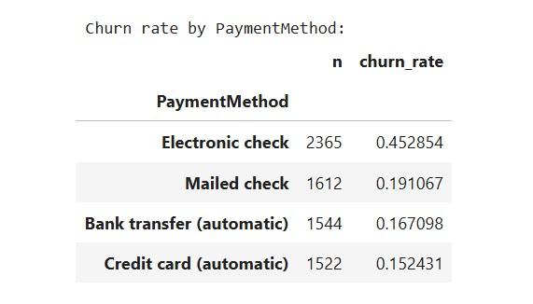
Notes:
We made a column Churn_Flag where:
1 = customer left (churned)
0 = customer stayed
We add up all the 1’s and divides by total customers giving the percentage of customers who churned.

Slide 14
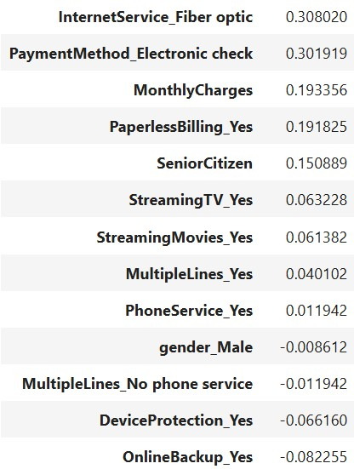
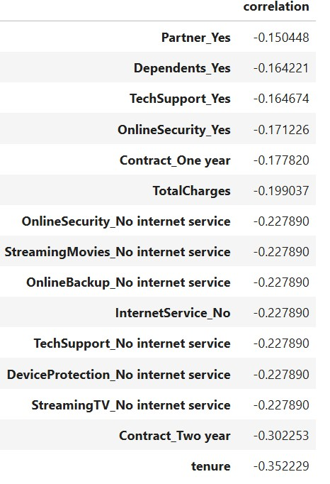
Positive corelation
Negative corelation
Notes:
Top positive correlations with Churn_Flag (signals of higher churn):
Top negative correlations with Churn_Flag (signals of retention):

Slide 15
How do we judge the model?
Accuracy — out of everyone, how many did we get right overall?
Precision — when we said “will churn”, how often were we right? (few false alarms)
Recall — of all the real churners, how many did we catch? (few misses)
F1 — one number that balances precision and recall.
ROC AUC — how well we rank churners above non‑churners across all thresholds.
Notes:
1. Accuracy – “How many total customers did we guess right?” If we predicted churn for 100 customers and 85 were correct (either stayed or left), our accuracy is 85%. 💡 In churn prediction: High accuracy means we’re usually right overall — but it can be misleading if churners are rare.
2. Precision – “When we said someone will leave, how often were we right?” If we warned 10 customers they might leave, but only 7 actually left → precision = 70%. 💡 In churn prediction: High precision means fewer false alarms — we don’t annoy loyal customers with unnecessary retention offers.
3. Recall – “Of all the people who really left, how many did we catch?” If 20 customers actually left but we only flagged 12 → recall = 60%. 💡 In churn prediction: High recall means we catch most churners, so fewer slip away unnoticed.
4. F1 Score – “A single score that balances precision and recall.” If you want both few false alarms and few misses, F1 combines them into one number (0–1). 💡 In churn prediction: F1 is useful if we care equally about not bothering loyal customers AND not missing churners.
Receiver Operating Characteristic - Area Under the Curve
5. ROC AUC – “How well do we rank churners above non-churners, no matter the cut-off?” Imagine sorting all customers by how likely they are to churn — AUC measures how well that list puts real churners at the top. 💡 In churn prediction: High ROC AUC means our model is good at separating churners from stayers overall.

Slide 16
Model building
Selected target variable
Split data into Train & Test sets
Tried multiple algorithms
Hyperparameter tuning
Evaluated models with multiple metrics
Compared results & selected best model
Notes:
Selected target variable
Churn_Flag (1 = churn, 0 = stay) as our prediction target.
Split data into Train & Test sets
Train = learn patterns.
Test = check how well it works on unseen data.
Tried multiple algorithms
Logistic Regression (tuned).
Random Forest (tuned).
Hyperparameter tuning
Adjusted model settings to get the best performance.
Evaluated models with multiple metrics
Accuracy, Precision, Recall, F1, ROC AUC.
Checked error rates (MAE, RMSE) and fit score (R²).
Compared results & selected best model
Both models achieved very high scores.
Logistic Regression slightly better on errors.

Slide 17
Model Results (test set)
Model |  | MAE (probs) | RMSE (probs) | R² (probs)
LogisticRegression |  | 0.0311 (~3.11%) | 0.0424 (~4.24%) | 0.9908
RandomForest |  | 0.0371 (~3.71%) | 0.0573 (~5.73%) | 0.9831
Notes:
1. MAE (Mean Absolute Error)
Says: “On average, how far off were our guesses?”
Logistic Regression: 3.11% off on average.
Random Forest: 3.71% off on average.
2. RMSE (Root Mean Squared Error)
Similar to MAE but penalizes big mistakes more.
Logistic Regression: 4.24% off (slightly bigger than MAE because of some bigger misses).
Random Forest: 5.73% off.
3. R² (R-squared)
Says: “How much of the variation in churn can we explain?”
1.0 means perfect prediction, 0 means “no better than guessing.”
Logistic Regression: 0.9908 → explains 99% of churn variation.
Random Forest: 0.9831 → explains 98% of churn variation.
For MAE and RMSE, lower is better because they measure the size of your prediction errors — smaller errors mean more accurate predictions.
For R², higher is better because it tells you how much of the variation in churn your model explains — closer to 1 means the model fits the data very well.

Slide 18
Which model is best and why?
We choose LogisticRegression because:
Tie‑breaker: better probability errors (MAE 3.11% vs 3.71%, RMSE 4.24% vs 5.73%).
It’s simpler and easier to explain, and often more stable.
Notes:
For MAE and RMSE, lower is better because they measure the size of your prediction errors — smaller errors mean more accurate predictions.
For R², higher is better because it tells you how much of the variation in churn your model explains — closer to 1 means the model fits the data very well.
MAE (Mean Absolute Error)
MAE (Mean Absolute Error)

Slide 19
Model is too good to be true?
In real business churn data, people’s decisions are unpredictable ,so you’ll never see ROC AUC = 1.0 or R² ≈ 1 unless the model has cheated.
Data leakage , when the model accidentally gets access to information that it wouldn’t have in the real world at prediction time (e.g., future data, or a variable that directly reveals churn).
Why it’s bad:
The model will look amazing in testing but fail badly in real use, because the info won’t exist in real life.
You end up with a model that’s overfitted memorizing your dataset instead of learning patterns.
Notes:
Leakage
In machine learning, data leakage happens when the model sees information during training that it shouldn’t have .
it could be the information that directly or indirectly contains the answer.
in my case,
it would be better if we knew TotalCharges is calculated before or after churn. If after, that’s leakage.
because, when we build a churn prediction model, the goal is to predict before the customer leaves.
That means we should only use information that would have been available at the moment of prediction.
Any columns that have a near-perfect correlation with Churn will also cause the leakage
Month-to-month contracts often have much higher churn rates, so the model could almost perfectly separate churners from non-churners just from this column. this means the data in too easy.
For example, if "Contract" = 'Month-to-month' always means churn, and "Two-year contract" always means no churn, the model just uses that one rule and gets 100% accuracy.
overfitting
If the dataset is small, a powerful model (like Random Forest with many deep trees) can memorize every customer’s data instead of learning patterns.
How to solve
- Limit the complexity of models like Random Forest (e.g., max_depth=5, fewer trees).

Slide 20
FINDINGS
Churned customers tend to have:
Lower TotalCharges
Higher MonthlyCharges
Shorter Tenure
Contract Type
Longer contracts = lower churn.
Internet Service Type
among DSL, no internet and fiber optic, Fiber optic customers are most likely to leave.
Payment Method
Automatic payment methods are linked to lower churn.

Slide 21
Model deployment
Created a GitHub repo
Pushed code to GitHub
Used GitHub Desktop
Opened project in VS Code
Saved the trained model
Prepared the code for predictions
Deployed to Render
Connected our GitHub repo to Render
Tested the deployment

Slide 22
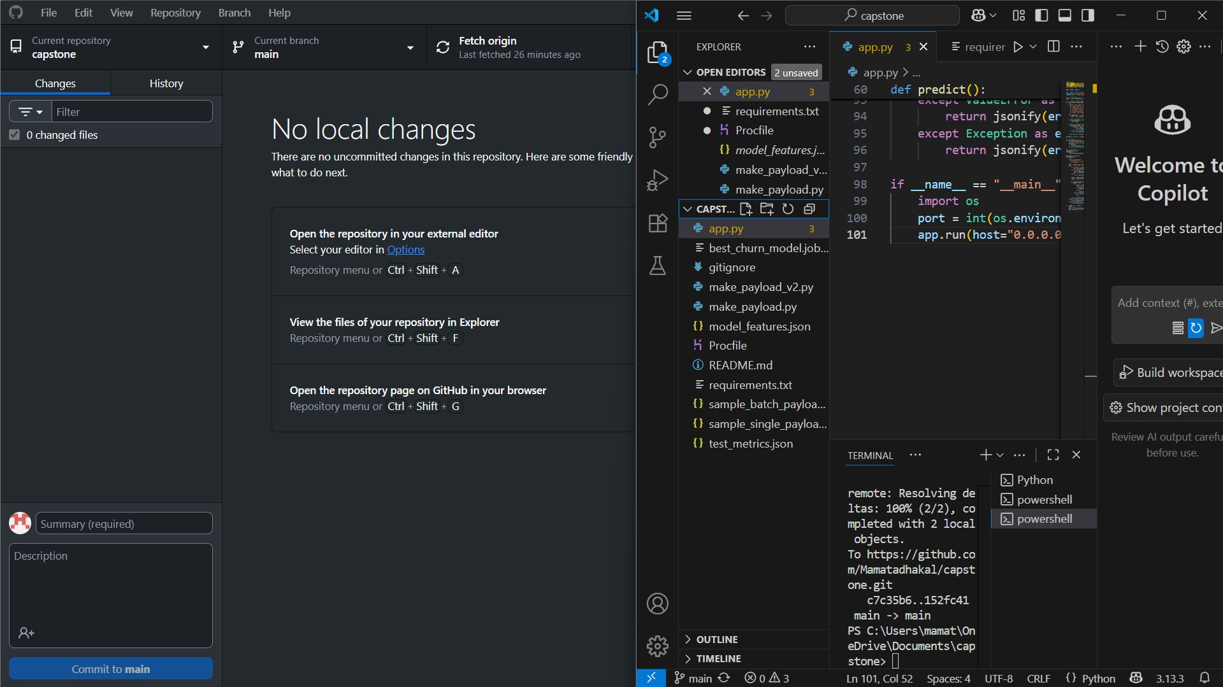

Slide 23
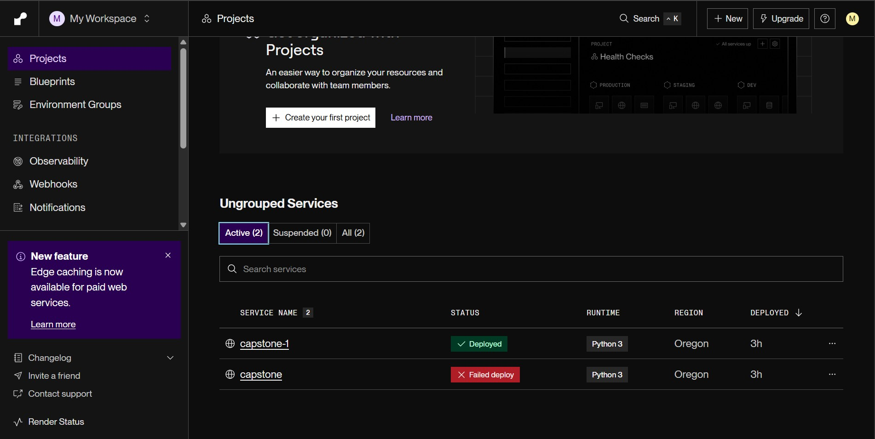

Slide 24
Business Recommendations
Target Month-to-Month Customers
Offer discounts or incentives to encourage switching to yearly contracts.
Improve Customer Support Services
Provide free or discounted tech support and online security for at-risk customers.
Review High Monthly Charges
Introduce loyalty programs or bundled services to reduce costs for high-bill customers.
Retention Campaigns for At-Risk Groups
Use the churn prediction model to identify high-risk customers and reach out before they leave.
Monitor Customer Satisfaction Regularly
Implement surveys and feedback loops to detect dissatisfaction early.

Slide 25
Conclusion
The churn prediction model can accurately identify customers likely to leave, allowing the business to act proactively.
Insights from the analysis show that contract type, service quality, and pricing are major churn drivers.
By using these insights and targeting interventions effectively, the company can reduce churn, increase customer lifetime value, and boost revenue.
Deployment of the model makes churn prediction automated and accessible, enabling real-time decision-making.

Slide 26


