Slide 1

Tableau
-Mamatha Ramanujam

Slide 2
Data Visualization
Data Visualization is one of the most important part of data analysis. It has always been important to present the data in an understandable and visually appealing format. Data visualization is one of the skills that Data analysis have to master in order to communicate better with the end users

Slide 3
What is Tableau
Tableau is the rapidly growing visualization tool used for different business applications. It is high in demand software due to its easy access to use. It is widely used in Business Intelligence (BI) processes.
Tableau is crafted in such a way that all kinds of charts, plots, and graphs with different designs can be positioned simultaneously for visualization.
If we talk about the data type and structure and their access in tableau, it can work on any kind of data type either data is structured, unstructured datasets with the accessing of any sort of programming language as R, Python, SAS, etc.

Slide 4
Researchers described Tableau as a "highly interactive and intuitive visual-based exploration experience for business users to easily access, prepare and analyze their data without the need for coding"
Tableau has plenty of easily accessible functions that can create highly simplified graphs or charts for any set of complex data.
A business analyst can investigate any pattern, insight, flow, or trends from visually available data and hence predict or conclude for any business problem.

Slide 5
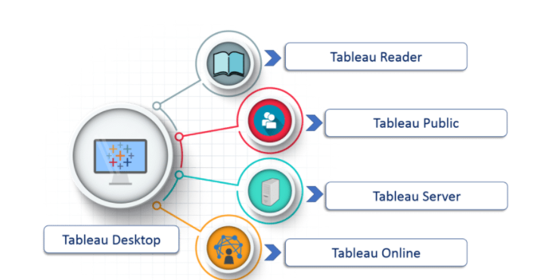
Tableau Types
(i)Tableau Desktop:
It is a self service business analytics and data visualization that anyone can use. It translates pictures of data into optimized queries. With tableau desktop, you can directly connect to data from your data warehouse for live upto date data analysis. You can also perform queries without writing a single line of code. Import all your data into Tableau’s data engine from multiple sources & integrate altogether by combining multiple views in a interactive dashboard.
(ii)Tableau Server:
It is more of an enterprise level Tableau software. You can publish dashboards with Tableau Desktop and share them throughout the organization with web-based Tableau server. It leverages fast databases through live connections.
(iii)Tableau Online:
This is a hosted version of Tableau server which helps makes business intelligence faster and easier than before. You can publish Tableau dashboards with Tableau Desktop and share them with colleagues.
(iv)Tableau Reader:
It’s a free desktop application that enables you to open and view visualizations that are built in Tableau Desktop. You can filter, drill down data but you cannot edit or perform any kind of interactions.

Slide 6
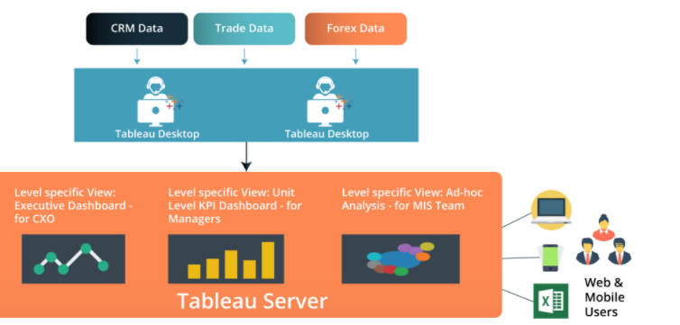
Architecture

Slide 7
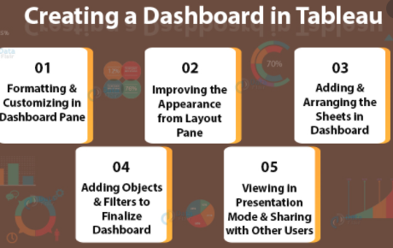
How to create Dashboard in Tableau

Slide 8
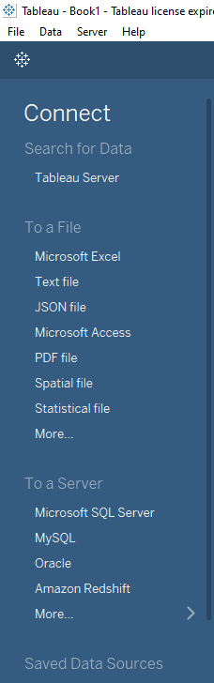
Tableau desktop

Slide 9
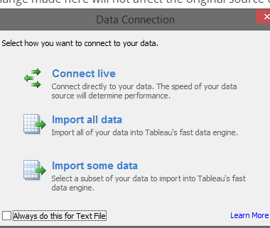
Data Connection
On Tableau, data can have Live Connection where any change in the source data will be automatically updated in Tableau. On the other hand, data can be Extracted to Tableau repository so that any change made here will not affect the original source data.

Slide 10
Menu
The menu bar in Tableau consists of various options to edit your visualization. Let me take you through them one by one

Slide 11
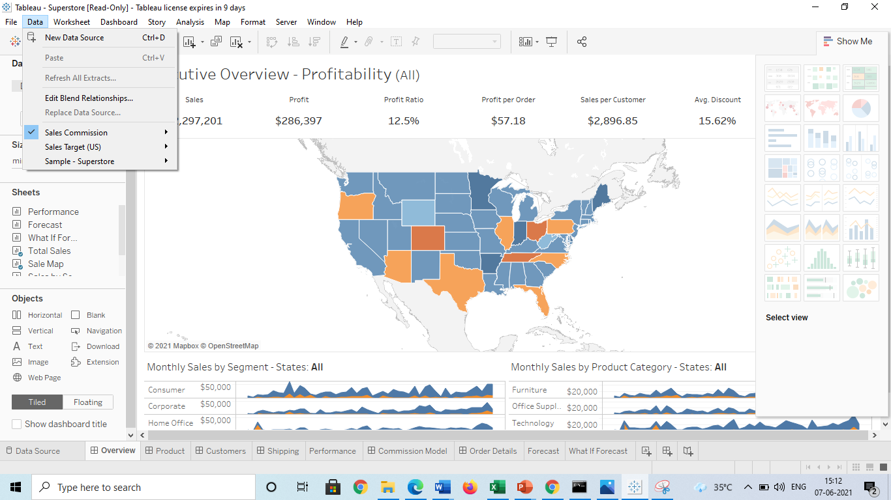
Data Menu
Data Menu
This Menu is used to create new data source to fetch the data for analysis and visualization. It also allows you to replace or upgrade existing data source.
The important features in this menu are as follows:
New Data Source to see all the types of connections available and choose from it.
Refresh All Extracts to refresh the data form source.
Edit Relationships option is used to define the fields in more than one data source for linking.

Slide 12
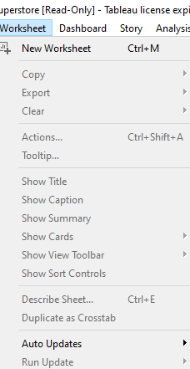
Worksheet menu
Worksheet menu
This Menu is used to create new worksheet along with various display features like showing the title and captions etc.
The important features in this menu are as follows:
Show summary to see the summary of the data used in the worksheet like count etc..
Tooltip to show the tooltip when hovering above various data fields.
Run Update option is used to update the worksheet data or filters used.

Slide 13
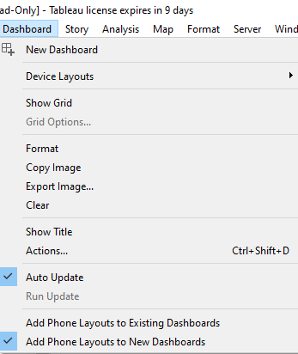
Dashboard menu
Dashboard menu
This Menu is used to create a new dashboard along with various display features like showing the title and exporting the image etc..
The important features in this menu are as follows:
Format is used to set the layout in terms of colours and sections of the dashboard.
Actions to link the dashboard sheets to external URLS or other sheets.
Export Image option is used to export an image of the Dashboard.

Slide 14
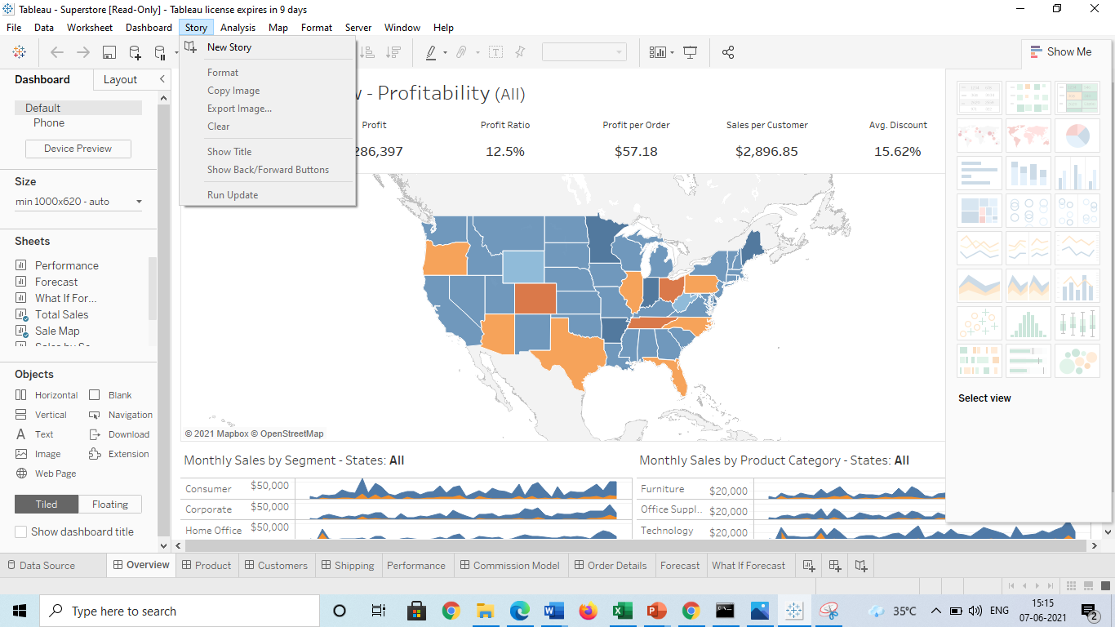
Story Menu
Story Menu
This Menu is used to create a new story which has many sheets or dashboards with related data.
The important features in this menu are as follows:
Format is used to set the layout in terms of colours and sections of the story.
Run Update to update the story with latest data form source.
Export Image option is used to export an image of the story.

Slide 15
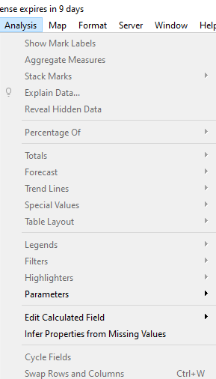
Analysis Menu
Analysis Menu
This Menu is used for analyzing the data present in the sheet. Tableau provides many out of box features like calculating the percentage and doing a forecast etc..
The important features in this menu are as follows:
Forecast to show a forecast based on available data.
Trend Lines to show the trend line for s series of data.
Create calculated Field option is used to create additional fields based on certain calculation on existing fields.

Slide 16
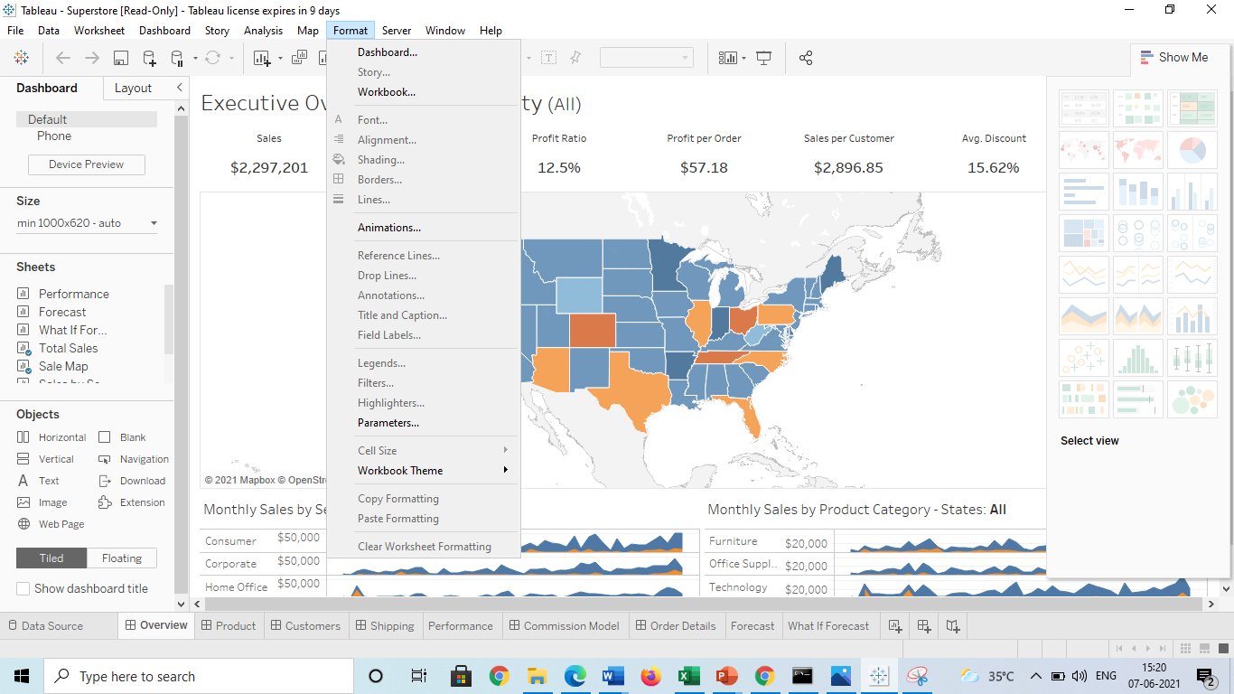
Format Menu
Format Menu
This Menu is used for applying the various formatting options to enhance the look and feel of the dashboards created. It provides features like borders, colours, alignment of text etc..
The important features in this menu are as follows:
Borders to apply borders to fields displayed in the report.
Title and caption to assign a Title and caption to the reports.
Cell Size to customize the size of the cells displaying the data.
Workbook Theme to apply theme to the entire workbook.

Slide 17
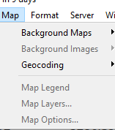
Map Menu
Map Menu
This Menu is used for building map views in Tableau. You can assign geographic roles to fields in your data.
The important features in this menu are as follows:
Map Layers to hide and show map layers, such as street names and country borders, and add data layers.
Geocoding to create new geographic roles and assign them to the geographic fields in your data.

Slide 18
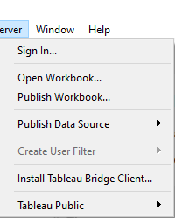
Server Menu
Server Menu
Server Menu is used to login to the Tableau server if you have access and publish your results to be used by others. It is also used to access the workbooks published by others.
The important features in this menu are as follows:
Publish Workbook to publish the workbook in the server to be used by others.
Publish Data source to publish the source data used in the workbook.
Create User filters to create filters on the worksheet to be applied by various users when the access the report.

Slide 19
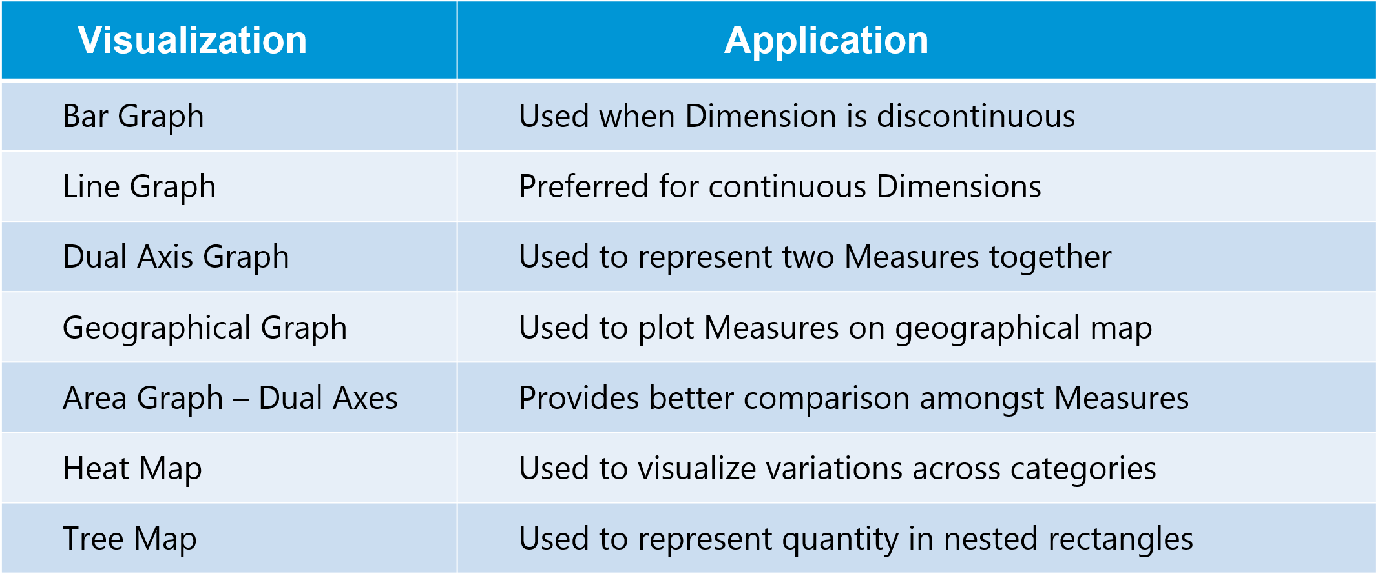
Create Visualizations
Above in this Tableau tutorial, you have seen the different The following table tells you how to choose the right visualization for your dataset out of many available options.

Slide 20
Types of filter
In Tableau, filters are used to restrict the data from database.
The different filters in Tableau are: Quick , Context and Normal/Traditional filter are:
Normal Filter is used to restrict the data from database based on selected dimension or measure. A Traditional Filter can be created by simply dragging a field onto the ‘Filters’ shelf.
Quick filter is used to view the filtering options and filter each worksheet on a dashboard while changing the values dynamically (within the range defined) during the run time.
Context Filter is used to filter the data that is transferred to each individual worksheet. When a worksheet queries the data source, it creates a temporary, flat table that is uses to compute the chart. This temporary table includes all values that are not filtered out by either the Custom SQL or the Context Filter.

Slide 21
Process flow steps of BI
Step 1) Choose Tableau Server from options
Select the "Tableau Server" option given in the data tab.
Step 2) In the next screen, 1. Select the SuperStore.csv / Select sample data from online Tableau 2. Click on "Open" Option. This will connect the text file into Tableau

Slide 22
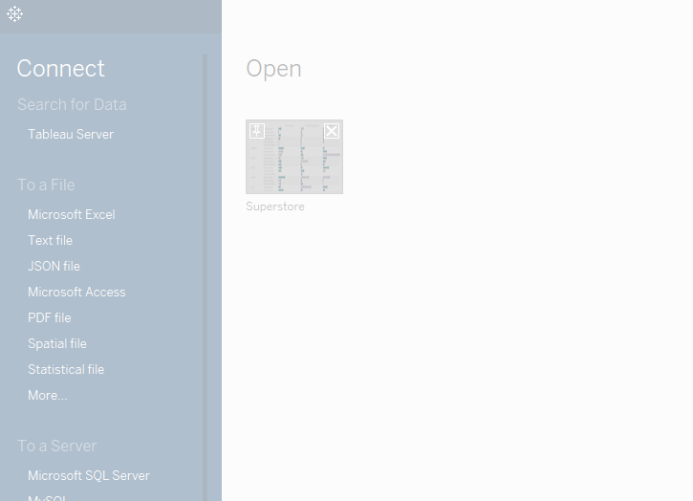
Step 3) Establish a connection
This will connect Tableau Server into Tableau Desktop.
Select the data set as shown in the figure.
This will import the dataset into Tableau.

Slide 23
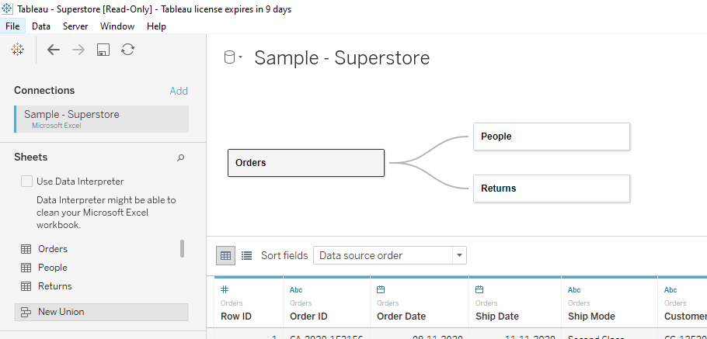
Data Relationship
A relational Database/Excel file consists of multiple Tables/sheets. These multiple tables/sheets can be connected to each other in Tableau. This connection is established by 'Join' or 'Union' feature present in Tableau. The relationship between data in two or more tables needs to be specified while joining tables.
Step 1) Once an Excel is connected, Drag the required sheet into data window as shown in the figure.

Slide 24
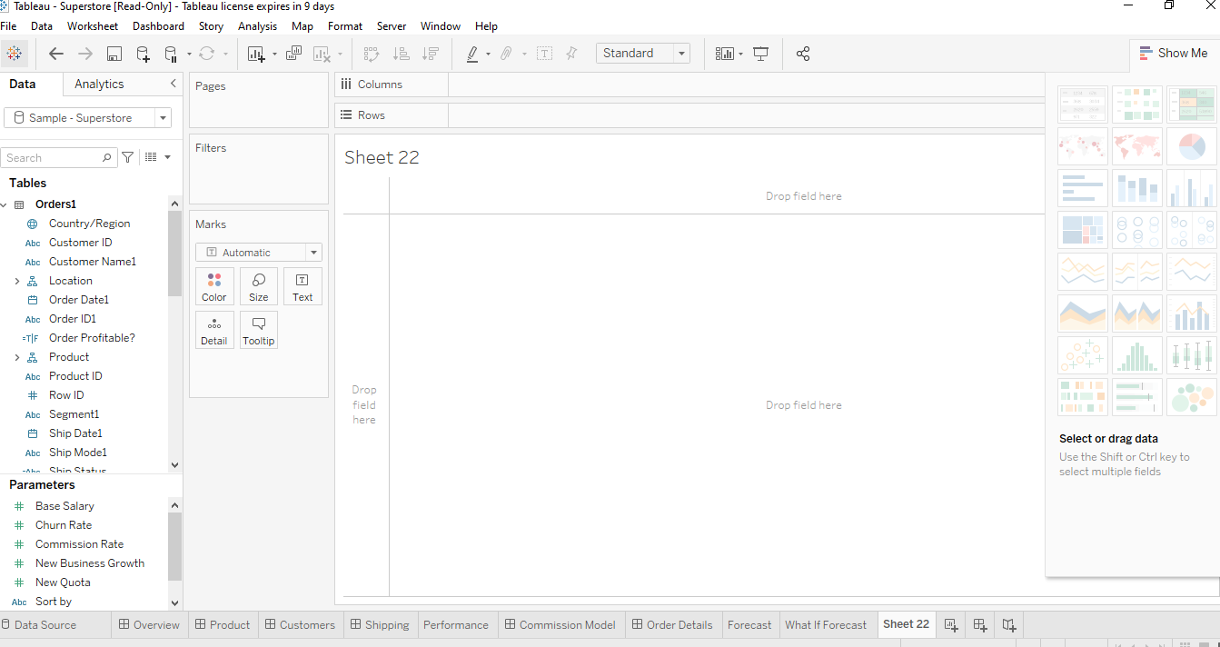
Worksheet

Slide 25
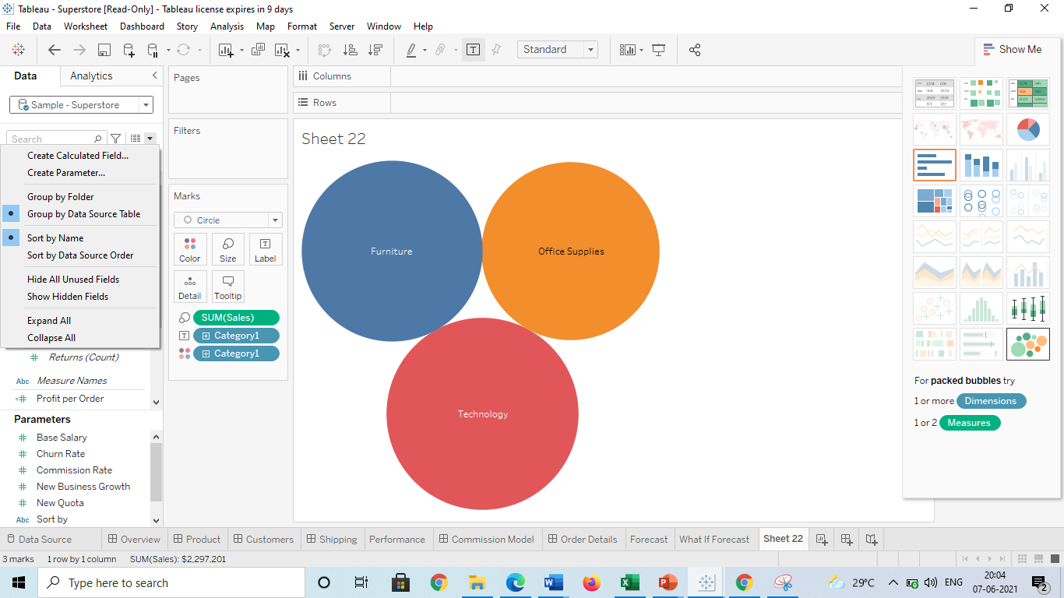
Data Sorting
Data present in the data source can be sorted based on the user requirement. It can be sorted using data source order, ascending, descending, ascending per table and descending per table.

Slide 26
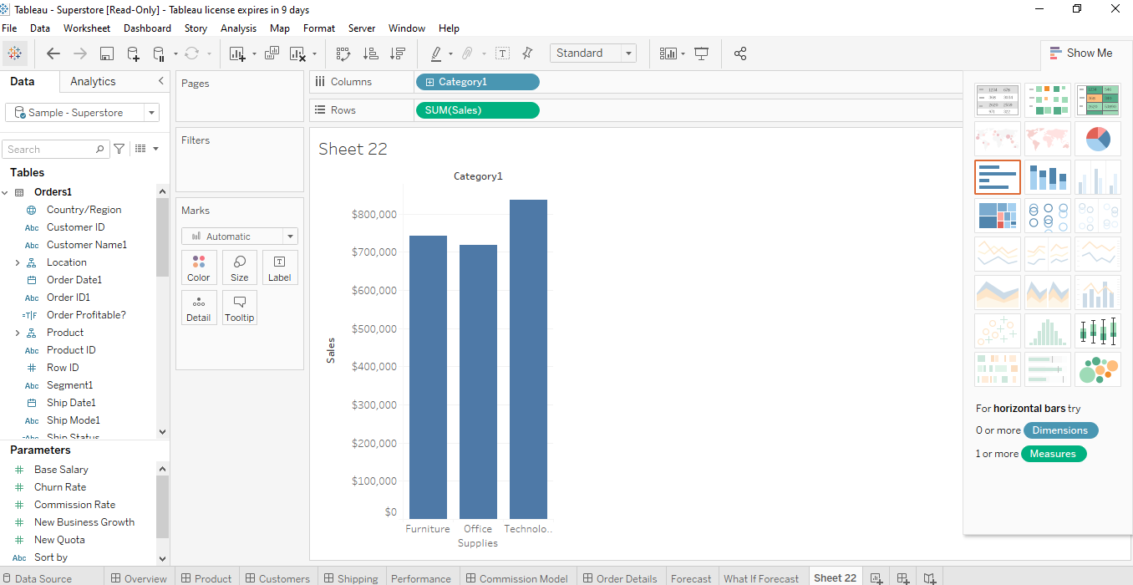
Visualize data

Slide 27
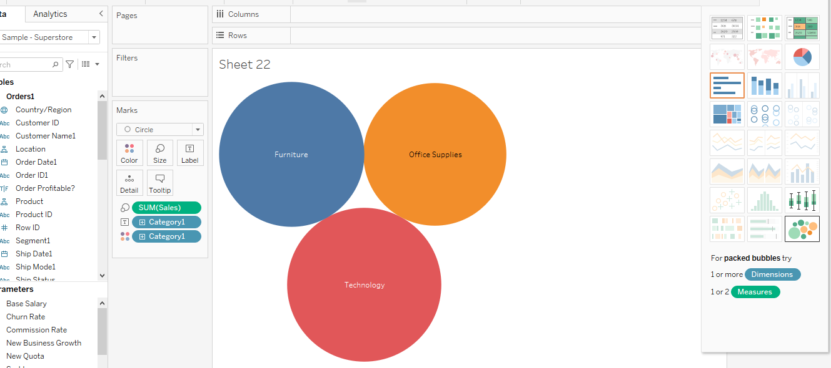

Slide 28
