Slide 1
Day3- TABLEAU
FILTER
-Mamatha Ramanujam

Slide 2
Scenarios:
1. Find the profit and sales for each subcategory of every type of product.
2. In case 1, change the color of the view from the Marks card.
3. In the view, in the Sub-Category filter card, clear all of the check boxes except Bookcases, Machines, and Tables to have closer look on each value.
4. Show the sales region wise for every subcategory and category and every year.
5. Duplicate your worksheet and check sales region vise for Machine type subcategory.
6. Rename your worksheet.
7. Save your workbook.

Slide 3
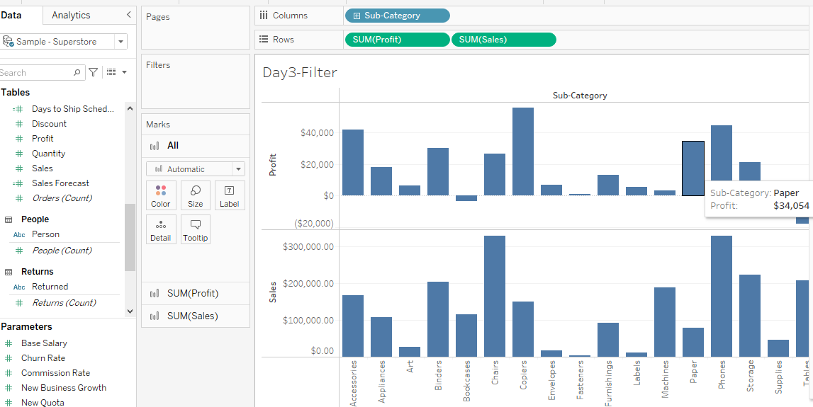
1. Find the profit and sales for each subcategory of every type of product.
Step1:
Drag the sub category to columns shelf
And Profit and Sale units to Row shelf

Slide 4
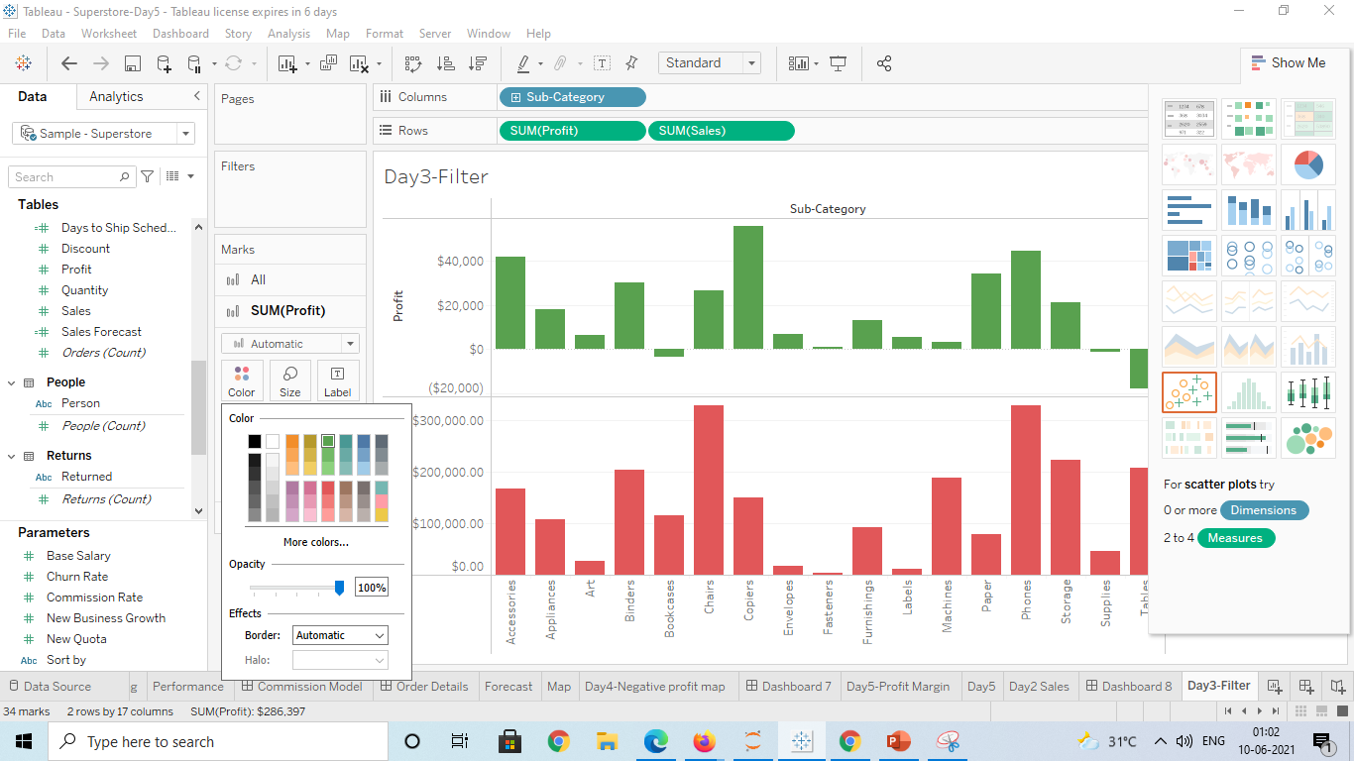
2. In case 1, change the color of the view from the Marks card.
Step2: Select the color for each from mark view and change

Slide 5
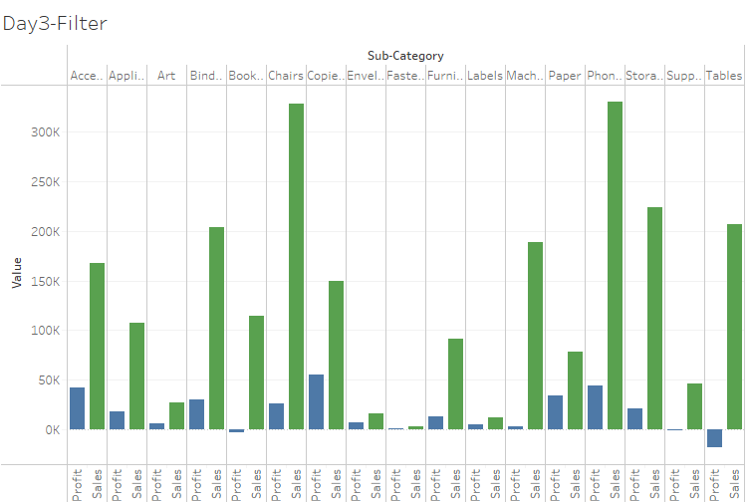
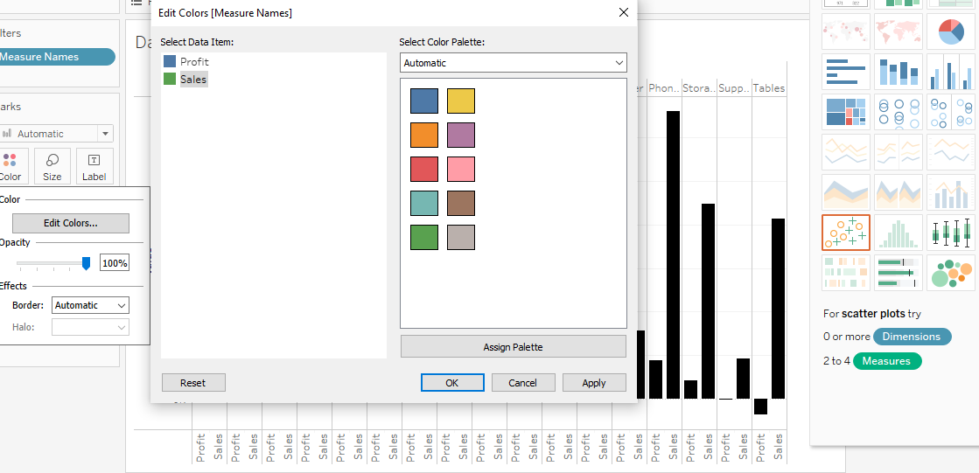
To show the Sales and Profit together with different color

Slide 6
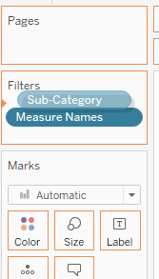
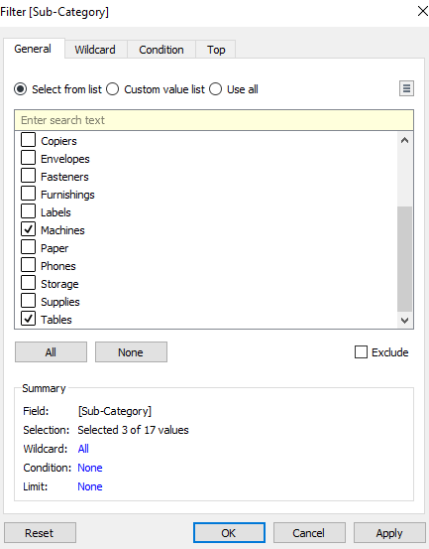
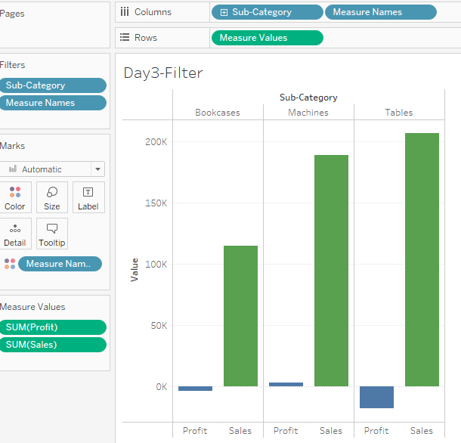
3. In the view, in the Sub-Category filter card, clear all of the check boxes except Bookcases, Machines, and Tables to have closer look on each value.
Step3: Drag and drop sub category in filter and in filter tab slect 3 values

Slide 7
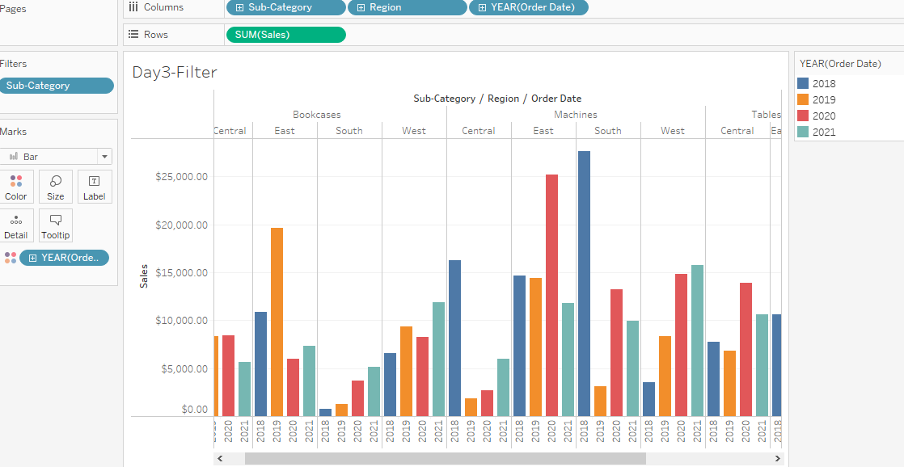
4. Show the sales region wise for every subcategory and category and every year.
Step4: Drag and drop Order date and region which depicts the sale region wise for every year

Slide 8
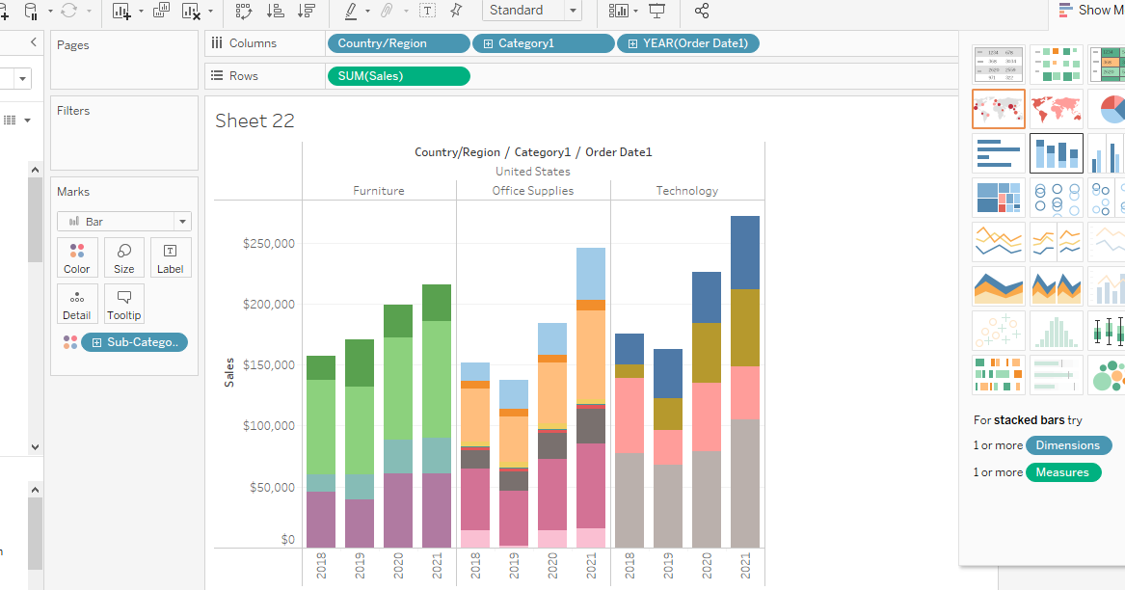
Different Visualization

Slide 9
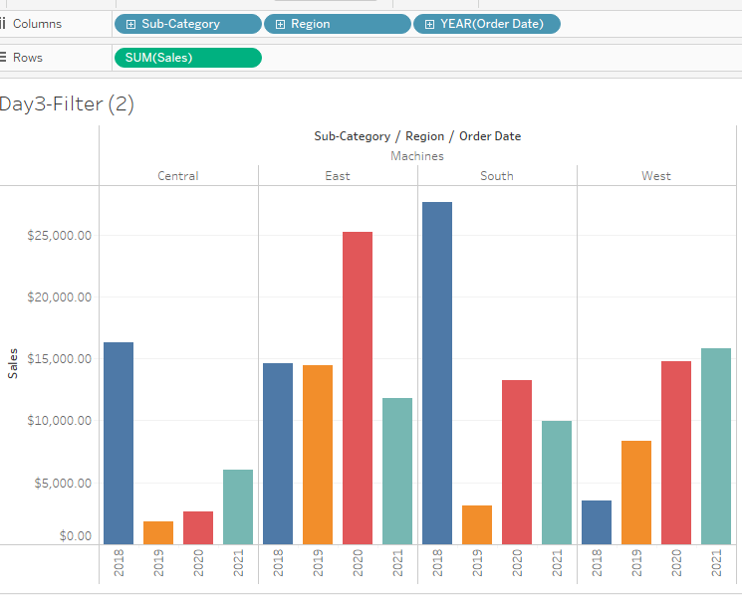
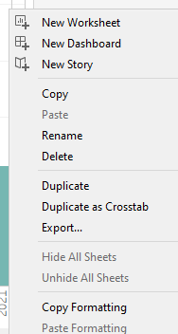
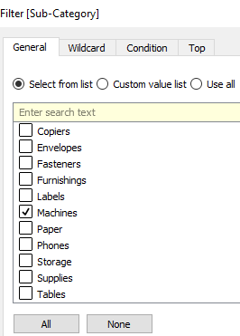
5. Duplicate your worksheet and check sales region vise for Machine type subcategory.
Step 5:Right click on duplicate and create a new worksheet in Filter option for subcategory remove other two values and select only machie

Slide 10
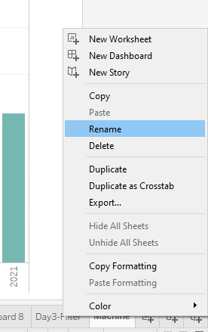
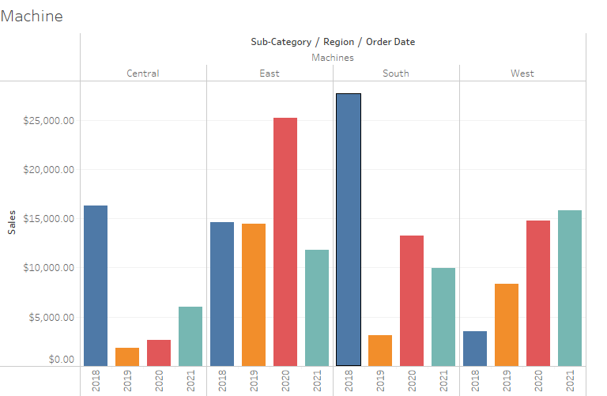
6. Rename your worksheet.
Step6: Right click on the duplicate worksheet click the rename option and rename as ‘Machine’

Slide 11
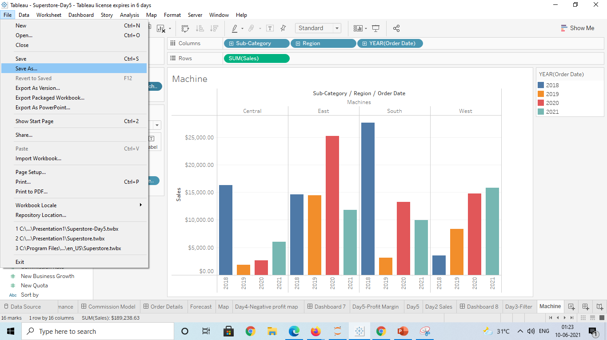
7. Save your workbook.
Save the workbook clicking the save as option

