Slide 1
Machine
File created on: 10-06-2021 02:22:37

Slide 2
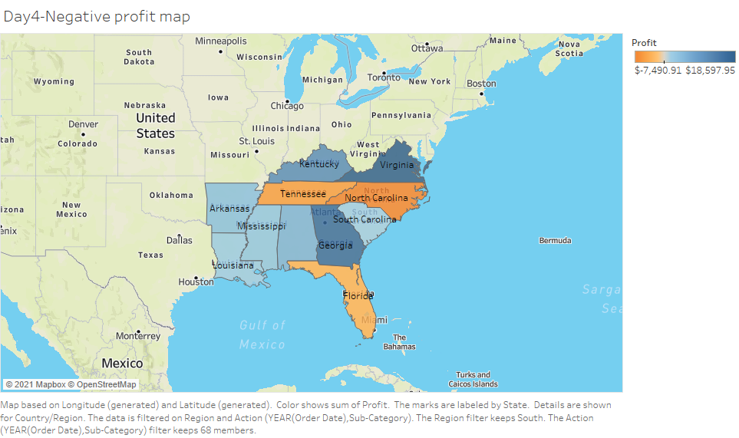

Slide 3
