Slide 1

Auditor Flow

Slide 2

Auditor Login

Slide 3

Auditor Login With OTP

Slide 4
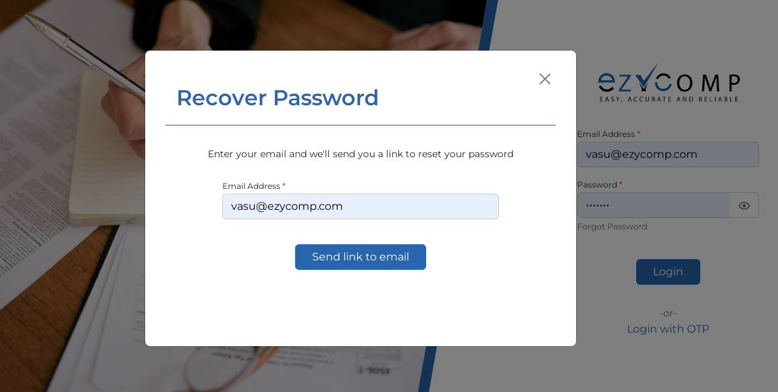
Auditor Forgot Password

Slide 5
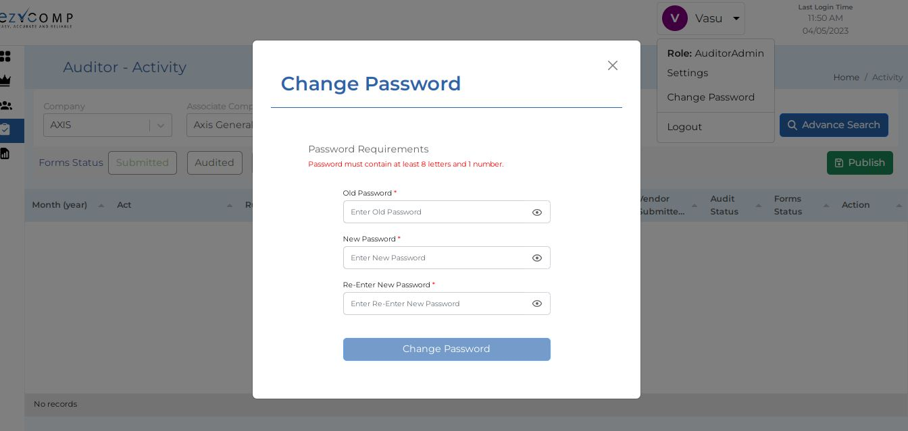
Auditor Change Password

Slide 6
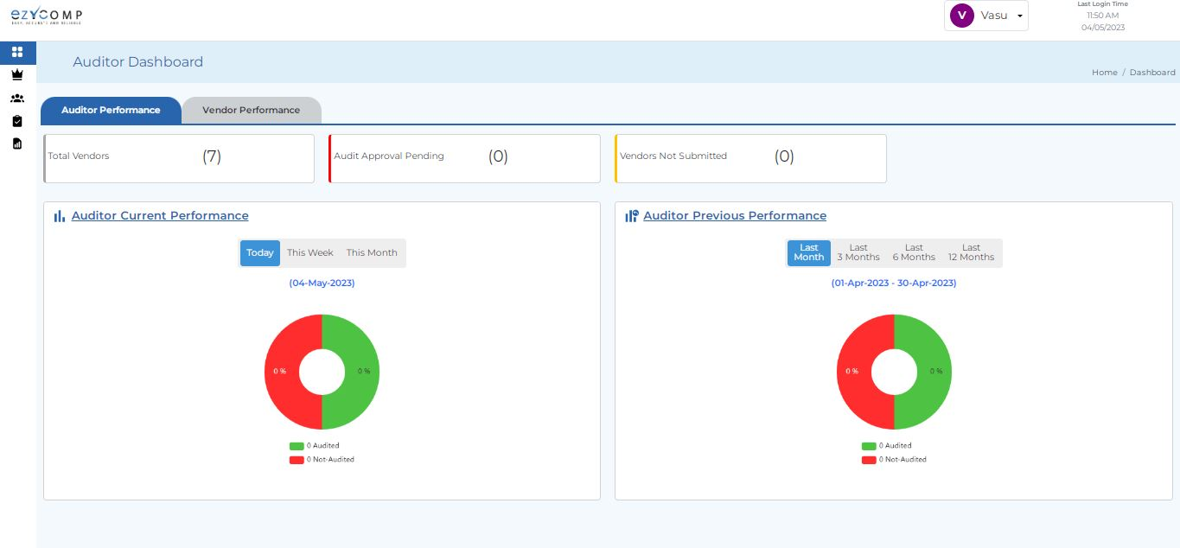
Auditor Dashboard Auditor Performance

Slide 7
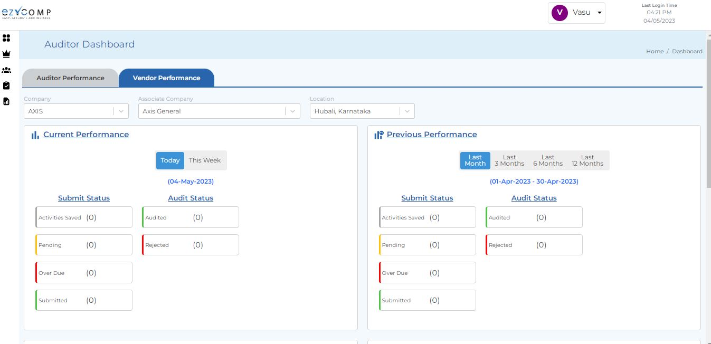
Auditor Dashboard Vendor Performance(1)

Slide 8
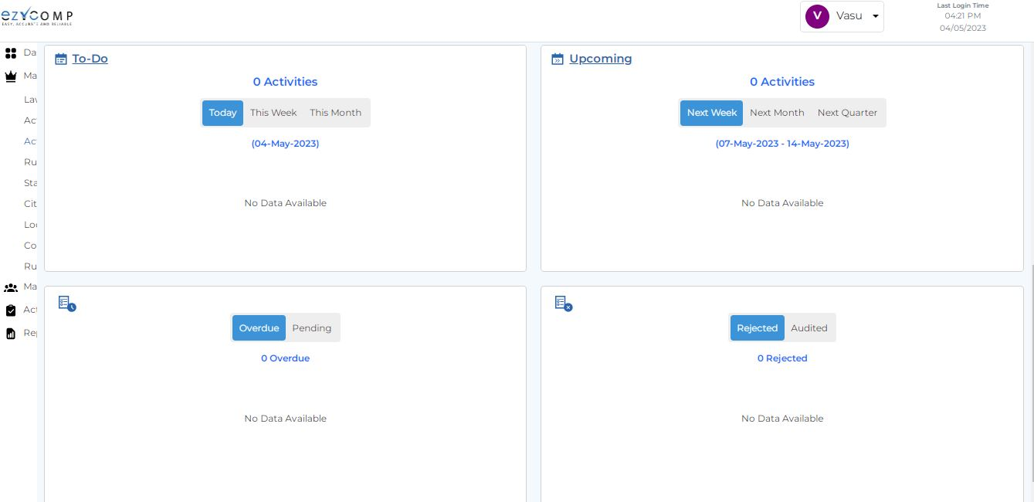
Auditor Dashboard Vendor Performance(2)

Slide 9
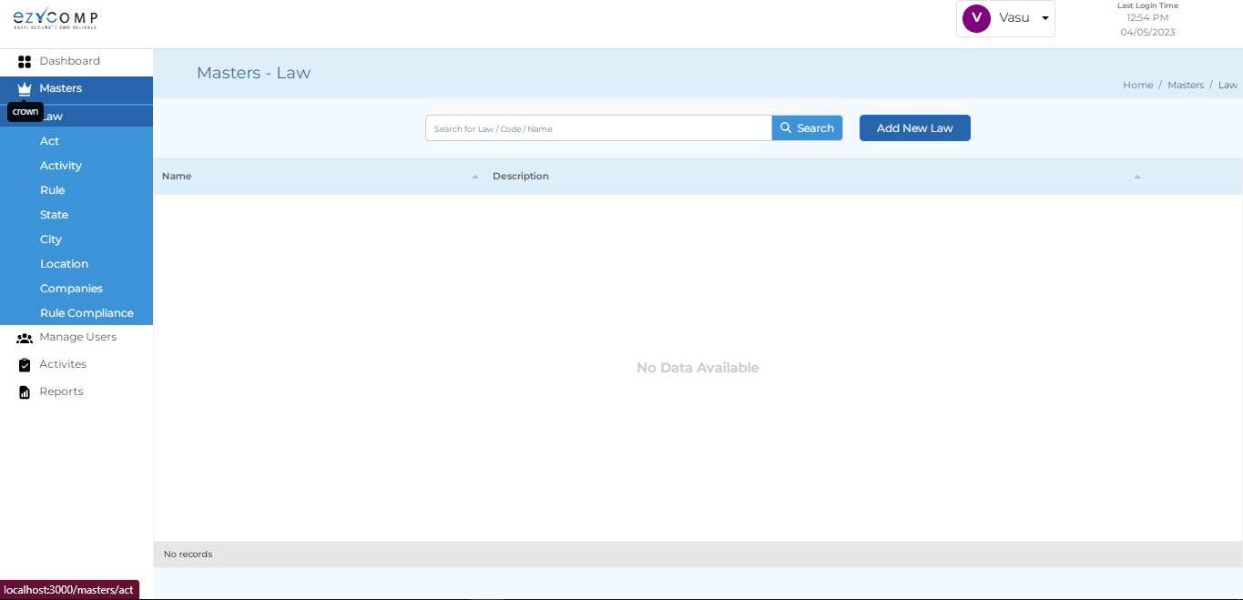
Auditor Expand Dashboard

Slide 10
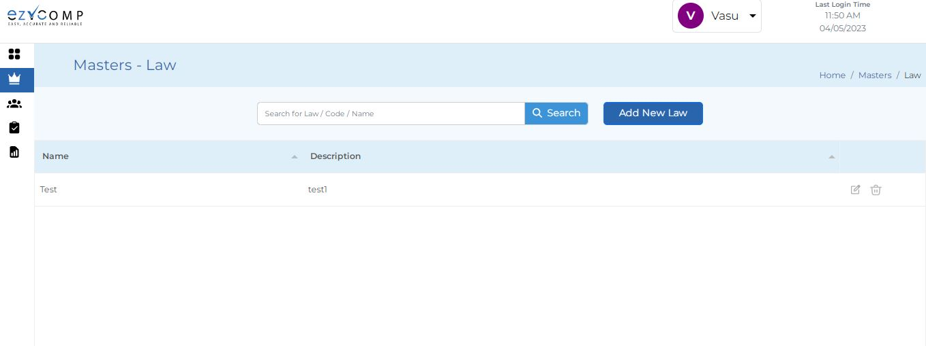
Auditor Dashboard Master Law

Slide 11
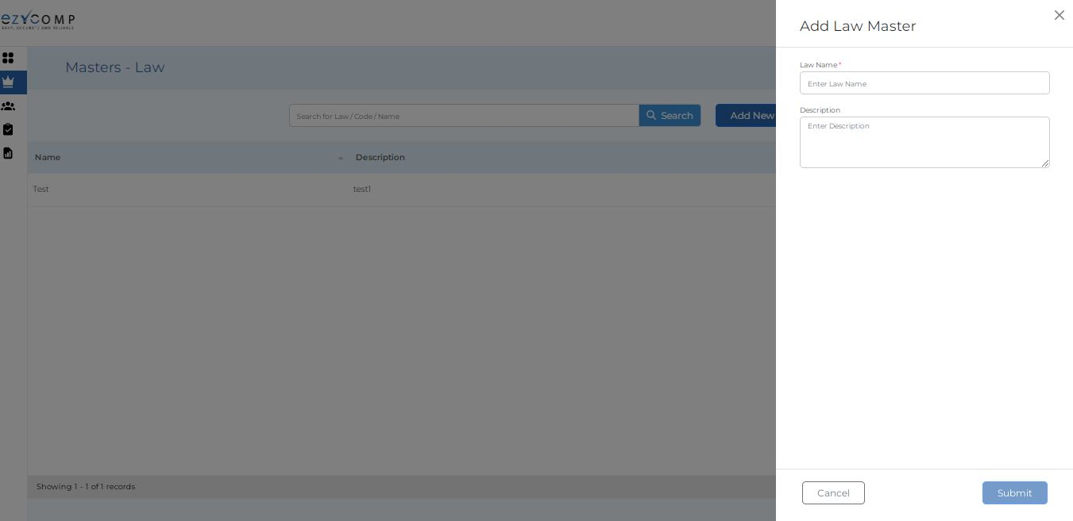
Auditor Dashboard Master Add New Law

Slide 12
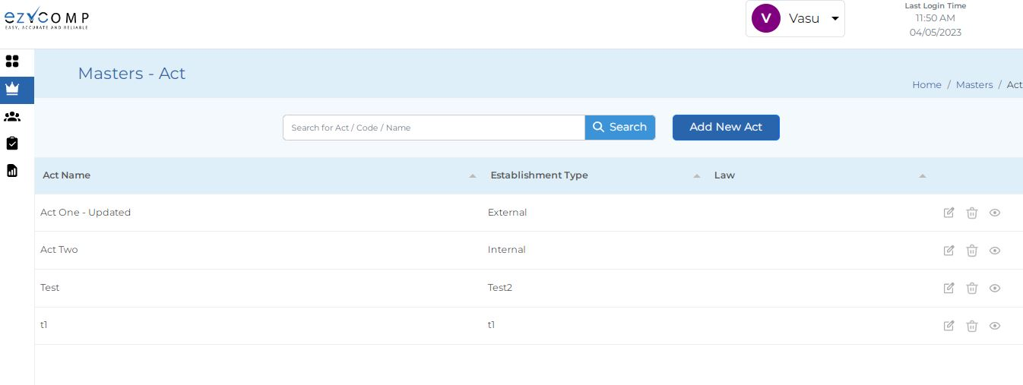
Auditor Dashboard Master Act

Slide 13
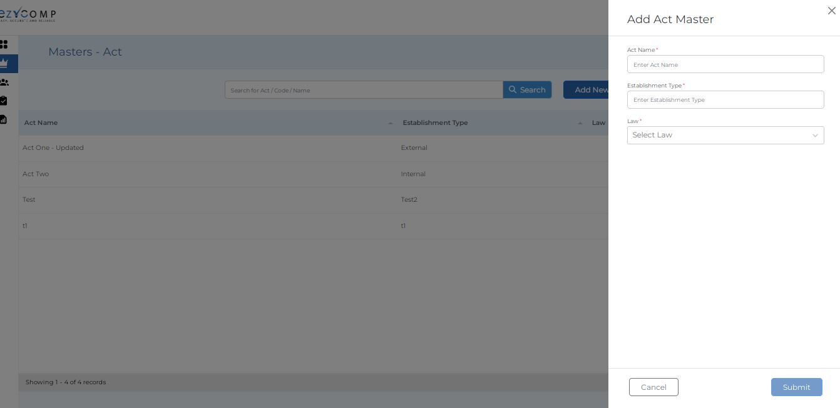
Auditor Dashboard Master Add New Act

Slide 14
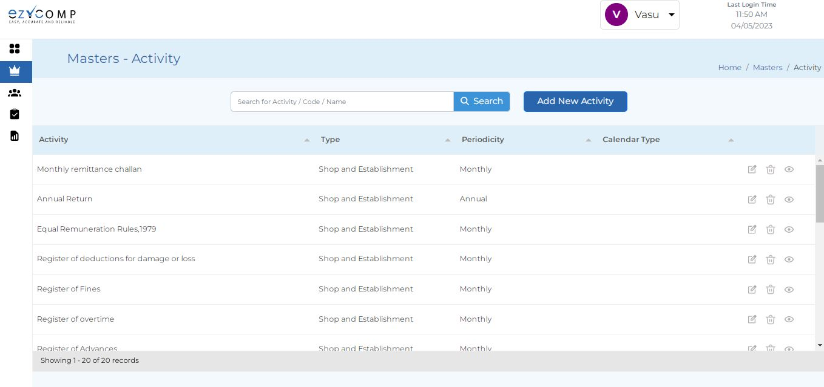
Auditor Dashboard Master Activity

Slide 15
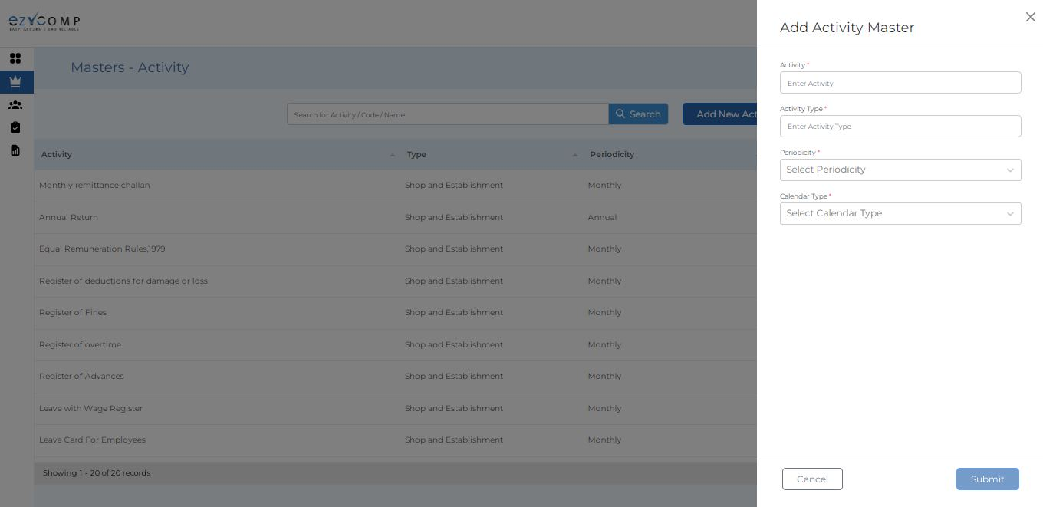
Auditor Dashboard Master Add New Activity

Slide 16
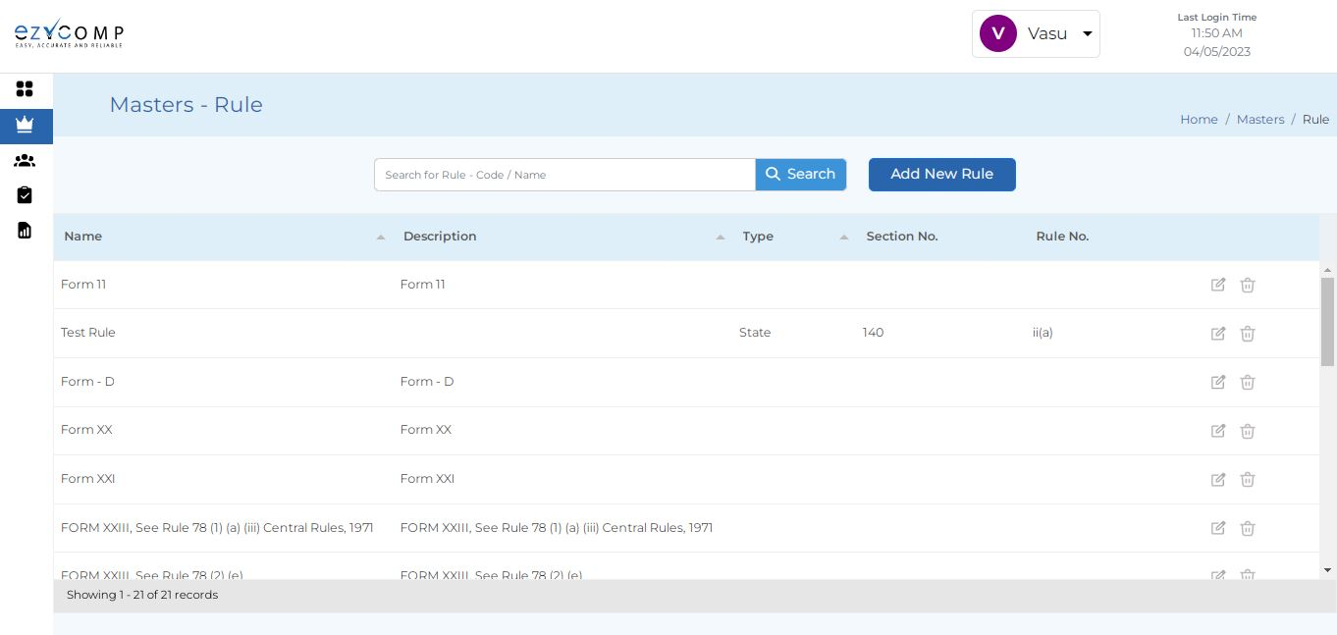
Auditor Dashboard Master Rule

Slide 17
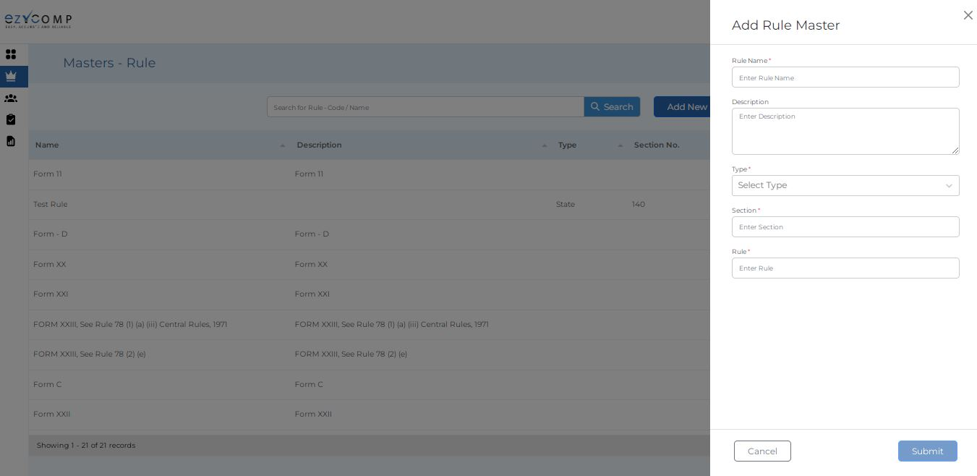
Auditor Dashboard Master Add New Rule

Slide 18
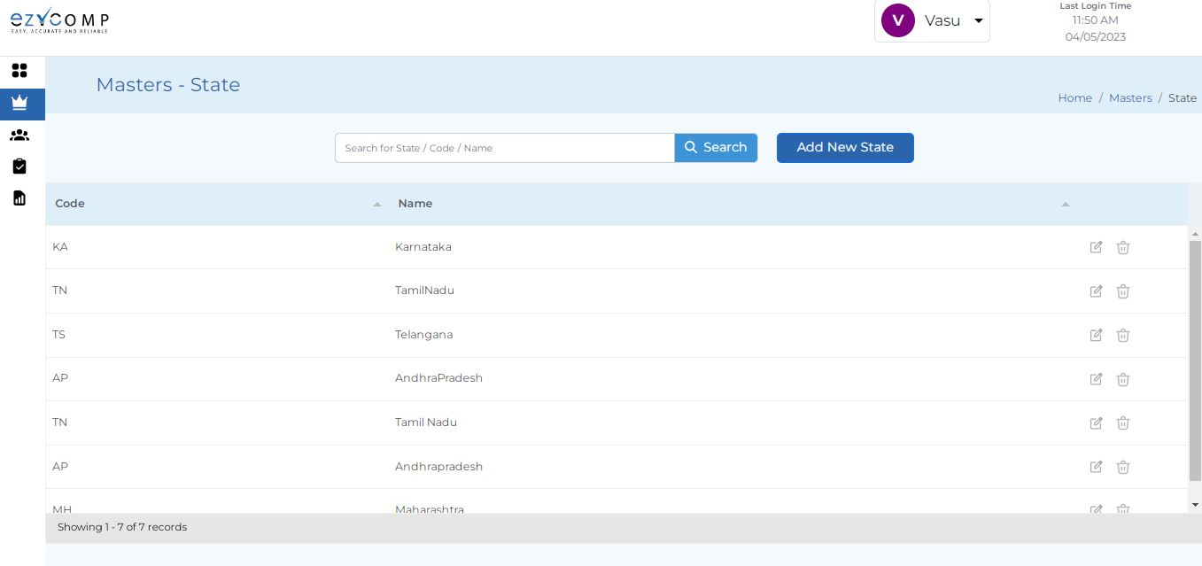
Auditor Dashboard Master State

Slide 19
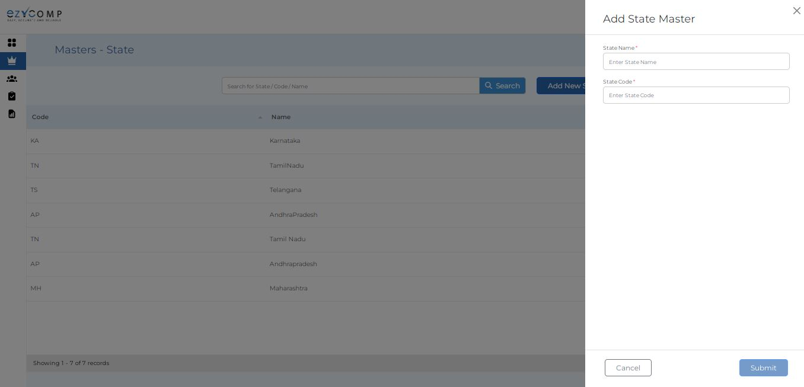
Auditor Dashboard Master Add New State

Slide 20

Auditor Dashboard Master City

Slide 21
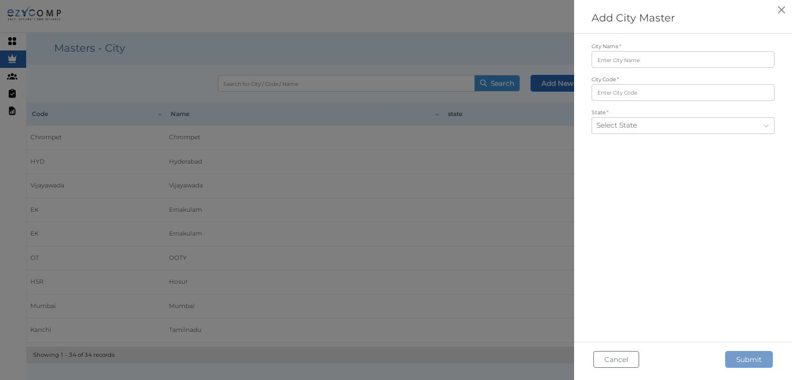
Auditor Dashboard Master Add New City

Slide 22
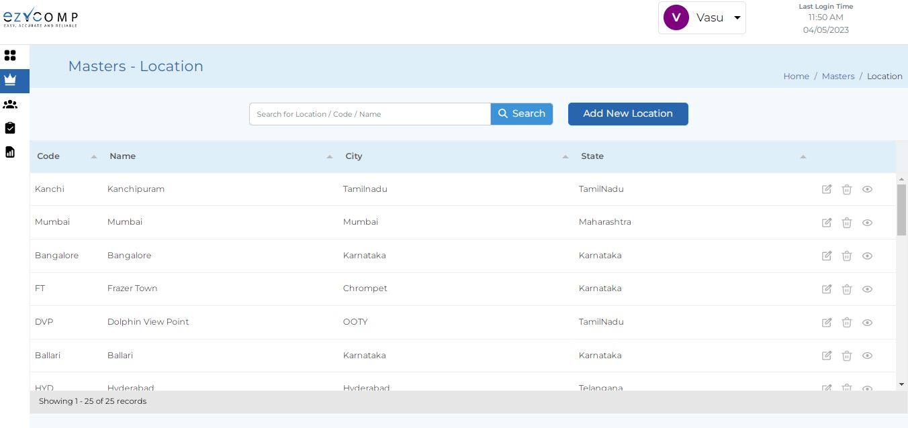
Auditor Dashboard Master Location

Slide 23
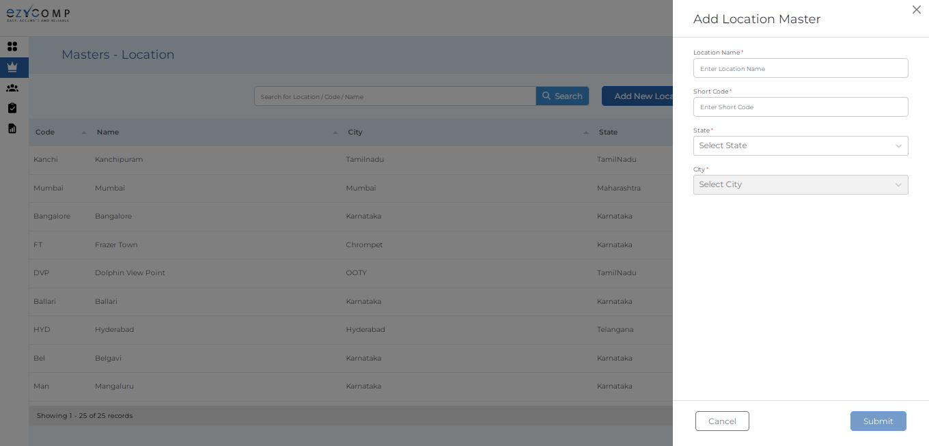
Auditor Dashboard Master Add New Location

Slide 24
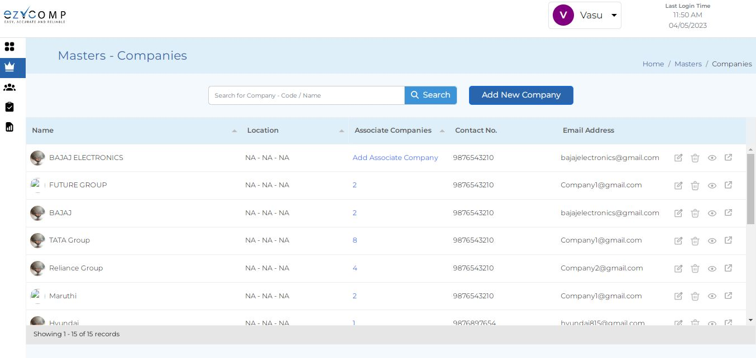
Auditor Dashboard Master Companies

Slide 25
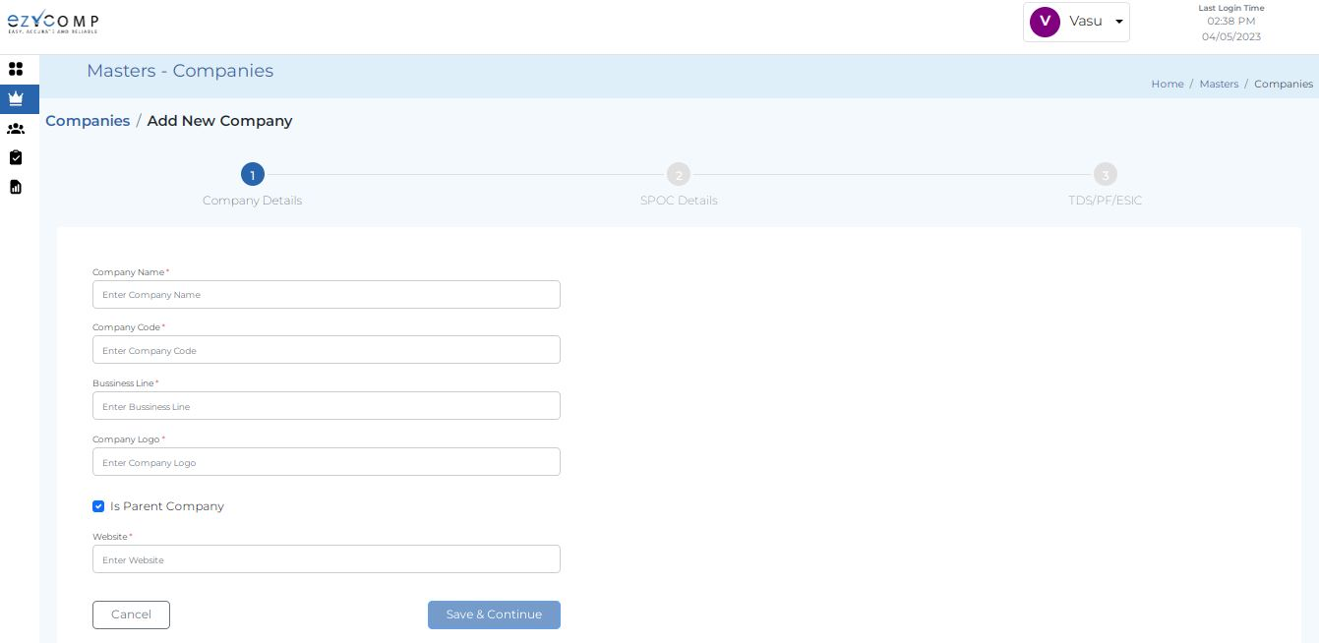
Auditor Dashboard Master Add New Companies

Slide 26
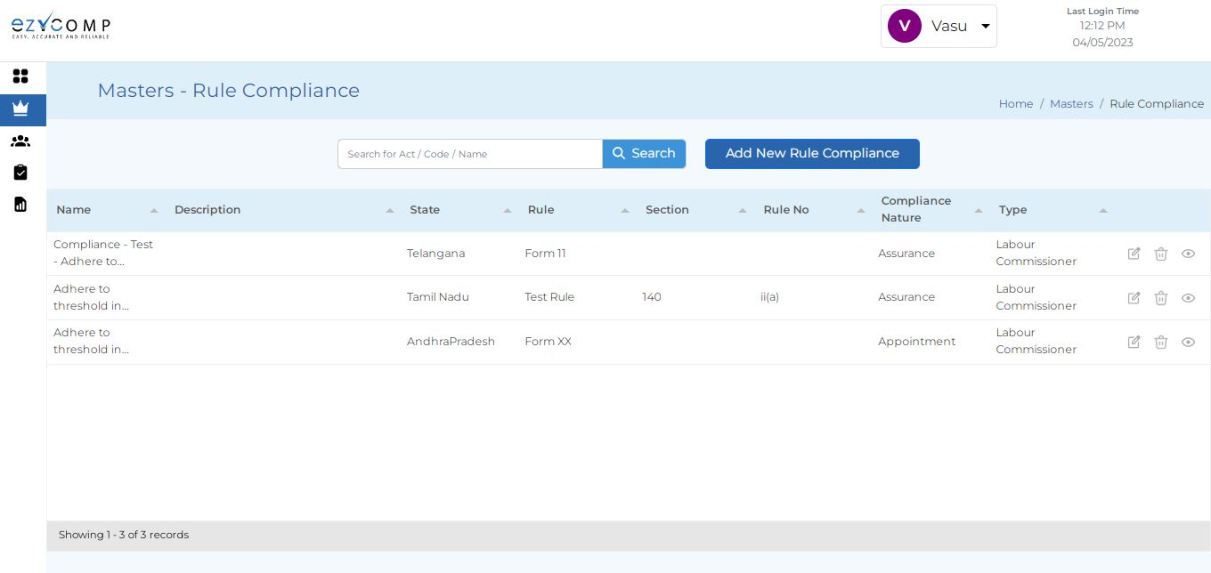
Auditor Dashboard Master Rule Compliance

Slide 27
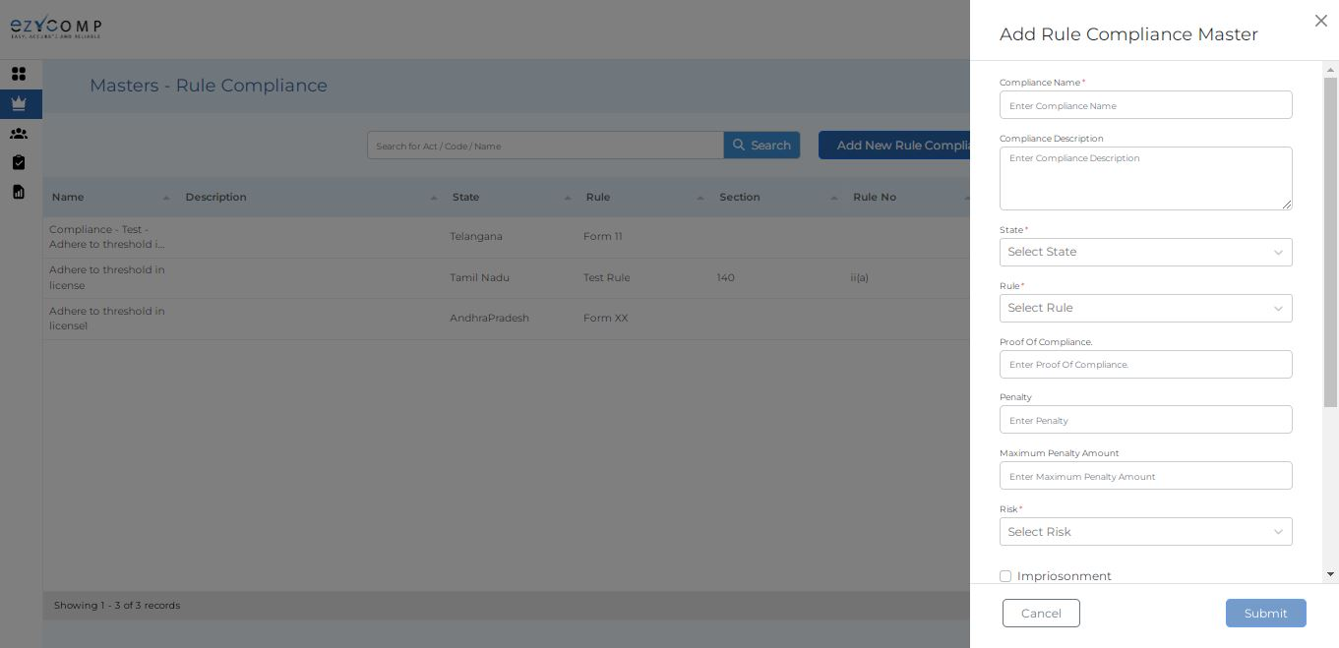
Auditor Dashboard Master Add New Rule Compliance

Slide 28
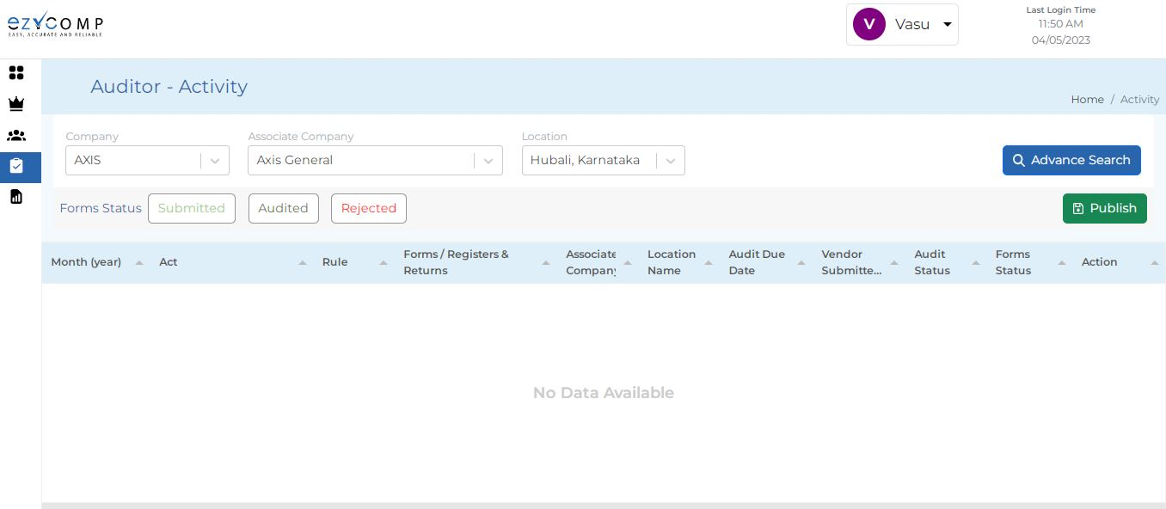
Auditor Activities

Slide 29
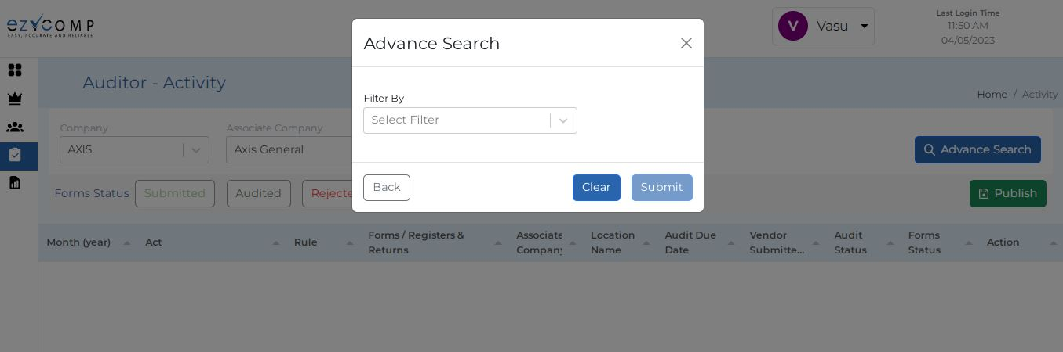
Auditor Activities Advance Search

Slide 30
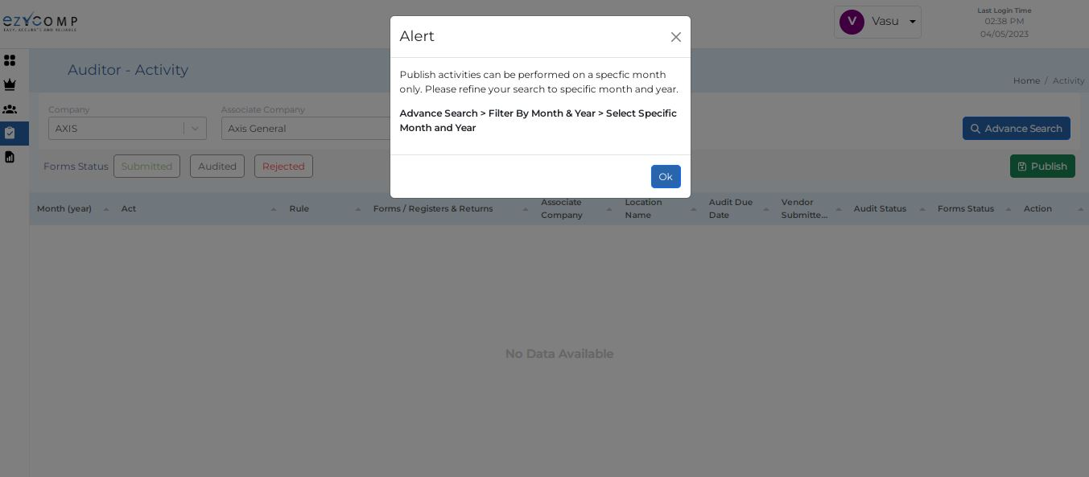
Auditor Activities Publish

Slide 31
Vendor Flow

Slide 32
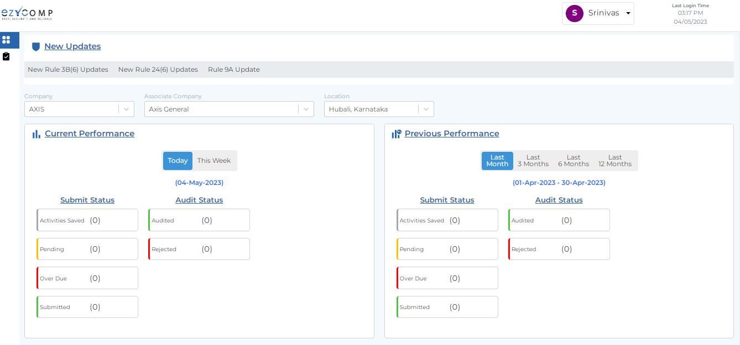
Vendor Dashboard(1)

Slide 33
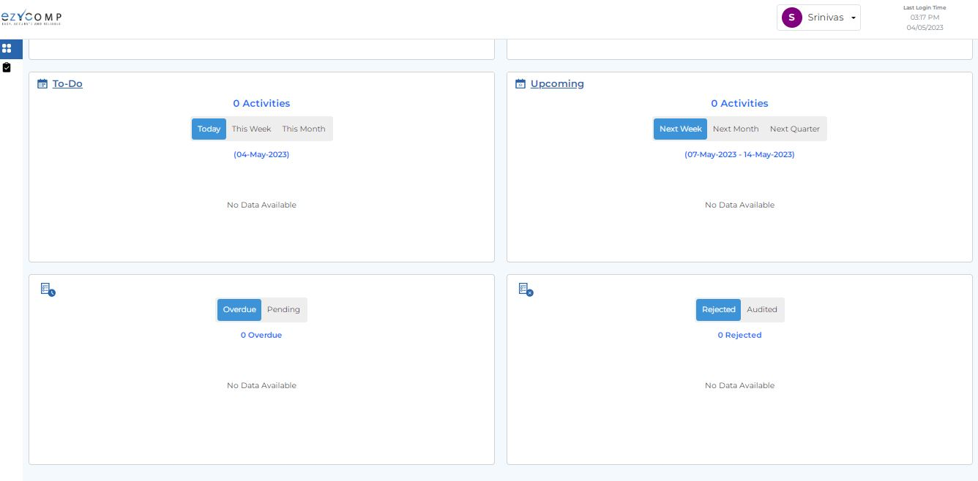
Vendor Dashboard(2)

Slide 34
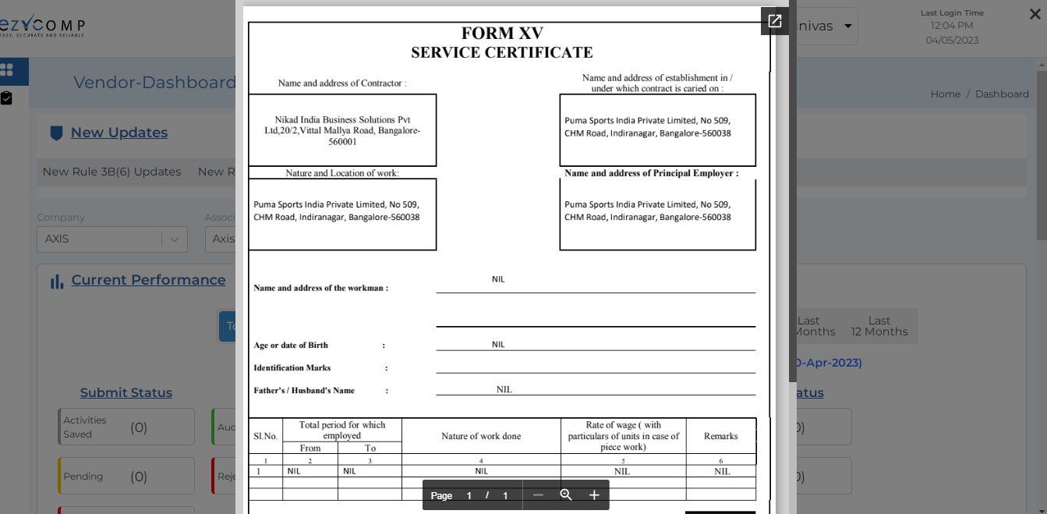
Vendor Dashboard New Rule 3B

Slide 35
Vendor Dashboard New Rule 24

Slide 36
Vendor Dashboard New Rule 9A

Slide 37
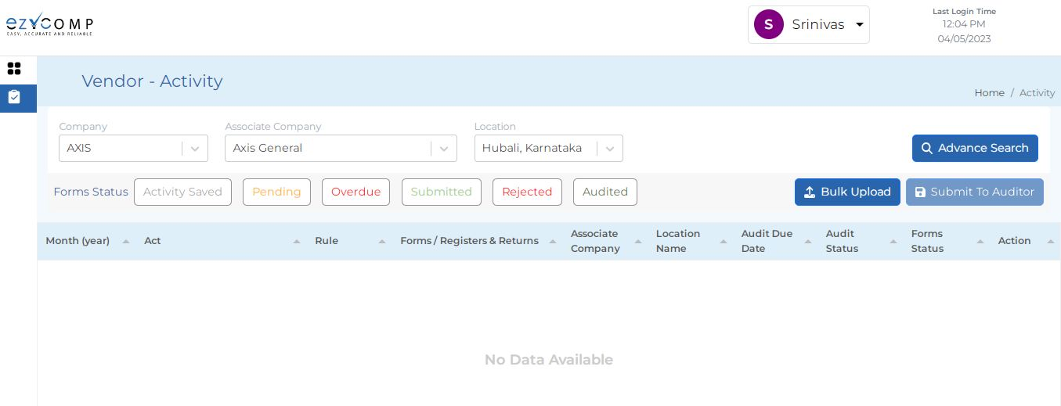
Vendor Activities

Slide 38
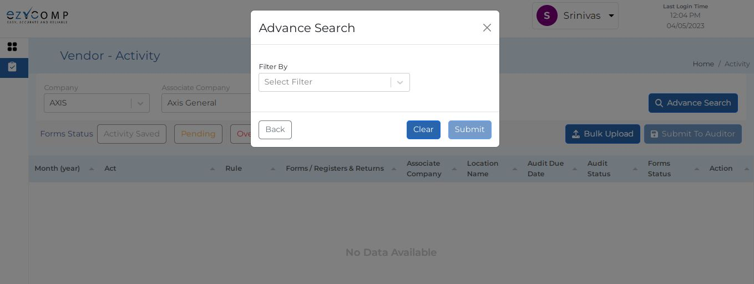
Vendor Activities Advance Search

Slide 39
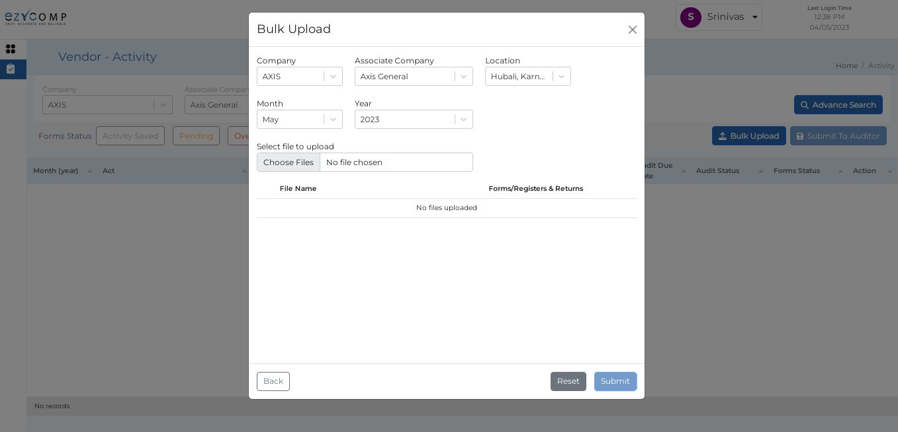
Vendor Activities Bulk Upload

