Slide 1
AUTOMATIC TIME TABLE GENERATING SYSTEM Team name : Code Crushers
Team members
MAMATHA (17691a0569)
MOUNIKA (17691A0579)
PRIYANKA (17691A0598)

Slide 2
ABSTRACT
Time table generation is tedious job for educationalist with respect to time and man power. Providing a automatic time table generator will help to generate time table automatically proposed system of our project will help to save time. It avoids the complexity of setting and managing Timetable manually. The system will take various inputs like number of subjects, teachers, workload of a teacher, semester, priority of subject. By relying on these inputs, it will generate possible time tables for working days of the week for teaching faculty. The timetable is needed to be scheduled in such a way that the number of subjects in each, handled by a limited faculty provided with their slots and timings does not overlap.

Slide 3
INTRODUCTION
our project entitle “AUTOMATIC TIME TABLE GENERATING SYSTEM" is meant to generating timetable scheduling process in colleges or in any other institutions which could minimize the human work and maximize the efficiency and the timetable was stored in a centralized server which could be easy to access everywhere.

Slide 4
PROBLEM STATEMENT
In olden days time tables are set manually.
In this system also the time tables are set manually, but by using the application.
Focuses on two modules class and faculty time tables.
Detects the collisions occurred during the time table generation.
The class time table module mainly focusing on the fields like year, branch, semester and section.
The faculty time tables focusing on the fields on the fields like faculty id and faculty name

Slide 5
FUNCTIONAL REQUIREMENTS
HARDWARE REQUIREMENTS
Pentium IV processor architecture with
1.512 MB RAM
2.80 GB Hard Disk Space
SOFTWARE REQUIREMENTS
Operating System : Windows 10
User Interface : Java
Database : Oracle
Designing : Rational Rose

Slide 6
STATIC DIAGRAMS
CLASS DIAGRAM
A class diagrams is a type of static structure diagram that describes the structure of a system
CONTENTS
classes, interfaces, collaborations, relationship, note, grouping things.
REQUIRED CLASSES
Staff
Admin
Timetable viewer
Timetable generator
Student

Slide 8
OBJECT DIAGRAM
Object diagram models the instance of classes from the class diagram.
Object diagram represent the static part of a system.
Contents
Objects
links
annotations things
grouping things

Slide 9
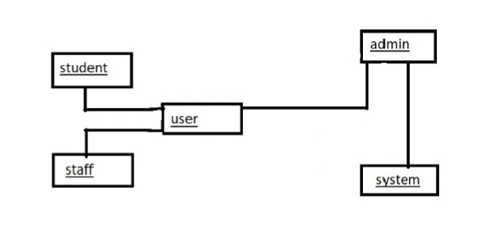

Slide 10
COMPONENT DIAGRAM
A physical and replacable part of a system is called component. It is a represented using a tabbed rectangle.
REQUIRED COMPONENTS
User
Timetable generator
Admin

Slide 12
DEPLOYMENT DIAGRAM
It is used to represent the dynamic behaviour of a system. It is represented using a node.
REQUIRED NODES
Admin
User
Timetable generator

Slide 14
DYNAMIC DIAGRAMS
USECASE DIAGRAM
Use case diagram are one of the five behavioral diagrams for modelling diagrams aspects of a system. It specifies what the system does.
REQUIRED ACTORS
Admin
Staff
Student
User

Slide 16
INTERACTION DIAGRAM
It is one of the dynamic behavioural diagram of UML. With which you are able to design the dynamic aspects of a system.
INTERACTION
An interaction is a behavioural that contains a set of messages exchanged between objects.
Interaction diagrams are represented in 2 ways.
Sequence diagram(Time ordering of messages)
Collaboration diagram(structural organization)

Slide 17
SEQUENCE DIAGRAM
The sequence diagram is one of the 2 interactions diagrams. It emphasizes on time ordering of messages.
REQUIRED OBJECTS
Admin
User Timetable generator

Slide 19
COLLABORATION DIAGRAM
The collaboration diagram is one of the 2 interaction diagrams. The main focus is on structural organization of objects.
REQUIRED THINGS
Admin
User
Timetable generator

Slide 21
ACTIVITY DIAGRAM
It is similar like a flowchart. It can be used to represent the flow of execution from one activity to another activity. In case of interaction diagram, it can be represent the flow of control among objects. An activity diagram can be used to represent dynamic view of a system.
REQUIRED THINGS
Start
Stop
Activity
Branch
Fork
Transition
Swim lane

Slide 23
STATECHART DIAGRAM
STATE
It is a behavioural thing, the group of interaction take place among objects with occurrence of events.
STATECHART
It is a state machine focusing on the flow of control from state to state on every occurrence of events
REQUIRED TOOLS
Initial state
Final state
State
Transition

Slide 25
SYSTEM IMPLEMENTATION
Modules
Creating credentials
If any user want to view the particular timetable they must have the valid credentials provided by admin of the institution . So the admin create credentials for the users.
Adding classes
To create a timetable for a particular class ,that class room number must to present in the database . So the admin adds the class room numbers into the database.

Slide 26
Generating timetable Admin will generate the timetable for the added room numbers by using the available staff in the database. He must check the generated timetable should satisfy all the constraints of the institution. Updating and deleting details If there are any updates in the users details, then the admin must update it time to time . For example ,if any staff leaves the college no timetable must be generated by assigning a class for that faculty . So his details must be deleted in the database. Saving timetable in database The user must be able to view the required timetables saved in the database . So the admin must save the generated timetables in the database for further usage.

Slide 27
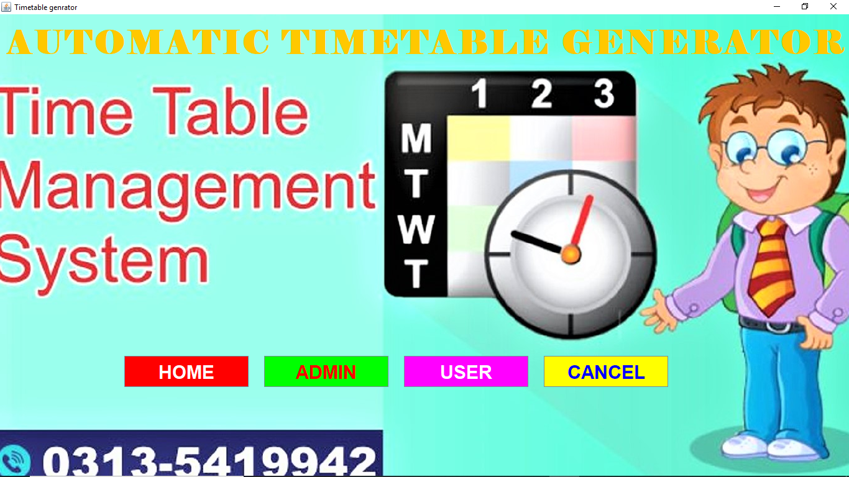
RESULTS AND ANALYSIS

Slide 28
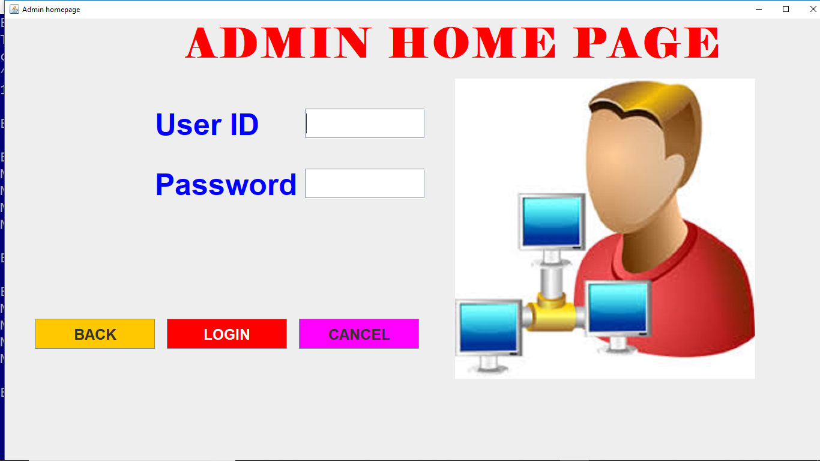

Slide 29
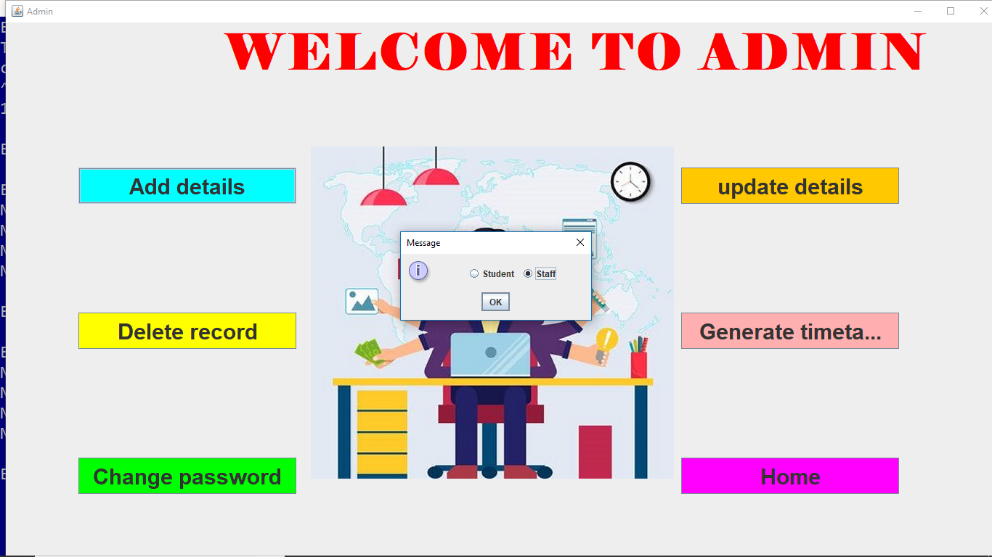

Slide 30
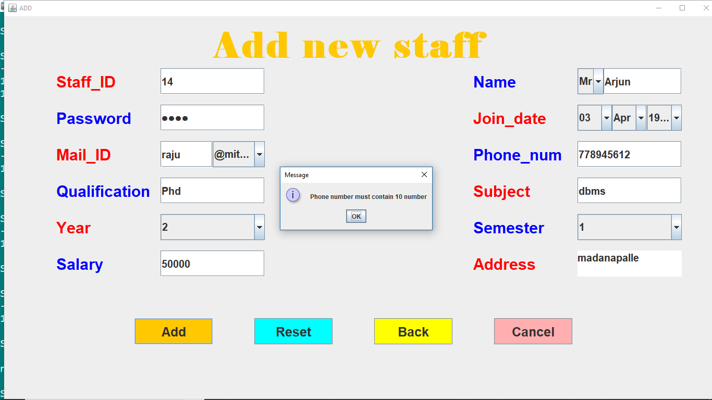

Slide 31
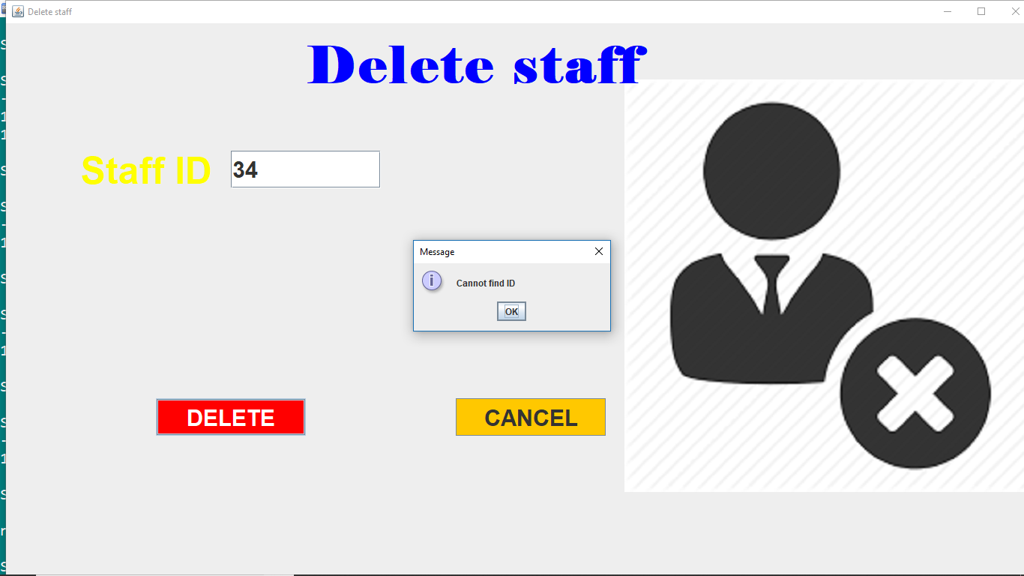

Slide 32
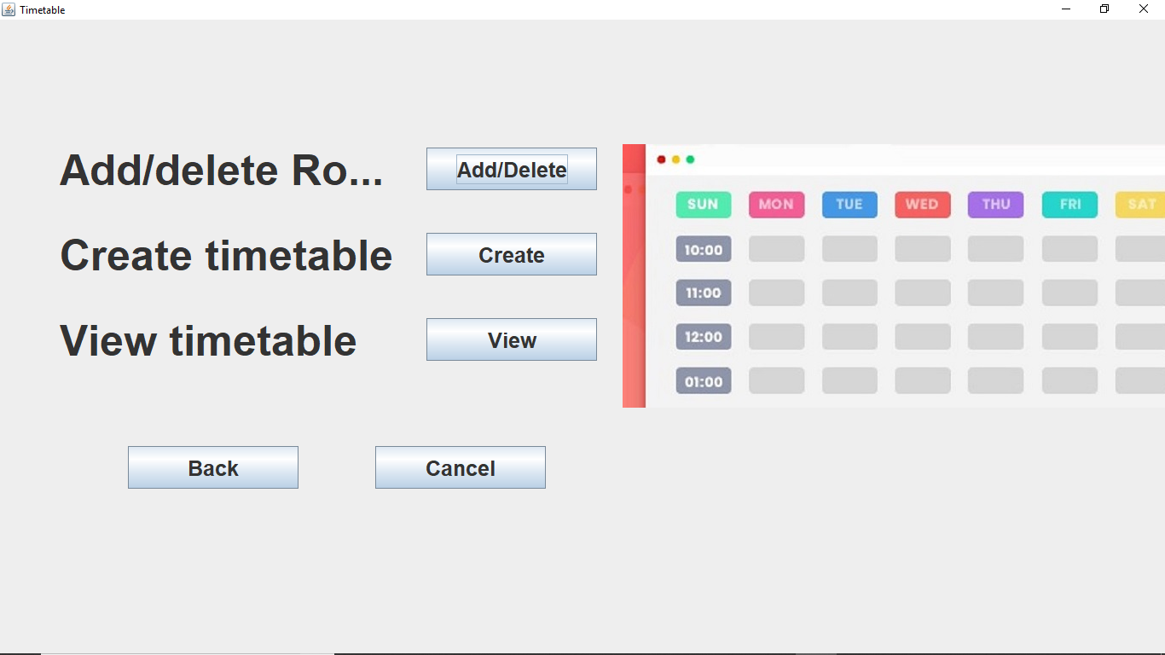

Slide 33
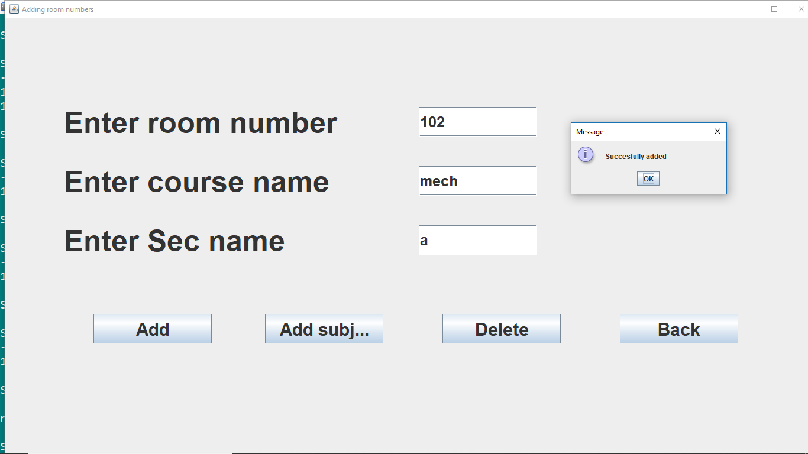

Slide 34
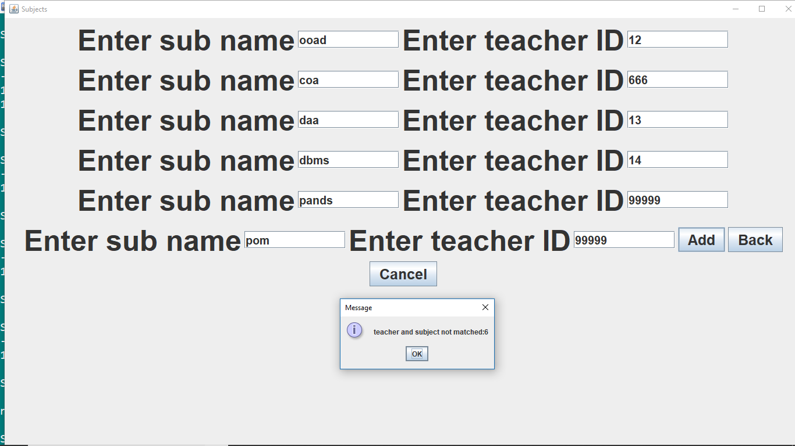

Slide 35
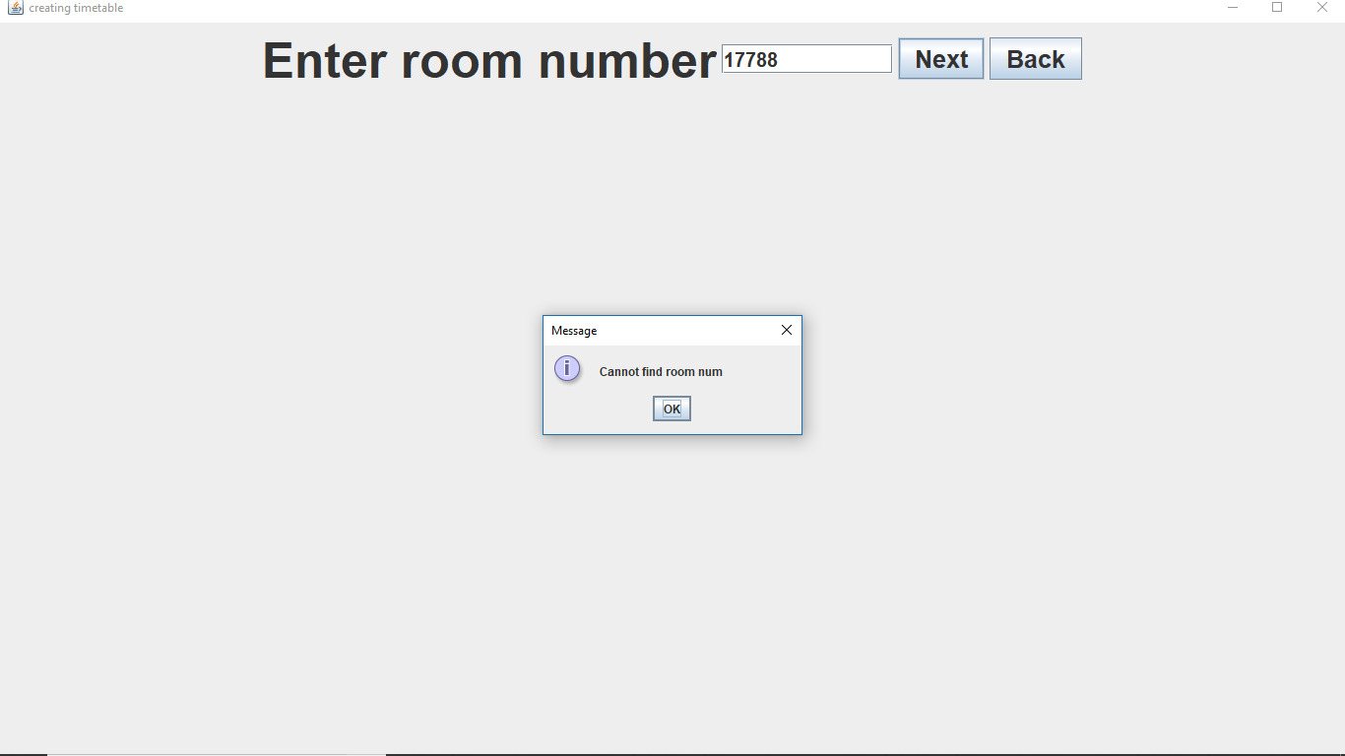

Slide 36
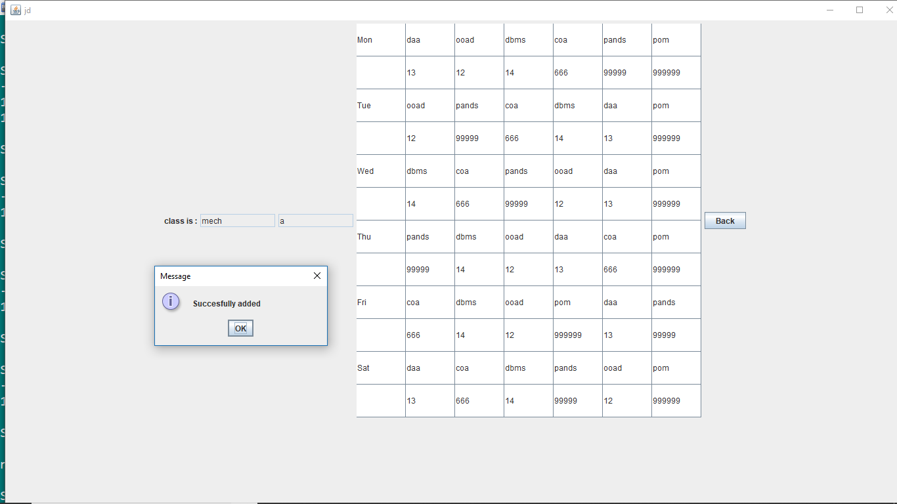

Slide 37
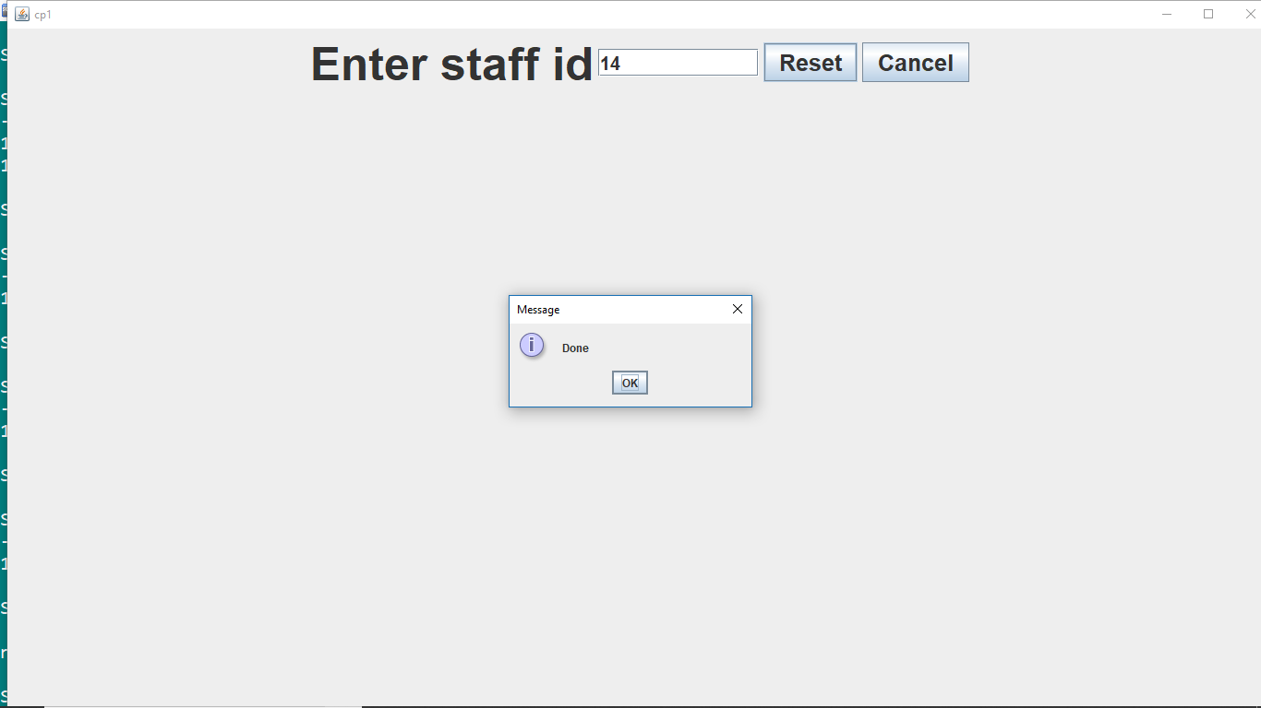

Slide 38
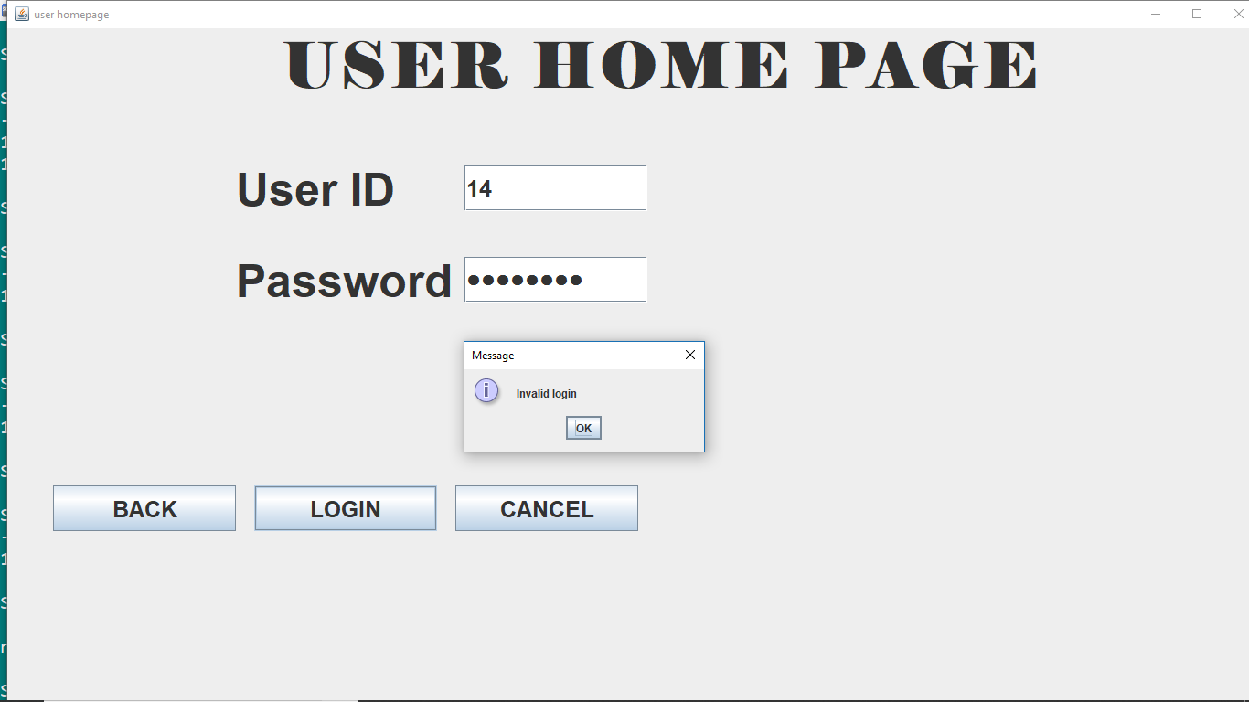

Slide 39
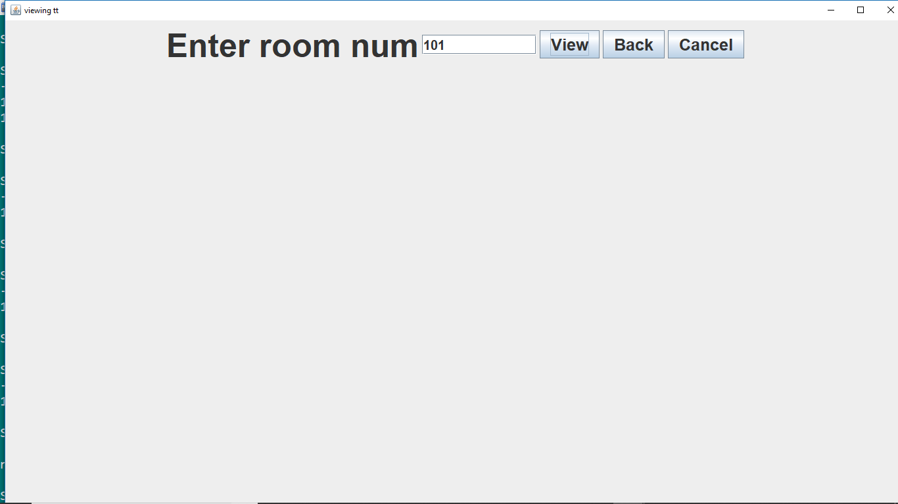

Slide 40
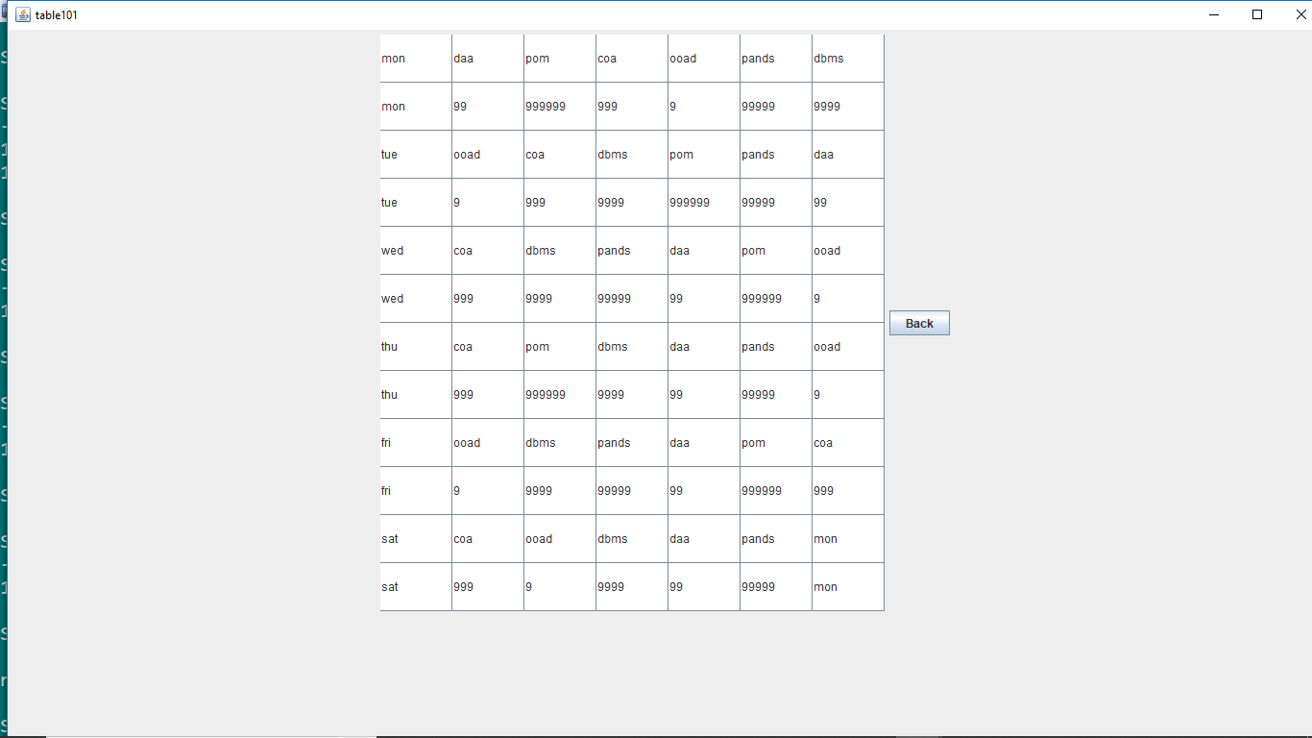

Slide 41
CONCLUSION
Now a days timetable is being prepared manually in all schools and colleges which is a time waste process. Doing this manually may include many errors. To avoid this we had built a new automatic time table generating system. Our project will generate a timetable automatically without an collisions which will minimize the human work and maximizes the efficiency. Our project is completely a time saving process . This system can be used by any college or institution for generating a timetable.

Slide 42


