Slide 2

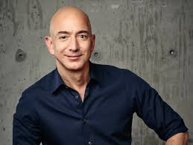
AMAZON
Headquarters: Seattle, Washington, USA.
Founded: July 5, 1994.
Founder: Jeff Bezos.
Publicly Traded: Amazon went public on May 15, 1997, and is listed on the
NASDAQ under the ticker symbol AMZN.
Business Model: Primarily an online retail platform, Amazon sells both its own
products & third- party products. It also operates cloud computing services (Amazon
Web Services), video streaming (Amazon Prime Video), and digital products.
Successful: 2021 was the peak year for Amazon; it witnessed a great increase of 37.6% in revenue in 2020, reaching 386 billion US dollars, making it the third-largest company by revenue in the world. This was their major revenue hit, but Amazon continued to dominate the market afterward and is still flourishing with many other services they offer and new ones they are developing.

Slide 3
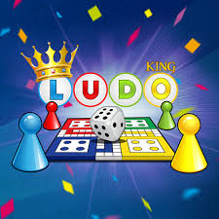
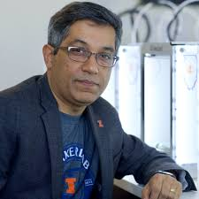
LUDO KING
Founder: Vishal Sachdev
Founded: 2009
Released: February 20, 2016
Nationality: India
Successful: Ludo king's success is due to its combination of nostalgia, easy-to-learn gameplay, multiplayer options, social interaction, cross-platform accessibility, and continuous updates. The game has a universal appeal, making it popular in both traditional and digital spaces. Its free-to-play nature, coupled with the global trend of casual mobile gaming, has made it one of the most successful mobile games in the world.

Slide 4

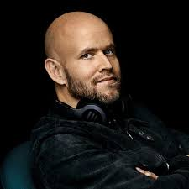
Spotify
Founded: On 23 April 2006
Founders: Daniel E.K And Martin .Lorentzon
Country Of Origin: Sweden
Launched: 7 October 2008; 16 Years Ago
Growth: As of september 2024, it is one of the largest providers of music
Streaming services, with over 640 million monthly active users comprising
252 million paying subscribers. Spotify is listed (through A luxembourg city-
Domiciled holding company, spotify technology S.A) on the new york stock
Exchange in the form of american depositary receipts.
Competitors: Include Soundcloud , Apple Music, Amazon Music, And Youtube
Music.

Slide 5
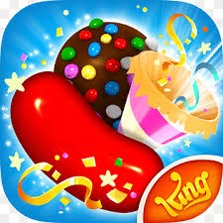
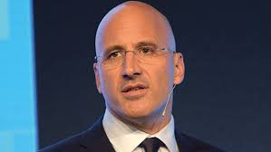
Candy crush
Founders: Riccardo Zacconi
Founded: 2003
Country Of Origin: Italian
Successful: Five years after its release on mobile, the candy crush saga series has received over 2.7 billion downloads, and the game has been one of the highest-grossing and most-played mobile apps in that time frame. As of september 2023, it had reached over $20 billion in lifetime revenue.
Competitors: Bubble Witch Saga (King), Pet Resourse Saga

Slide 6
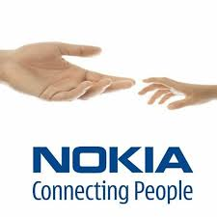
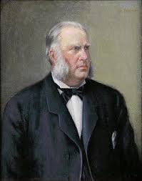
Nokia
Founders: Fredrik Idestam
Founded: 12 May 1865; 159 Years Ago
Headquarters: Finland
The company was viewed with national pride by finns, as its mobile phone business made it by far the largest worldwide company and brand from finland. At its peak in 2000, nokia accounted for 4% of the country's GDP, 21% of total exports, and 70% of the nasdaq helsinki market capital.
Failure: Nokia's downfall in the mobile phone market was not caused by a single issue but by a combination of strategic missteps, a slow response to the smartphone revolution, an outdated operating system, and internal management challenges. While nokia was once the world's leading mobile phone manufacturer, its inability to adapt to the changing landscape and failure to respond to competitors like apple and android led to its decline in the mobile market.

Slide 7
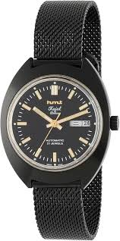
HMT watch
Full Form: Hindustan Machine Tools(HMT)
Founder: Government Of India
Founded: 7 February 1953; 71 Years Ago
Headquarters: Bellary
Watch division: HMT set up A watch manufacturing factory in Bangalore in collaboration with citizen watch, A Japanese company, in 1961. The first batch of mechanical (hand wound) wrist watches manufactured here was released by the then prime minister of India, Jawaharlal Nehru. The most popular mechanical watch was HMT Janata. Other mechanical watch styles included HMT pilot, HMT Jhalak (semi skeletal), HMT Sona, HMT braille.
Failure: Hmt’s failure can be attributed to its failure to innovate, adapt to new technologies, and respond to market demands. While the brand holds a place in india's watchmaking history, its inability to transition with changing times contributed significantly to its decline.

Slide 8

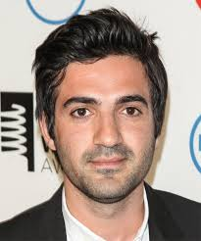
Vine
Vine Was A Free Mobile App That Allowed Users To Record And Share Short, Looping Video Clips That Were Up To Six Seconds Long.
Founded: June 2012
Founders: Rus Yusupov
Failure: Vine’s algorithm and user interface were not as effective in promoting new content or helping users discover creators. This made it difficult for new users to find and engage with the best content, limiting growth. As a result of these issues, vine was shut down in 2016, just three years after it launched. The space it left behind was quickly filled by platforms like Instagram and Tiktok, which better met the needs of creators and users.

Slide 9
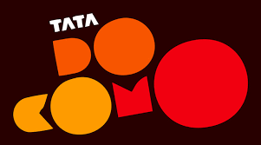
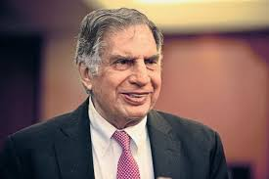
TATADOCOMO
Founder: Ratan Tata
Founded: November 2008; 16 Years Ago
Headquarters: Mumbai, Maharashtra, India
Failure: In 2017, tata docomo was absorbed by airtel following the acquisition of tata teleservices (the parent company of tata docomo) by bharti airtel. This merger marked the end of tata docomo as an independent entity, largely due to its inability to compete in A market dominated by larger, more financially stable players. In summary, tata docomo's failure can be attributed to A combination of aggressive pricing without sustainability, poor network infrastructure, inability to innovate, intense competition, and management issues. These factors led to its eventual merger with airtel.

